Slide 1

Start..

Slide 2
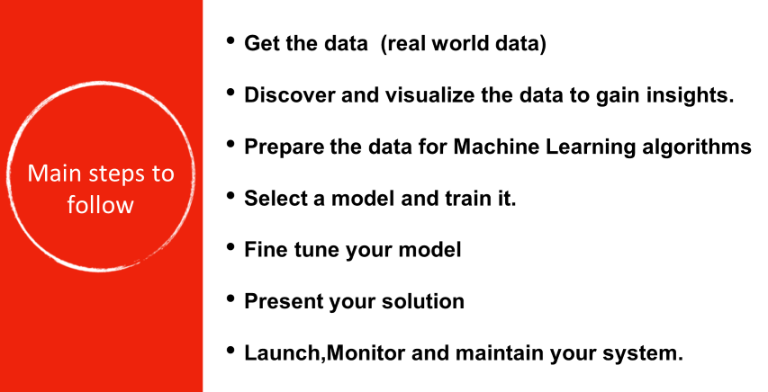

Slide 3
Key Points
Dataset: Collection of data
Model: Representation of what an ML System has learned from training data
Training : Process of determining the ideal parameters
Learning : Output of the training process, which a Machine Learning model can use to make predictions
Training dataset: subset of the data set to train a model
Validation dataset: Also a subset of dataset, disjunct from training dataset, that we use to adjust hyperparameters
Testing dataset : Used to test model which has gone through initial vetting by validation set.
Hyperparameter : Values which are set before training a model
Parameter : A variable of a model that ML System trains on its own.
Target: Output of the input variable also called as Dependent variable or Response variable.

Slide 4
Key Points
Feature : Individual Independent variables that act as input in your system. These are also called as Independent variables or Predictor variables.
Label : Labels are the final output, such as output classes.
Fit : Capture patterns from provided data. Heart of Modelling.
Evaluate : Determine how accurate the model’s predictions are.

Slide 5
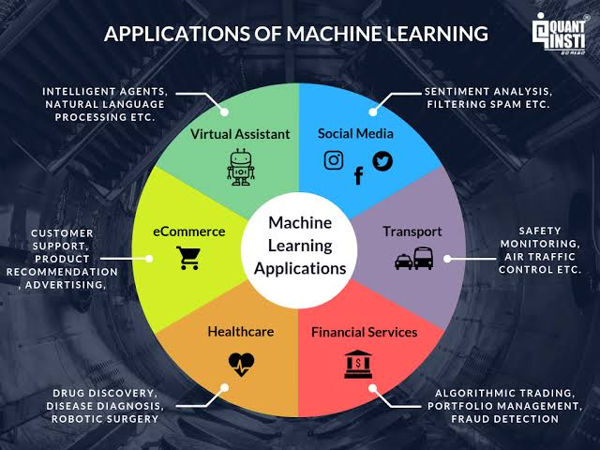

Slide 6
Selecting a Model
Y = f(x) + e, where ‘f’ is the target function and ‘e’ is a random error term
Just like ‘Target function’ ,some other functions which are frequently tracked are
Cost Function (Error Function) It helps to measure the extent to which the model is going wrong in estimating the relationship between X and Y.
Loss Function is almost synonymous to Cost Function-the only difference being loss function is usually a function defined on a data point.

Slide 7

Regression
Relationships
In science, we frequently measure two or more variables on the same individual (case, object, etc). We do this to explore the nature of the relationship among these variables. There are two basic types of relationships.
Cause-and-effect relationships.
Functional relationships.

Slide 8

Regression
Function: a mathematical relationship enabling us to predict what values of one variable (Y) correspond to given values of another variable (X).
Y: is referred to as the dependent variable, the response variable or the predicted variable.
X: is referred to as the independent variable, the explanatory variable or the predictor variable.

Slide 9
Linear Regression
One of the easiest statistical models in machine learning.
It is used to show the linear relationship between a dependent variable and one or more independent variables.
Typical applications of regression can be seen in:
i.Evaluating Trends and Sale Estimates
ii.Impact of Price changes
iii.Weather forecast

Slide 10
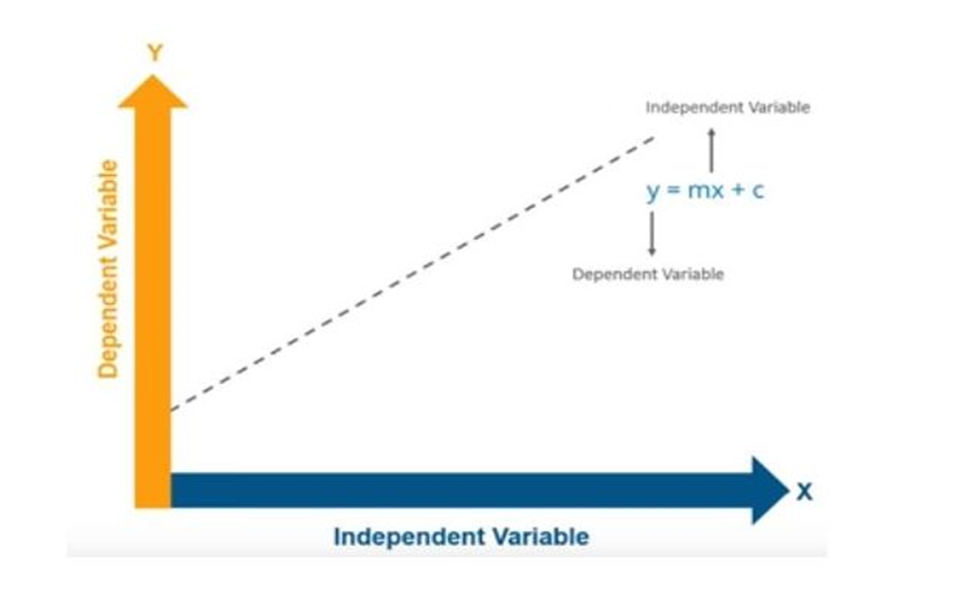
Representation

Slide 11
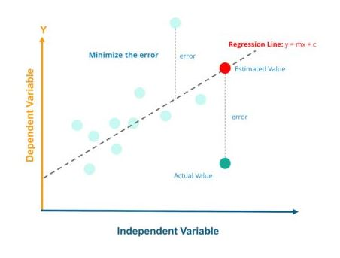
A typical Linear Regression model can be represented in the form : y = b1x + b0 where b1 is slope and b0 is the intercept.

Slide 12
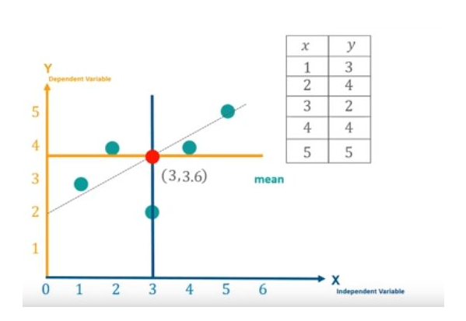
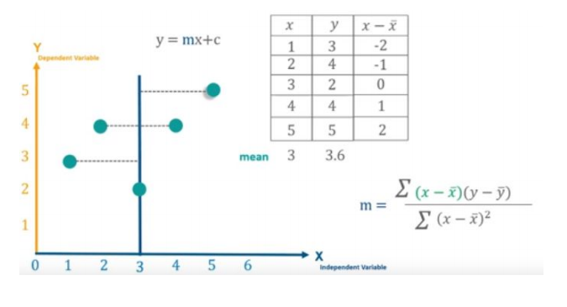

Slide 13
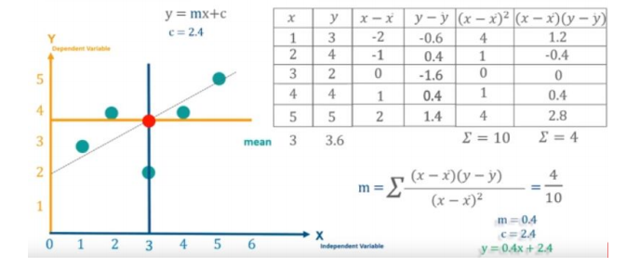

Slide 14
Steps to do:
Examine the scatterplot of the data.
i. Does the relationship look linear?
ii. Are there points in locations they shouldn’t be?
iii. Do we need a transformation?
Assuming a linear function looks appropriate, estimate the regression parameters.
i. How do we do this? (Method of Least Squares)
If there is a significant linear relationship, estimate the response, Y, for the given values of X, and compute the residuals

Slide 15
Regression Analysis
Thus we have the regression formula as :
Y = b1X +b0 + error(e)
Initially we calculate the value for slope and predict the values of Y for any given X values we have.
Slope(b1) = ∑(x - (mean of x)(y - (mean of y))/∑(x - (mean of x))^2
Thus we calculate the b0 value and find out the “Line of Regression”.

Slide 16
Final Step:
Next our job is to reduce the distance between the actual value and the predicted value or in other words reduce the error between the actual and predicted value. Thus the line with least error will be the “Best Fit Line”.
In order to check it out we calculate the “Coefficient of Determination”[R-squared value].
R-squared value = 1 - ∑(y predicted - mean of y )^2/ ∑(y - mean of y)^2.
R^2 = 1 – SS(res) / SS(tot)
Thus our ultimate aim is to reduce the error i.e., distance between the actual and predicted values.

Slide 17


Importance :
In a curvilinear relationship, the value of the target variable changes in a non-uniform manner with respect to the predictor (s).
In Linear Regression, with a single predictor, we have the following equation:
This linear equation can be used to represent a linear relationship. But, in polynomial regression, we have a polynomial equation of degree n represented as:
The number of higher-order terms increases with the increasing value of n, and hence the equation becomes more complicated.

Slide 18
Polynomial Regression
It is a form of regression analysis in which the relationship between the independent variable x and the dependent variable y is modelled as an nth degree polynomial in x.
It is considered to be the special case of “Multiple Linear Regression” where we fit a polynomial equation on the data with a curvilinear relationship between the target variable and the independent variables.

Slide 19
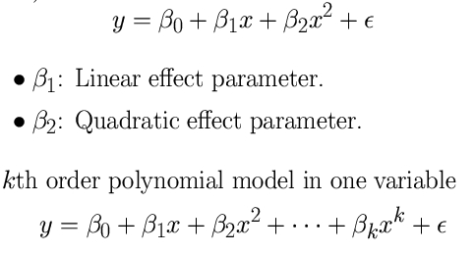
Polynomial Models in One Variable
A second-order model (quadratic model):

Slide 20
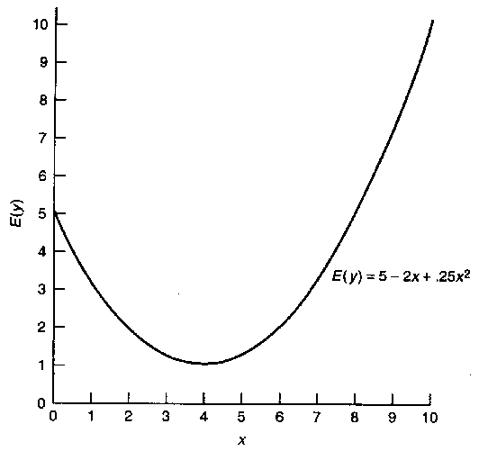
Representation
Polynomial models are useful in situations where the analyst knows that curvilinear effects are present in the true response function.
Polynomial models are also useful as approximating functions to unknown and possible very complex nonlinear relationship

Slide 21
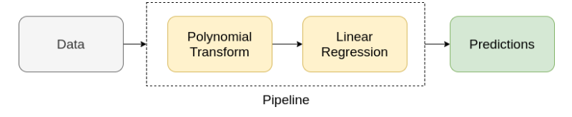
Steps to do:
We transform our data into a Polynomial using the Polynomial Features function from scikit-learn Library.
Then we use Linear Regression to fit the parameters.

Slide 22


