Slide 1
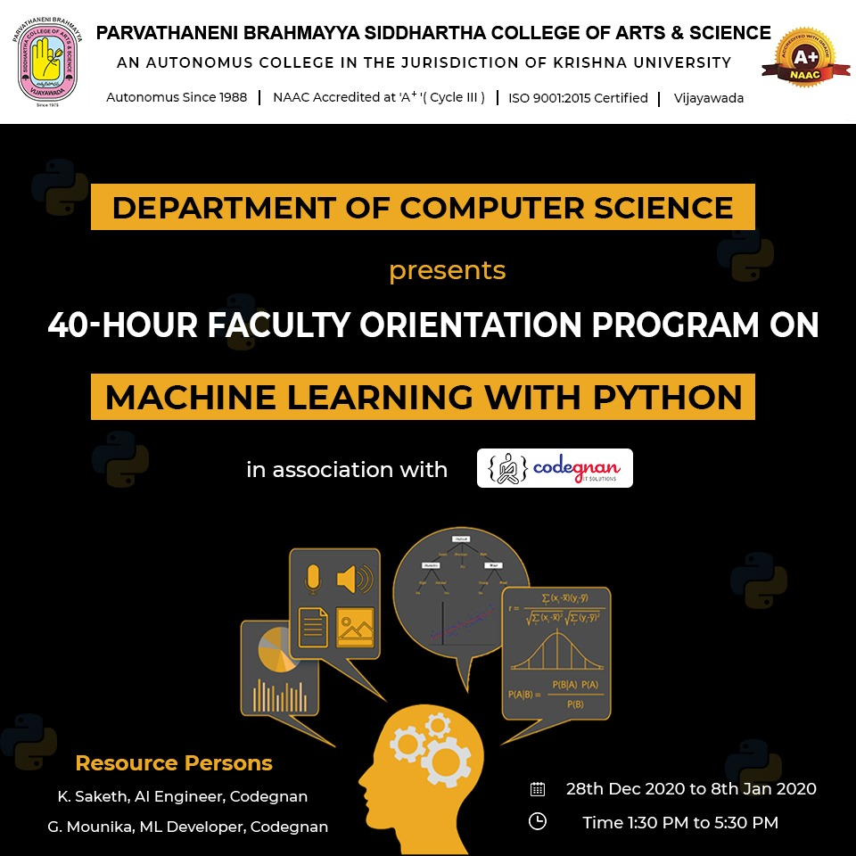
Start..

Slide 2
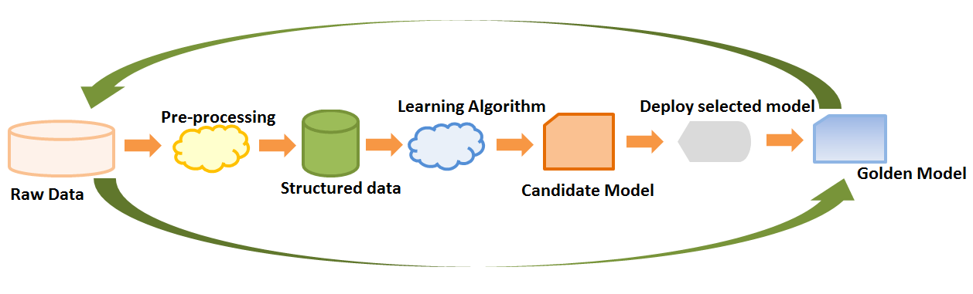
Learning

Slide 3
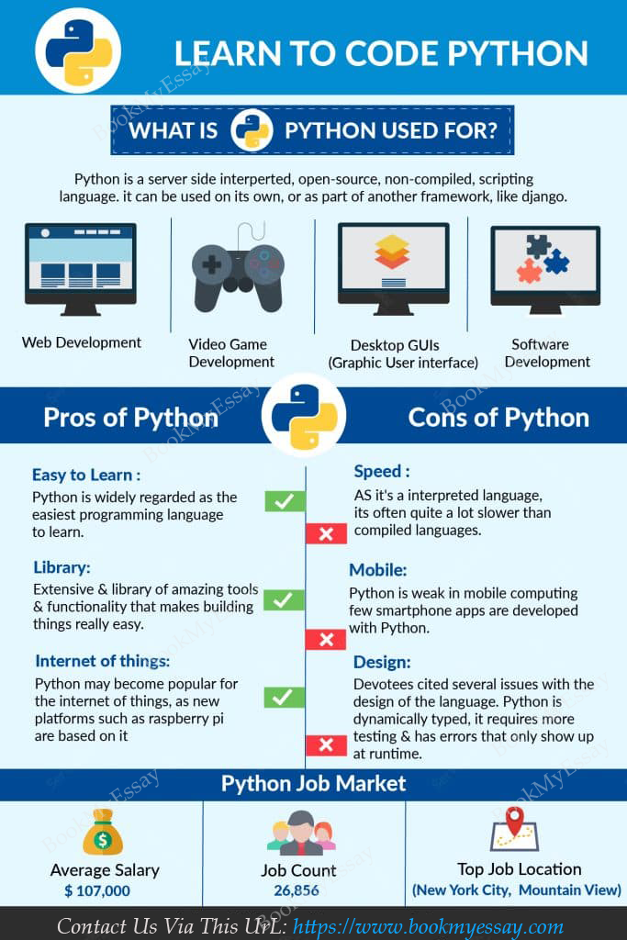
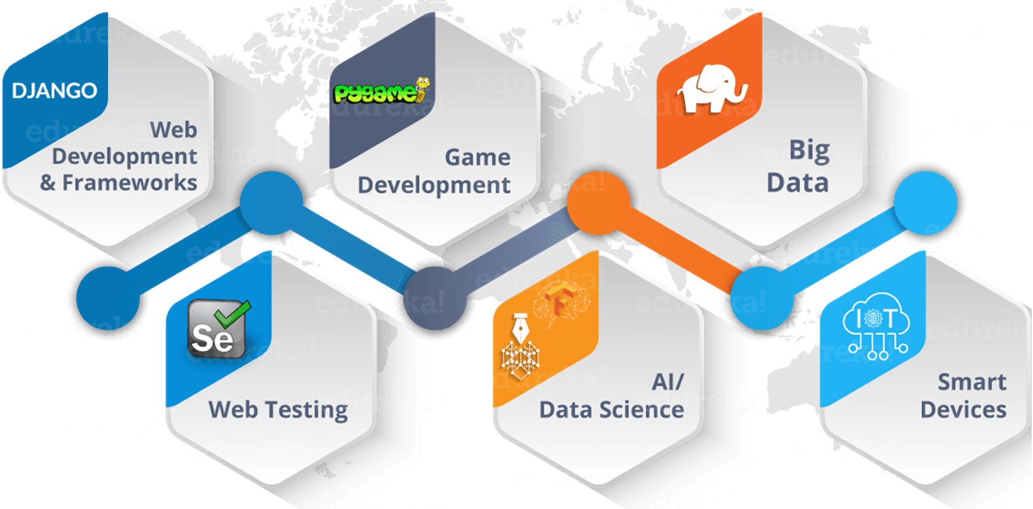

Slide 4
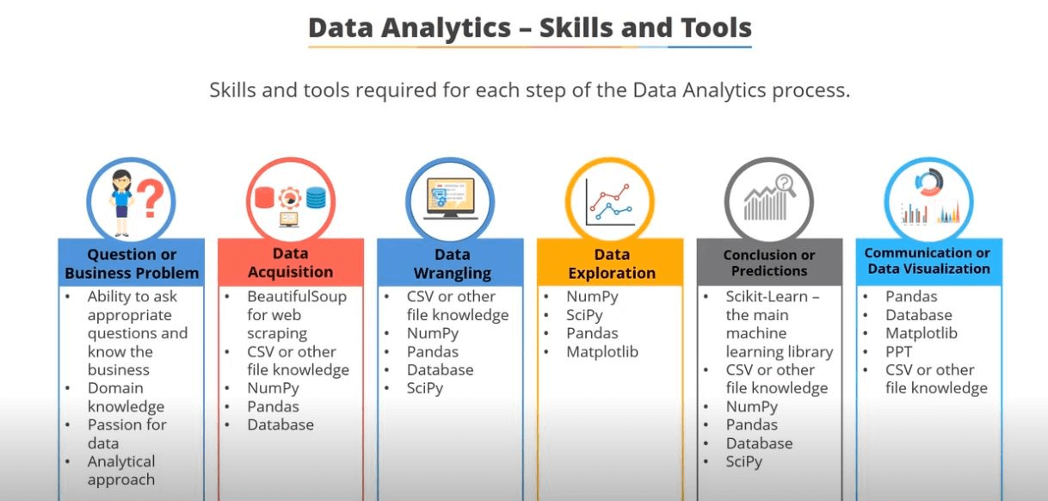

Slide 5
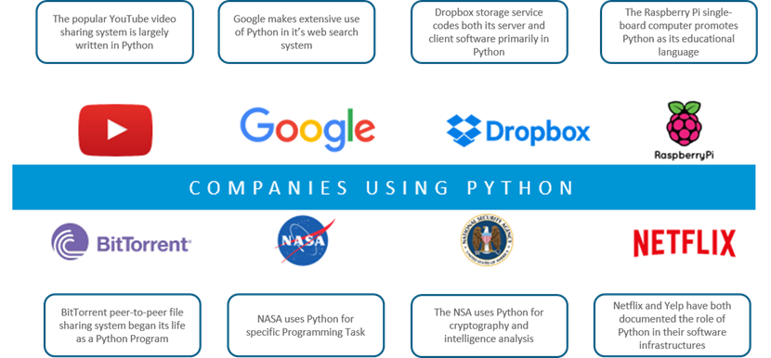

Slide 6

Python Libraries for Data Analysis
Popular Python toolboxes/libraries:
NumPy
Scikit-Learn
Visualization libraries
Matplotlib
Pandas

Slide 7

Numpy
NumPy, short for Numerical Python, is one of the most important foundational packages for numerical computing in Python
Numpy performs complex Computations on entire arrays without the need for Python for loops
pip install numpy in command prompt
Tools for reading/writing array data to disk and working with memory-mapped files

Slide 8
Pandas
Pandas is an open-source Python Library providing high-performance data manipulation and analysis tool using its powerful data structures.
The name Pandas is derived from the word Panel Data – an Econometrics from Multidimensional data, as it includes observations over multiple time periods.
It can work with any format of file like .xlsx,.csv,.html,.json formats. Pandas stores data in two types : Series and DataFrame
pip install pandas in command prompt

Slide 9


