Slide 1

Start..

Slide 2

Matplotlib
Matplotlib is Python’s fundamental plotting library. It is extremely flexible and gives the user full control over all elements of the plot.
The name Matplotlib stands for Mathematical Plotting Library
It produces Publication-quality figures in a variety of hardcopy formats and interactive environments across platforms
pip install matplotlib in command prompt

Slide 3

Scikit-Learn Design
The main design principles are :
Consistency - Estimators (fit()),Transformers (fit_transform()) and Predictors (predict() and score()) methods.
Inspection - Estimators hyper-parameters.
Nonproliferation of classes – Datasets are represented as Numpy arrays,instead of homemade classes.
Composition - To create a Pipeline Estimator.
Sensible defaults - Reasonable default values for most parameters

Slide 4
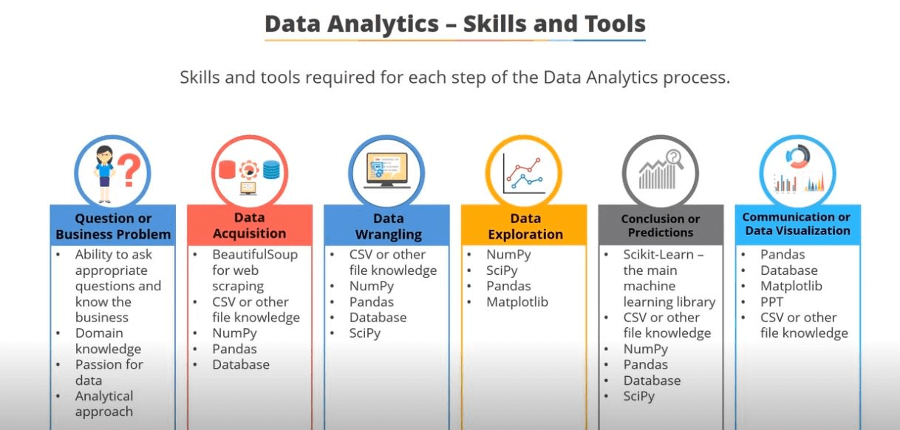

Slide 5
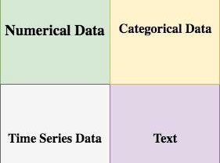
Data
Data might be of any form. Broadly it is categorized as:
Qualitative(Categorical) and Quantitative(Numeric)
Nominal and Ordinal,
Interval and Ratio.
Notes:
Nominal - no numeric such as Blood Group and Gender so no arithmetic operation only mode no other statistical functions.Ordinal is better or greater such as satisfaction very happy,sad and so on.Thus ordering is possible thus quartiles,mean is possible.Whereas for Numeric Interval and ratio arithmetic operations are possible.

Slide 6
Did you know?
Machine learning saves life - ML can spot 52% of breast cancer cells, a year before patients are diagnosed
US Postal Service uses Machine Learning for handwriting recognition
Facebook’s News Feed uses machine learning to personalize each member feed.
Uttar Pradesh has deployed AI-enabled video analytics platform “Jarvis” in 70 prisons to monitor inmates.
Robocop joins Kerala Police in 2019
Online Education with Autosuggestions
Tesla Invented their own Neural Network “Systems and methods for adapting a neural network on a hardware platform”

Slide 7
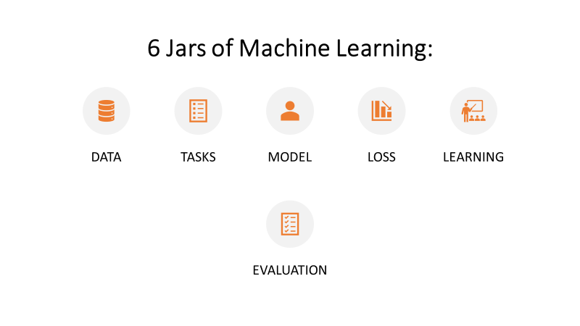

Slide 8
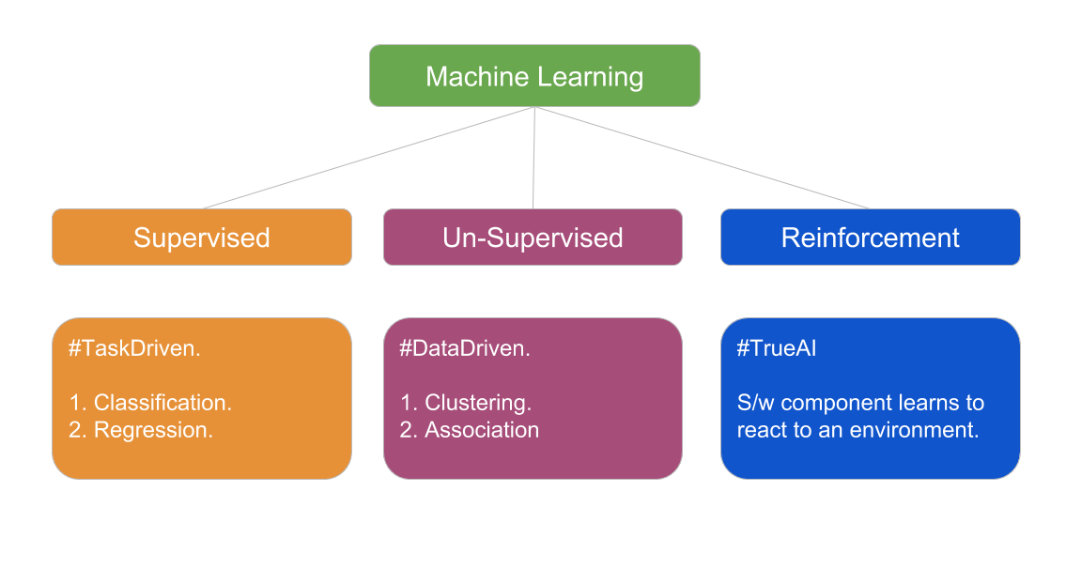

Slide 9
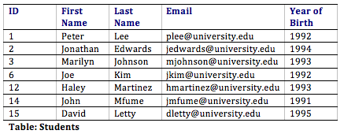
Attributes can also be termed as Feature, Variable, Dimension or Fields

Slide 10
Feature Engineering
Features are individual independent variables. It is an attribute of a dataset.
Feature Engineering - Translating a dataset into features which will be able to represent the dataset more effectively and result in a better learning performance
It has two major elements :
Feature Transformation
Feature Subset-selection.
Feature Transformation - Transforms the data- structured or unstructured into a new set of features which can represent the underlying problem which machine learning is trying to solve. There are two variants of Feature Transformation
Feature Construction
Feature Extraction.

Slide 11
Feature Construction process discovers missing information about the relationships between features and augments the feature space by creating additional features.
Feature Extraction is the process of extracting or creating a new set of features from the original set of features by doing some transformation in order to remove redundancy. Thus new features can represent the data very likely to the old features.
Unlike Feature Transformation, in case of Feature Subset-selection (Feature Selection) no new feature is generated. The objective of feature selection is to derive a subset of features from the full feature set which is most meaningful in the context of a specific machine learning problem

Slide 12
Model Representation
The goal of Supervised Machine Learning is to learn or derive a target function which can best determine the target variable from the set of input variables.
A key consideration in learning the target function from the training data is the extent of generalization
There arises two problems → Underfitting
→ Overfitting

Slide 13
Underfitting
If the target function is kept too simple, it may not be able to capture the essential nuances and represent the underlying data well.
Many times underfitting happens due to unavailability of sufficient training data.
Underfitting results in both poor performance with training data as well as poor generalization to test data
Underfitting can be avoided by
Using more training data
Reducing features by effective Feature Selection

Slide 14
Overfitting
Overgeneralizing is something that we humans do all too often, and unfortunately machines can fall into the same trap if we are not careful.
This is called Overfitting, it means model performs well on the training data, but it does not generalize well.
In such a case, any specific deviation in the training data, like noise or outliers, gets embedded in the model. It adversely impacts the performance of the model on the test data.
Overfitting results in good performance with training data set, but poor generalization and hence poor performance with test data set. It can be avoided by
Using re-sampling techniques like k-fold cross validation
Hold back of a validation data set
Remove the nodes which have little or no predictive power for the given machine learning problem.

Slide 15
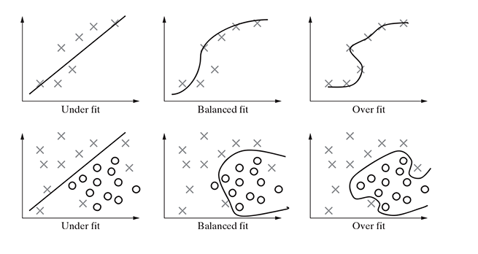

Slide 16
Bias -Variance Trade-off
Bias – This part of generalization error is due to wrong assumptions. A high-bias model is most likely to underfit the training data.
Variance – This part is due to the model’s excessive sensitivity to small variations in training data. A model with many degrees of freedom is likely to have high variance.

Slide 17
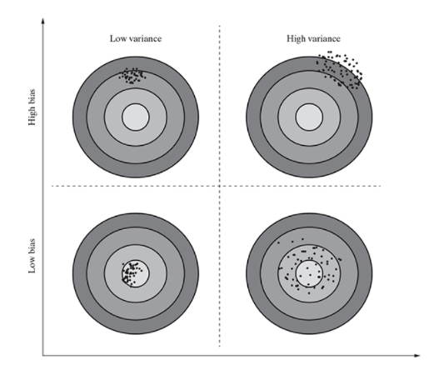

Slide 18
Steps:
Handling data - We load the data from csv file and spread it into training and tested assets
Summarizing data - We summarize the properties in the training dataset so that we can calculate the probabilities and make predictions
Making a Prediction - Making a particular prediction, where we use the summaries of generate a single prediction and after that we generate predictions given a test dataset and a summarized training dataset.
Evaluate Accuracy - We evaluate the accuracy of the predictions made for a test dataset as a percentage correct out of all the predictions made and finally we tie together and form our own model.

Slide 19
Multiple factors play a role when we try to select the model for solving a machine learning problem.
The most important factors are :
The kind of problem we want to solve using machine learning
The nature of the underlying data.

Slide 20
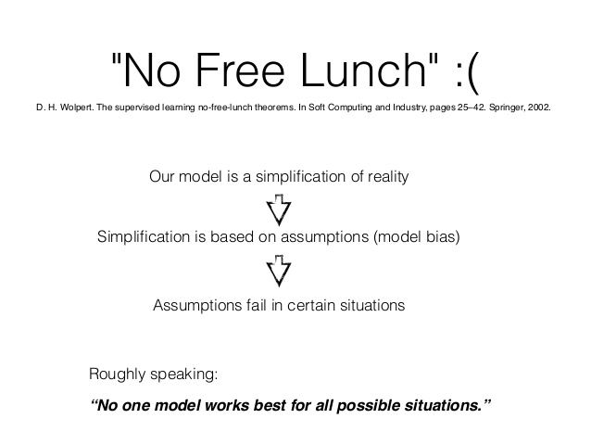

Slide 21


