Slide 1
Eightfold Talent Insights Project
Presented by
Ramya mamidipaka

Slide 2
Profile Data
2 min
Contains resume Data from 13K profile regarding past and present experience on professional with people analytics related experience i.e., HR, Strategy, Data and Analytics, Sales etc.
Since the Data contains a greater number of Senior level data, this is not random sample but belongs to the “professionals” with a decent number of YOE in the field
The data procured from industries like Computer Software, Finance, HR, IT services etc. has details like education level, location, Company details, seniority level, gender and race including current title and each title held over the span of the career
Based on the above data, a detailed study on the professional would give us insights on the gender, race , education , YoE of the professionals

Slide 3
Features
YoE
Seniority Level
Race
Gender
Job Function
Department
Tenure at each role
Education & Major
Current work details(title, start, end)

Slide 4
Basic Insight - Univariate
1 min
California, New York and Texas are the topmost locations for professionals
Number of Profiles of upper management more than the entry level positions

Slide 5
Basic Insight - Univariate
2 min
Masters and Bachelors level education count
Advanced Degree Major

Slide 6
Basic Insight - Univariate
2 min
Countries with most number of professionals work prior to the current role
Asians, Hispanic and Black constitute of a quarter of the population

Slide 7
Basic Insight - Univariate
2 min
Female Directors
YoE distribution, right skewed
Job functions with the greatest number of profiles
Male CXO

Slide 8
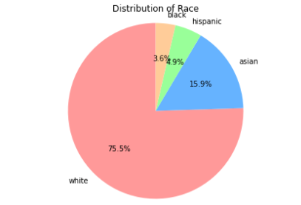
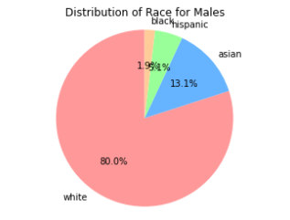
Basic Insight – Bivariate(Gender & Race)
2 min
Gender, equal in number approximately.
Black Women are approximately twice in number than black men!!

Slide 9
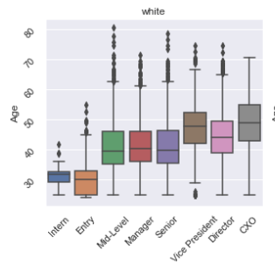
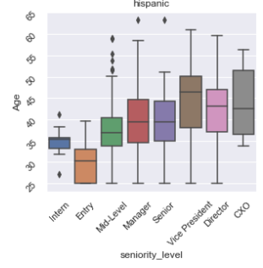
Basic Insight- Bivariate(Age, Race)
2 min
Derived Age column through YoE and Gap years
Hispanics on Average have 5 years more age than white people in the same seniority level

Slide 10
Basic Insight – Bivariate(Tenure, Seniority Level)
2 min
Derived Tenure column by YoE and Number of Past titles
Total YoE and seniority level
On Average Professionals spend around 2-3 years in a role

Slide 11
Intermediate Insight – (Gender, seniority, Education)
2 min
Masters to Bachelors level count ratio for each seniority level. As level increases, number of people doing higher degree is increasing. Highest ratio for the CXO position
Equal representation of each gender in each particular position(except for CXO position, we have female 99 and male 207)
Education?
YoE
Titles?
Other?
Notes:
Q1. for CXO position, we see twice as many males than females. Is the reason Education level? Is the reason YOE? Or is it due to race? Or is it due to the industry ?

Slide 12
Intermediate Insight cntd…
2 min
Masters to Bachelors level count ratio for Male and Female in CXO position
Distribution of YoE for each gender
Notes:
For now, let us assume that it is different due to some bias called x, which is unknown for now

Slide 13
Intermediate Insight cntd…
1 min
Mean number of titles Held by male and female are approximately same
6.56
6.66
Notes:
For now, let us assume that it is different due to some bias called x, which is unknown for now

Slide 14
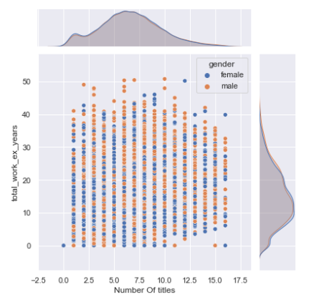
Intermediate Insight – (Past-titles, YoE, Gender)
2 min
Number of Past-titles, YoE for each gender
Unlike expected, that more the number of titles more the number of years of experience, We see that there is very low correlation(0.32) between number of years of experience and number of titles
This means that, Professionals are staying for longer duration at the same role, but on further investigation it can be concluded that this can be because of data irregularities.
Notes:
Data points in red block have mentioned only one role(the current role) and didn’t fill all the details

Slide 15
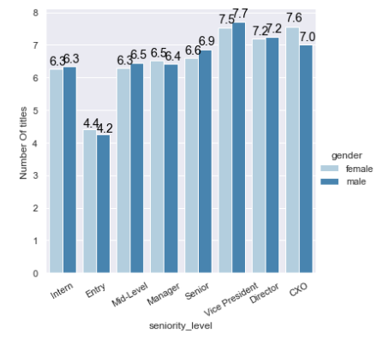
Intermediate Insights- (Past-titles, Seniority , Gender)
2 min
Number of Past-titles, Seniority Level for each gender
We see a greater number of titles for intern than Entry. So, we can assume that a considerable amount of people are doing an advanced degree full time after spending few years in the industry
We see a considerable difference in number of titles by women and men to reach the CXO level. We also saw the difference in number of CXO titles held by men and women

Slide 16
Gap Between Work Experience
3 min
Unemployed/ Taking a break between two jobs
YoE -> 35 + 47 + 145 -> 225 months -> ~ 19 years
Gap -> 176 + 101 + 116 (Last day to present) -> 393 months -> ~32 years
1972-08-12
1990-04-10
2001-08-10
1975-08-11
1995-03-11
2012-09-12

Slide 17
Intermediate Insight (Gender, race, Gap)
2 min
Asian Female has the highest gap between careers
YoE for each race and gender
We see that Asian Women have highest gap between careers, thus having low YoE
Notes:
For now, let us assume that it is different due to some bias called x, which is unknown for now

Slide 18
Summary of Insights
Even though the people analytics field has an equal gender diversity, the “chief” positions are not having equal representation of women.
While this position has seen a great improvement in the last few years, Many studies have shown that having a more diverse board is good for business
Hispanics on average take more years to reach a particular seniority level than whites
This may be due to late college enrollments or high college dropouts in this community
We saw correlation between Number of Past roles, and YoE , lowest of both being “Entry” level and highest being for “CXO” level
A considerable amount of people are doing an advanced degree full time after spending few years in the industry
Studies have showed that professionals prefer to join workforce right after college and would like to gather money for paying advanced degree and Masters being one of the gateway to pursue career in USA
Asian women have a high amount of career gaps and thus having less YoE
Studies show that women tend to have careers gaps due to family issues, kids etc.

Slide 19
Coding Challenge
Given a list of experiences (and their respective start and end dates)
Find the total work experience (accounting for overlaps/gaps)
Identify profiles that have gaps

Slide 20
Algo 1
[2019-May, 2019 September],[2020-Jan, 2020- Mar],[2020-Jan, 2020-April]
[2019-May, 2019-June, 2019-July, 2019-Aug, 2019-September]+[2020-Jan, 2020-Feb, 2020-Mar]+ [2020-Jan, 2020-Feb, 2020-Mar, 2020-April]
Use of Set => [2019-May, 2019-June, 2019-July, 2019-Aug, 2019-September, 2020-Jan, 2020-Feb, 2020-Mar, 2020-April]
Length of the above set gives us the total Experience
(Start_date to present_date in months) – (Length of the set ) gives us Gap
Time Taken 253 Seconds for whole dataset

Slide 21
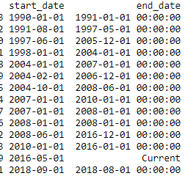
Algo 2
[1990-01-01, 1991-01-01]
[1991-08-01, 1997-05-01]

Slide 22
Algo 2
[1990-01-01, 1991-01-01]
[1991-08-01, 1997-05-01]
[1997 -06-01, 2005-12-01]

Slide 23
Algo 2
[1990-01-01, 1991-01-01]
[1991-08-01, 1997-05-01]
[1997 -06-01, 2005-12-01]
[1997 -06-01, 2005-12-01]

Slide 24
Algo 2
[1990-01-01, 1991-01-01]
[1991-08-01, 1997-05-01]
[1997 -06-01, 2005-12-01]
[1997 -06-01, 2005-12-01]
[1997-06-01, 2007-01-01]

Slide 25
Algo 2
[1990-01-01, 1991-01-01]
[1991-08-01, 1997-05-01]
[1997 -06-01, 2005-12-01]
[1997 -06-01, 2005-12-01]
[1997-06-01, 2007-01-01]
[1997-06-01, 2007-01-01]

Slide 26
Algo 2
[1990-01-01, 1991-01-01]
[1991-08-01, 1997-05-01]
[1997 -06-01, 2005-12-01]
[1997 -06-01, 2005-12-01]
[1997-06-01, 2007-01-01]
[1997-06-01, 2007-01-01]
[1997 -06-01, 2008-06-01]

Slide 27
Algo 2
[1990-01-01, 1991-01-01]
[1991-08-01, 1997-05-01]
[1997 -06-01, 2005-12-01]
[1997 -06-01, 2005-12-01]
[1997-06-01, 2007-01-01]
[1997-06-01, 2007-01-01]
[1997 -06-01, 2008-06-01]
[1997 -06-01, 2010-01-01]

Slide 28
Algo 2
[1990-01-01, 1991-01-01]
[1991-08-01, 1997-05-01]
[1997 -06-01, 2005-12-01]
[1997 -06-01, 2005-12-01]
[1997-06-01, 2007-01-01]
[1997-06-01, 2007-01-01]
[1997 -06-01, 2008-06-01]
……
[1997 -06-01, 2021-06-01]

Slide 29
Algo 2
[1990-01-01, 1991-01-01] ~ 1yr
[1991-08-01, 1997-05-01] ~ 6.7yr
[1997 -06-01, 2021-06-01] ~ 24 yr
Total YoE ~ 30.7 yr
Total Career length => [1990-01-01 , 2021-06-01] ~ 31.5 Yr
Total Gap => 31.5 – 30.7 ~ 0.75 yr
Time Taken 150 Seconds for whole dataset

Slide 30

Case 1
End date before Start date
Dropping the entry
Swapping

Slide 31
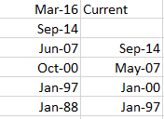

Case 2
No End Date Mentioned
Filling with “Current”
Dropping the data row
Filling the end date with next work- start_date (Assuming no gaps)
${RMSE}_{3}$ < ${RMSE}_{2}$ < ${RMSE}_{1}$ with the Algo2

