Slide 1

Selenium
Web Test Tool Training
Portnov Computer School presents:
Discover the automating power of Selenium
Presented by:
Kangeyan Passoubady (Kangs)
Copy Right: 2008, All rights reserved by Kangeyan Passoubady (Kangs). Republishing requires author’s permission

Slide 2
3
Lesson
Selenese Commands

Slide 3
Variable Substitution #1
You can store any value into a variable using selenium accessors.
Variable substitution provides a simple way to include a previously stored variable in a command parameter
If you give the variable name as intAmount. To use the variable anywhere else use ${intAmount}. This will substitute the actual value in the place of ${intAmount}.
Use echo ${intAmount} to display the values in the Log.
Any of the selenium accessors can be used to store a value.
Some of the key accessors are
  storeText, storeValue, storeCookie, storeAlert and storeEval

Slide 4
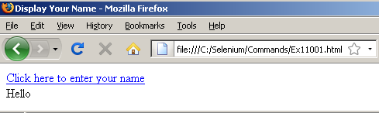
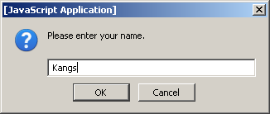
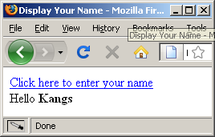
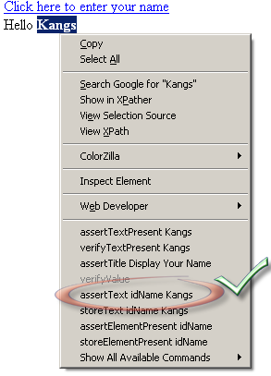
Variable Substitution #3
Open the HelloWorld.html in Firefox
Create a test case by opening Firefox→Tools→Selenium IDE (by default it is in Recording mode)
Update the base URL of Selenium IDE with the URL in the Firefox address
Click on the link “Click here to enter your name”, when prompter for your name, enter your name.
Your name will be displayed in next line.
Highlight your name Right click and select the assertText, then Stop the recording in Selenium IDE.
Rerun the test case in Selenium IDE

Slide 5
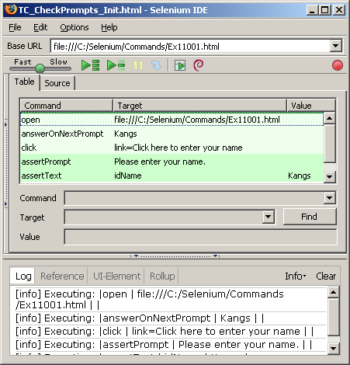
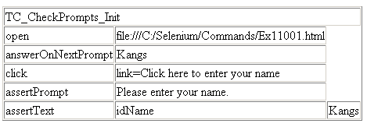
Variable Substitution #4
Your test case will look like in Selenium IDE as shown in the figure right side
Try to run multiple time and make sure your test case is passed without any failures.
Now save the test case as “Recorded_TestCase_HelloWorld.html”
Double click and open the “Recorded_TestCase_HelloWorld.html” either in IE or Firefox.
You can see all the commands in an HTML table.
Your answerOnNextPrompt should be before than the click command.
Make sure it precedes otherwise your test case will fail.

Slide 6


Variable Substitution #5
Now we’ll try to do the same exercise using variable substitution
In the Selenium IDE, select “answerOnNextPrompt”, Right Click and Select a new command
Select the command “store”
Target “Kangeyan”
Value “vName”
Store | Kangeyan | vName
Underneath insert a new command and provide the below values
echo | ${vName}
Right click and copy the “echo” command, and paste before the assertText command line

Slide 7
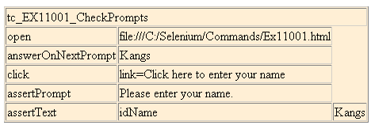
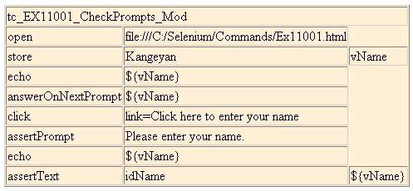
Variable Substitution #6
Your recorded test case will look something similar to this one
Change something similar to this one
See how the ${vName} is used in multiple places

Slide 8
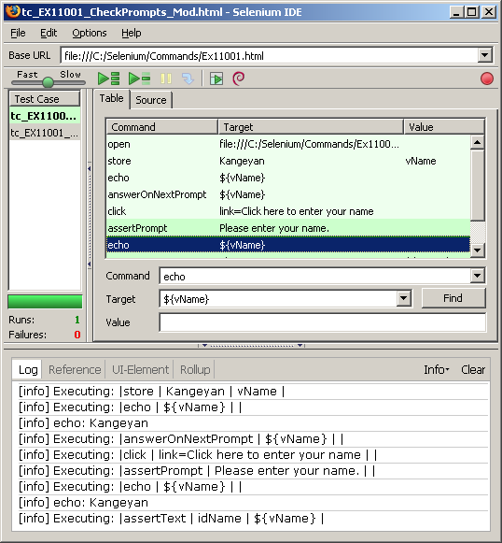
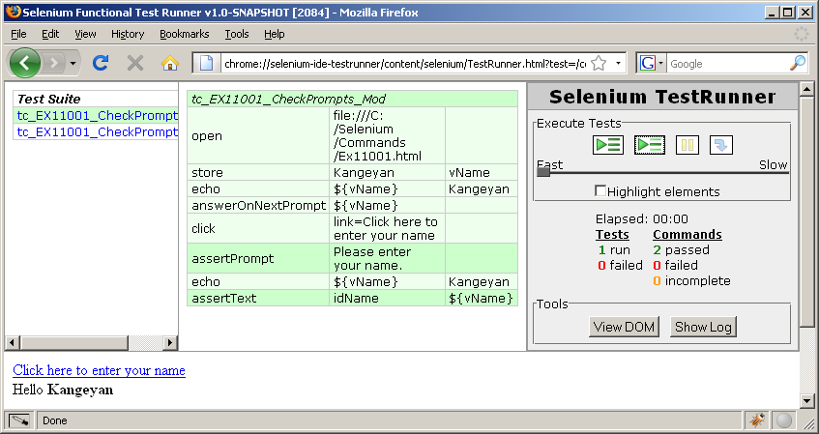
Variable Substitution #7
echo shows the variable values in the Log
See the usage of ${vName} in answerOnNextPrompt and assertText
echo prints the variable values in the third column of the command in Test Runner

Slide 9
storedVars #1
All the variables are internally stored in a map named “storedVars”.
storedVars allows you to access the ${varName} using the “varName” key within the map.
Using storedVars you can reference the values within Javascript Evaluation code.
What is a Map?
Maps provide a more general way of storing elements. An object that maps keys to values. A map cannot contain duplicate keys (duplicate variable names); The Map collection type allows to store pairs of elements, termed "keys" and "values", where each key maps to one value. Here Keys refers Selenium variable Names and values refers to their values.

Slide 10
storedVars #2
Open URL: http://mail.yahoo.com
Type username: <username>
Type password:<passwd>
Press Sign In button
AssertTextPresent <username>
Press SignOut
waitForTextNotPresent <username>

Slide 11
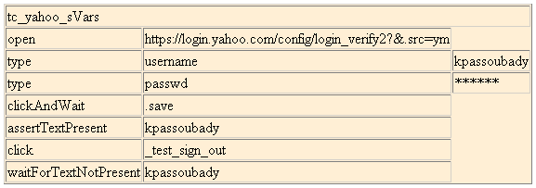
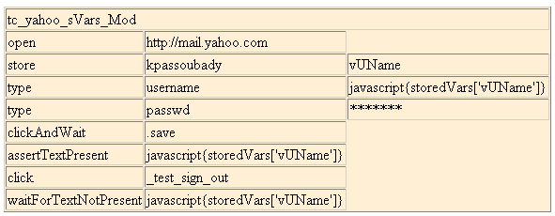
storedVars #3
Your recorded test case will look something similar to this one
Change something similar to this one
See how the storedVars is used in multiple places

Slide 12
JavaScript Evaluation #1
JavaScript evaluation allows full power of JavaScript code in constructing the Command Parameter
JavaScript snippet can be given using the following syntax.
  Javascript { <code snippet goes here> }
  Javascript keyword is optional
  The code given is treated as a JavaScript code and executed.
  storedVars Map can be used to access the previously stored variables
  Variable substitution should be handled carefully within the JavaScript code.

Slide 13
JavaScript Evaluation #2
You can use any of the following Eval commands
  assertEval, assertNotEval, VerifyEval, verifyNotEval, waitForEval, waitForNotEval, storeEval
You can use any of the following Expression commands
  assertExpression, assertNotExpression,verifyExpression, verifyNotExpression, waitForExpression, waitForNotExpression, storeExpression, store and WaitForCondition

Slide 14
Barnes and Nobles Problem #3
Open a specific URL (http://www.barnesandnoble.com/)
Search for a specific text (“Javascript”) in #1 page
Sort by “Prize^{v}”
How do you check “Online Price: $$$” is in sorted order?

Slide 15
Answer #4
In this case I have decided to check the first two Amounts displayed on that page are in the ascending order.
The first value is A, the second value is B
If A <= B then we assume the first two listed prices are in ascending order.
Now get the third value C
If B <= C then we assume that A, B and C are in ascending order. (i.e., A <= B <=C )

Slide 16
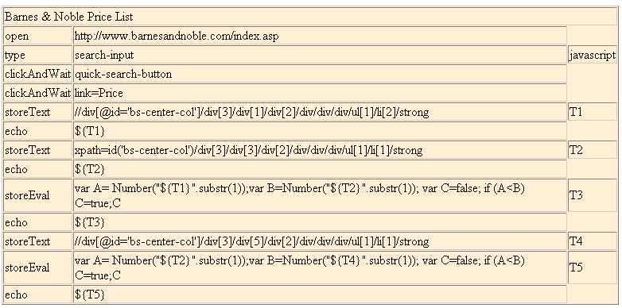
Answer #5

Slide 17
Answer #6
Xpath for first amount
storeText in a variable T1
Echo Prints the values in the Log
Substr(1) Removes ’$’ and only takes the numeric value.
Number converts the string type into a Number type

Slide 18
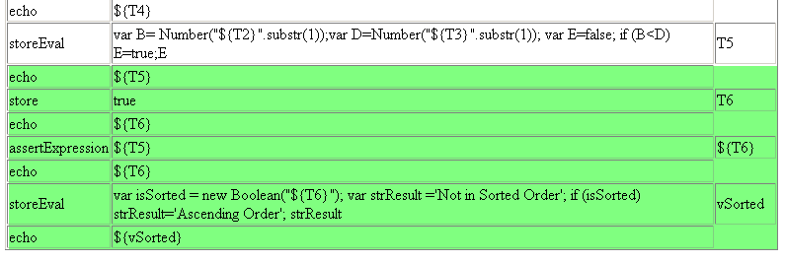
Answer #7
Now we can store “true” in T6 and compare with value with T5
If that comparison yields true then it is Ascending Order
Store T6 with true
Check whether T5 and T6 both contains true
Now echo Sorted or Not Sorted

Slide 19
Alert #1
storeAlert(seleniumVariableName)
  Checks for JavaScript Alert, stores the alert message. If no alert generated then throws an exception.
  Getting an alert has the same effect as manually clicking OK.
  If an alert is generated but you do not get/verify it, then the next Selenium action will fail.
  JavaScript alerts will NOT pop up a visible alert dialog.
  Selenium does NOT support JavaScript alerts that are generated in a page's onload() event handler. In this case a visible dialog WILL be generated and Selenium will hang until someone manually clicks OK.
Returns:
  The message of the most recent JavaScript alert.
Other Alert commands are:
  assertAlert ( pattern ), assertNotAlert ( pattern ), verifyAlert ( pattern )
  verifyNotAlert ( pattern ),waitForAlert ( pattern ),waitForNotAlert (pattern)

Slide 20
AlertPresent #2
verifyAlertPresent()
  The best way to check the alerts are using this command
  This command never throws an exception
Returns:
  True or False.
Other AlertPresent Commands are:
  storeAlertPresent ( seleniumVariableName )
  assertAlertPresent ( )
  assertAlertNotPresent ( )
  verifyAlertNotPresent ( )
  waitForAlertPresent ( )
  waitForAlertNotPresent ( )

Slide 21
Alert #3
Download the ClickAlert.html under the Alert section
  Record a test
  Are you able to test it?
    (This is do-able)
Download the OnLoadAlert.html
  Are you able to test it?
    (This should be challenging)

Slide 22

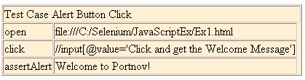
Alert #4
On load Alert will not be sensed by Selenium. You need to manually press “Ok” to continue the test.
Selenium able to intercept the button Click Alert.

Slide 23
goBack #1
goBack and goBackAndWait are the two commands simulates a user clicking on the “back” button of the browser.
Download the SelectAWebSite.html under Exercises.
Record the test as listed below:
  Select Google, after going to Google assertTitle then go back
  Select Portnov, after going to PortNov assertTitle then go back
  Select Microsoft, after going to MicroSoft assertTitle then go back
  Select Yahoo, after going to MicroSoft assertTitle then go back
Run the test
  Why it fails?
  How do you fix it?

Slide 24
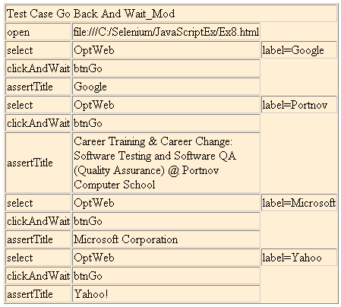
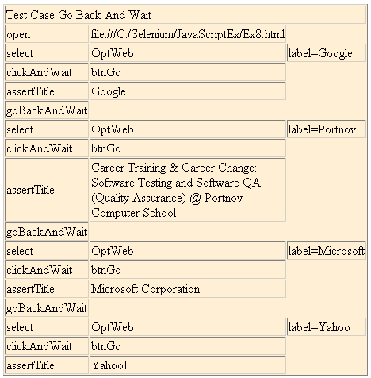
goBackAndWait #2
Try goBack, and goBackAndWait, which one works well?
Add goBackAndWait, see the results

Slide 25
waitForPopup #1
waitForPopUp ( windowID,timeout ) and selectWindow ( windowID ) are the two commands allows you to test the Popup Windows.
selectWindow selects a specific Popup, use null to select Parent window.
Download Ex1.html to Ex3.html under wait for Popup, Open CreatePopUps.html in Firefox browser.
Record the test as listed below:
  Click Create Windows button
  Select win1, click the button “Click and get the Welcome Message”, minimize win1
  Select win3, select any option, press “Submit” button
  Go back to the parent window, press “close button”
Run the test
  Is it fails?
  How do you fix it?

Slide 26
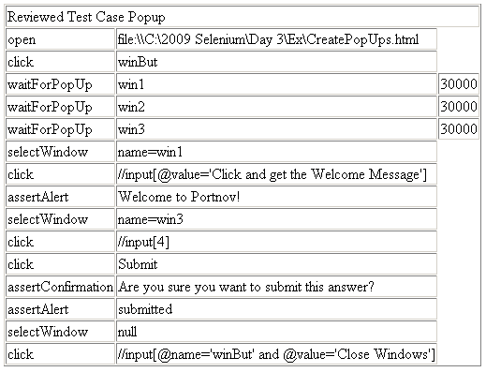
waitForPopup #2
Fix the code something similar to shown here
To select Parent Window use “null”

Slide 27
Navigator Properties #1
To get Browser information, you can use navigator object
  The common properties of navigator object is like
    appName
    appCodeName
    appEnabled
    JavaEnabled
    language
    cookieEnabled
    navigator.userAgent
    navigator.plugins
    navigator.platform
    navigator.mimeTypes
  The common properties of browserVersion object is like
    browserVersion.name
    browserVersion.browser
    browserVersion.isFirefox
ArrayTypes: has multiple values
Not all the browsers support these properties

Slide 28
Navigator Properties #2
Download “Test Case Navigator Properties.html” from the Exercises Section
Run the Test Case
Look at the Selenium IDE Log
You can See all the Navigator Properties

Slide 29
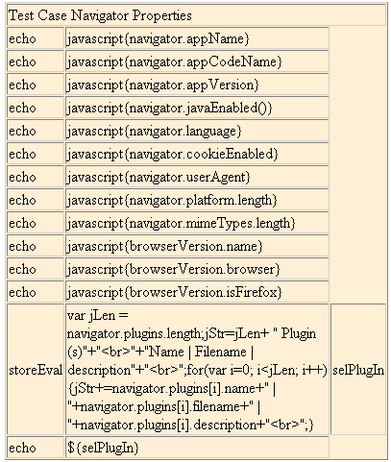
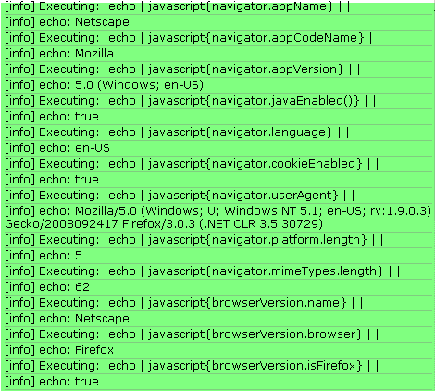
Navigator Properties #3
Create a string to display the object properties
Look at the log for results

Slide 30
Test Suite on Commands #1
Create a Test Suite based on the previous exercises:
We’ll use the following three test cases to create one Test Suite (Test Script Package)
  Test Case Alert Button Click.html
  Test Case Navigator Properties.html
  Reviewed Test Case Popup.html
Use the test cases which are reviewed and working well.

Slide 31
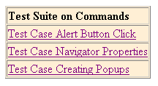
Test Suite on Commands #2
You can download the test suite from Exercises Section:
Test Suite on Commands.html
<tr><td><a href="Test Case Alert Button Click.html">Test Case Alert Button Click</a></td></tr>
<tr><td><a href="Test Case Navigator Properties.html">Test Case Navigator Properties</a></td></tr>
<tr><td><a href="Reviewed Test Case Popup.html">Test Case Creating Popups</a></td></tr>
Use the test cases which are reviewed and working well.

Slide 32
Test Suite on Commands #3
To CREATE a test suite from the scratch do the following activities:
Open “Test Case Alert Button Click.html” in the Selenium IDE
Select File → Save Test Suite As “Test Suite on Commands.html”
Open the “Test Suite on Commands.html” in notepad
Add the below HTML codes before the </tbody>
Select File → Save to save the test case.
<tr><td><a href="Test Case Navigator Properties.html">Test Case Navigator Properties</a></td></tr>
<tr><td><a href="Reviewed Test Case Popup.html">Test Case Creating Popups</a></td></tr>
All the test cases in the same folder

Slide 33
Creating Test Suite From Scratch #4
Open the Firefox browser
Open the Selenium IDE
Select File → Open Test Suite
Choose the “Test Suite on Commands.html” from your local folder
Press the TestRunner icon to run the test suite
It will show the Test Suite in the firefox browser
Click the “Run All Tests” button to run all the test cases
Click the “Run the Selected Tests” button to run a specific test case

Slide 34
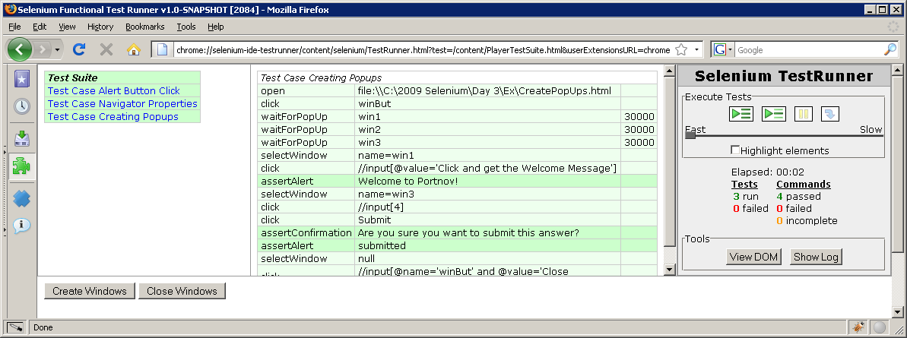
Run Test Suite on Commands #5

Slide 35
Exercise 1 – DevRy Popup Window
Create a test case with the following steps:
Open http://www.devry-degrees.com
At the bottom of the page, you will see 5 footer links
Click a link at a time, this will create a popup
AssertTitle on the Popped Up window
Close the Popup
Click on the next link in the parent window, this will create a popup
AssertTitle on the Popped Up window
Close the Popup, Continue the same for all the 5 links

Slide 36
Exercise 1 – Questions
Answer the below Questions once you complete your Devry Popup Window Test Case:
  What are the Popup’s link works without any problem?
  Why one of the Popup’s assertTitle produces an Error?

