Slide 1

GARMENT WORKER PRODUCTIVITY
"Enhancing Efficiency and Quality in the Apparel Industry"

Slide 2

MEET OUR TEAM - “WE TRIED”
Bapuji Satyala (U61600601)
Ajay Srikar Medidi(U85645387)
Sanjana Anumula (U64639710)
Ramyasri Muthineni (U41740753)
Rehaan Ahmed Abdul (U84763124)
Gayatri Sowbhagya Lakshmi Akkireddi (U37764178)

Slide 3

Addressing Workforce Productivity Challenges in the Apparel Industry
Low Wages and more work-load
Poor Working Conditions
Lack of Job Security
Health and Mental Health Issues Education and Training

Slide 4
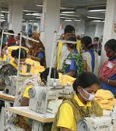
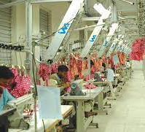

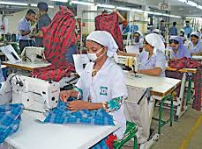

IMPACT
Increased Output and Efficiency
Cost Reduction
Quality Control
Competitive Advantage
Economic Growth
Worker Retention

Slide 5

How can we help?
We are using exploratory data analysis and machine learning to predict worker productivity, classifying them into productive and non-productive categories based on relevant features and historical data.

Slide 6

DATASET
Dataset Characteristics : Multivariate
Subject Area : Business
Associated Tasks : Classification
Feature Type : Integer, Categorical
Instances : 1197
Features : 15

Slide 7


ROADMAP FOR Model Planning
Modelling
Prediction
Training
Preprocessing
Import

Slide 8
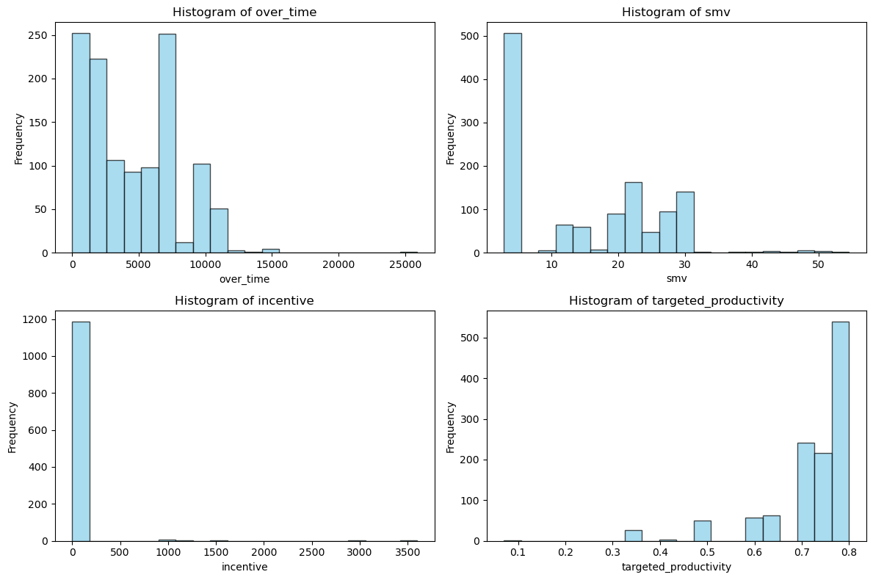
CONTINUOUS FEATURES

Slide 9
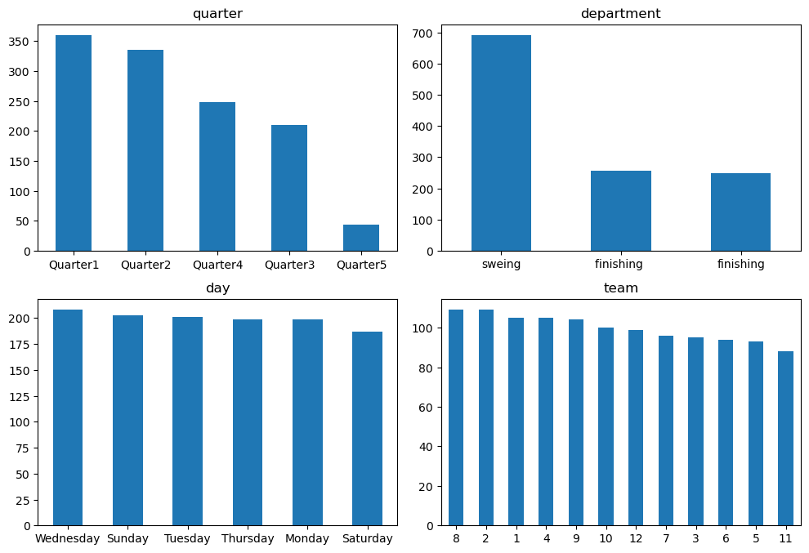
Categorical Features

Slide 10
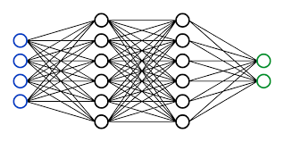
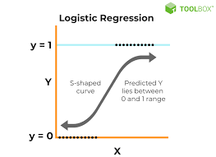

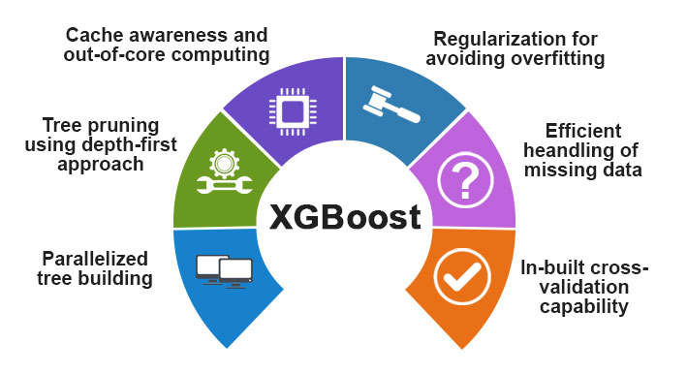
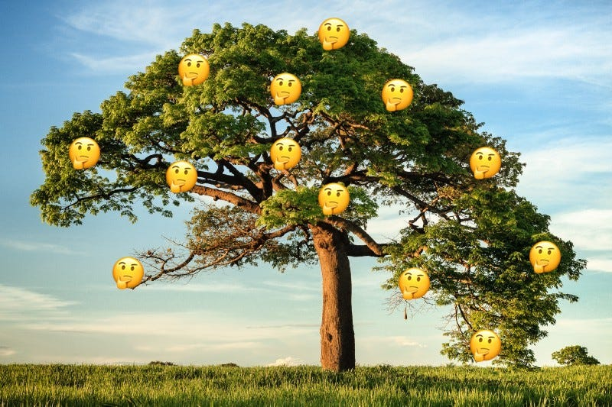
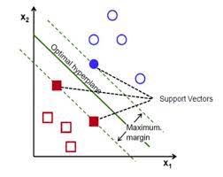
NEURAL NETWROKS
Logistic regression
Random Forest
MODELS
XGBOOST
SVM
Decision Tree

Slide 11




Metric Selection There are two possible errors: FN and FP depending on the scenario both errors might have same impact as the dataset is balanced , We opt for Accuracy.
Predicted Productive
Predicted Unproductive
Productive
TN
FP
Unproductive
FN
TP

Slide 12

What accuracy can do?
Quality Assurance
Efficiency
Customer Satisfaction
Compliance
Cost Control
Worker Training and Development

Slide 13
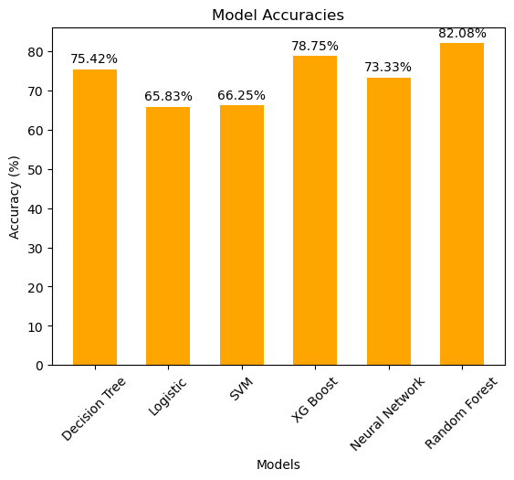
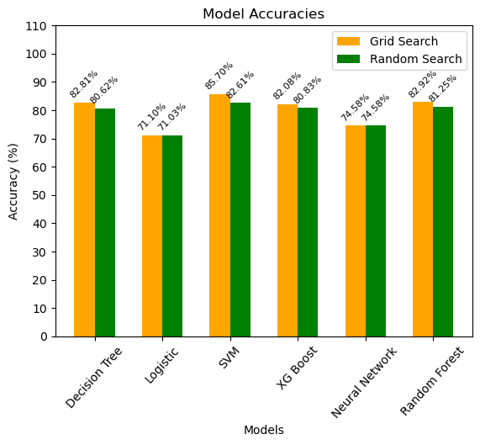
PERFORMANCES

Slide 14

Enhance garment worker productivity through training, technology, safety, and incentives. Optimize workflows, quality control, and inventory management. Foster employee well-being, engagement, and sustainability for increased efficiency and profitability.

Slide 15

ANY QUERIES?

Slide 16
THANKYOU

