Slide 1

Accents – Agnostic Speech Transcription Model for Enhanced Accessibility
Team Name: Titans Alliance
Team Members
RamyaSri Muthineni – U41740753
Ruchitha Paccha – U70955896
Bojanapally Santhoshini – U88362375

Slide 2

Introduction to the problem: Challenges in transcribing spoken audio due to diverse accents and dialects.
Importance of addressing this challenge in e-learning platforms for enhanced accessibility.

Slide 3
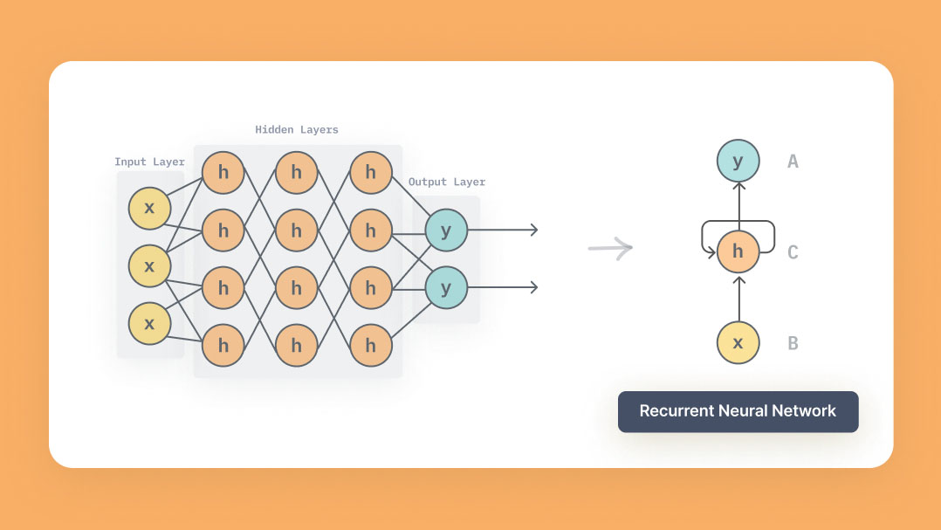

Business Context

Slide 4

Objectives
Addressing the challenge of accurate transcription for diverse accents.
Developing a robust transcription model.
Utilizing Mozilla Common Voice dataset.
Evaluating model performance using standard metrics.

Slide 5




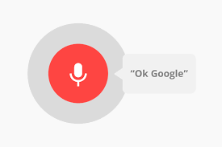


Project Resources

Slide 6
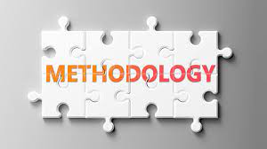
Data pre-processing steps:
Extracting features (MFCCs).
Normalization and scaling.
Model selection:
RNN, LSTM, GRU.
Model architecture and training process.

Slide 7
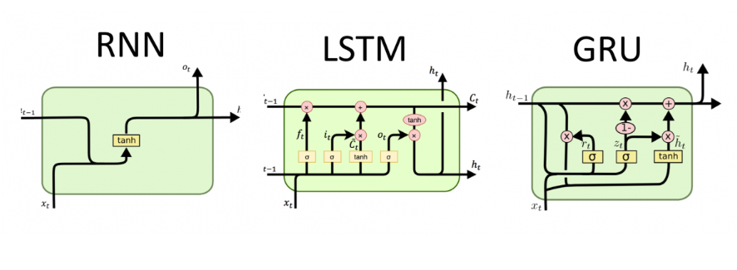
Model Architecture

Slide 8

Challenges encountered during the project.
Accents and dialects.
Data availability.
Model generalization.
Computational resources.

Slide 9

Summary of expected outcomes:
Robust speech transcription model.
Potential applications in various industries.

Slide 10
