Slide 1
Task 4 – Sales & Financial Dashboard
Data Analyst Internship
Interactive Power BI Dashboard
Task 4 – Sales & Financial Dashboard

Slide 2
Objective
Design an interactive dashboard for business stakeholders.
Present important sales KPIs in a simple visual format.
Analyse sales by product category and region.
Show sales trends over time.
Use slicers to make the dashboard interactive.
Task 4 – Sales & Financial Dashboard

Slide 3
Dataset & Dashboard Components
Dataset: Sales data in CSV format.
Important fields include Sale Date, Sales Amount, Quantity Sold, Product Category, Region and Sales Channel.
KPIs: Total Sales, Average Sales, Total Quantity and Total Transactions.
Charts: Sales by Product Category, Sales by Region and Sales Trend Over Time.
Slicers: Sales Channel, Product Category and Region.
Task 4 – Sales & Financial Dashboard

Slide 4
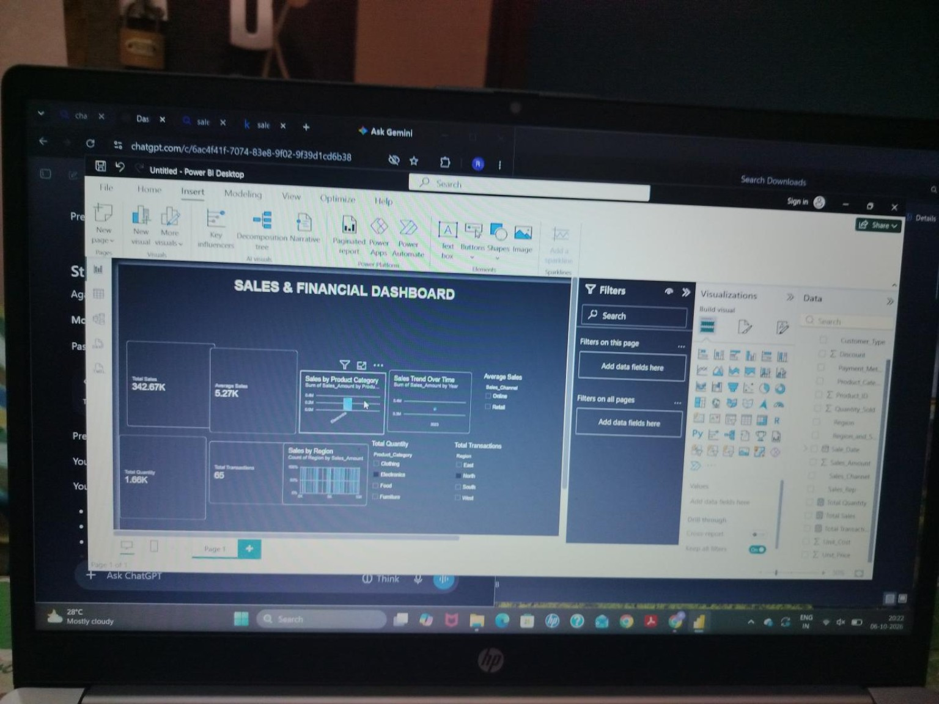
Power BI Dashboard – Full View
Task 4 – Sales & Financial Dashboard

Slide 5
Dashboard Features & Interactivity
KPI cards provide a quick summary of sales performance.
Sales by Product Category compares performance across categories.
Sales by Region compares sales performance across regions.
Sales Trend Over Time supports time-series analysis.
Sales Channel, Product Category and Region slicers allow interactive filtering.
Task 4 – Sales & Financial Dashboard

Slide 6
Conclusion
The Power BI dashboard provides an interactive view of sales performance.
KPI cards give stakeholders a quick summary of important measures.
Charts help compare categories and regions and understand sales trends.
Slicers allow users to explore the data from different perspectives.
The dashboard supports data-driven business decision-making.
Task 4 – Sales & Financial Dashboard

