Slide 1
FINAL ENGINEERING BOSS BATTLE
My 60-Day
Software
Engineering
Journey
ABTalks 60-Day Software Engineering Challenge
Ramya N · Final-Year B.E. Computer Science & Engineering
Notes:
Welcome everyone. I'm Ramya N, a final-year Computer Science student. Over the past 60 days, I took on the ABTalks challenge to build real software engineering habits through deliberate daily practice.

Slide 2
THE 60-DAY CADENCE
Consistent practice built my skills
Learn
Build
Debug
Optimize
Showcase
Coding practice, debugging, problem-solving
Project development, documentation, presentation

Slide 3
TECHNICAL COMPETENCIES
Technical skills I developed
CORE SKILLS
APIs, databases, and authentication
Debugging, testing, GitHub, and documentation
Programming and problem-solving
Data structures and algorithms
Frontend and backend development
LEARNING
Java and system design
Notes:
Here is my skillset breakdown. I stay completely honest about where I stand: full-stack JavaScript and core DSA are solid, while Java and System Design are actively in progress.

Slide 4
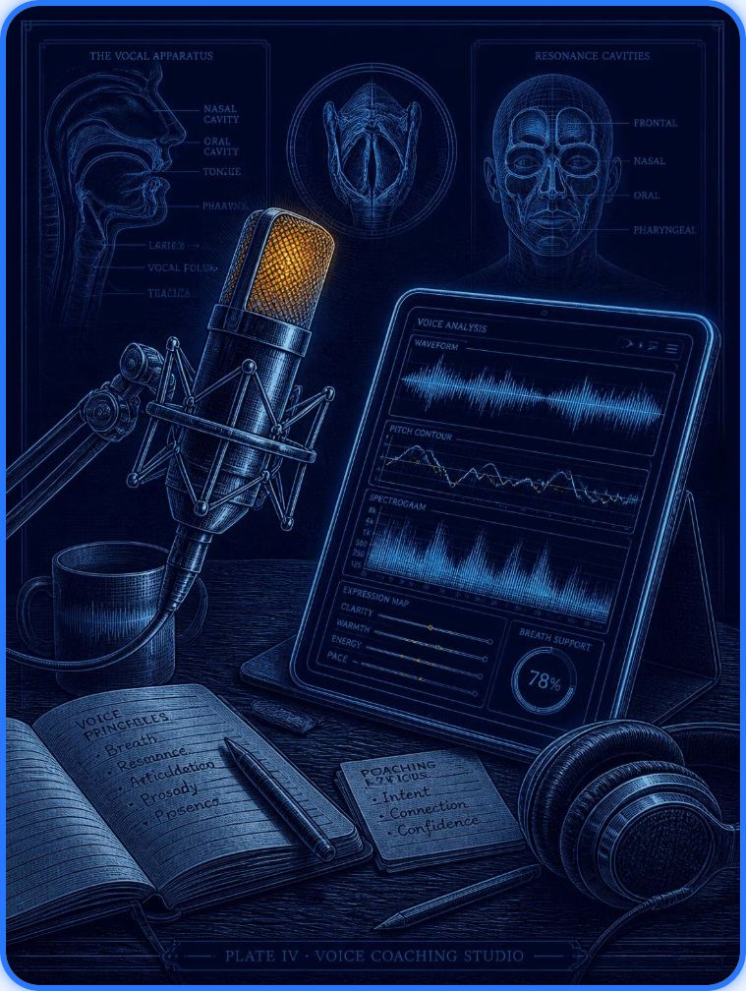
FLAGSHIP CAPSTONE
GD Prep Coach: Group Discussion Practice
A full-stack web application designed to help students simulate discussion topics, organize talking points, and refine communication.
Problem: Students lack realistic prompts and structured feedback when preparing for placement group discussions. Solution: Generates context-rich topics, offers real-time prompt analysis, and provides AI-assisted critique.
Stack: React + Vite, Node.js + Express, MongoDB Atlas, JWT auth, Google Gemini API. Lesson learned: Projects connect theory with practical skills.
Architecture: User → React Frontend → Express API → MongoDB / Gemini API
Notes:
GD Prep Coach was my biggest capstone. It connects a React front-end through an Express backend to MongoDB for auth and Gemini API for prompt generation and feedback.

Slide 5
PRACTICAL BUILDS
Three more projects, three more lessons
PROJECT 01
PROJECT 02
PROJECT 03 · LEARNING PROTOTYPE
Inventory Management System
ProjectFlow
Smart Spam Detector
Problem / solution: MERN project manager with JWT authentication, protected routes.
Technologies: MERN, JWT authentication.
Key learning: Dashboard calculates statistics on page load.
Problem / solution / key learning: Product management, stock tracking, CRUD.
Technologies: Node.js, Express, MongoDB, HTML/CSS/JavaScript.
Problem / solution: Learning prototype exploring spam classification.
Technologies / key learning: Text processing and ML concepts.
No implementation details unless verified.

Slide 6
CHALLENGE → APPROACH → LESSON
Hard problems get solved in small steps
CHALLENGE
APPROACH
LESSON
Break complex problems into smaller tasks
Debug errors systematically
Understand data flow between frontend and backend
Handle API requests and authentication
Improve readability and documentation
Notes:
Whenever I got stuck, I fell back on this framework: break the feature down, trace the data flow with logs, and document what worked so future bugs are easier to solve.

Slide 7
CODE QUALITY & COMPLEXITY
Readable code first, optimize with evidence
Write readable, maintainable code. Test edge cases. Use appropriate data structures. Measure before optimizing.
INITIAL APPROACH
REFACTOR
Two Sum
Two Sum
Nested loops
Hash map lookup in one pass
Notes:
A classic example that cemented data structures for me is Two Sum. Going from nested loops to a single-pass hash map reduces time complexity from O(n squared) to O(n).

Slide 8
Portfolio and evidence
GitHub profile
Project repository links
https://github.com/ramyanagesh29
https://github.com/ramyanagesh29/gd-prep-coach
Challenge repository
Depolyed Link
https://github.com/ramyanagesh29/ABTalks-60-days-Challenge-for-Software-Engineering
https://gd-prep-coach.vercel.app/
Certificates or completion evidence
https://abtalks.in/verify/ABT-CC-4JWUU
Notes:
GitHub profile and challenge repository links, project repository links, application screenshots, certificates or completion evidence.

Slide 9
RETROSPECTIVE
Consistent practice matters.
Debugging is part of engineering.
Projects connect theory with practical skills.
Documentation and communication matter.
Feedback and iteration improve software.
What I learned and how I grew
I grew by connecting theory with practical skills and learning through feedback and iteration.

Slide 10
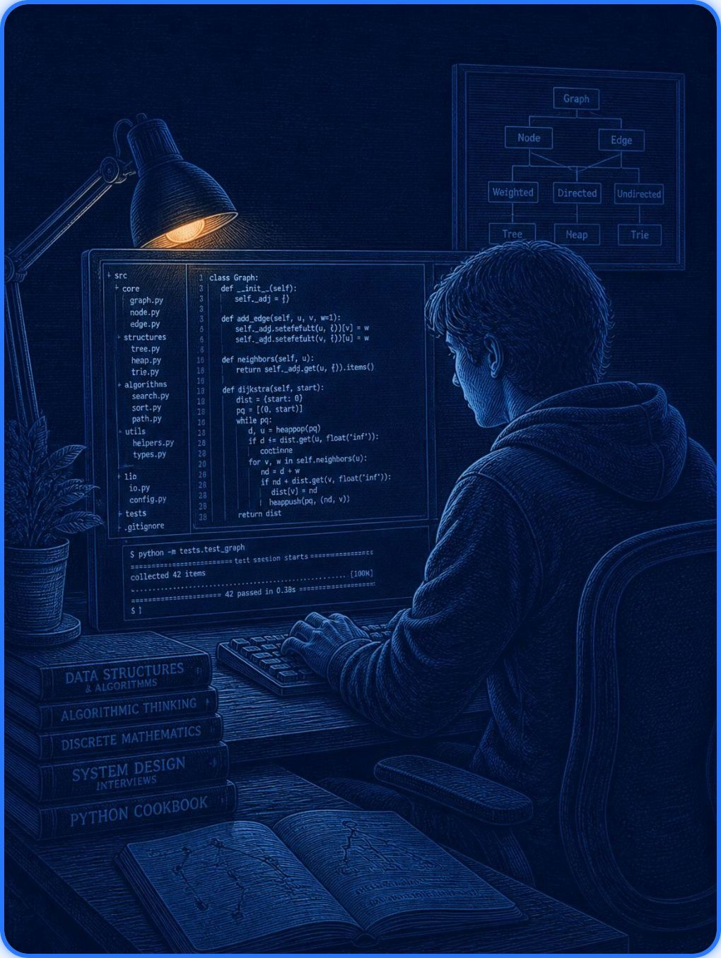
FORWARD TRAJECTORY
What's next: the journey continues
Continue Java and DSA practice; strengthen full-stack skills.
Improve testing, code quality, system design fundamentals; build and document more portfolio projects.
Prepare for campus placements and technical interviews.
"Every bug is a lesson. Every project is progress. The journey continues."
Thank You | https://github.com/ramyanagesh29
Notes:
Thank you for following along. Day 60 marks the completion of the challenge, but my preparation for campus placements and technical interviews is just getting started. Check out my GitHub for all the code!

