Slide 1
Human Emotions Detector(HED) - An Android Application
Team Members Group No: T13
Project Advisor: Dr. Bagavathi Sivakumar P/Associate Professor/ CSE Department
S.No | Reg.No | Name of the Student | Section
1 | CB.EN.U4CSE14401 | R ABISHEK | E
2 | CB.EN.U4CSE14428 | NEHA KANNAN | E
3 | CB.EN.U4CSE14439 | RAMYA ANANTH | E
4 | CB.EN.U4CSE14445 | SHANMUGANATHAN T | E
Date: 28 Aug 2017
Group No: T13

Slide 2
Content
Introduction (2 Slides)
Motivation (1 Slide)
Problem Definition ( 1 Slide)
Challenges and Approaches ( 2 Slides)
Time Schedule of activities (1 slide)
References (2 slides max)
Date: 28 Aug 2017
Group No: T13

Slide 3
Introduction
Due to the rapid changes occurring in our daily life, we have switched to text messages(WhatsApp) than phone calls when it comes to communication.
Since all of it happens over a textual platform, it is getting difficult for people to understand what emotion is held within these text messages.
The project mainly deals with this determining of emotions based on the text messages from the user’s mobile phone.
Date: 28 Aug 2017
Group No: T13

Slide 4
The application will try to understand the usage of words in a person’s text and categorize them.
This categorization will help in generating a usage pattern for the text messages and understand a person’s emotional state.
Once this conclusion has been made, the project will shift to a proper mobile platform android application
Main Concepts involved:
Human-Mobile Interaction
Natural Language Processing
Pattern Recognition
Predictive Analysis
Android App Development
Date:
Group No:

Slide 5
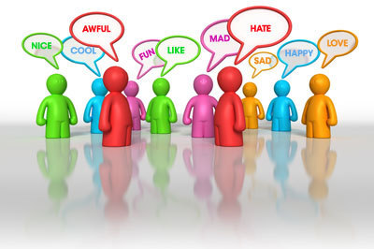
Motivation
To find a secure way to guard our chats and stop miscommunication between two people.
Date: 28 Aug 2017
Group No: T13

Slide 6
Problem Definition
Detecting human emotions using accelerometer data with the help of text extraction methods, predictive analysis, and emotion analysis
Date: 28 Aug 2017
Group No: T13

Slide 7
Challenges
Understanding the working and data extraction method of an accelerometer.
Time division of activities.
Creating a user template.
Learning app development.
Data integration.
Determining a proper prediction technique.
Date: 28 Aug 2017
Group No: T13

Slide 8
Approaches
Literature survey of papers and projects on determining the right technique for integration of all the collected data.
Analysing scholarly material and understanding how prediction techniques work, and how to determine it on a mobile platform.
Dividing work equally among the team members depending on our strengths and weaknesses.
Understanding and learning how to build an application.
Date: 28-08-2017
Group No: T13

Slide 9
Time Schedule of Activities
WEEK | TASK
Week 1 | Determining feasible technique
Week 2 | Data collection
Week 3-4 | Data consolidation and categorization
Week 5 | Learning app development
Date: 28 Aug 2017
Group No: T13

Slide 10
References
Projects:
  IBM Watson Tone Analyser
  Emo-Vu Software Development Kit
Papers:
  Mood Scope: Building a Mood Sensor from Smartphone Usage Patterns
  A Behavioural Biometrics User Authentication Study Using Motion Data from Android Smartphones
  Detecting Human Emotions Using Smartphone Accelerometer Data
Date: 28 Aug 2017
Group No: T13

