Slide 1
CIS5376 - Machine Learning Project
Prof. Sam Lee
Team Members:
Abelardo Garcia
Sujan Pokharel
Ramyanth Nakshathram
Sai Lakshman Ethakatla
Rupadevi Raga
Sathya Priya

Slide 2
Agenda
Business scenario
Yelp data
Data description
Data transformation
Data Analysis
Conclusion

Slide 3
Business Scenario
Mcdonald executives wants to improve its business by reviewing the following points.
Ratings
Comments
Location

Slide 4
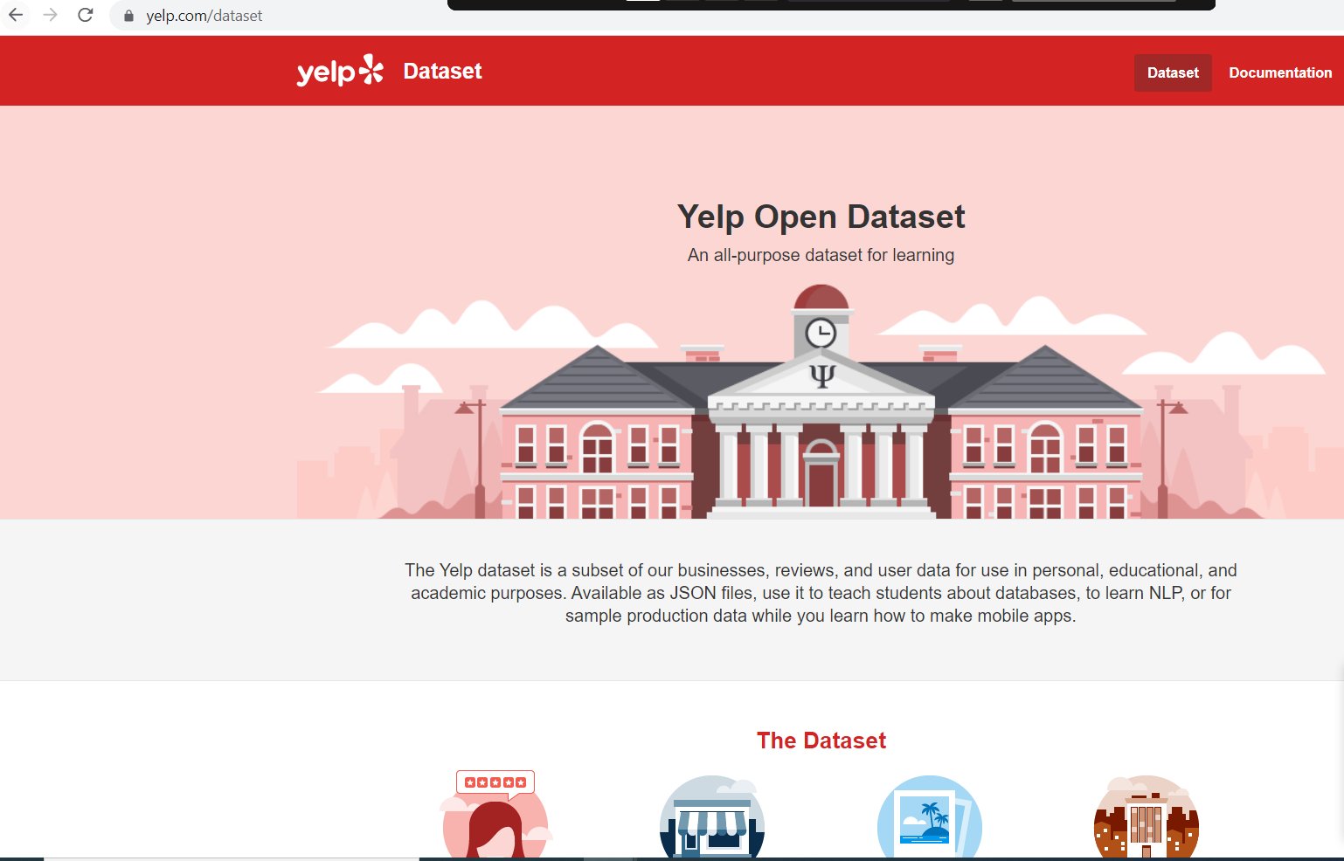
Yelp Data
We collected the data by downloading the yelp dataset which can be found at this website: https://www.yelp.com/dataset
After unzipping the downloaded file, we were able to find 3 different json files.

Slide 5
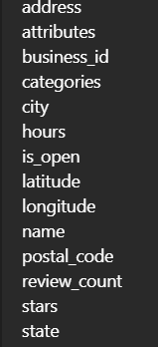
Data description (Yelp Business Dataset)
14 variables in yelp business dataset.
Size of the dataset - 113.36 MB
9 Variables used :
Address
Business_id
Categories
City
Name
Postal_code
Review_count
Stars
State

Slide 6
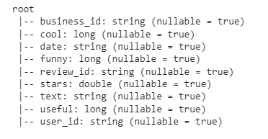
Data description (Yelp Business Review Dataset)
9 variables are present in yelp business review dataset.
Size of the dataset - 4.98GB
5 Variables used :
Business_id
Review_id
Stars
Text
user_id

Slide 7
Data transformation
Since Business id is string in the yelp business dataset, we can create an index field for future model.
User id is string in the yelp business review dataset, we can also create an index field for future model.

Slide 8
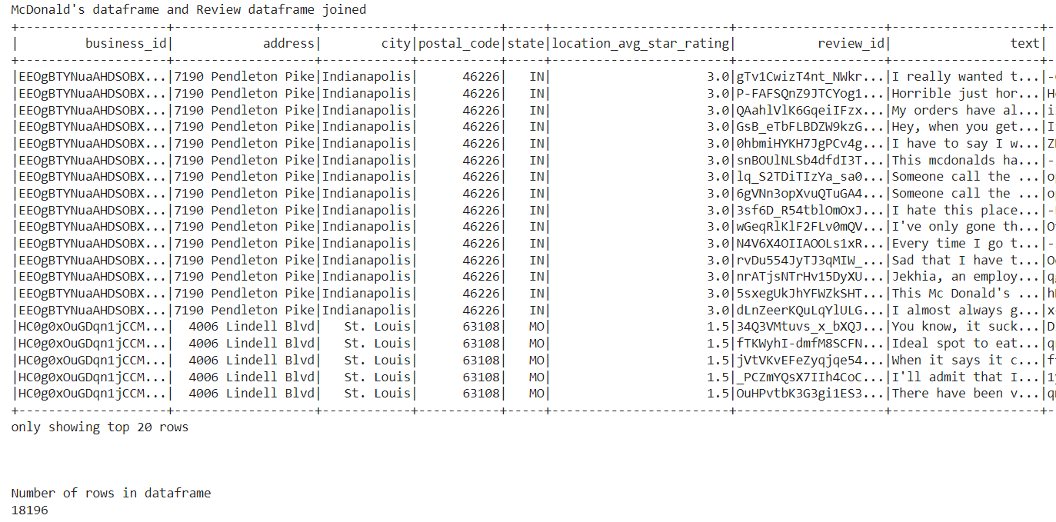
Data joining
We joined Yelp business dataset and yelp review dataset to do analysis based on ratings, comments and location for McDonald’s.

Slide 9
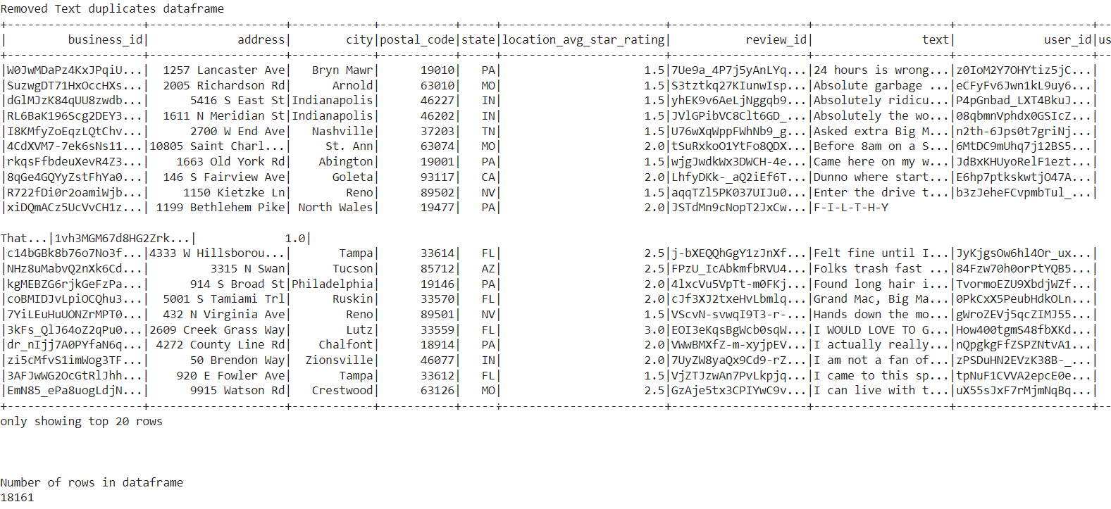
Remove Duplicates
We deleted duplicate review text for McDonald’s.

Slide 10
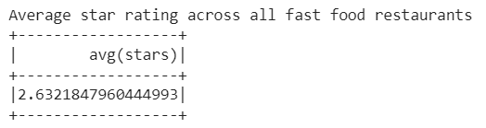
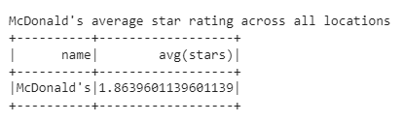
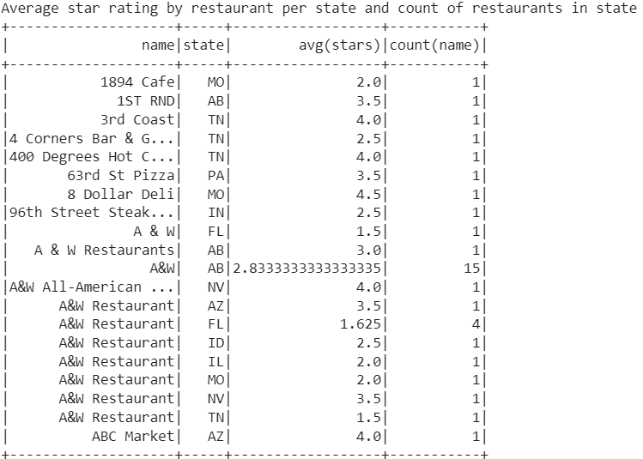
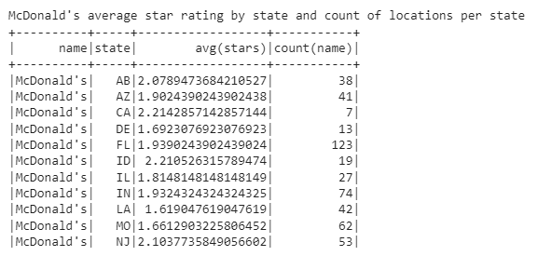
Data analysis
Below is the image of Average star rating across all fast food restaurants and McDonald’s average star rating across all locations.

Slide 11
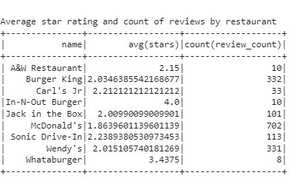
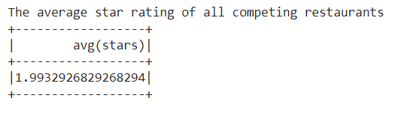
Data analysis cont..
Below is the image about the average star rating of all competing restaurants and average star rating and count of reviews by restaurant.

Slide 12
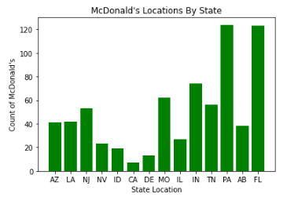
Data Visualization
Below image describe about the Number of McDonald’s restaurant by State.

Slide 13
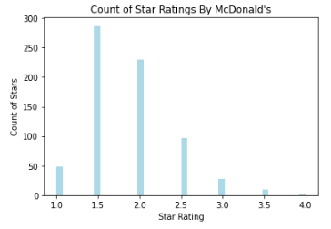
Data Visualization cont…
Below image describe about the Number of ratings by McDonald’s.

Slide 14
Conclusion
Compared McDonald’s across all locations
Reviewed the Ratings based on locations
Analyzed the Review Comments by locations
We will be building machine learning Recommendation model for project presentation 2 with the dataset that we discussed earlier.

Slide 15
Thank you

