Slide 1

Work-let Name: Vector implementation of Attention layer on CVA6 RISC-V core
Worklet Details
Worklet ID: 24CTO09CITB
College Name: Cambridge institute of technology
Successfully implemented attention layer using RISC-V vector extensions.
matrix multiplications (Q × Kᵀ and result × V) using pulp simulator.
Integrated basic softmax approximation and scaling for attention mechanism.
KPIs achieved till now
Any Challenges/ Issues faced
Limited hardware support for floating-point operations and softmax on embedded RISC-V platforms.
Next Steps
Benchmark attention layer performance (latency, resource usage) vs standard CPU/GPU.
Extend to multi-head attention and integrate with a simplified transformer encoder block.
Explore deployment for on-chip AI use cases (low-power NLP/computer vision).
Attention mechanism successfully simulated with matrix-vector operations on CVA6.
Demonstrated feasibility of transformer-like workloads on RISC-V architecture.
Gained insight into optimizing neural net primitives for open hardware.
Key Achievements/ Outcome till now
Date:21-04-2025

Slide 2
Work-let Name: Vector implementation of Attention layer on CVA6 RISC-V core
Worklet Details
Worklet ID: 24CTO09CITB
College Name: Cambridge institute of technology
College Name: xxxxxxxxxxxxxxxxxxxxxxxxxxxxxxxxxxxxxxx
Vector instruction manual and performance profiler for CVA6.
Samsung prism registration is done waiting for
Github link request for access
Resource Requirement Identified with Status
Github Repository Link and PRISM Portal Registration Status
Any Anticipated Break (Due to exams etc
Lab internal is on 24-04-2025 and 25-04-2025
2nd internals-23-05-2025 to 26-05-2025
Attention is All you Need (neurips.cc)
Data Collection Information
Date: xxxxxxx

Slide 3
Work-let Name: Vector implementation of Attention layer on CVA6 RISC-V core
Worklet Details
Worklet ID: 24CTO09CITB
College Name: Cambridge institute of technology
Carried out the matrix operations: Query × Keyᵀ, followed by scaling, softmax approximation, and then multiplication with Value matrix.
Last Month’s Progress
Technical Challenges and Solutions
Functional softmax module implemented and tested on the RISC-V CVA6 core.
Limited support for floating-point operations and softmax on CVA6 hardware.
Ensuring memory alignment and vector width compatibility.
Results till now
Date: 21-04-2025

Slide 4
Work-let Name: Vector implementation of Attention layer on CVA6 RISC-V core
Worklet Details
Worklet ID: 24CTO09CITB
College Name: Cambridge institute of technology
The vectorized attention mechanism significantly reduces the compute cycles required for core matrix operations like Q × Kᵀ and V multiplication.
Fixed-point and softmax approximations produced results with minimal loss in accuracy, validating the efficiency of low-resource implementations.
Upcoming Month’s plan
Extend the single-head attention module into a multi-head attention framework.
Benchmark performance with larger input sizes and various vector lengths to identify optimal configurations.
Observations based on the results obtained
Date: 21-04-2025

Slide 5
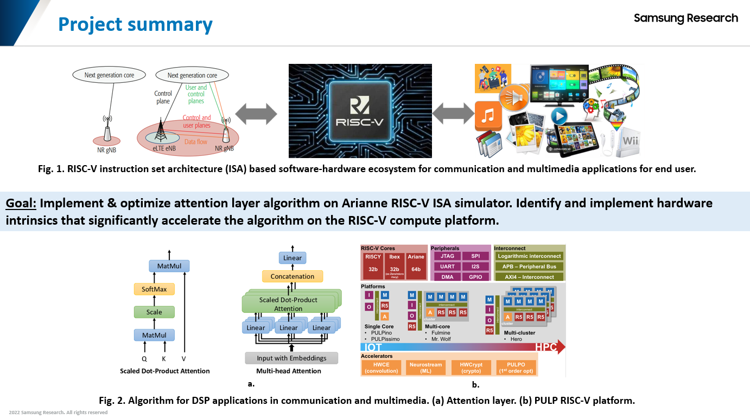
Work-let Name: Vector implementation of Attention layer on CVA6 RISC-V core
Worklet Details
Worklet ID: 24CTO09CITB
College Name: Cambridge institute of technology
Date: 21-04-2025

Slide 6
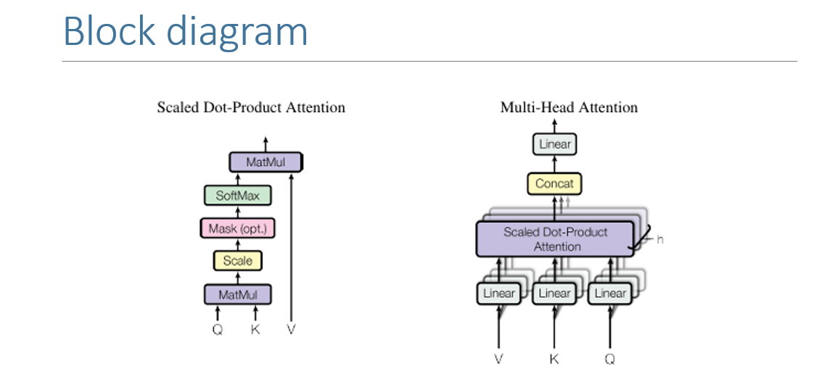
Work-let Name: Vector implementation of Attention layer on CVA6 RISC-V core
Worklet Details
Worklet ID: 24CTO09CITB
College Name: Cambridge institute of technology
Date: 21-04-2025

Slide 7
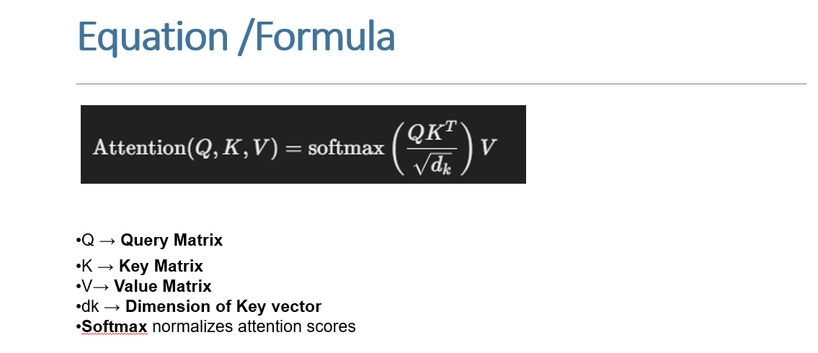
Work-let Name:Vector implementation of Attention layer on CVA6 RISC-V core
Worklet Details
Worklet ID: 24CTO09CITB
College Name: Cambridge institute of technology
Date: 21-04-2025

Slide 8
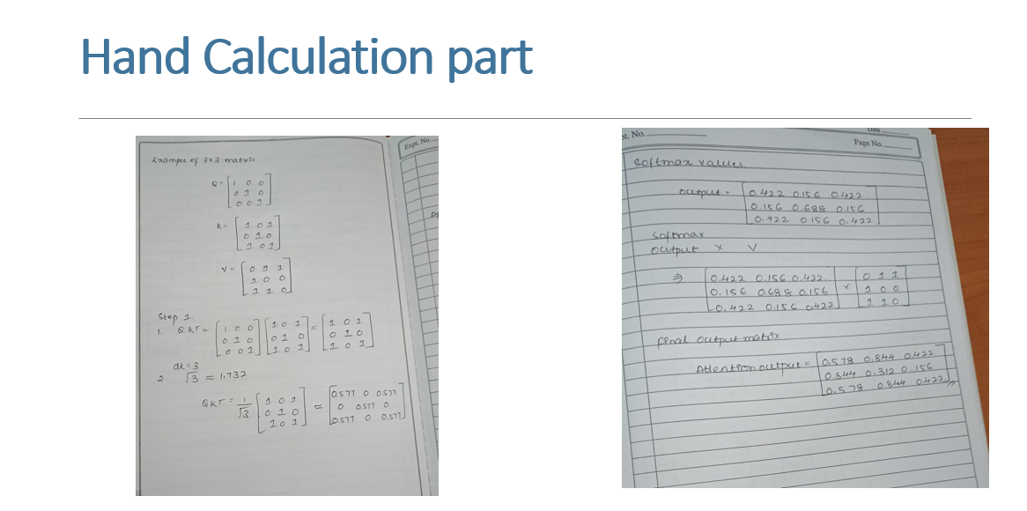
Work-let Name: Vector implementation of Attention layer on CVA6 RISC-V core
Worklet Details
Worklet ID: 24CTO09CITB
College Name: Cambridge institute of technology
3*3 Matrix
Date: 21-04-2025

Slide 9
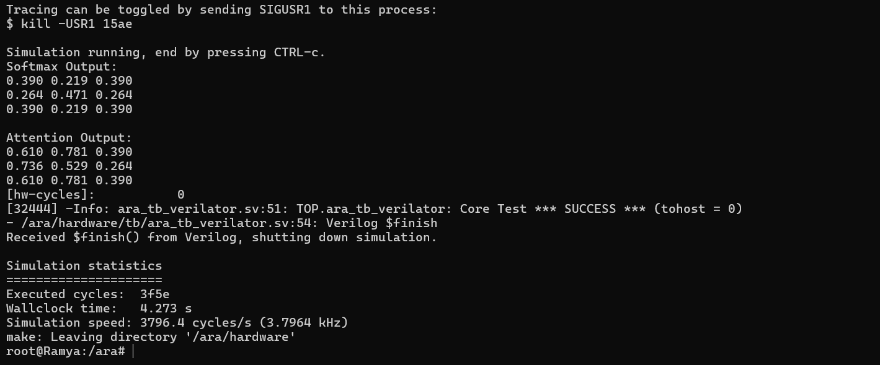
Work-let Name: Vector implementation of Attention layer on CVA6 RISC-V core
Worklet Details
Worklet ID: 24CTO09CITB
College Name: Cambridge institute of technology
Output
Date: 21-04-2025

Slide 10
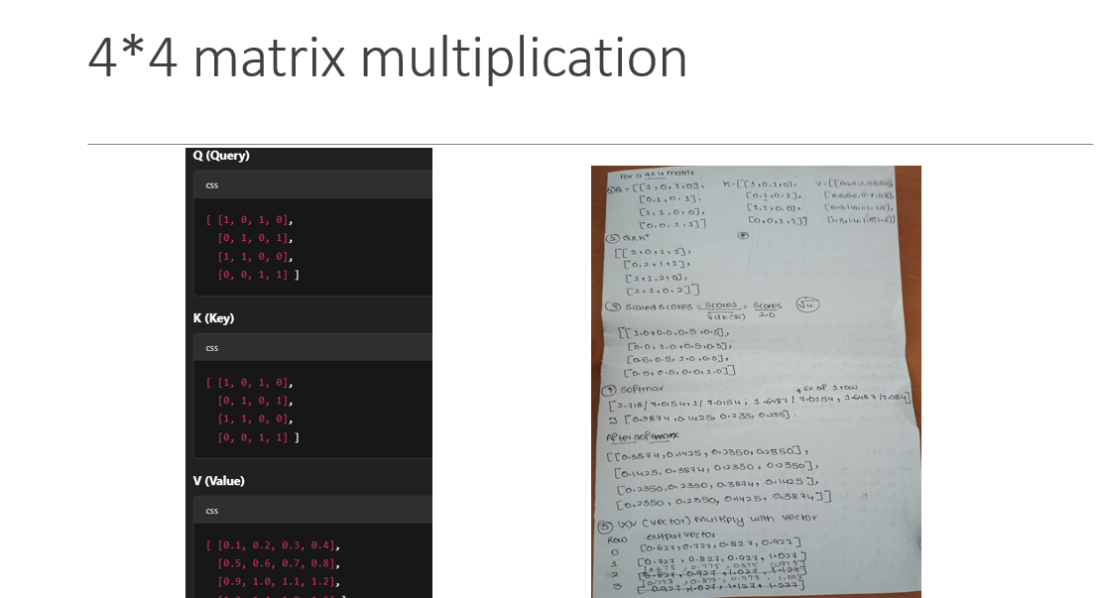
Work-let Name: Vector implementation of Attention layer on CVA6 RISC-V core
Worklet Details
Worklet ID: 24CTO09CITB
College Name: Cambridge institute of technology
Date: 21-04-2025

Slide 11
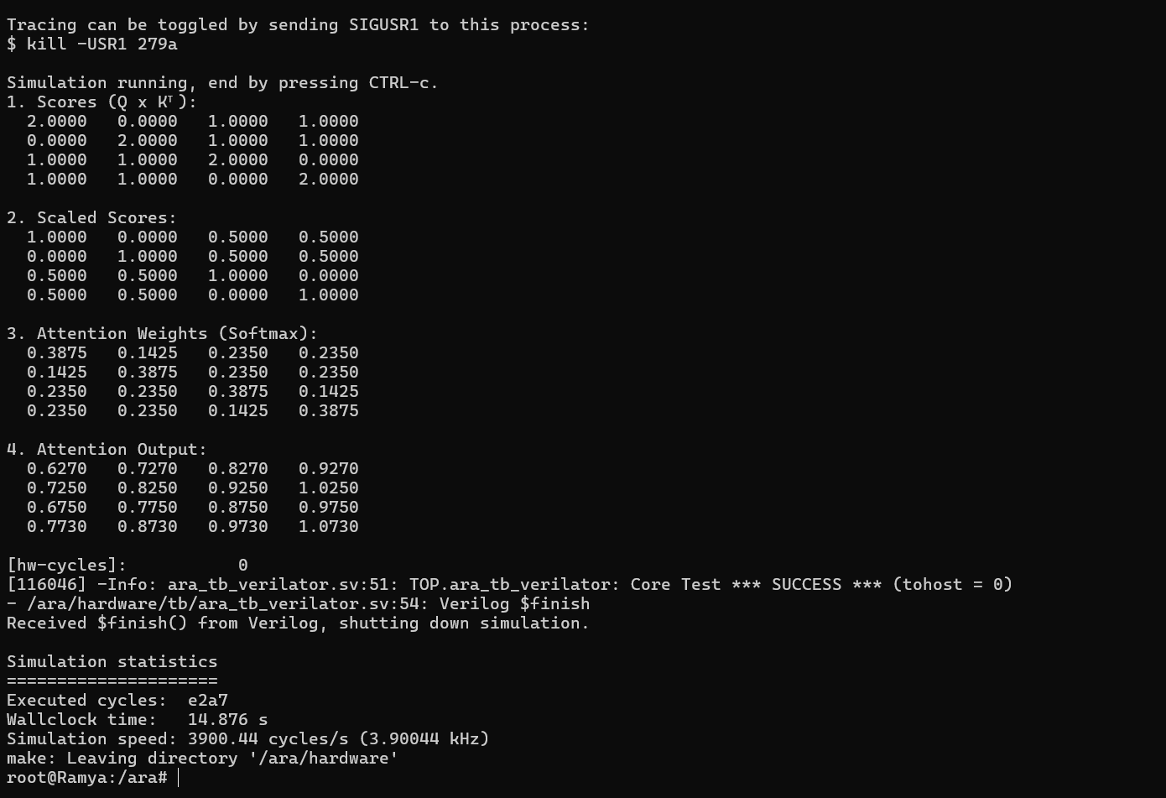
Work-let Name: xxxxxxxxxxxxxxxxxxxxxxxxxxxxxxxx
Worklet Details
Worklet ID: 24CTO09CITB
College Name: Cambridge institute of technology
Output
Date: 21-04-2025

Slide 12
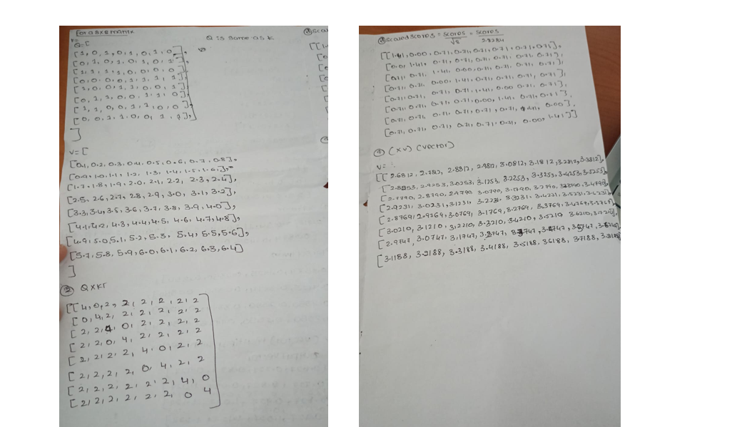
Work-let Name: Vector implementation of Attention layer on CVA6 RISC-V core
Worklet Details
Worklet ID: 24CTO09CITB
College Name: Cambridge institute of technology
8*8 Matrix
Date: xxxxxxx

Slide 13
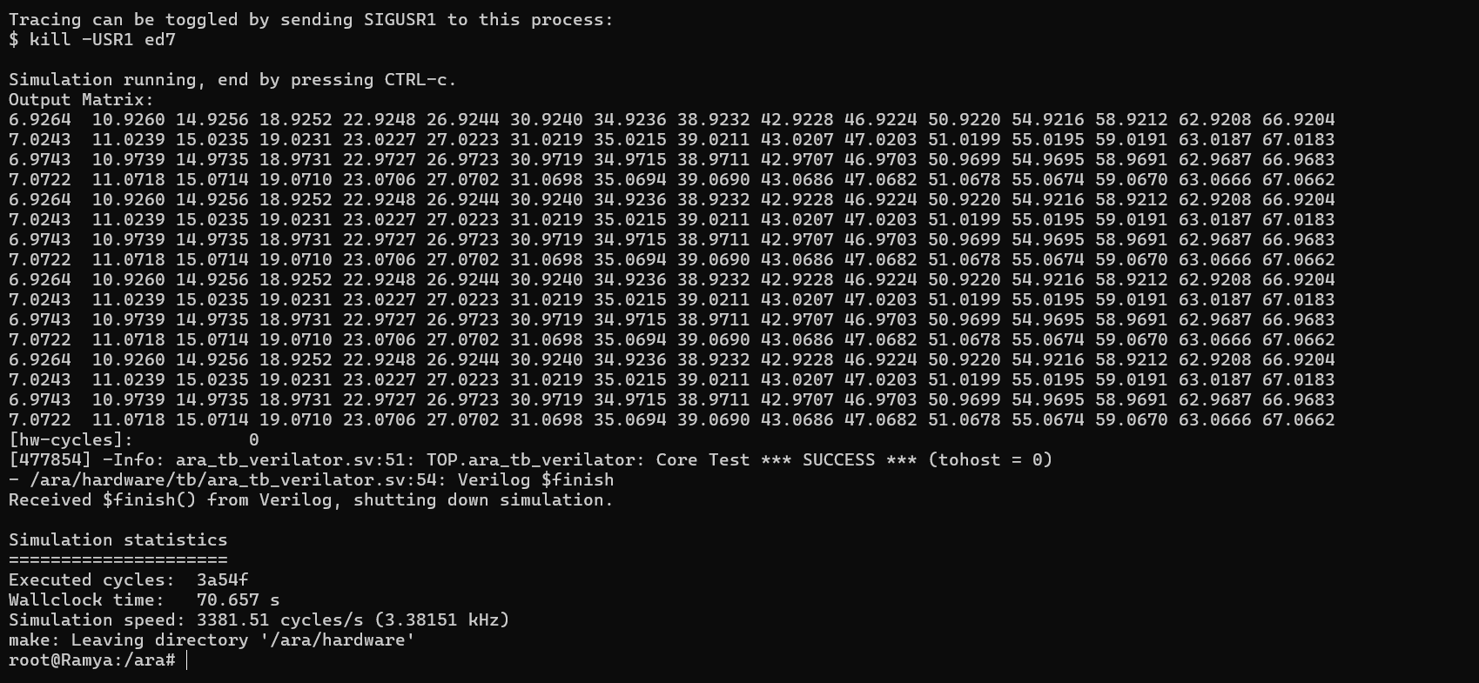
Work-let Name: Vector implementation of Attention layer on CVA6 RISC-V core
Worklet Details
Worklet ID: 24CTO09CITB
College Name: Cambridge institute of technology
Output
Date: 21-04-2025

Slide 14
Work-let Name: Vector implementation of Attention layer on CVA6 RISC-V core
Worklet Details
Worklet ID: 24CTO09CITB
College Name: Cambridge institute of technology
Output comparison
Softmax layer | 3*3 | 4*4 | 8*8
Executed cycle | 16222 | 58023 | 239567
WallClock time | 4.273 s | 14.876 s | 70.657 s
Simulation speed | 3796.4 cycles/s | 3900.44 cycles/s | 3381.51 cycles /s
Date: 21-04-2025

Slide 15
Work-let Name: Vector implementation of Attention layer on CVA6 RISC-V core
Worklet Details
Worklet ID: 24CTO09CITB
College Name: Cambridge institute of technology
We will update by next session
Professor Comments (To be filled in and presented by professor (Either)
It will be updated in next session
COMPUTATION RESOURCE Details:
Date: 21-04-2025

