Slide 1


Department of Computer Science and Engineering
GENDERTONE: VOICE GENDER RECOGNITION WITH SENTIMENT ANALYSIS
Mrs. Divya M,
Department of CSE
Rajalakshmi Engineering College Chennai, India
2116220701217 RAMYA P

Slide 2
Problem Statement and Motivation
Student Performance Predictor Analysis – Traditional academic systems focus only on marks and ignore behavioral factors like attention span and distractions.
Most platforms lack the ability to predict a student’s future academic performance using data analytics.
Students receive generic feedback instead of personalized, actionable suggestions.
Important behavioral metrics like phone usage patterns are often neglected in student evaluations.
Educators and parents lack timely insights to identify struggling students early.
Existing tools are not user-friendly or secure enough for continuous performance tracking.

Slide 3
Existing System
Focuses only on academic marks and attendance, lacking deeper performance insights.
Provides static, periodic reports without real-time or predictive analysis.
Ignores behavioral factors like phone usage that impact attention and performance.
Offers generic feedback instead of personalized recommendations.
Does not use modern technologies like machine learning or data analytics for early risk detection
Does not evaluate or incorporate attention span as a factor in academic performance.

Slide 4
Objectives
Predict student academic performance using machine learning based on marks, attendance, and phone usage.
Integrate behavioral analytics to go beyond traditional academic evaluations.
Provide personalized feedback with actionable suggestions for improvement.
Address modern challenges like phone addiction and reduced attention span.
Support parents and educators with comprehensive insights for timely intervention.
Ensure a user-friendly,easily accessible ui, secure, and accessible system for continuous performance tracking

Slide 5
Abstract
Intelligent web-based application designed to predict student performance using academic and behavioral data.
Utilizes a trained linear regression model to analyze subject-wise marks, attendance, and phone usage.
Features secure user authentication for personalized tracking and data privacy.
Provides personalized feedback focusing on academics, attendance, and digital behavior.
Introduces attention span estimation through phone usage analysis for a holistic evaluation.
Lays the groundwork for future upgrades like real-time analytics and broader data integration.

Slide 6
Proposed System
Uses a machine learning model (linear regression) to predict final academic scores.
Analyzes subject-wise marks, attendance percentage, and phone usage hours.
Estimates attention span indirectly through daily phone usage patterns.
Provides personalized feedback to help students improve academic focus and habits.
Offers a secure, interactive web platform with user login for personalized tracking.
Helps educators and parents identify performance risks early for timely intervention.

Slide 7
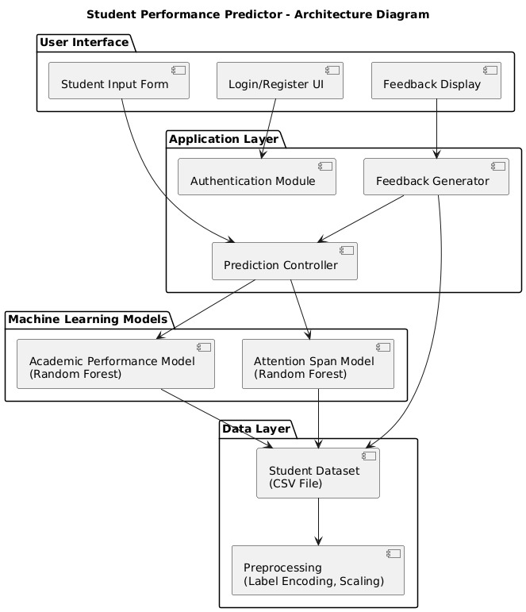
System Architecture
Layered Architecture: The system is divided into User Interface, Application Layer, Machine Learning Models, and Data Layer for modular and maintainable design.
Dual ML Models: Utilizes two Random Forest models — one for academic performance prediction and another for estimating attention span based on phone usage.
Prediction Controller: Acts as the central logic unit, linking user input with model outputs and feedback generation.

Slide 8
List of Modules
SStreamlit: Builds the web-based user interface for user interaction.
Python: Core language for system development and machine learning.
Scikit-learn: Implements the linear regression model for student performance prediction.
Pandas: Handles data manipulation and preprocessing tasks.
NumPy: Supports numerical operations and efficient data handling.
Flask: Serves as the backend framework to integrate the ML model and handle HTTP requests.
Heroku: Hosts and deploys the web app for real-time online access.

Slide 9
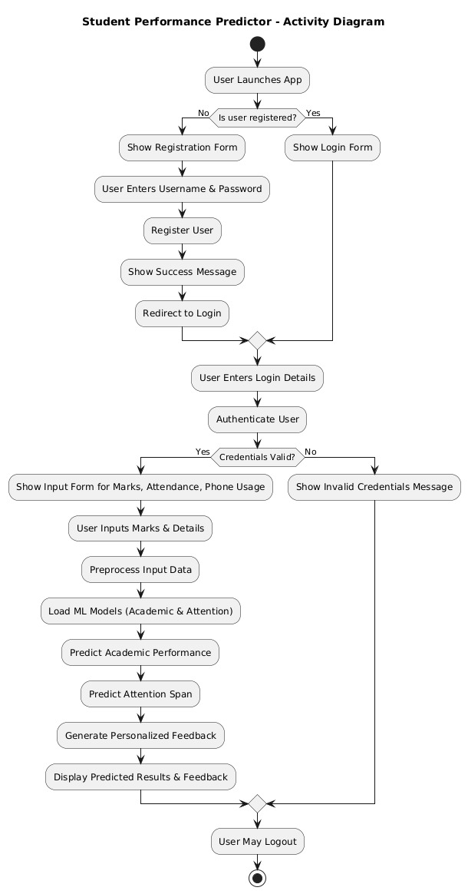
Functional Description for each modules with DFD and Activity Diagram
User Interface Module collects student details and displays performance predictions.
Backend Server Module manages data flow between the frontend and the prediction engine.
Prediction Engine Module processes input and predicts student scores using machine learning.
Data Processing Module cleans and structures user input for accurate prediction.
Deployment Module hosts the system online for real-time, global user access.

Slide 10
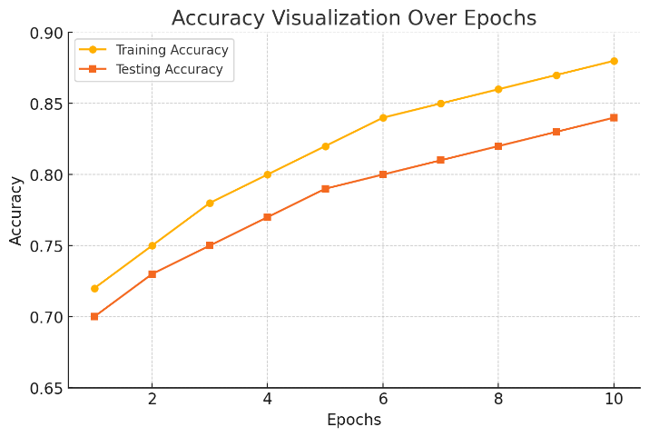
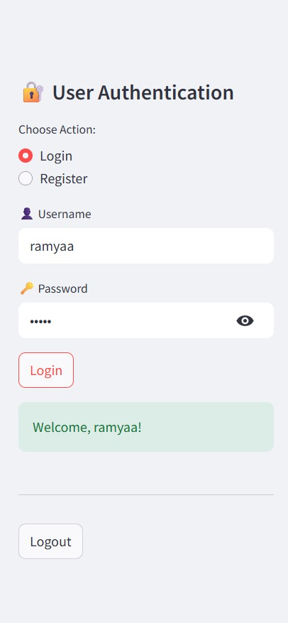
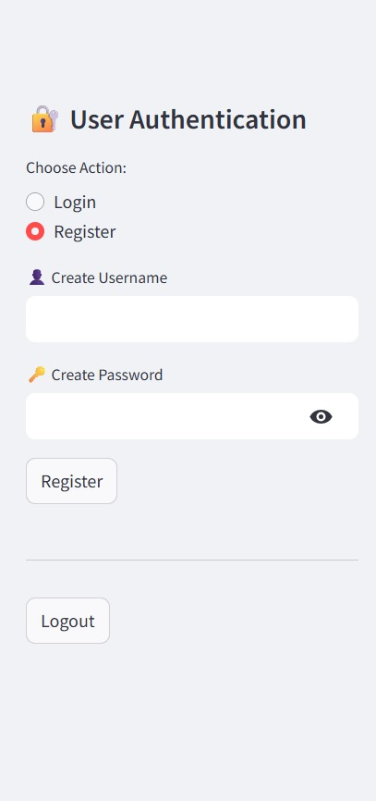
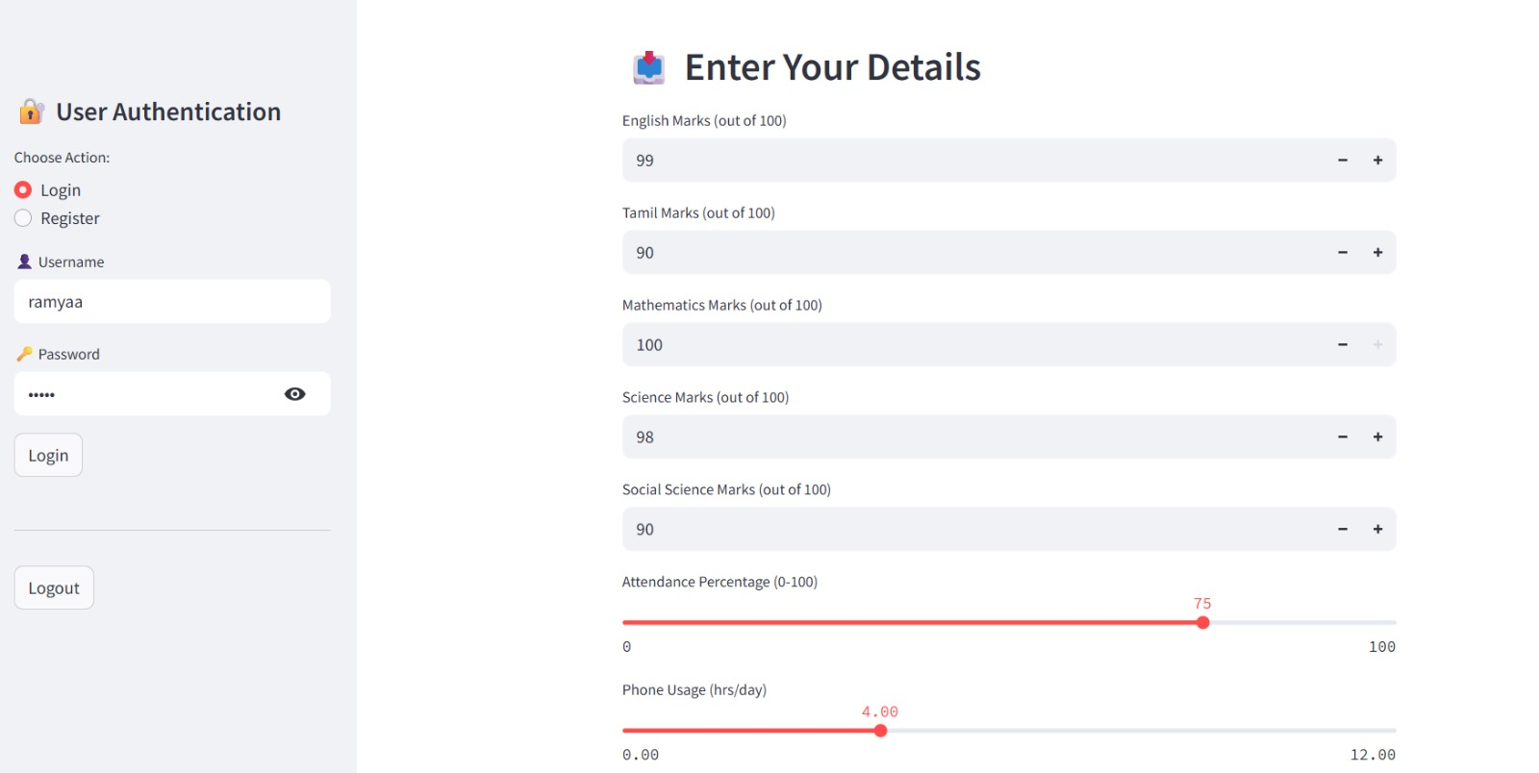
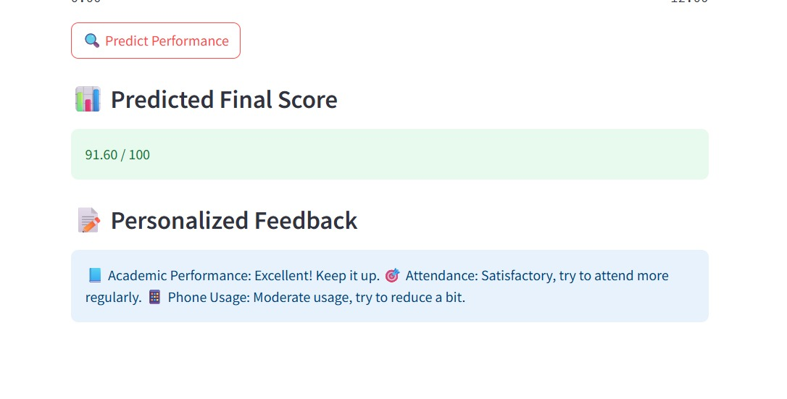
Implementation & Results of Module

Slide 11
Conclusion & Future Work
Developed a web-based Student Performance Predictor using machine learning (linear regression) to forecast outcomes based on marks, attendance, and phone usage.
Offers a user-friendly interface with real-time predictions and actionable feedback for students, parents, and educators.
Ensures lightweight and efficient performance with minimal computational resources.
Integrates frontend and backend components smoothly, with a modular structure supporting scalability.
Future improvements include using advanced models (Random Forest, Neural Networks) and adding features like behavioral parameters, dashboards, and mobile support.

Slide 12
References
M. M.E. Khoudier et al., "Prediction of Student Performance Using Machine Learning Techniques," in Proc. 2023 5th Novel Intelligent and Leading Emerging Sciences Conf. (NILES), 2023, pp. 1–6, doi: 10.1109/NILES59815.2023.10296766.ResearchGate
Z. Gupta and S. Gupta, "Monitoring and Predicting Performance of Students in Degree Programs Using Machine Learning," in Proc. 2023 10th Int. Conf. on Computing for Sustainable Global Development (INDIACom), 2023, pp. 1311–1315.ResearchGate
B. Althaph, S. V. N. Sreenivasu, and D. V. Reddy, "Student Performance Analysis with Ensemble Progressive Prediction," in Proc. 2023 5th Int. Conf. on Smart Systems and Inventive Technology (ICSSIT), 2023, pp. 1513– 3782–3785

Slide 13
Paper Publication Status
Yet to Publish

Slide 14
Thank You

