Slide 1

MINISTRY OF EARTH SCIENCE

Slide 2

ATOMISES
CONTIGENT:
    Parikshit S lakhani.
    Ramya Prabha K
    Samuel Johnson R
    Sanjay B
    Navneeth V
    Ruddhika M M
MENTOR:
    Mr. Senathipathi K
VENUE :
    CHENNAI, TAMIL NADU

Slide 3

MAP PLOTTING OF EARTHQUAKES:
The software should support selection of multi-configurations with click for various options, such as
i) plotting of recent earthquake.
ii) plotting past earthquakes from the database in a text file.
iii) limiting the plot of past earthquakes to a particular year, month, date and magnitude, etc.
iv) colour schemes (option to configure colour of icons) .
v) size and colour of symbol (circle, square, triangle, etc.) according to the magnitude, focal depth and time of occurrence of earthquake .
vi) plotting the selected (or all) seismic observatories in the area of interest.
vii) depicting the seismic zones, tectonic features and hazard map with Latitude and Longitude information.
viii) District and State boundaries with important towns and cities, ix) legends, etc.

Slide 4

To create a web portal to display the various information about the earthquake and tectonic regions of the globe.
The home page will contain a world map marked with all the major earthquake that have occurred in the recent years along with the option to filter the map based on the region or time or magnitude or type or origin or all based on the need of the user.
Based in the query the map will be modified and the corresponding details will be fetched from the database and those will be plotted on the map to give the user the required information.
Additionally if the user wants the information about a particular earthquake he/she can get all the info just by clicking on it, clicking it will automatically redirect the user to a page containing all the info about the requested earthquake.
The legends will be provided, differentiating all the earthquake based on the magnitude, origin, loss of property etc.. By using various colors, shapes, and structures.
Also we will provide another option to the users to view all the tectonic zones along with recent seismic activities occurred and the marking the regions prone to earthquakes(A different view of the map).

Slide 5


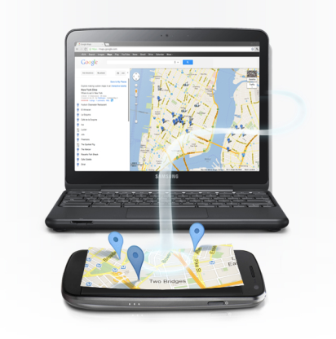

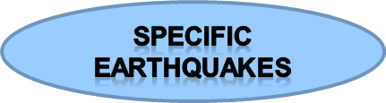

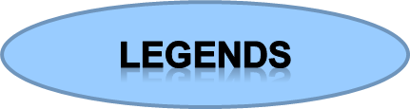
All major information
User query
Web site

Slide 6
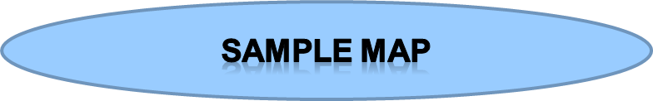
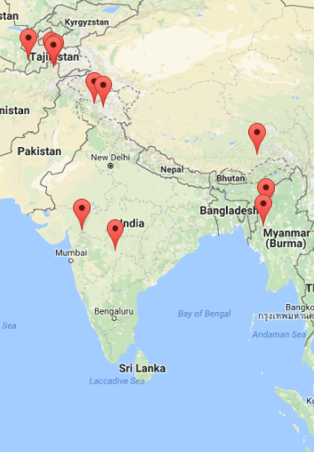

Slide 7
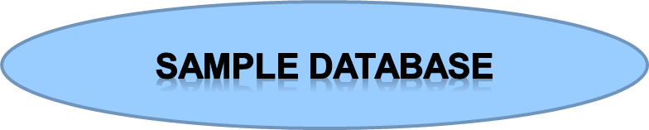
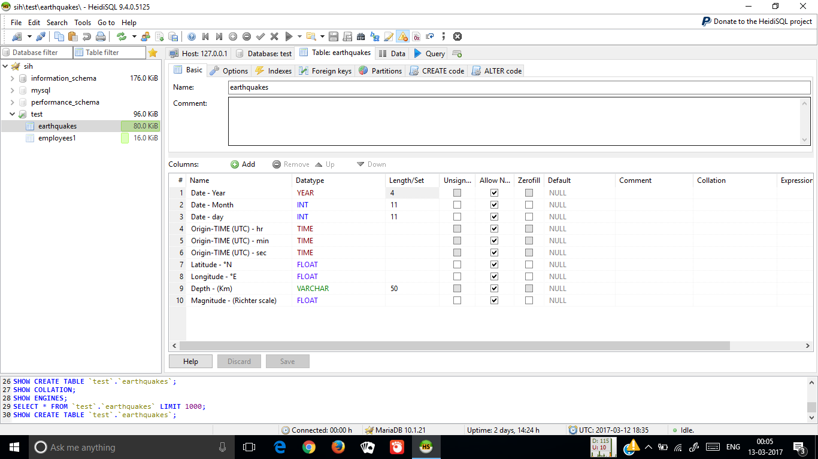

Slide 8

TOOLS:
    VISUAL STUDIO CODE
    XAMPP
    HEIDISQL
  LANGUAGES:
    HTML
    CSS
    JAVASCRIPT
    PHP

Slide 9

THANK YOU

