Slide 1
E-Medicare
RLL Project Group -O6

Slide 2
TEAM MEMBERS :
GithubLink : https://github.com/RLLPROJECT-2023/RLL-2023-E-Medicare-06
Prithvi Suresh Bagewadi -2576041 Priya Kumari -2576242 R Nandakumar -2576051 Ramya P -2576325
Regu Naga Jyothi -2577152 Reshma G -2576043 Sadula Spurthi -2575835 Sahana M Tattimani -2576815

Slide 3
ABSTRACT
The purpose of E-Medicare application is to switch an electronic medicare information system from paper-based medical records to an electronic medical related data that offers e-Medicare information and integrates well with computer-based judgment making systems.
E-Medicare System, can lead to error free, secure, reliable and fast management system.
This mainly focuses on the Medical such as better description of medicine what we use , reduced transportation, better reliability of purchasing quality medicine , increased utilization of health facilities .

Slide 4
INTRODUCTION
The main aim of this project is to develop an Online Medicare Management portal this can handle easiest way to order the medicine and delivery at your doorstep.
This project is very helpful to both Medicare staff as well as to the public.The growing quality demand in the hospital sector makes it necessary to exploit the whole potential of stored data efficiently.
In this, users can choose a desired medicine and add them to cart and then proceed to payment , in order to minimize transport costs and improve the needs for the user .

Slide 5
PROPOSED SYSTEM
The proposed medical Booking Store System will completely Revolutionize the industry.
Searching of products, order placing, billing and product stock can be maintained by a single click.
The payment of the order can also be done by credit cards.

Slide 6
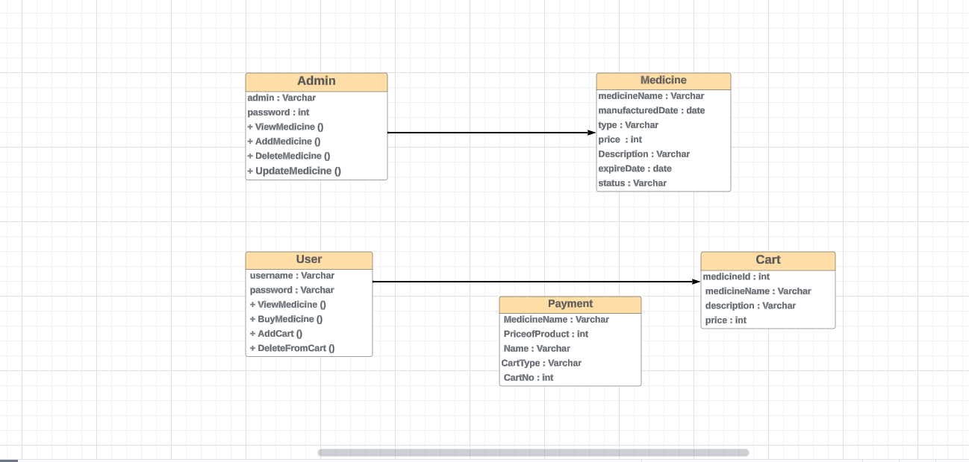
ENTITY RELATIONSHIP DIAGRAM

Slide 7
TECHNOLOGY USED
HTML : Page layout has been designed in HTML.
CSS : CSS has been used for all the designing part.
Java : All the business logic has been written in Java.
Angular CLI : Command-line interface tool that we use to initialize.
MySQL : MySQL database has been used as database for the project.
Hibernate : Used for object-table mapping.
Spring-boot : Server side setup.
Tomcat : Server.

Slide 8
SYSTEM OVERVIEW:
The “E-Medicare” should support basic functionalities for all below listed users.
Login Module: Used for managing the login details.
Users Module: Used for managing the users of the system.
Admin Module: Used for managing. medicine details and user information.
Medicine Module: Used for managing the Medicine details.
Contact us: Used if customer is having complaints.
Cart Module: Used for managing the details of Cart.
Payment Module: Used for managing the details of Payment, add ,update module…

Slide 9
AUTHENTICATION & AUTHORIZATION
Authentication:
Any end-user should be authenticated using a unique username and password.
Authorization:
The operations supported and allowed would be based on the user type. For example , Administrator has the rights to add product information and view customer details. He can also view order detail and purchase details of a medicines. Whereas User/Buyer has a right to Add, Remove and Clear all the products from cart.

Slide 10
FUNCTIONAL FLOW
Admin
DES Application
HTTP /GET
HTTP Response
Database
User
GUI
Server

Slide 11
ENVIRONMENT
Server – Apache Tomcat 9.0.8
Database – MySQL
My SQL J Connector
Node Version 18.8.2
Angular CLI
JDK 1.8
Eclipse IDE or Spring Tool Suite

Slide 12
UML DIAGRAM
UML - - - Unified Modeling Language
It is a standardized modeling language consisting of an integrated set of diagrams, developed to help system and software developers for specifying, visualizing, constructing, and documenting the artifacts of software systems, as well as for business modeling and other non-software systems.
The UML is a very important part of developing object oriented software and the software development process.
The UML uses mostly graphical notations to express the design of software projects.

Slide 13
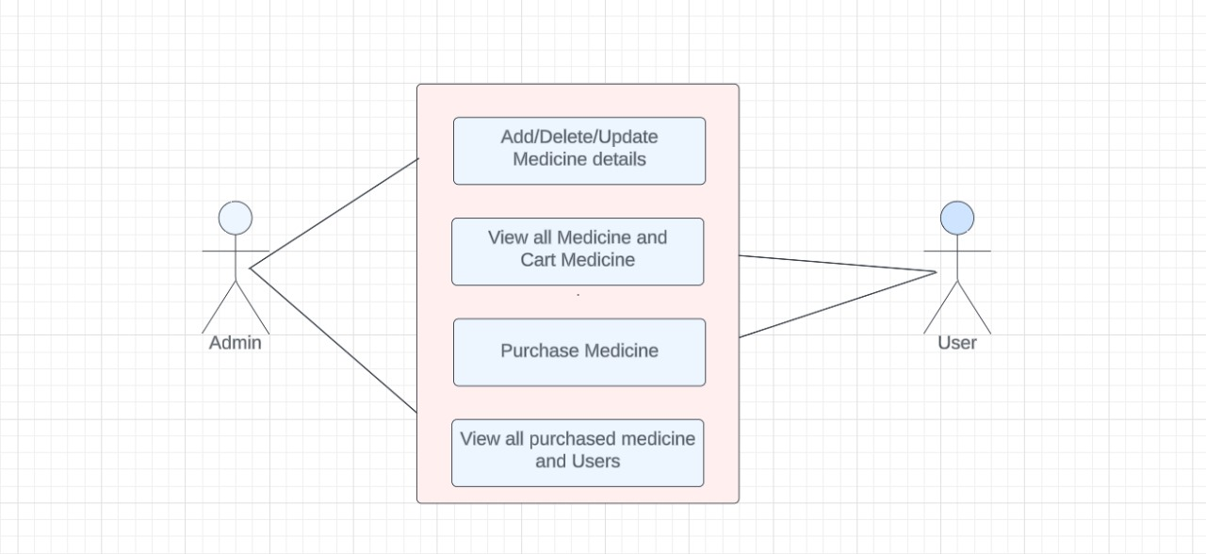
CASE DIAGRAM

Slide 14
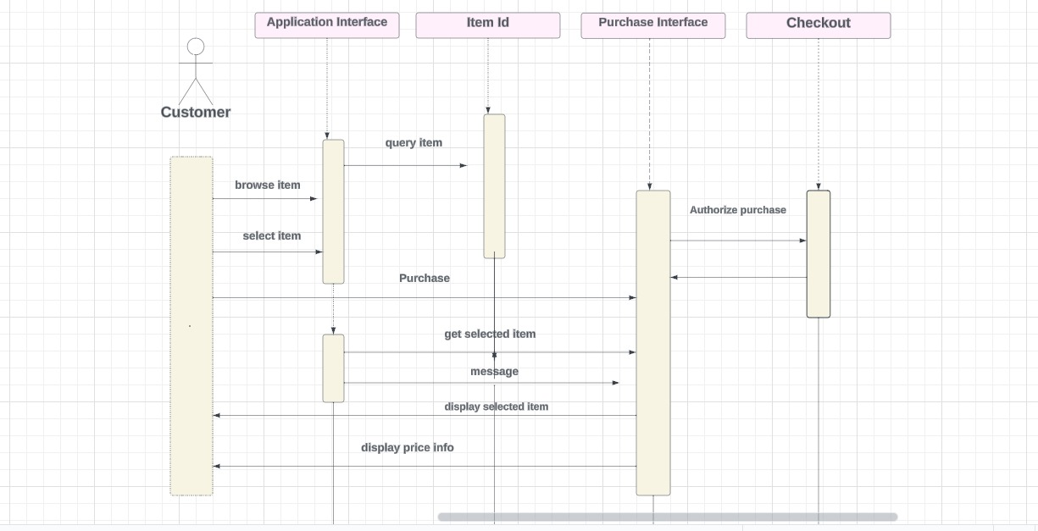
SEQUENCE DIAGRAM

Slide 15
UNIT TESTING
JUnit is a unit testing framework for Java programming language. It plays a crucial role test-driven development, and is a family of unit testing frameworks collectively known as XUnit.
Features of JUnit:
Unit is an open source framework, which is used for writing and running tests.
Provides annotations to identify test methods.
Provides assertions for testing expected results.

Slide 16
ADVANTAGES
Cost efficient.
Easy Secured payments.
User can view different categories of product of different pharma company .
Saves Money.
Diminishes Medical Wastes.
Delivery drug stores accomplish greater accuracy more than the local store.

Slide 17
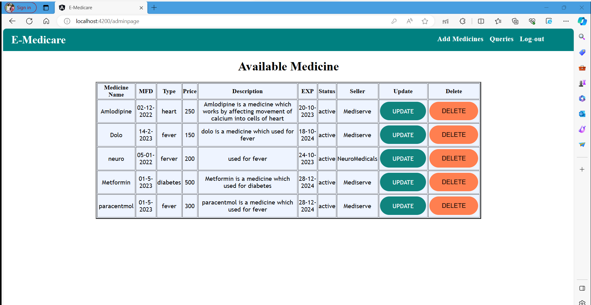
Available Medicine:
OUTPUT SCREENSHOTS

Slide 18
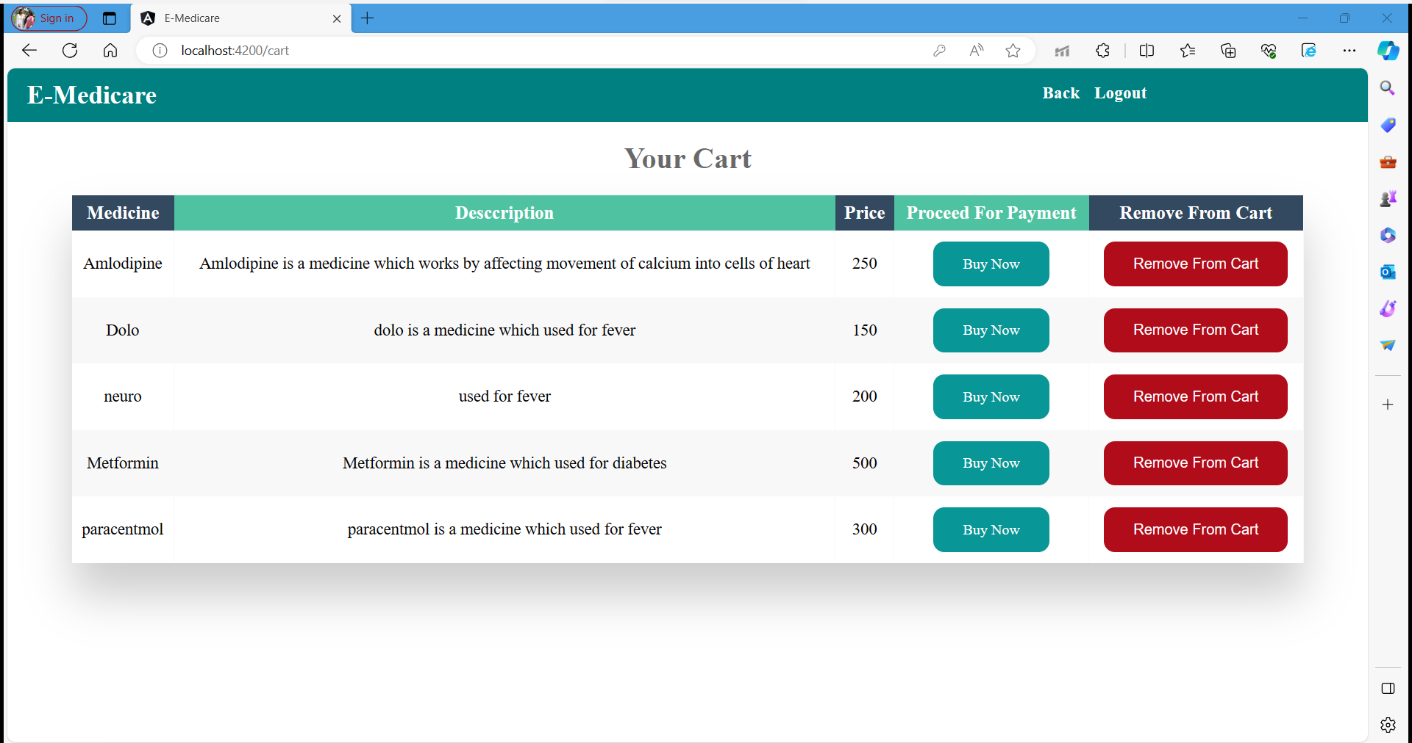

Slide 19
CONCLUSION
Our E-Medicare project represents a significant step, enhancing in healthcare management through technology. By prioritizing user-friendly nature practices and adopting robust software planning methodologies, We as a Team as made an reliable and efficient software system.
At the end we have made effort on following points –
●We included features and operations in a detail, including screen layouts.
●We designed user interface and security issues related to system.
● Finally, the system is implemented and tested according to test cases.
has context menu

Slide 20
Thank You !

