Slide 1
Collection Framework

Slide 2
What is collection?
Why do we need a framework?
What is collection framework in java?

Slide 3
What is a collection?
A group of things is called a collection
In our applications we make use of collections a lot.
Like for example in nnmi we say collection of nodes, interfaces , devices etc.
Even though its group of things based on how we can do the grouping and how we want to access it , we can have different categories of collections.

Slide 4
Why do we need a framework?
Java Frameworks always helps in easing out a developers job. Redundant mundane things are often put in a framework.
Frameworks brings up uniformity in place.

Slide 5
What is collection framework in java?
This framework was introduced from java 1.2
Before this we used Vector, Arrays Hash tables separately. Each of this had their own implementations and method signatures.
There is already defined methods to create a collection, to modify to access it and we can directly use these methods and concentrate on the actual problem than the collections used.
This whole framework is part of java.utils package.

Slide 6
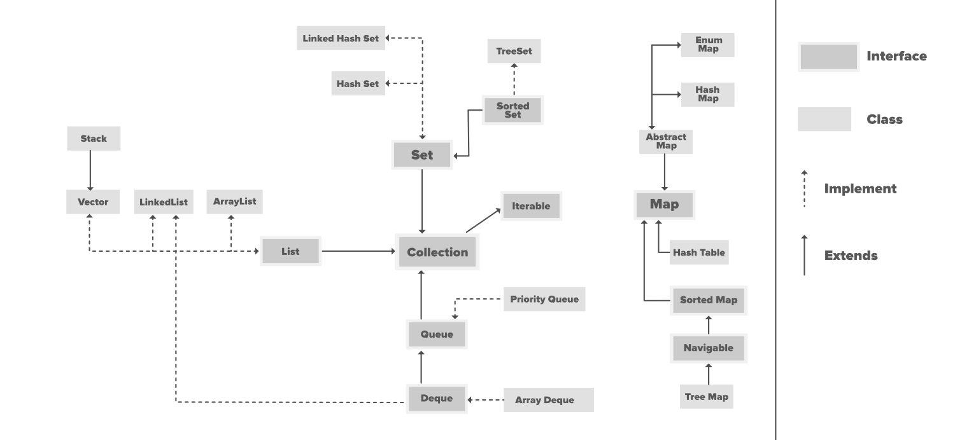

Slide 7
Depending on how the data has to be stored and accessed we have main two interfaces defined in framework
Map Interface → In case data has to be stored in key and value structure
Collection Interface → In case it has to be in specific order

Slide 8
Collection Interface
Here order of data is maintained
Can have duplicate values
We can iterate trough the collection using iterator
If the index of the object is known can be accessed by its index.

Slide 9
Methods defined in collection Interface
add(Object) This method is used to add an object to the collection.
addAll(Collection c) This method adds all the elements in the given collection to this collection.
clear() This method removes all of the elements from this collection.
contains(Object o) This method returns true if the collection contains the specified element.
containsAll(Collection c) This method returns true if the collection contains all of the elements in the given collection.
equals(Object o) This method compares the specified object with this collection for equality.
hashCode() This method is used to return the hash code value for this collection.
isEmpty() This method returns true if this collection contains no elements.
iterator() This method returns an iterator over the elements in this collection.
max() This method is used to return the maximum value present in the collection.
parallelStream() This method returns a parallel Stream with this collection as its source.
remove(Object o) This method is used to remove the given object from the collection. If there are duplicate values, then this method removes the first occurrence of the object.
removeAll(Collection c) This method is used to remove all the objects mentioned in the given collection from the collection.
removeIf(Predicate filter) This method is used to removes all the elements of this collection that satisfy the given predicate.
retainAll(Collection c) This method is used to retains only the elements in this collection that are contained in the specified collection.
size() This method is used to return the number of elements in the collection.
spliterator() This method is used to create a Spliterator over the elements in this collection.
stream() This method is used to return a sequential Stream with this collection as its source.
toArray() This method is used to return an array containing all of the elements in this collection.

Slide 10
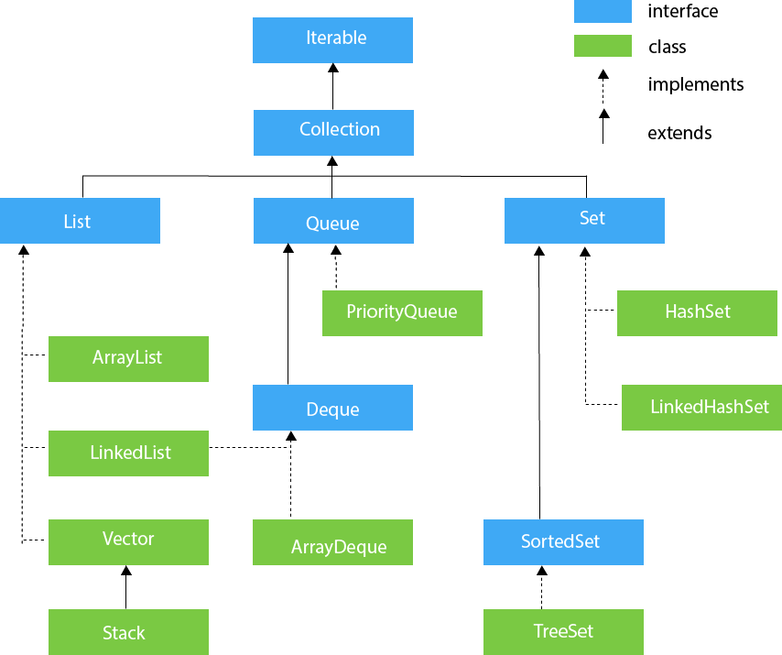

Slide 11
List , Set and Queue
List —> It handles sequential list of objects.
ArrayList, Vector and LinkedList classes implement this interface.
Queue —> It handles the special group of objects in which elements are removed only from the head.
LinkedList and PriorityQueue classes implement this interface.
Set —> It handles the group of objects which must contain only unique elements.
This interface is implemented by HashSet and LinkedHashSet classes and extended by SortedSet interface which in turn, is implemented by TreeSet.

Slide 12
When to use List and when to use set?
Ordered data or unordered?
Allow duplicates or not?

Slide 13
ArrayList and LinkedList
Array list uses Array as its internal implementation to store the data
Array is always of a fixed size. While defining we define the size and this cannot be changed.
Arraylist was created to help overcome this drawback.
Linked list uses double linked list as its internal implementation to store the data
When we need to just store and access the data use ArrayList
When we need to modify the data use LinkedList.

Slide 14
Vector and Stack
Vector uses arrays for its internal implementation.
Vector is synchronized , ie thread safe
For each addition, or modification it tries to add a lock , get the object and then perform the operation
Time consuming
Stack class extends vector class and supports FILO model.
It has methods like push, pop

Slide 15
Priority Queue

Slide 16
Dequeue and Array Dequeue

Slide 17
HashSet and LinkedHashSet:
HashSet is used when data is unordered.
It uses HashTable for its internal implementation
LinkedHashSet used double linked list in its internal implementation, and hence order is maintained in this one.

Slide 18
Sorted Set and Tree Set
Sorted Set is an interface which extends the Set interface.
TreeSet is implemented the sorted set interface and has a tree structure.
This has sorted list of elements

Slide 19
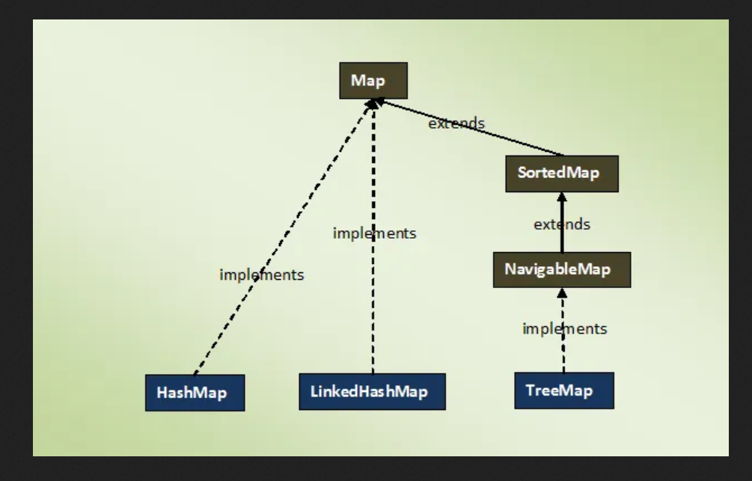

Slide 20
HashMap and Linked HashMap
A HashMap contains values based on the key.
It contains only unique elements.
It may have one null key and multiple null values.
The only difference between the two is that the linked HashMap maintains order.

Slide 21
TreeMap
A TreeMap contains values based on the key..
It contains only unique elements.
It cannot have null key but can have multiple null values.
It is same as HashMap instead maintains ascending order.

Slide 22
Thank you ☺

