Slide 1
Introduction About me
Iam Vemula.Anusha only Daughter of Vemula.Srinivas and Dhana laxmi

Slide 2
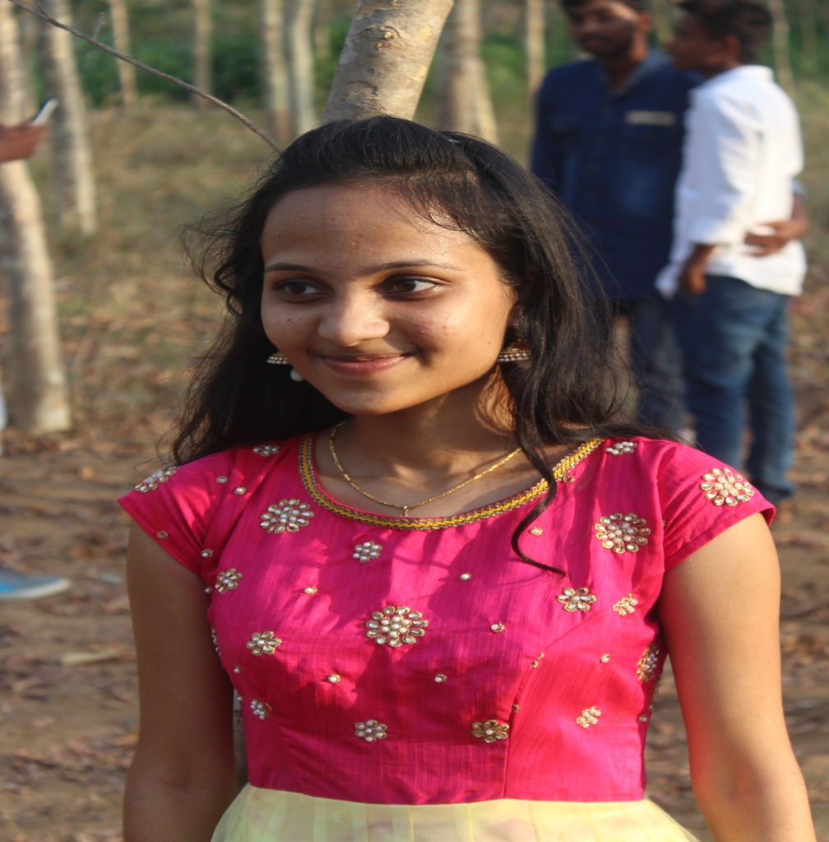
It is me Vemula.Anusha

Slide 3
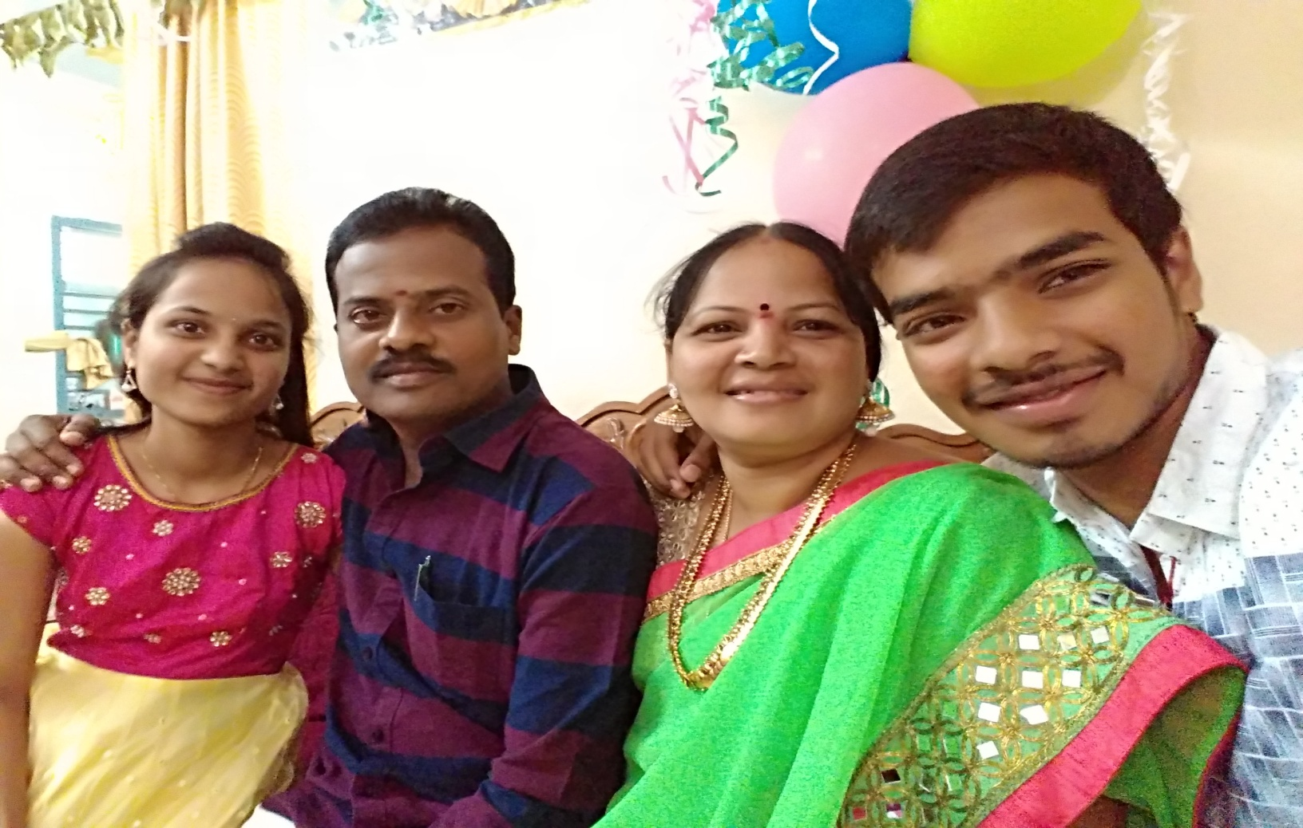
This is my cute and sweet Family

Slide 4
About My ChildHood Days
My birth place is Bellampally Dist:Adilabad.
I completed my schooling upto 5th class in St.Antony High School.
And 6th to 9th standard at Krishnaveni Talent School in Godavarikhani Dist: Karimnagar.
10th standard in Montessori group of school Bhupalapelly.

Slide 5
Intermediate at Sri Chaithanya Junior college.
My Graduation in Balaji Institute of Technology and Science.
After completion of my graduation started taking coaching on java in Codethantra .
At present Working in Nixinn Insights pvt.

Slide 6
Strength
Quick learner and ability to crop up with different situaeons
Dedicated to work
Team management
I have positive attitude in my future.
Curious to learn
Unhesitant to intimate the work and ask dout

Slide 7
EXTRA CURRICULAR ACTIVITIES
Successfully completed Real Time Applications of Embedded Systems workshop at KU Warangal.
Attended Workshop Robotics for 1 week.
Internship on Power Plant Stimulation & Distributing Controlling for 15 days at NTPC,Ramagundam.
Attended work shop about list of internet.
Volenter for NSS BITS

Slide 8
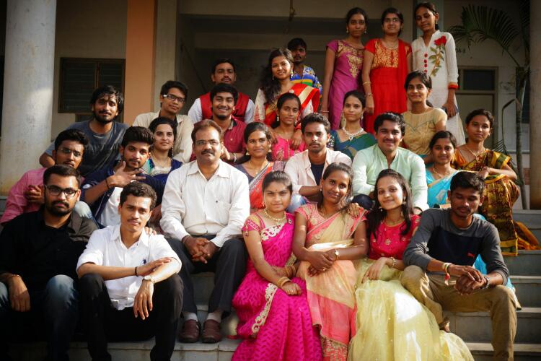
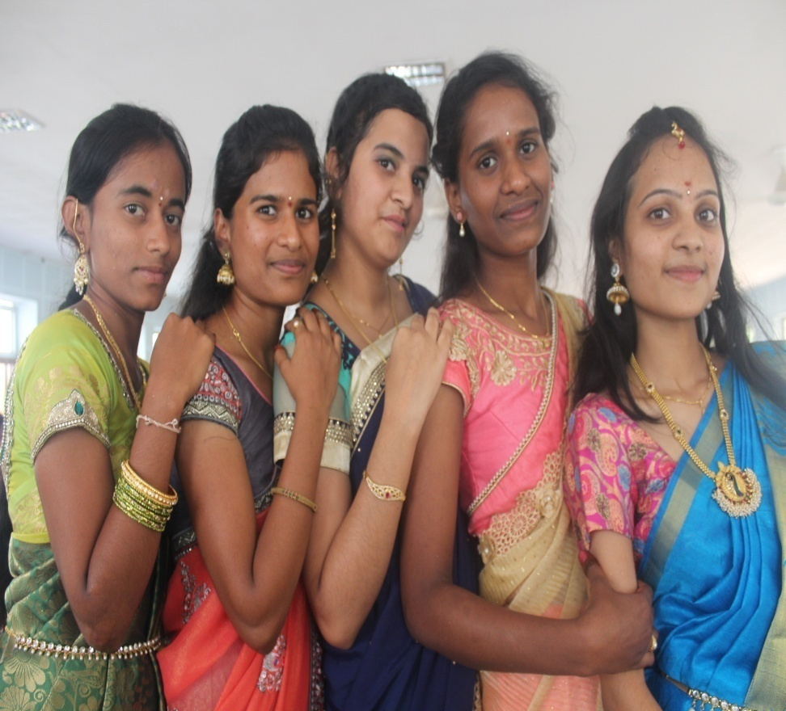
About my friends

Slide 9

Thank-You

