Slide 1

PYTHON
PRESENTATION OF

Slide 2

History of Python
Invented in the Netherlands, early 90s by Guido van Rossum
First public release in 1991, Named after Monty Python
Considered a scripting language, but is much more
Open sourced from the beginning
Scalable, object oriented and functional from the beginning
Used by Google from the beginning

Slide 3
What is Python?
interpreted, object-oriented high-level programming language.
GUI based application
Web development , scientific and mathematical applications
YouTube, Instagram, data science and MI
Large library support
Easy to learn and easy syntax

Slide 4
Simple to learn and use
Multiple library-framework
Useful in ML and AI
Why Python?
Highly secure
Use in web development
Portable Features
High job, salary

Slide 5
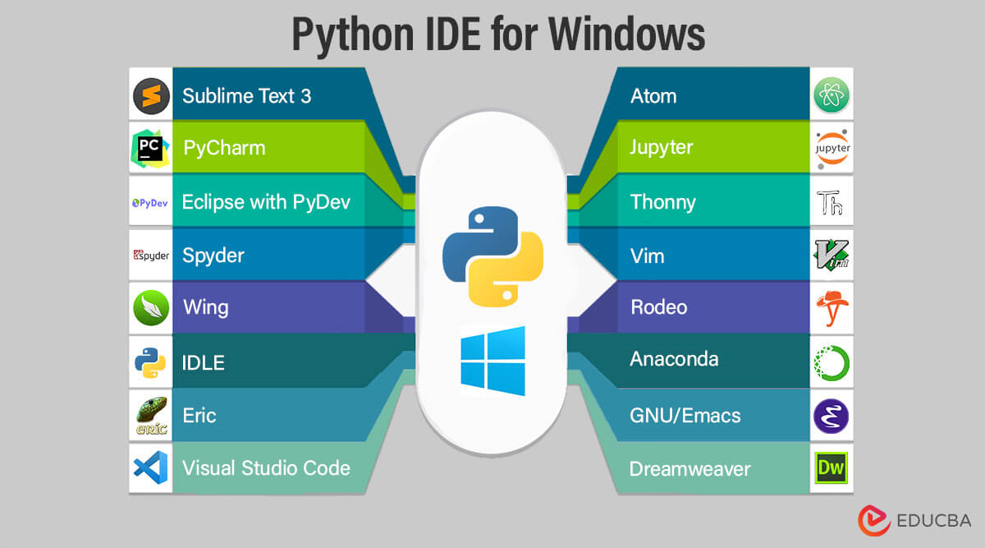
Python Editors
IDLE
Jupyter
Spyder
Visual studio code
PyCharm
Google colab

Slide 6
Top 7 Python Applications
Web development
Software development
App development
Game development
Data-Science
AI and ML
Embedded System

Slide 7
Disadvantage of Python
Poor memory efficiency
Poor Database access
Runtime Error
Slow speed
Week in mobile computing
Design Restriction

Slide 8
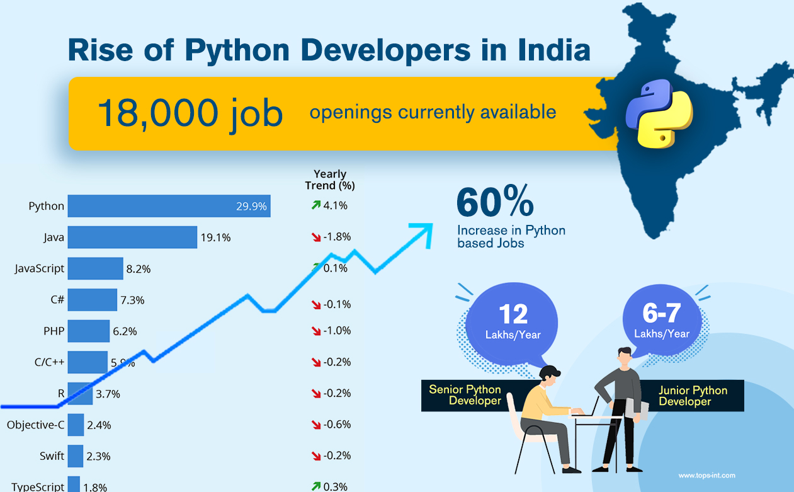

Slide 9
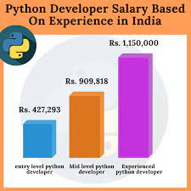
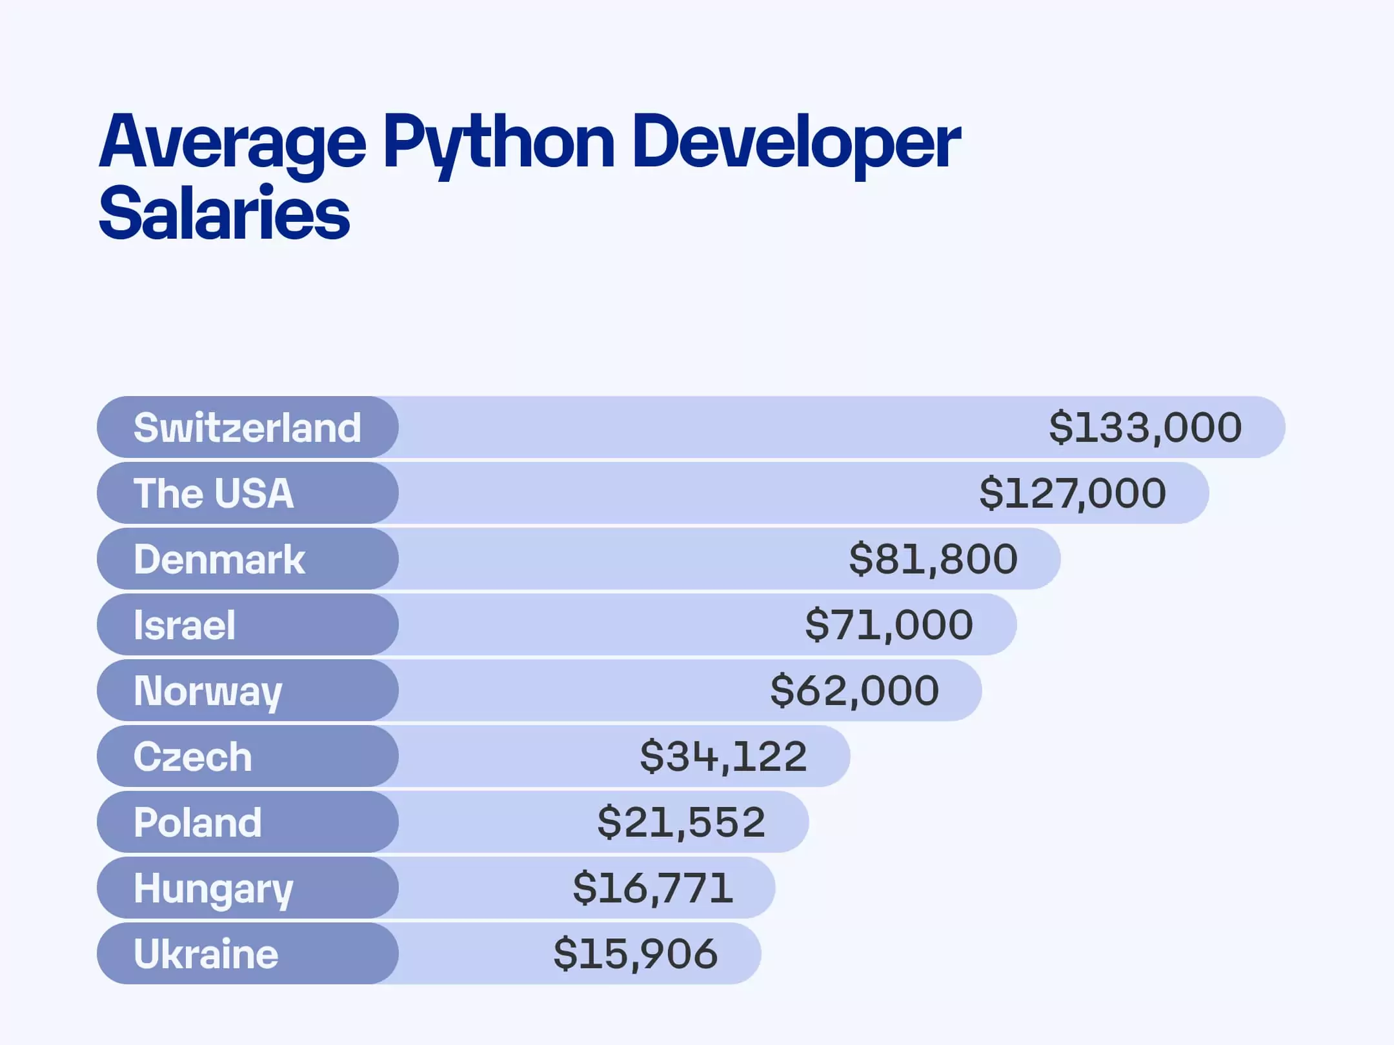
SALARY DETAILS
INDIA VS FOREIGN COUNTRY

Slide 10
Conclusion Python is easy to use , Open sourced Python is high level object oriented language Any one can code in Python Python is awesome!

Slide 11
THANK YOU

