Slide 1

Library Management System Manage books , members, and borrowing
PRESENTED BY:
Rahul C -24SUUBEDAS243
Rahul Kumar -24SUUBEDAS244
Rakshitha N -24SUUBEDAS247
Ramyashree S -24SUUBEDAS251
Ranjitha MG -24SUUBEDAS252
UNDER THE GUIDENCE OF
MR ANIL KUMAR T
Department of CSE-DS

Slide 2

INTRODUCTION
A Library Management System is a software application used to manage library activities in an organized and efficient way.
It helps in storing and maintaining details of books, members, and borrowed books digitally.
This system reduces manual work and saves time. It makes the process of adding books, registering members, and issuing books simple and accurate.

Slide 3

OBJECTIVE
To manage library records in a systematic way
To add and maintain book details
To register and manage members
To issue books to members easily
To reduce manual work and save time

Slide 4
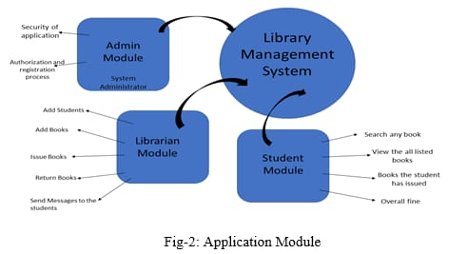
SYSTEM MODULES
The Library Management System is divided into the following modules:
Book Management Module
Used to add and view book details.
Member Management Module
Used to add and manage library members.
Borrowing (Issue Book) Module
Used to issue books to members and maintain records.

Slide 5

BOOK MANAGEMENT
To manage book details in the library.
Functions:
Add new books using Book ID and Book Name
Store book information
Display the list of available books
Benefits:
Easy tracking of books
Reduces manual record keeping

Slide 6

MEMBER MANAGEMENT
To manage library members efficiently.
Functions:
Add new members using Member ID and Name
Store member information
Display the list of registered members
Benefits:
Easy tracking of members
Reduces manual registration work

Slide 7

BORROWING(ISSUE BOOK)
Purpose:
To issue books to library members and maintain records.
Functions:
Enter Book ID and Member ID to issue a book
Store issued book information
Display the list of issued books
Benefits:
Easy tracking of borrowed books
Ensures accurate record-keeping

Slide 8

TECHNOLOGIES USED
Java – For understanding backend and object-oriented concepts
HTML – To create the structure of the web page
CSS – To design and style the user interface
JavaScript – To handle logic and user actions
LocalStorage – To store data permanently in the browser

Slide 9
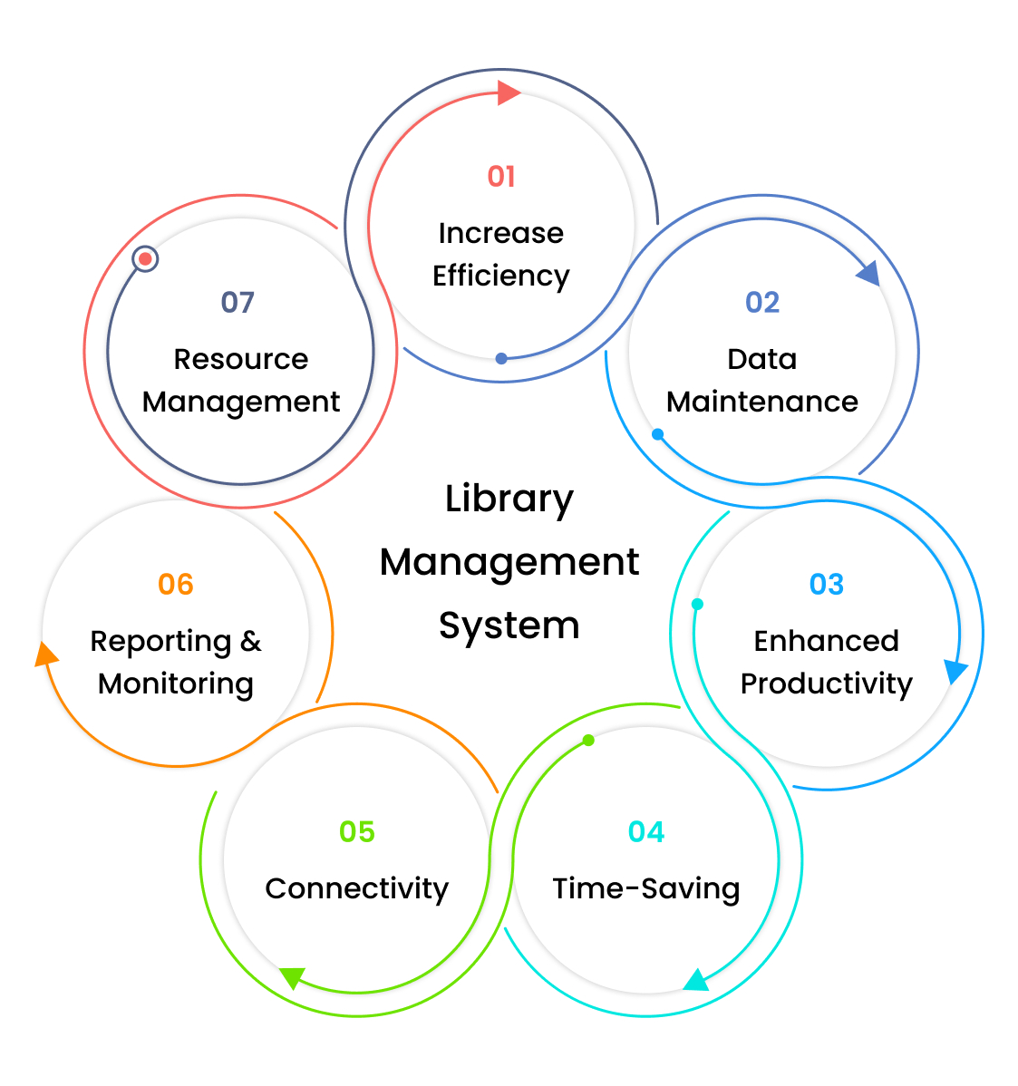
DATA STORAGE MECHANISM
Uses LocalStorage to save data permanently in the browser
Stores information about:
Books
Members
Issued books
Data remains even after page refresh or closing the browser
Acts like a simple database for this system

Slide 10

WORKING OF THE SYSTEM
User enters book/member details or issues a book.
Clicks the Add / Issue button to save the data.
Data is stored in LocalStorage permanently.
Tables on the web page update automatically to show current records.
Users can view books, members, and issued books anytime.

Slide 11
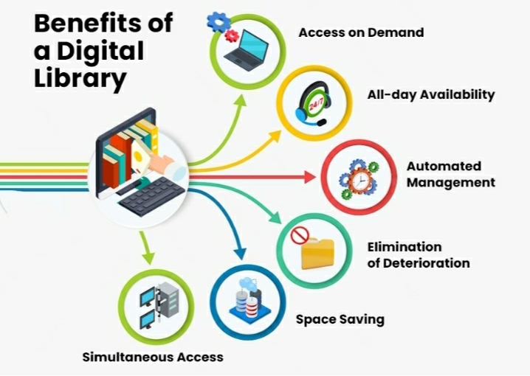
ADVANTAGES
Easy to use and user-friendly interface
Reduces manual work and paperwork
Data is stored permanently and can be viewed anytime
Efficient management of books, members, and borrowing
Can be extended for advanced library features

Slide 12

CONCLUSION
The Library Management System simplifies library operations.
Efficiently manages books, members, and borrowed books.
Reduces manual work and keeps records accurate.
Demonstrates basic concepts of Java and web-based storage.
Can be enhanced further with databases and advanced features.

Slide 13


