Slide 1

REWE Retail Intelligence: Turning Data into Strategic Advantage
Exploratory Insights from Retail Data - Sales, Price, Loyalty Programs, Competitor Benchmarking, Product, Category, Region & Date Trends
Candidate Information
Name: Ramya Subramanian Porselva Bharathi
Application for: Working Student — Business Insights, Retail Intelligence
Date: June 2025

Slide 2

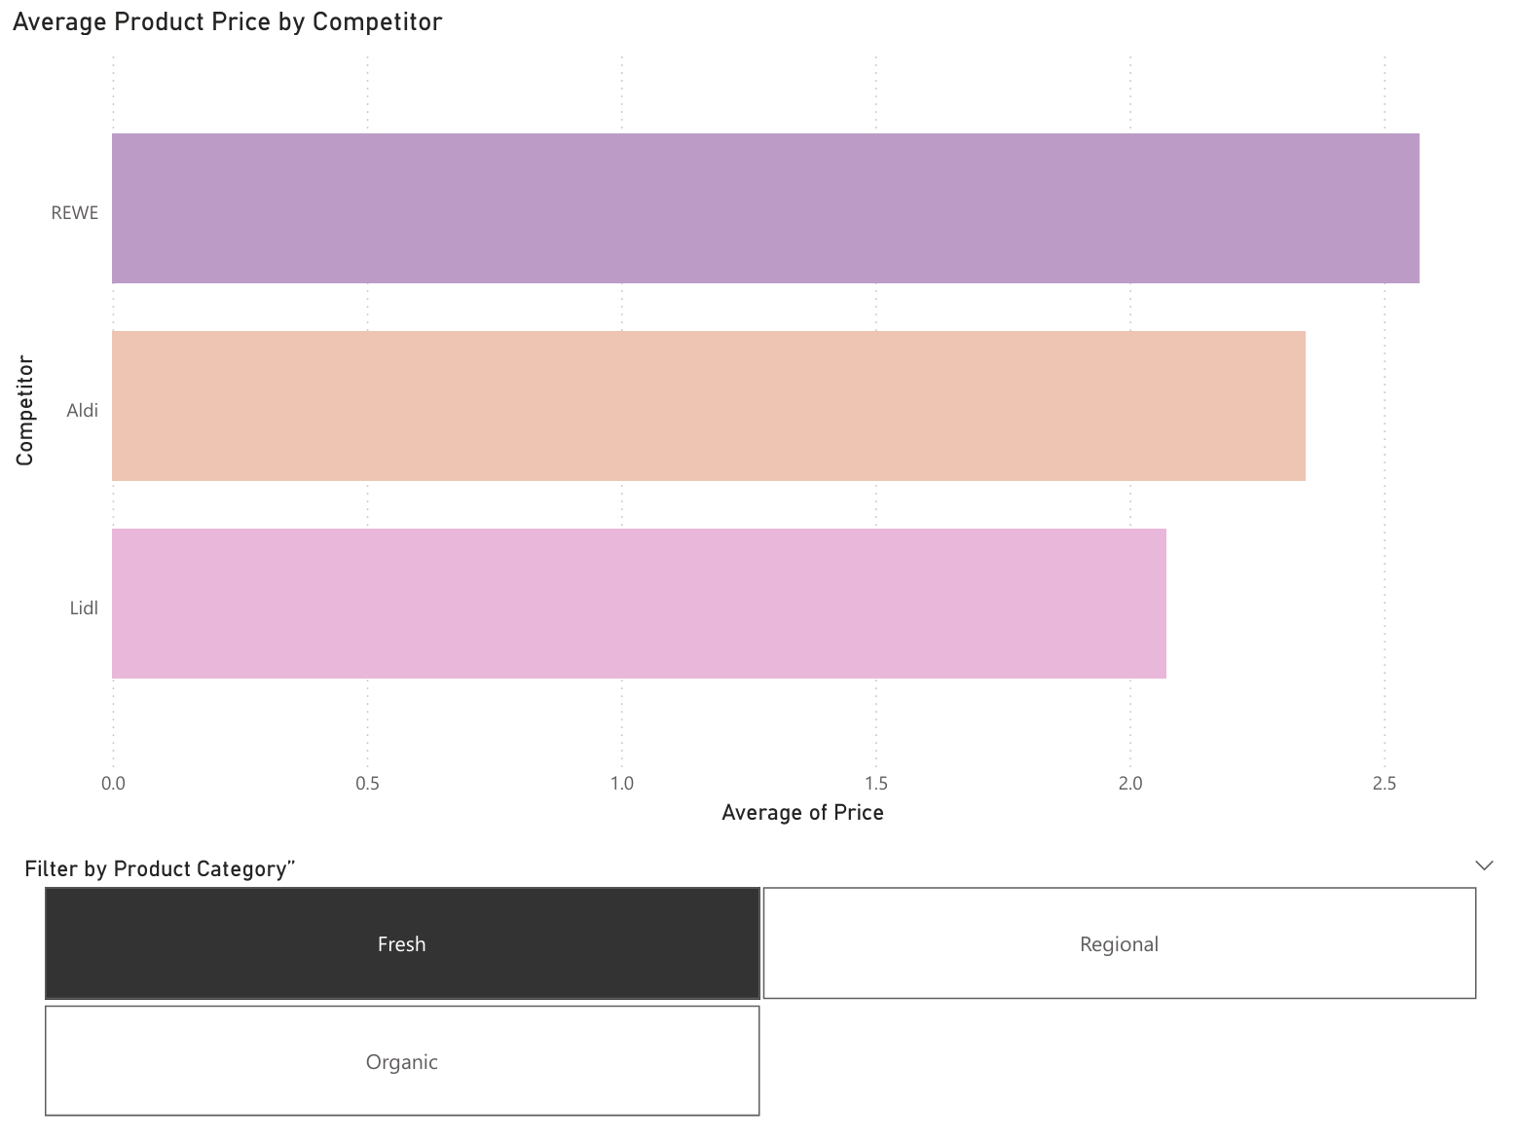

Competitor Price Comparison with Category Drill-Down
Business Insight:
Lidl consistently offers the lowest average product prices across all categories compared to REWE and Aldi. This pricing strategy gives Lidl a competitive edge in attracting price-sensitive customers.
Recommendation:
REWE should consider price-matching key items or offering loyalty discounts on selected high-traffic products in regions where Lidl has stronger pricing power (e.g., Organic products in Munich or Berlin).
Visual Shows:
A Clustered Bar Chart showing Average Price by Competitor
An interactive slicer allows filtering the chart by: Fresh, Organic, Regional

Slide 3
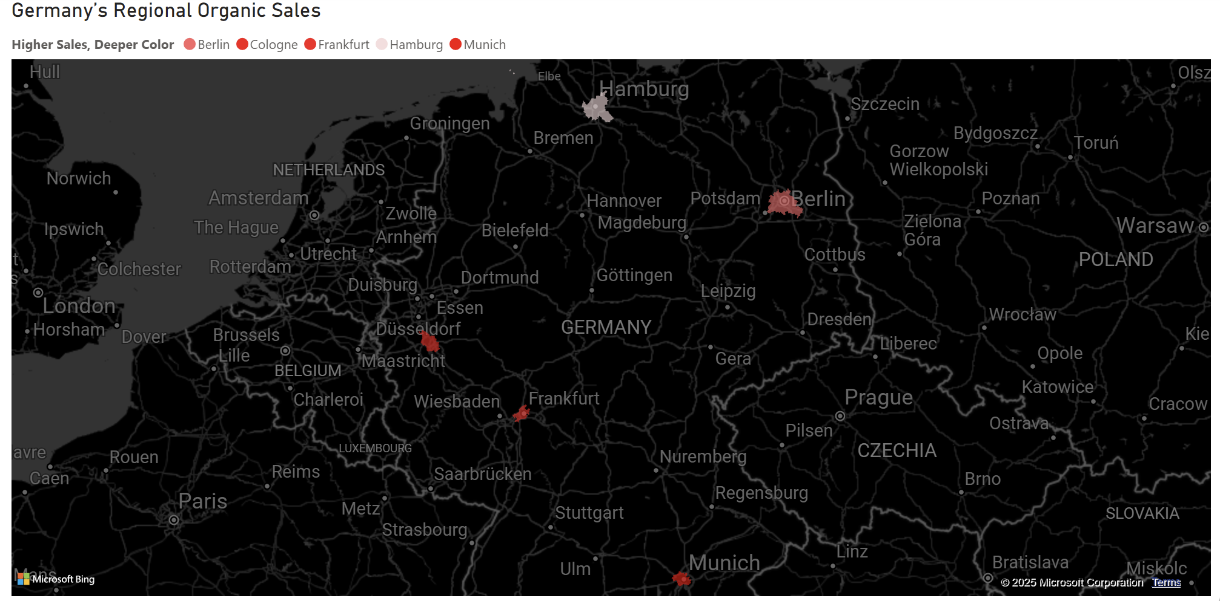
Munich Leads in Organic Sales: Regional Sales Insights
Business Insight:
“Munich reports the highest sales for Organic products among all regions.” This suggests a strong regional demand for organic items in southern Germany.
Recommendation:
REWE should consider increasing stock, promotions, and local supplier partnerships for organic items in the Munich region to meet growing demand.
Power BI Visual Shows:
Visual Type: Filled Map
Purpose: Displays regional organic product sales across cities in Germany.
Features:
Darker red areas indicate higher sales.
Each city is mapped based on the total sales of organic products.
Hovering over a city shows exact sales figures.
Map styling is based on the color saturation of the “Sales” metric.

Slide 4
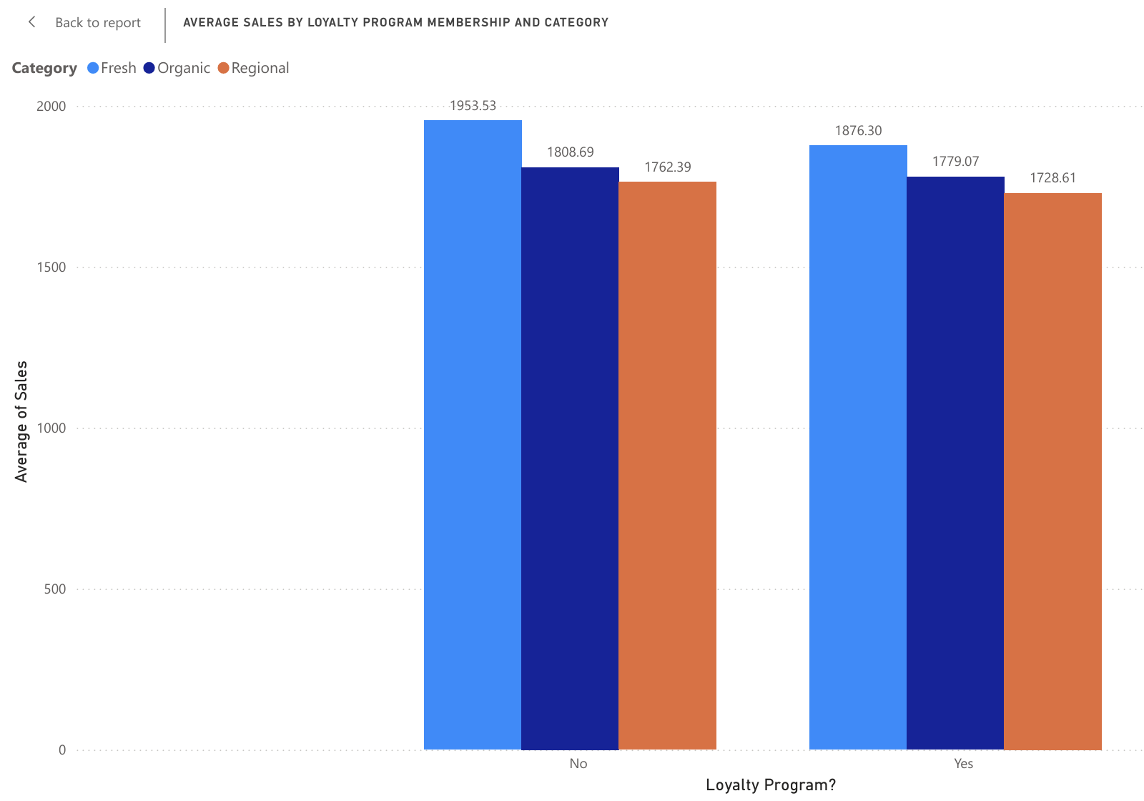
Loyalty Program Members Spend More: Boosting Value Through Retention
Business Insight:
Loyalty Program users spend significantly more on average compared to non-members, especially in the Organic and Regional categories. This suggests that loyalty participation directly correlates with higher basket value.
Recommendation:
REWE should actively promote its loyalty program to non-members, especially in regions with lower sign-up rates, and offer exclusive incentives in high-margin categories, such as organic and Regional products.
Visual Shows:
Visual Type: Clustered Column Chart
X-axis: "Loyalty Program?" – indicating whether customers are part of a loyalty program ("Yes" or "No").
Y-axis: "Average of Sales" – showing the average sales figures.
Legend (Color): Category – differentiates "Fresh", "Organic", and "Regional" product categories by color.
Data Labels: The exact average values are shown on top of each bar (e.g., 1953.53, 1808.69).
This visual helps compare average sales across different categories, segmented by loyalty program participation.

Slide 5
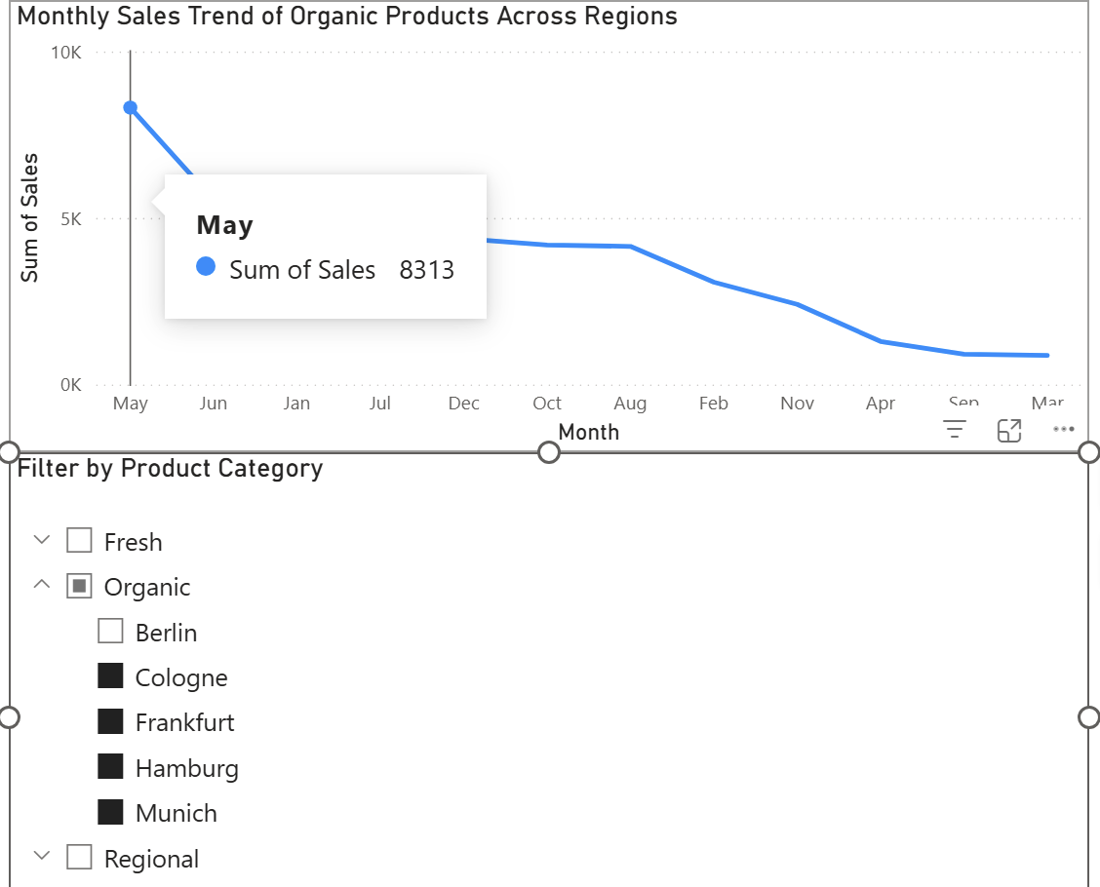
Organic Product Sales Peak During Spring and Early Summer
Business Insight:
Seasonal sales trends show that organic product sales peak in spring and early summer months, especially in regions like Bavaria and North Rhine-Westphalia.
Recommendation:
Leverage this seasonal pattern by planning targeted promotional campaigns from March to June, focusing on organic product discounts and loyalty offers during these high-demand months.
Visual Shows:
A Line Chart shows: Monthly sales trend for Organic Products X-axis: Month Y-axis: Total Sales
Slicer 1: "Filter by Product Category (Fresh, Organic, Regional)" Purpose: Let the user drill down into specific product types.
Slicer 2: "Select Region to View Local Trends" Purpose: Allows comparison of monthly trends by geographic area.

Slide 6
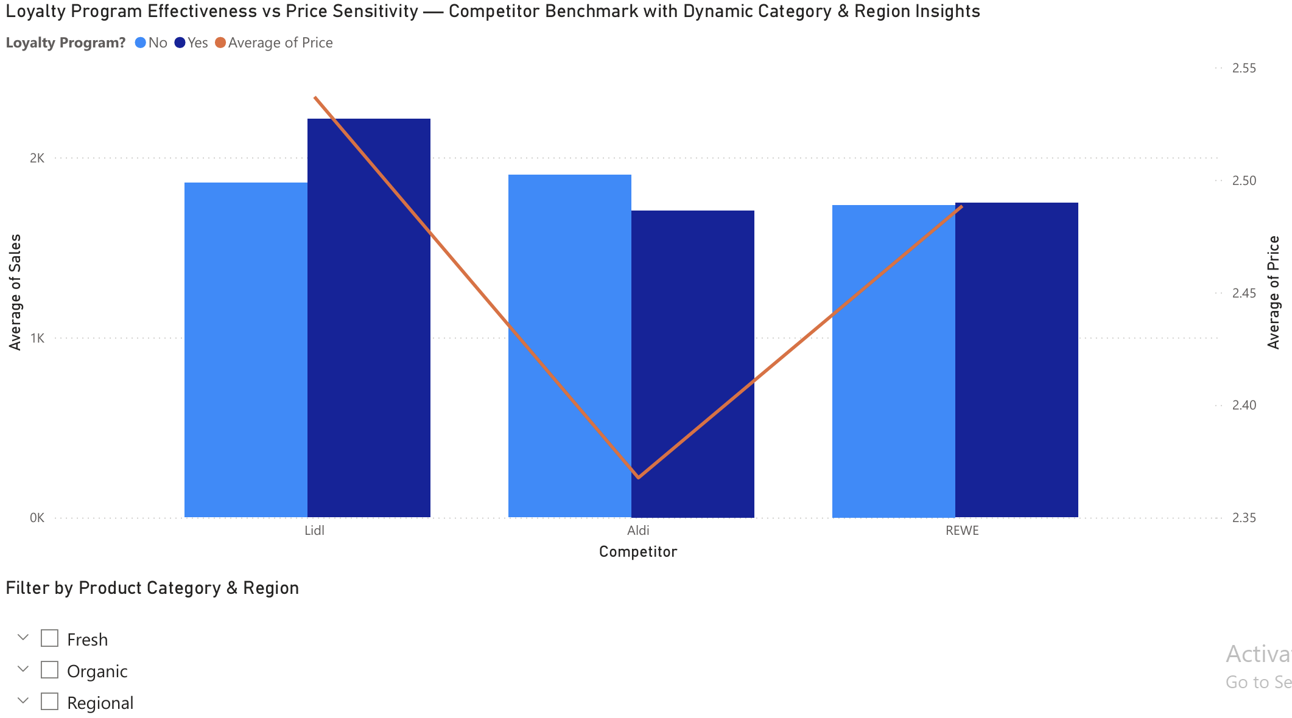
COMPETITOR LOYALTY PROGRAM EFFECTIVENESS ANALYSIS
Business Insight:
Lidl’s Loyalty Program drives higher sales despite higher product prices, indicating strong customer engagement and loyalty impact.
In contrast, REWE’s loyalty initiatives have shown minimal or negative sales impacts, suggesting program ineffectiveness or poor targeting.
Recommendation:
REWE should redesign loyalty programs with a focus on measurable sales uplift by: - Tailoring loyalty offers by product category and region. - Learning from Lidl’s model in driving engagement, even with higher pricing. - Prioritizing loyalty initiatives on premium or high-margin categories (e.g., Organic, Regional).
Visual Shows:
A Combo Chart comparing Average Sales (Bars) and Average Price (Line) by Competitor, split by Loyalty Program participation
Interactive Slicers enable dynamic filtering by: – Product Category: Fresh, Organic, Regional – Region: Munich, Hamburg, Cologne, etc.
Allows clear identification of how Loyalty Programs perform within specific market segments, uncovering hidden patterns not visible in overall averages

Slide 7

THANK YOU!

