Slide 1
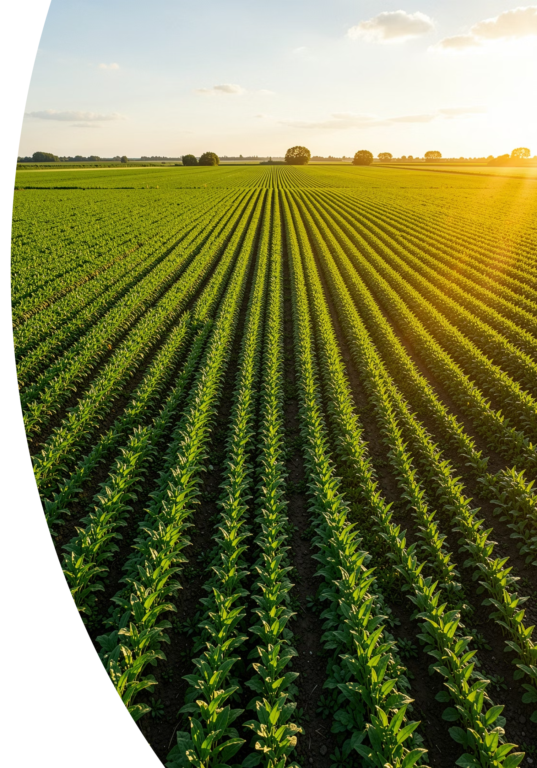
B.TECH FINAL YEAR PROJECT
SMART AGRICULTURE × AI
AI Powered Crop Yield Prediction Using Machine Learning
Predict crop productivity using agricultural and environmental data for smarter farming decisions.

Slide 2
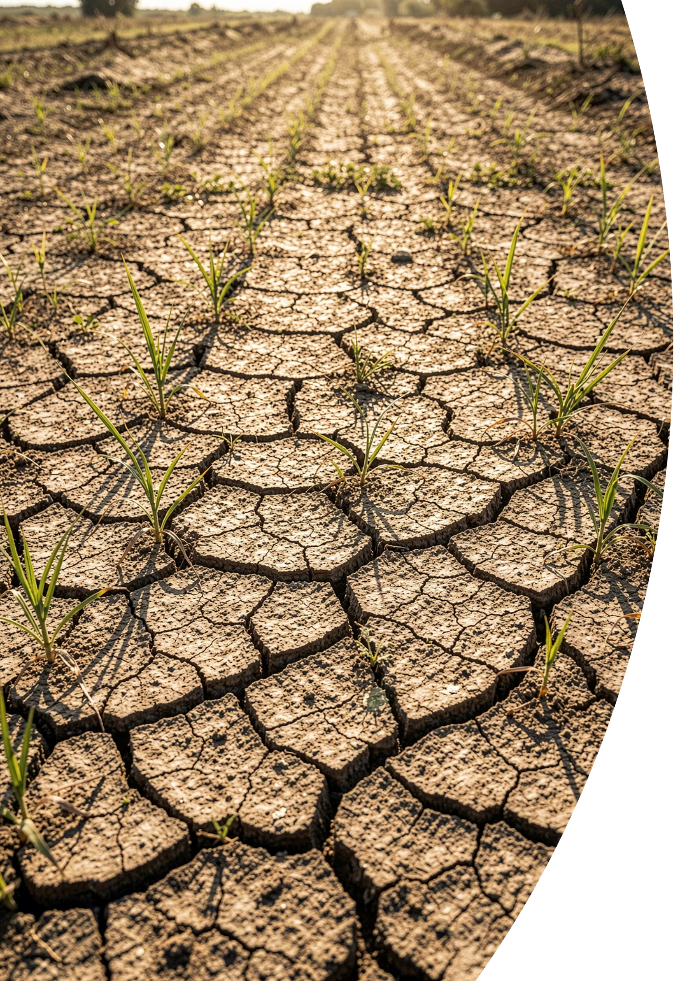
Problem Statement & Objectives
The Challenge
Project Objectives
Climate variability severely impacts crop production. Uncertain rainfall patterns and temperature fluctuations make it difficult to predict agricultural yield accurately, creating an urgent need for data-driven farming decisions.
Predict crop yield accurately using ML
Improve farmer decision making
Increase agricultural productivity
Support smart farming ecosystems
Climate variability affects crop production
Uncertain rainfall patterns
Difficulty in predicting yield accurately
Need for data-driven agricultural decisions

Slide 3
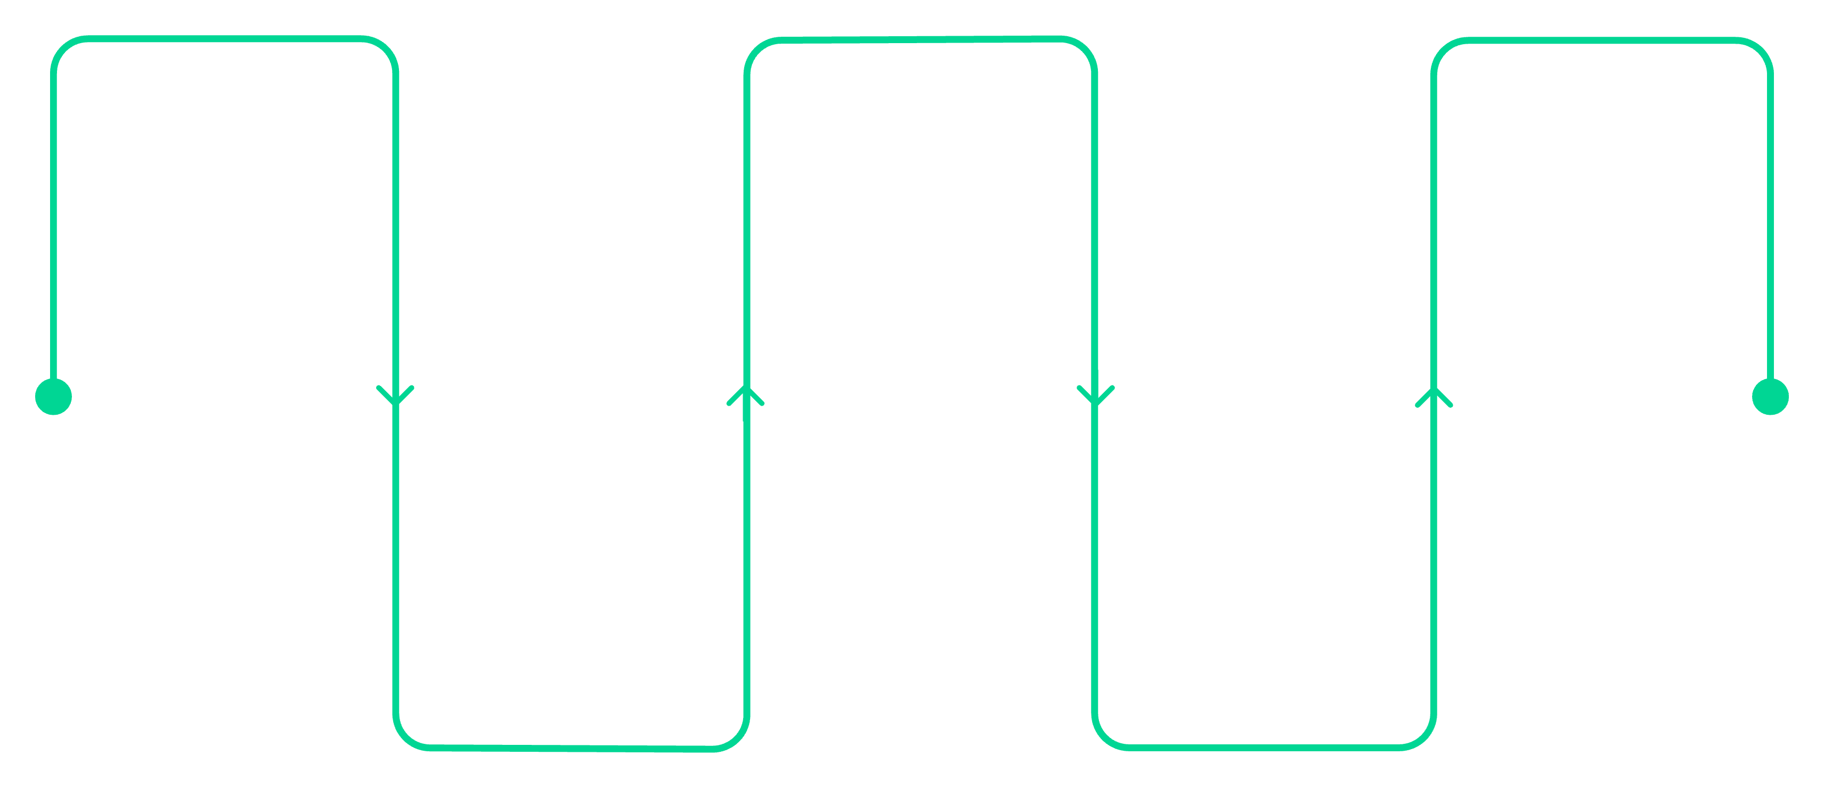
Proposed Solution & Workflow
Our system leverages machine learning to transform raw agricultural and environmental data into actionable yield predictions and farming recommendations.
Agricultural Data
Machine Learning Model
Recommendation System
Collect raw field and weather data
Provide actionable farming advice
Train models on historical data
Data Preprocessing
Yield Prediction
Clean, normalize, and feature engineer
Estimate crop yields per field
Input Features
Crop
Country
Year
Rainfall
Pesticides
Temperature

Slide 4
Dataset & Technology Stack
Dataset Features
Technology Stack
Country: Geographic region of cultivation
Crop Type: Specific crop category
Year: Harvest year for seasonal tracking
Average Rainfall: Annual precipitation (mm)
Pesticides: Chemical usage data
Average Temperature: Climatic temperature (°C)
Crop Yield: Target variable (hg/ha)
Frontend
Backend
HTML, CSS, JavaScript
Python, Flask
Machine Learning
Libraries
Scikit-Learn, Random Forest Regressor
Pandas, NumPy, Matplotlib, Seaborn

Slide 5
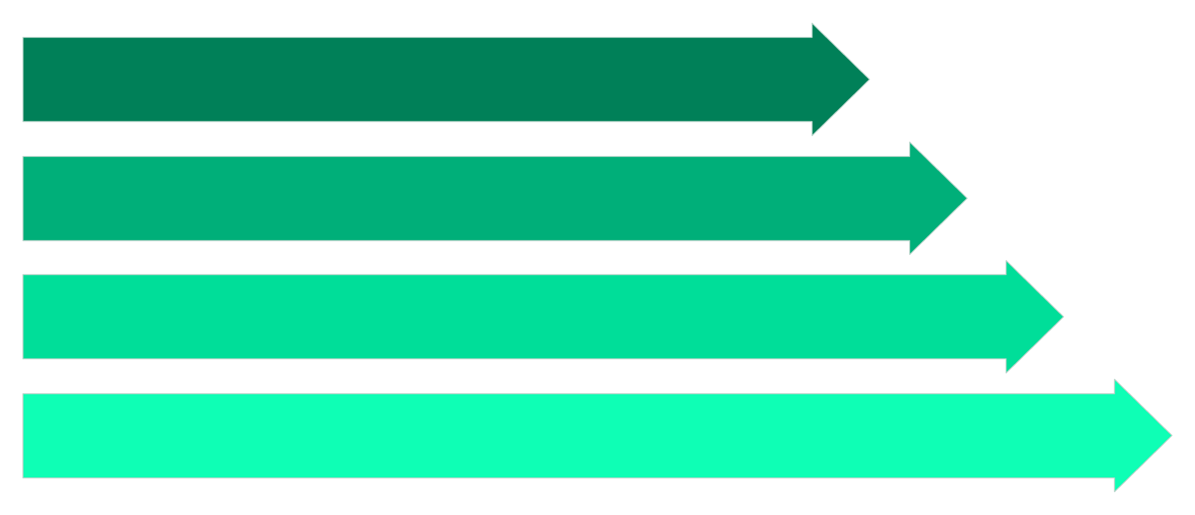
Data Preprocessing Pipeline
Raw agricultural data undergoes a structured preprocessing sequence to ensure high-quality inputs for the machine learning model, maximizing prediction accuracy.
Collect Data
Clean Data
Handle Missing
Encode Labels

Slide 6
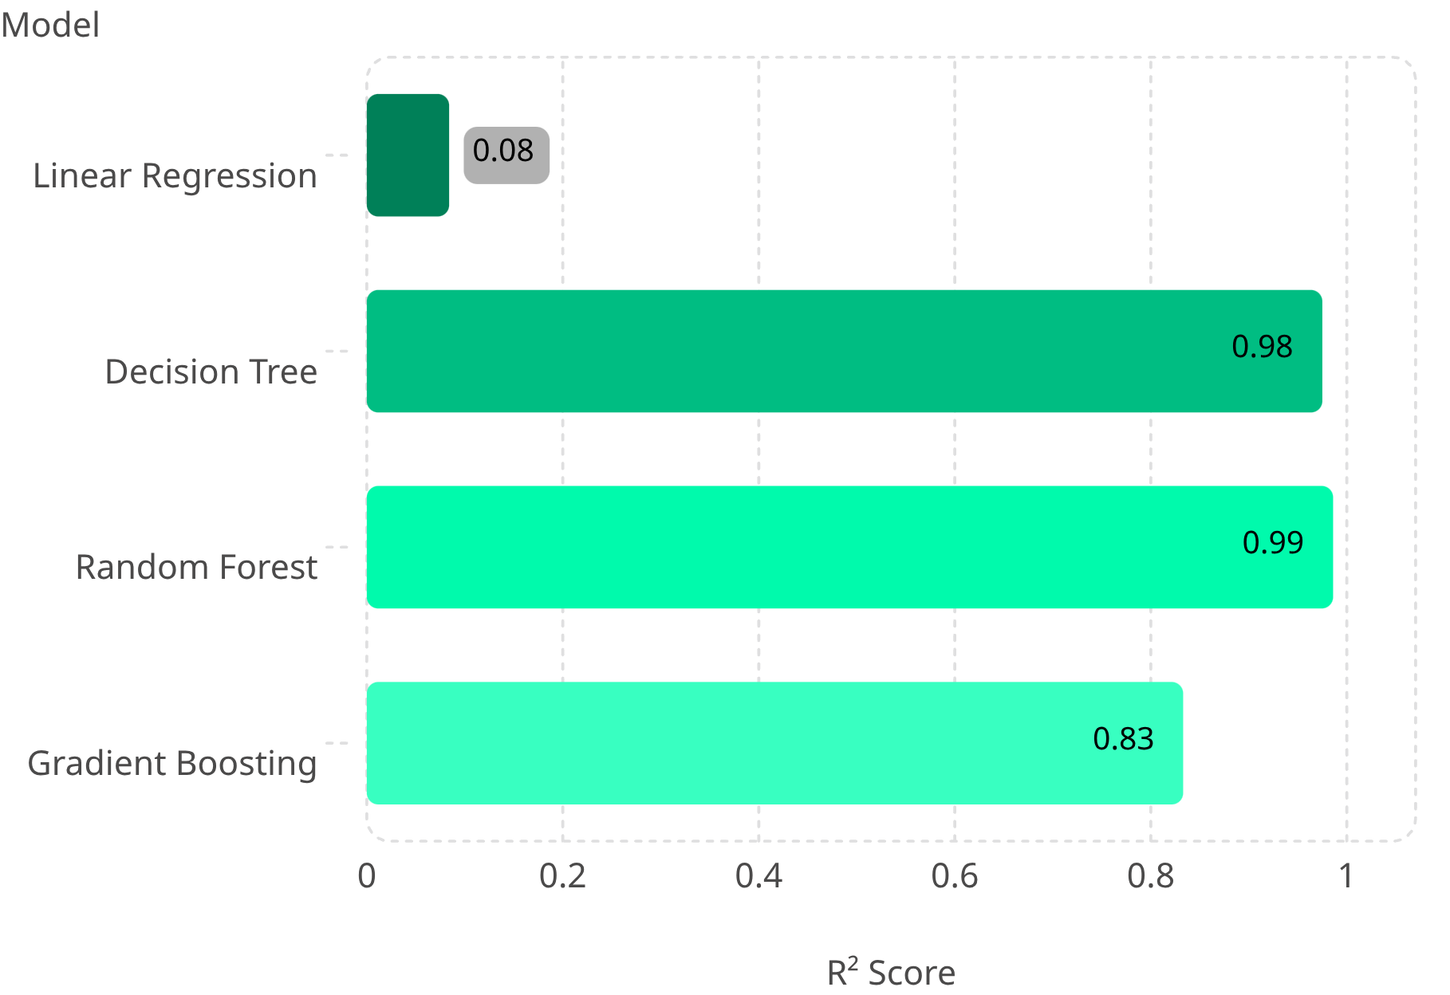

Model Comparison & Selection
Selected Model: Random Forest
Random Forest Regressor achieved the highest R² score of 0.986, demonstrating superior prediction performance and robustness against overfitting compared to other algorithms.
Highest R² Score & Best Prediction Performance

Slide 7
System Architecture
The end-to-end architecture flows from user inputs through the web interface and Flask backend to the Random Forest model, delivering crop yield predictions and recommendations.
User Inputs
Flask Backend
Random Forest
Country, Crop, Year, Rainfall, Pesticides, Temp
Routes requests and manages logic
Trained model predicts yield
Data Preprocessing
Web Interface
Collects and validates inputs
Clean, encode, and scale features

Slide 8
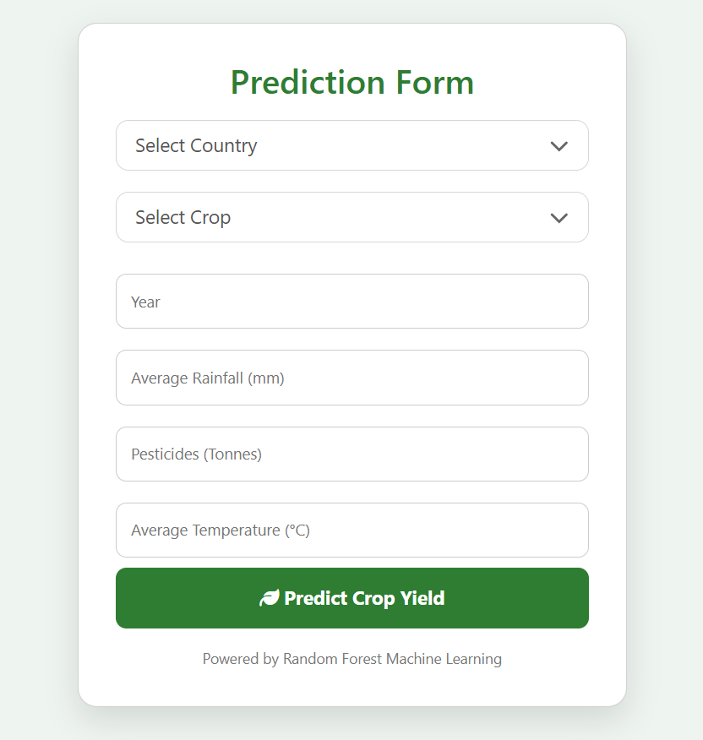
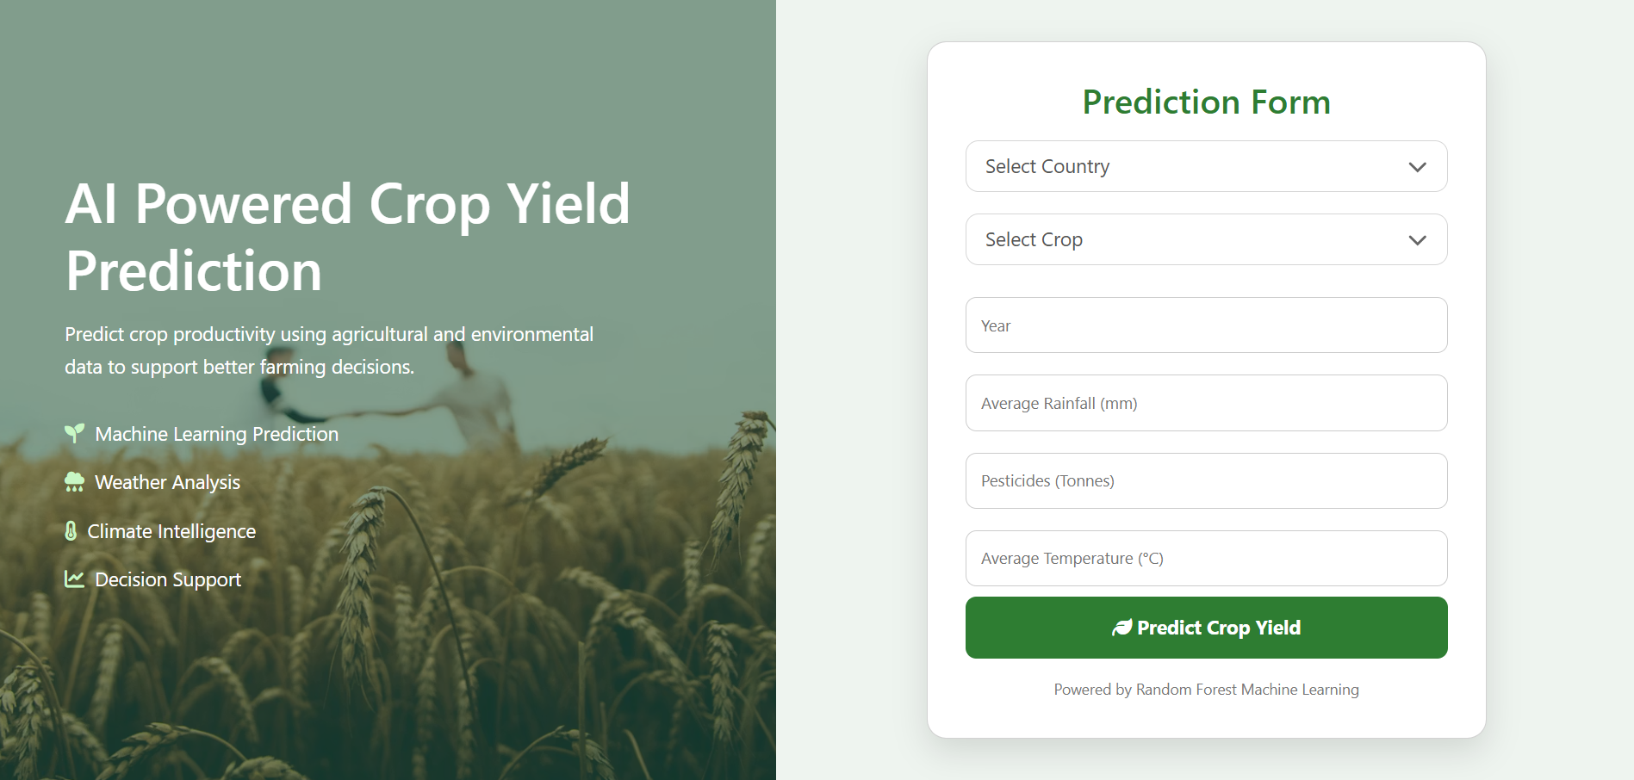
Application Interface
Prediction Form
Home Page
The landing page introduces the system with an
intuitive, agriculture-themed user interface.
Users input agricultural and environmental parameters to generate yield predictions.
User-friendly agriculture-based prediction interface.

Slide 9
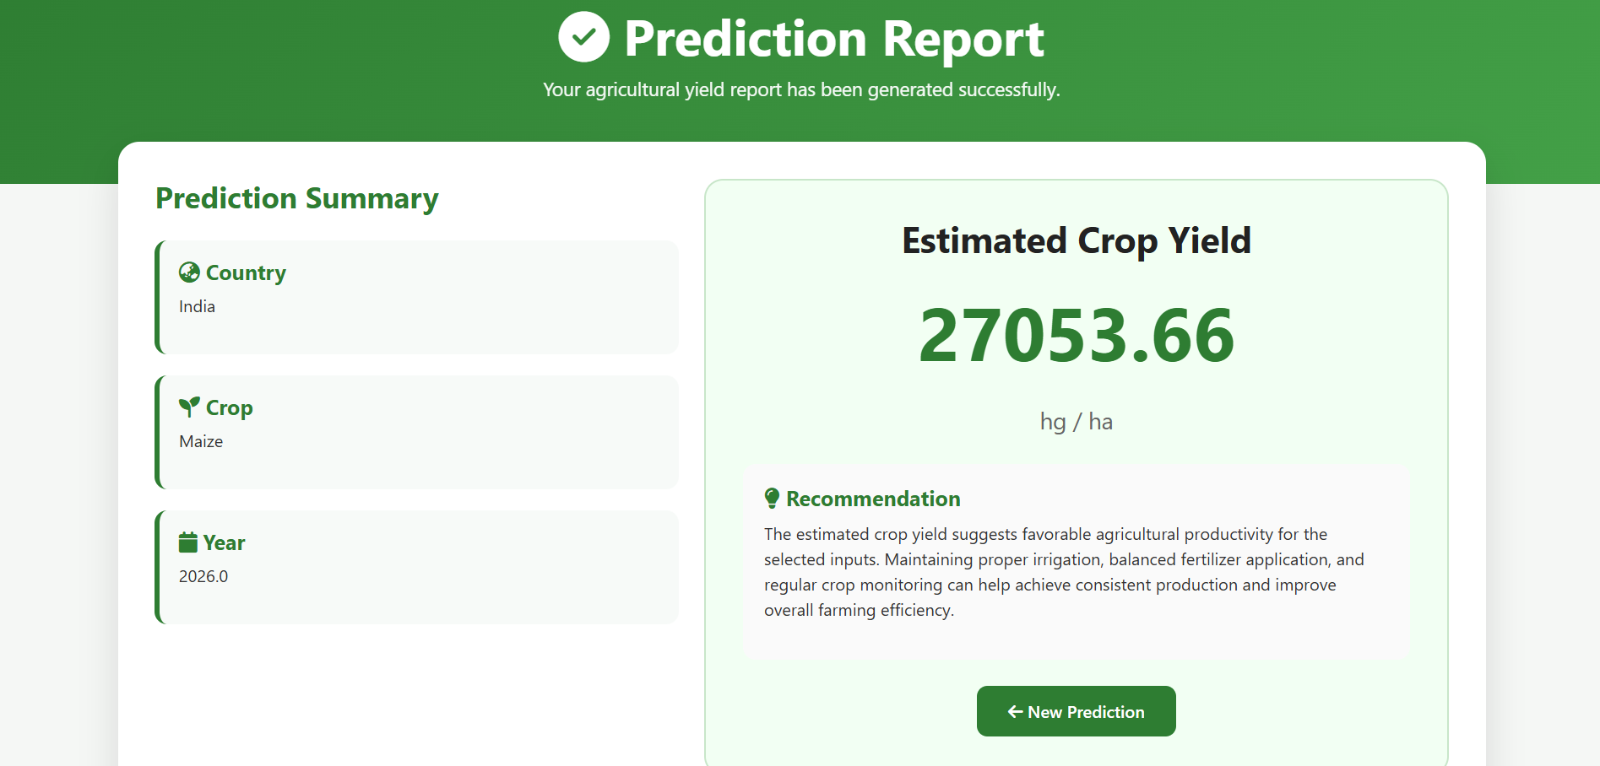
Prediction Results
Output Features
Prediction Report
1
2
Prediction Summary
Estimated Crop Yield
Overview of input parameters and model output
Precise yield value predicted in hg/ha
3
Recommendation Section
Actionable insights for optimal farming decisions

Slide 10


Advantages, Future Scope & Conclusion
Advantages
Future Scope
Accurate yield prediction using ML
Better crop planning and management
Increased agricultural productivity
Data-driven decision making
Real-time Weather API integration
Fertilizer recommendation system
Crop disease prediction module
Mobile application deployment
Random Forest-based Crop Yield Prediction helps farmers make informed decisions and supports the advancement of smart agriculture.
Thank You — Questions & Discussion

