Slide 1
MCP
RAMYASRI KURAKULA

Slide 2
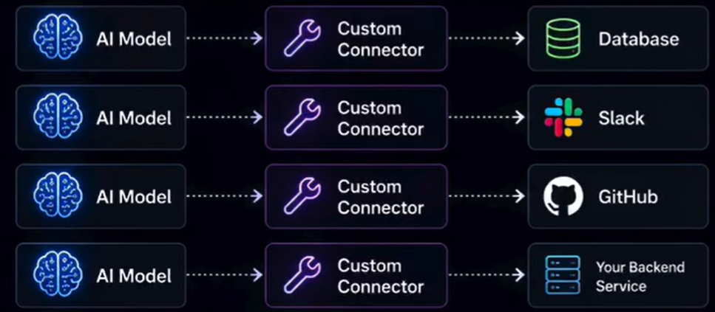
Let us first understand what problem an MCP solves. Right now if you want an AI chat to your cloud to interact with your database, Slack, or GitHub, you have to manually build a custom integration for each one. MCP is a universal adapter. All of the custom integrations will be replaced by the MCP layer.

Slide 3
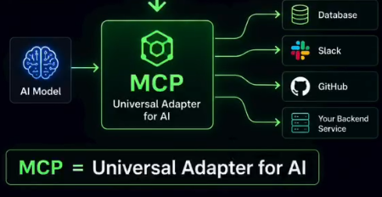
MCP stands for Model Context Protocol. Think of it like this: HTTP is a protocol that lets your browser talk to your server whereas MCP is the protocol that lets your AI model talk to your tools, data, and services. Same idea, but completely different layer.
let us understand how MCP is different than a REST API:
A REST API is a contrast: you call an endpoint and you get a response, whereas MCP is a conversation. The AI model tells the MCP server what exactly it wants. The server exposes tools, resources, and prompts and the AI decides which tool to use, what order, everything, automatically.

Slide 4
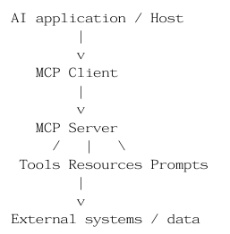
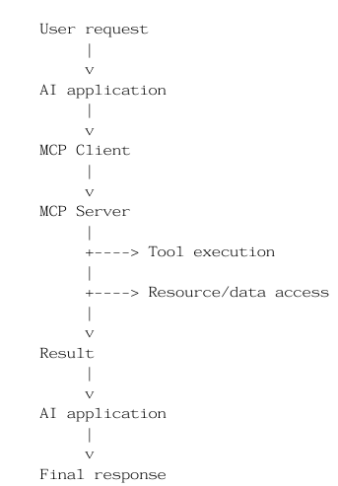
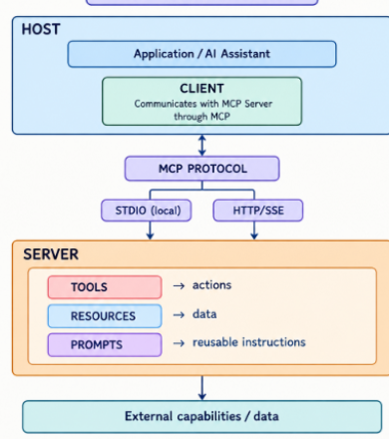
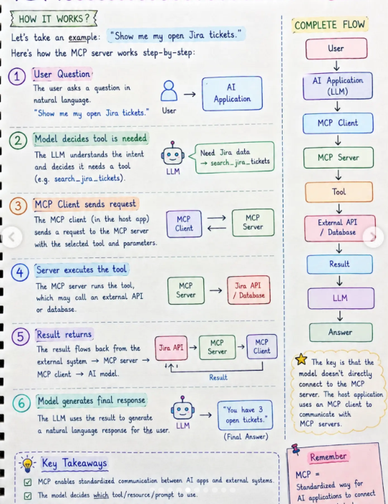
MCP ARCHITECTURE:
CLIENT AND SERVER FLOW:
MCP MODEL:
HOW MCP WORKS:

Slide 5
TOOLS RESOURCES AND PROMPTS:
TOOLS:
get_attendance()
get_marks()
find_classroom()
RESOURCES:
timetable
course information
campus information
PROMPTS:
"Explain my timetable"
"Summarize my course information"
STDIO AND HTTP/SSE:
How do Client ↔ Server communicate?
STDIO→ SAME computer
Client ↔ server.py
Docker:
Docker packages your MCP server and its dependencies into a container, so it can run consistently on different machines.
Docker Container
│ MCP Server
│ Python
│ Dependencies
│ Configuration

