Slide 1
Lending Club Case Study
Presented By
Ramyasri Gomatham

Slide 2
Problem Statement
The consumer finance company which specialises in lending various types of loans to urban customers. When the company receives a loan application, the company must decide for loan approval based on the applicant’s profile.
Two types of risks are associated with the bank’s decision:
If the applicant is likely to repay the loan, then not approving the loan results in a loss of business to the company
If the applicant is not likely to repay the loan, i.e. he/she is likely to default, then approving the loan may lead to a financial loss for the company

Slide 3
Problem solving Methodology
Data Cleaning : Removing the NULL valued columns and unnecessary variables. Removing NULL rows.
Data Understanding : Understanding Data Dictionary and getting knowledge of all columns.
Univariate Analysis : Data Understanding of each column and plotting the distributions of each column.
Segmented Univariate Analysis : Data Understanding of continuous data columns with respect to the categorical column
Bivariate Analysis : Analysing the two variable behaviour like term and loan status with respect to loan amount.
Conclusion:
Analysing and providing recommendations for reducing the loss of commercial bank by detecting columns best which contribute to loan defaulters.

Slide 4
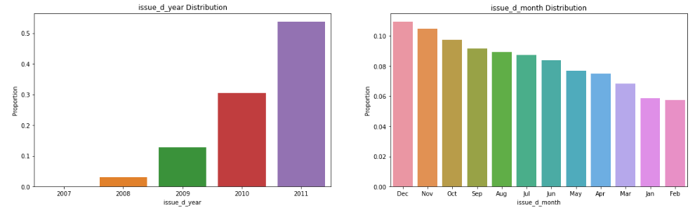
Loan Analysis over years
Lending club has really expanded from 2008 to 2011 and almost doubled every year.
Loans increased from Jan to Dec and most loans taken in final quarter of the year Oct-Dec due to festival and holiday time.

Slide 5
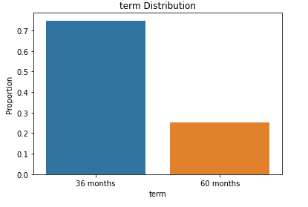
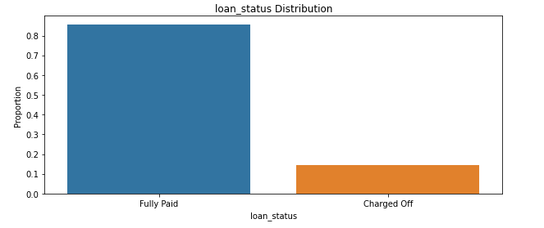
Term and Loan Paid Analysis
All the loans in dataset are of 36 and 60 months. And most the borrowers opted for 36 months loan term.
And there are good number of borrowers that is 80% who fully paid off the loan and 20% are charged off with their loan.

Slide 6
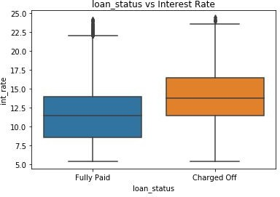
When the loan interest rate is high there is high chance of loan
getting defaulted

Slide 7
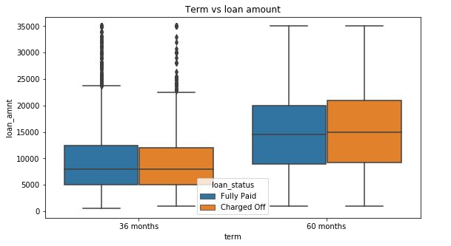
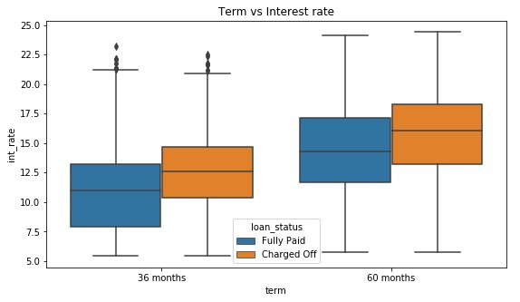
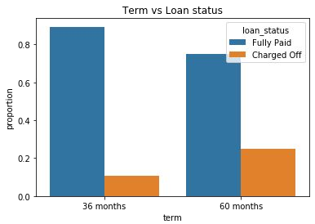
Analysis
The default rate is high in 60 months tenure because most people took high loan amount with high interest rate in it and they faced difficulties in returning the sum to bank.

Slide 8
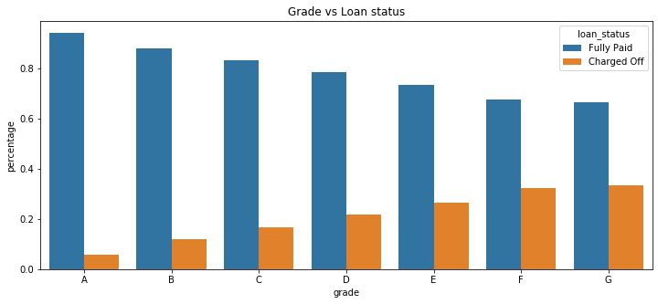
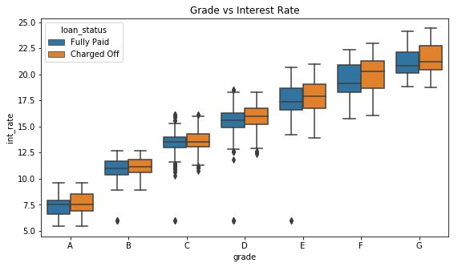
Analysis
Grades are very good category to tell the borrower probability of defaulting the loan.
The Lower grades(E,F,G) have higher chances of defaulting the loan than Higher ones(A,B)
Also the Lower grades are getting loans for higher interest rates which might be the cause for loan default.

Slide 9
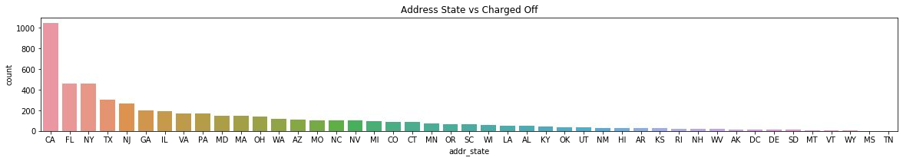
Analysis
The loans which are given for CA, FL and TX state borrower’s are defaulted more than other states.

Slide 10
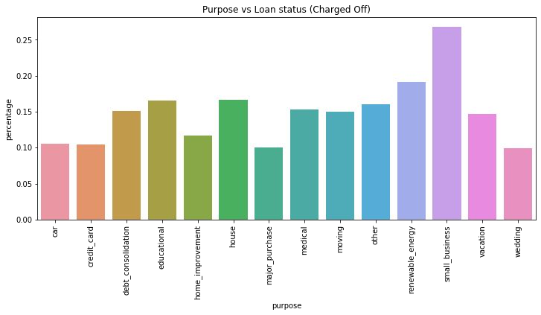
Analysis
Borrower’s who took loans for small business purpose have defaulted more.

Slide 11
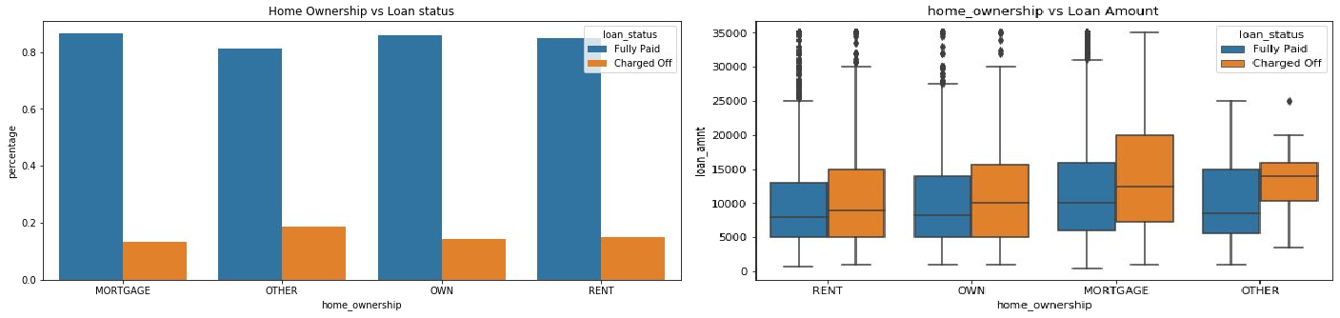
Analysis
There is around 20% chance of loan default in each home ownership category.
From the 2nd plot we can see the people with higher loan amounts in mortgage home ownership has high default rate than others.

Slide 12
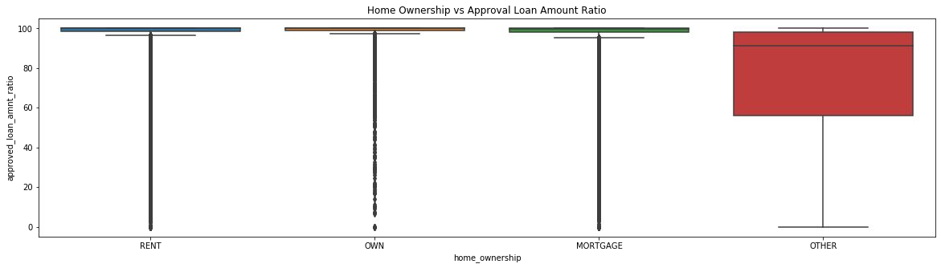
Approved loan (Funded Amount by investor) is less than than the requested loan amount by borrowers for Other Home ownership category.

Slide 13
Conclusions
Lending club should reduce the high interest loans for 60 months tenure, they are prone to loan default.
Grades are good metric for detecting defaulters. Lending club should examine more information from borrowers before issuing loans to Low grade (G to A).
Lending Club should control their number of loan issues to borrowers who are from CA, FL and NY to make profits.
Small business loans are defaulted more. Lending club should stop/reduce issuing the loans to them.
Borrowers with mortgage home ownership are taking higher loans and defaulting the approved loans. Lending club should stop giving loans to this category when loan amount requested is more than 12000.
People with more number of public derogatory records are having more chance of filing a bankruptcy. Lending club should make sure there are no public derogatory records for borrower.

