Slide 1
PROGRAMMING PARADIGMS AND OOPS ADVANCED CONCEPTS
By Ramya Sri Mantripragada

Slide 2
Procedure Oriented Paradigm
Based on procedural calls.
A procedure is a set of computational instructions to be executed.
Main
Global Data
Function1
Function2
Function3

Slide 3
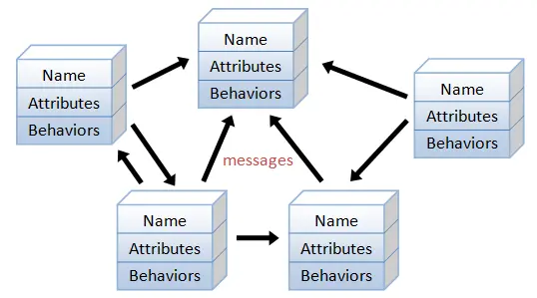
Object-Oriented Paradigm
Breaking down the task into objects that expose behaviors and properties using interfaces.

Slide 4
Declarative Paradigm
A non-imperative style of programming in which programs describe their desired results without explicitly listing commands or steps that must be performed.
List<int> collection = new List<int> { 1, 2, 3, 4, 5 };
Imperative Paradigm | Declarative Paradigm
List<int> results = new List<int>(); foreach(var num in collection) { if (num % 2 != 0) results.Add(num); } | var results = collection.Where( num => num % 2 != 0);

Slide 5
Logical Paradigm
A type of declarative programming in which the knowledge base (pre-requisite data) and the problem are given to the machine and machine produces output.
Plays an important role in AI
Knowledge Base
Machine
Solution
Problem

Slide 6
Structured Paradigm
A programming paradigm focused on improving clarity, quality and development time by extensive usage of control structure, subroutines and blocks.
Structured
Paradigm
Control Structures
Subroutines
Blocks
Sequence
Selection
Iteration

Slide 7
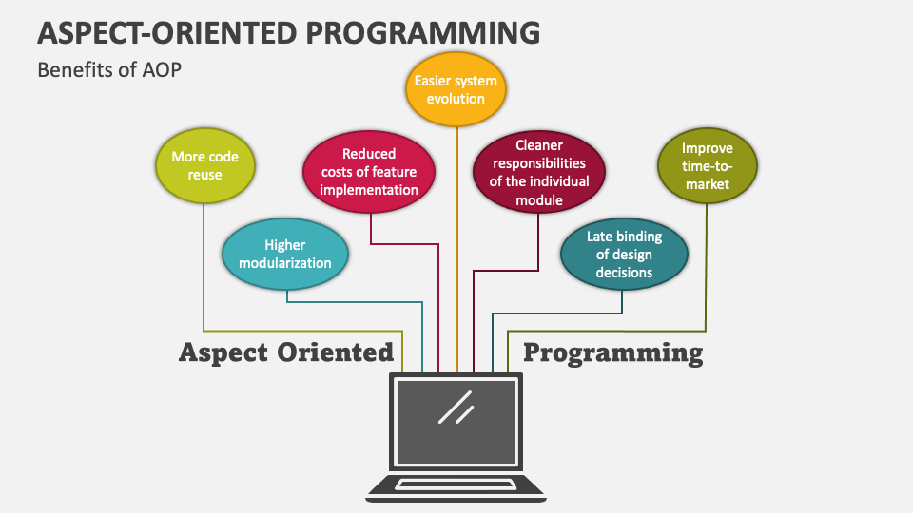
Aspect-Oriented Programming
Aspect Oriented Programming is a programming paradigm that aims to increase modularity by allowing the separation of cross-cutting concerns, such as logging, security, transaction management, etc., from the main business logic.

Slide 8
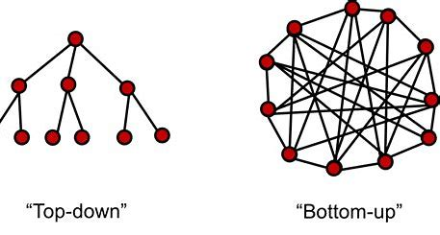
Top-Down Approach vs. Bottom-Up Approach
Top-Down Approach: Dividing problem into parts and sub parts and solving them. Emphasis is on doing things.
Bottom-Up Approach: Solving small chunks of problems and combining their solutions. Emphasis is on data.

Slide 9
Association
Establishing relation between classes using objects.
2 forms of association:
Composition is “part-of” relation
Aggregation is “has-a” relation
Association
Composition
Aggregation
Employee
Company
Departments
Has-a
Part-of

Slide 10
Inheritance
Establishing “Is-A” relationship between classes by deriving new class from already existing class.
Mobile Phone
IPhone
Samsung
OnePlus

Slide 11
Data Types: Primitive & Non-Primitive
Data Types
Primitive
Non-Primitive
Primitive
bool
byte
short
int
long
float
double
decimal
char
Non-Primitive
Classes
Structs
Enums
Arrays
Strings

Slide 12
Access Modifiers
Modifier | Description
public | The code is accessible for all classes
private | The code is only accessible within the same class
protected | The code is accessible within the same class, or in a class that is inherited from that class.
internal | The code is only accessible within its own assembly, but not from another assembly.

Slide 13
Constructors
Special method to initialize objects.
Has name same as class name, takes parameters and can not have a return type
Ex: class Car {
public string name;
public Car(string carName) {
name = carName;
}
static void Main(string[] args) {
Car suzuki = new Car(“Dzire”);
Console.WriteLine(suzuki.name);
}
}
Constructors
Default
Parameterized

Slide 14
Runtime Polymorphism
Runtime polymorphism is achieved using inheritance by overriding methods of parent class in child class.
class Animal
{
public void animalSound()
{
Console.WriteLine("The animal makes a sound");
}
}
class Pig : Animal
{
public void animalSound()
{
Console.WriteLine("The pig says: wee wee");
}
}
class Dog : Animal
{
public void animalSound()
{
Console.WriteLine("The dog says: bow wow");
}
}

Slide 15
Abstract Classes and Methods
The ‘abstract’ keyword is used to achieve abstraction.
An abstract class is a restricted class which can’t be instantiated and must be inherited by another class.
An abstract method is a method that can be declared only inside an abstract class and can be defined inside the class inheriting that abstract class.
Drawback: All abstract methods must be defined in the child class.
abstract class Animal
{
public abstract void animalSound();
public void sleep()
{
Console.WriteLine("Zzz");
}
}
class Dog : Animal
{
public override void animalSound()
{
Console.WriteLine("The dog says: bow wow");
}
}
class Program
{
static void Main(string[] args)
{
Dog snoopy = new Dog();
snoopy.animalSound();
snoopy.sleep();
}
}

Slide 16
Interfaces
An interface can have only declarations.
‘interface’ keyword is used to create an interface.
The class extending interface will define the members.
Useful in achieving total abstraction and multiple inheritance
interface IShape
{
double GetArea();
}
interface IColor
{
string GetColor();
}
class Rectangle : IShape, IColor
{
private double length;
private double breadth;
private string color;
public Rectangle(double length, double breadth, string color)
{
this.length = length;
this.breadth = breadth;
this.color = color;
}
public double GetArea()
{
return length * breadth;
}
public string GetColor()
{
return color;
}
}

Slide 17
Static Classes and Methods
A static class is declared by using ‘static’ keyword
Can have only static data and methods
Can not be instantiated
Static methods can access only static data
Syntax:
static class ClassName
{
// static data members
// static method
}

Slide 18
Partial Keyword
Special feature of c#.
Split the functionality of a single class into multiple files and all these files are combined to form the single class file during execution of application.
A partial class is created using ‘partial’ keyword.
Every partial class should be in the same assembly, namespace and should have same access modifier.
Syntax:
public partial class ClassName {
//members
//methods
}

Slide 19
Destructors
Destructors are methods that are used to destroy the objects when no longer needed.
Done implicitly by garbage collector.
Should have name same as class name(preceded by ~), can not take parameters and has no return type
A class can have only one destructor.
Can’t be overloaded or inherited
Syntax:
class Example
{
// Rest of the class
// members and methods.
// Destructor
~Example()
{
// Your code
}
}

Slide 20
Thank You!!

