Slide 1

Object Oriented Programming
By
Ramya Sri Mantripragada

Slide 2

What is Object Oriented Programming?
Object-Oriented Programming or OOPs refers to languages that use objects in programming.
Object-oriented programming aims to implement real-world entities and their properties in programming.

Slide 3
Why OOP?
POP
OOP
VS

Slide 4
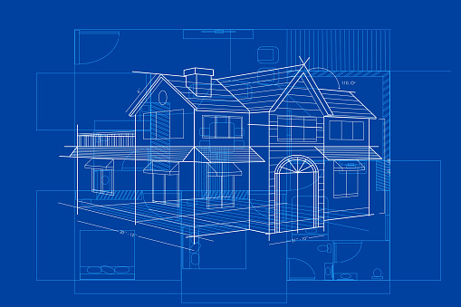
Class
A class is a blueprint or prototype of an object.
It consists of data members and member functions, which can be accessed and used by creating an instance of that class.
For example: Consider house as an object which requires a blueprint i.e,. Class.

Slide 5
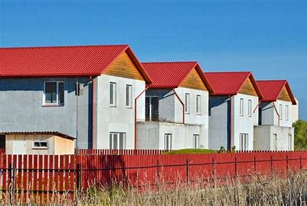
Object
An Object is an instance of a Class.
Basic unit of Object-Oriented Programming and represents the real-life entities.
For example: If we have a single blueprint of a house, we can build any number of houses from it.

Slide 6
Pillars of OOP
Data Abstraction
Encapsulation
Inheritance
Polymorphism
OOPS
Data Abstraction
Encapsulation
Inheritance
Polymorphism

Slide 7
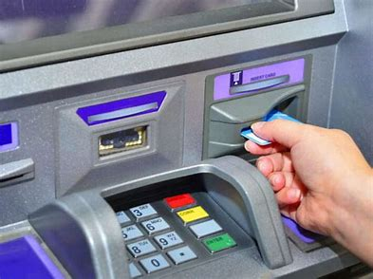
Data Abstraction
Data abstraction refers to providing only essential information about the data to the outside world, hiding the background details or implementation.
For example: A customer using ATMs to perform transactions will not have idea of how the machines works internally.

Slide 8
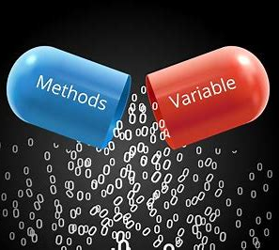
Encapsulation
Mechanism that binds together code and the data it manipulates.
Through encapsulation, data hiding is achieved.
For example: Different drugs are encapsulated into a single medicine capsule.

Slide 9
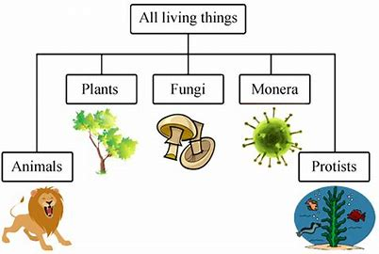
Inheritance
The capability of a class to derive properties and characteristics from another class is called Inheritance.
Inheritance allows the user to reuse the code whenever possible and reduce its redundancy.
For example: Living things are divided into various categories.

Slide 10


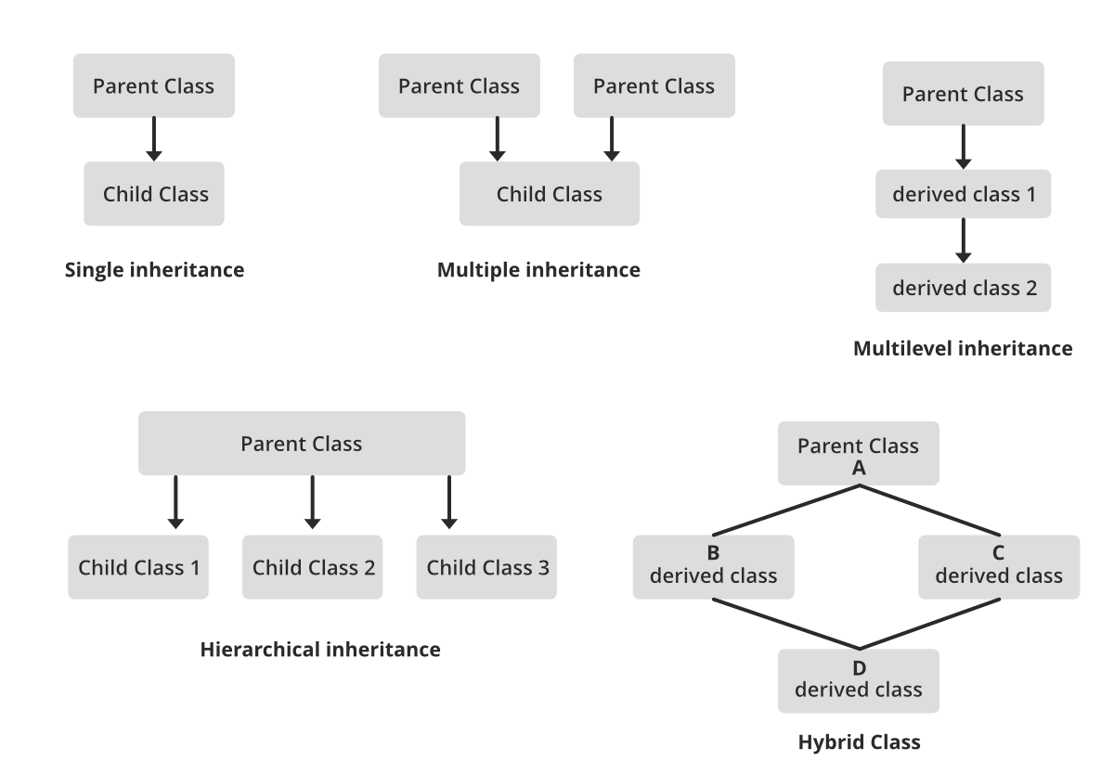


Types of Inheritance

Slide 11
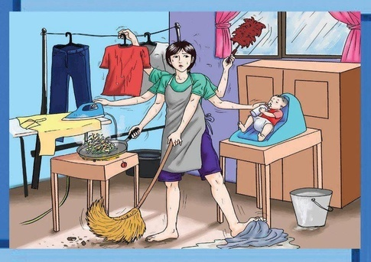
Polymorphism
Polymorphism is the ability of an entity to exhibit more than one form.
Describes situations in which something occurs in several different forms.
For example: A woman plays the role of mother, cook etc.

Slide 12
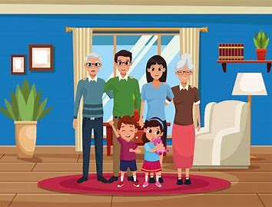
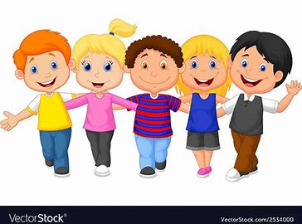
Types of Polymorphism
Compile Time Polymorphism
Run Time Polymorphism

Slide 13

Thank You!!
Ramya Sri Mantripragada
ramya_mantripragada@epam.com

