Slide 1
Loan Default Estimation
PGP-DSE-FT-BLR-JAN-2024
Group Number-3
Team members:
Aathira Rajagopal
Ramyashree S
Abishake N
Agniva Mukherjee
Usha Rani T
Faraz Ahmed Siddiqui

Slide 2
Problem Statement
Objective: Accurately predict loan defaults and understand contributing factors.
Challenges:
High-dimensional data with complex relationships.
Imbalanced classes (defaulted vs. non-defaulted loans).
Temporal aspects of loan performance.
Impact: Improve lending practices, reduce financial risks, and optimize loan portfolios.

Slide 3
Data Collection
Source: Lending Club loan data (2007-2015)
Initial dataset: 100,000 records, 73 features
Key variables:
Loan characteristics: Amount, Term, Interest Rate and Grade.
Borrower Information: Income, Employment and Credit History.
Loan Performance: Payment History and Current Status.
Data quality assessment: Missing values, outliers, and inconsistencies identified.

Slide 4
Data Cleaning
Removed 2,958 duplicate records.
Dropped columns with >30% missing values.
Handled outliers in numerical features (e.g., annual income and Revolving Balance, etc..).
Encoded categorical variables (e.g., Term, Grade and Verification Status, etc..).
Standardized date formats and created derived features.

Slide 5
Exploratory Data Analysis (EDA)
Key findings:
Loan Term: 36-month loans have lower default rates (15%) compared to 60-month loans (25%).
Loan grade: A and B grade loans show significantly lower default rates (<10%).
Loan purpose: Debt consolidation and credit card refinancing are most common (>60% combined).
Income verification: Verified incomes associated with slightly lower default rates.
Geographical trends: Certain states (e.g., Nevada, Florida) show higher default rates.

Slide 6
Data Preprocessing
One-hot encoding: Created binary features for categorical variables.
Feature binning: Grouped continuous variables into meaningful categories.
Feature scaling: Standardized numerical features to ensure comparability.
Handling imbalanced data: Applied SMOTE (Synthetic Minority Over-sampling Technique).
Dimensionality reduction: Performed Principal Component Analysis (PCA).

Slide 7
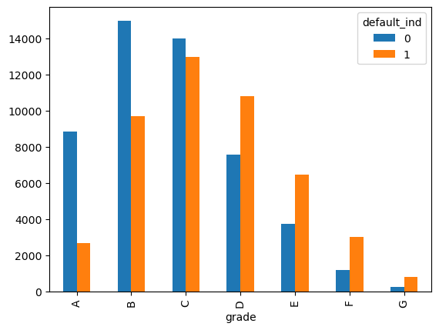
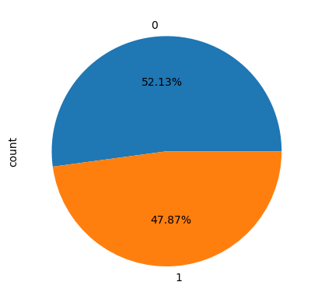
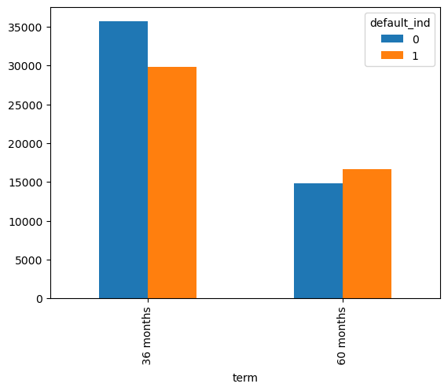
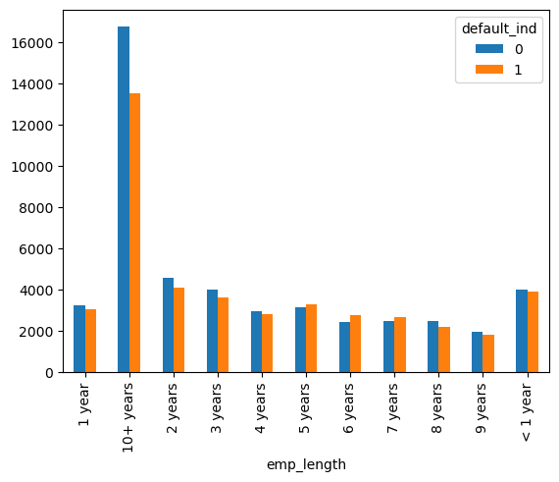
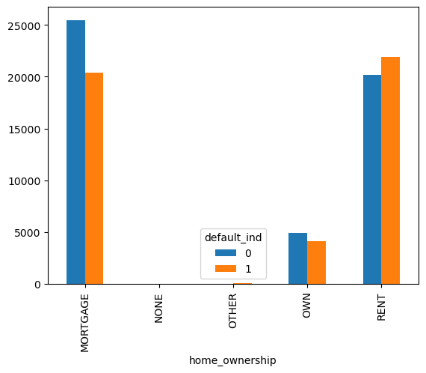
Visualization of Categorical Variables

Slide 8
Feature Engineering
Created new features:
Debt-to-income ratio buckets.
Credit history length.
Total credit utilization.
Payment-to-income ratio.
Interaction terms between key variables (e.g., loan amount and interest rate).

Slide 9
Model Building
Models developed and compared:
Logistic Regression
Logistic Regression with Outlier Treatments.
Logistic Regression with PCA.
Random Forest Classifier.
Hyper Parameter Tuning.
Tuned Random Forest.
Extreme Gradient Boost (XGBoost).

Slide 10
Model Evaluation: | Training Scores: |  | Testing Scores:
 | Class0 | Class1 | Class0 | Class1
Logistic Regression Base Model | 1.00 | 0.98 | 1.00 | 0.98
Logistic Regression after Outlier Treatment | 1.00 | 0.98 | 1.00 | 0.98
Logistic Regression with PCA Data | 0.99 | 0.85 | 0.99 | 0.85
Random Forest | 1.00 | 1.00 | 1.00 | 0.98
Tuned Random Forest | 1.00 | 1.00 | 1.00 | 0.98
XGBoost | 1.00 | 1.00 | 1.00 | 0.99
Smote Analysis | 1.00 | 1.00 | 1.00 | 1.00
Logistic Model after Binning | 0.98 | 0.98 | 0.98 | 0.98
Logistic Model after Binning with PCA | 0.96 | 0.95 | 0.96 | 0.95
Random Forest after Binning | 1.00 | 1.00 | 0.99 | 0.99

Slide 11
Results and Discussion
Top predictors of loan default:
Outstanding Principal.
Last Payment Date.
Total Principal Received.
Recoveries
Loan Issue Date
Interest Rate
Installment
Model insights:
Non-linear relationships between features and default probability
Interaction effects between loan characteristics and borrower profiles
Temporal patterns in payment history highly indicative of default risk

Slide 12
Business Insights
Implement risk-based pricing: Adjust interest rates based on predicted default probability
Enhance credit policy: Focus on key risk factors identified by the model
Develop early warning system: Monitor ongoing loan performance using model predictions
Optimize loan portfolio: Balance risk and return across different loan grades and purposes
Personalized loan offers: Tailor loan terms based on individual borrower risk profiles

Slide 13
Conclusion:
Comprehensive analysis reveals key factors in loan defaults, offering strategies for risk minimization and optimized loan portfolio management.
The most important features identified for influencing loan defaults, in line with the business objective of using machine learning techniques to enhance decision-making, reduce risk, and improve profitability for lending institutions, are outstanding Principal, last payment date, total recovered principal, loan issued year, interest rate, total recovered interest, and instalment amount.
Clustering technique has leveraged the organization to identify delinquent cases having high risk associated with them so that primitive steps can be initiated at early stages in order to save losses and mitigating the risk associated with such cases.

