Slide 1
AllergyGuardAI
AI-powered allergen and calorie checks for packaged foods.

Slide 2
Millions of people worldwide have food allergies, dietary restrictions, or conditions like diabetes.
Reading and interpreting ingredient labels for allergens, calories, and sugar content can be confusing or time-consuming.
Risk of accidental allergen exposure or excessive sugar intake can lead to serious health complications.
Current tools lack instant, AI-powered analysis that explains food safety in simple, personalized terms.

Slide 3
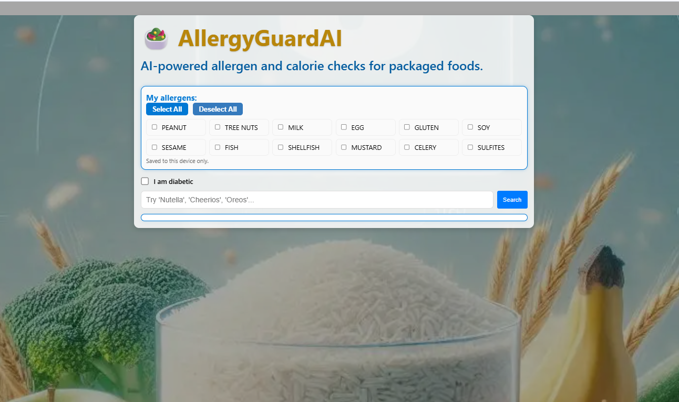
AllergyGuardAI – Startup View Select allergens, check diabetic option, and search packaged foods instantly.

Slide 4
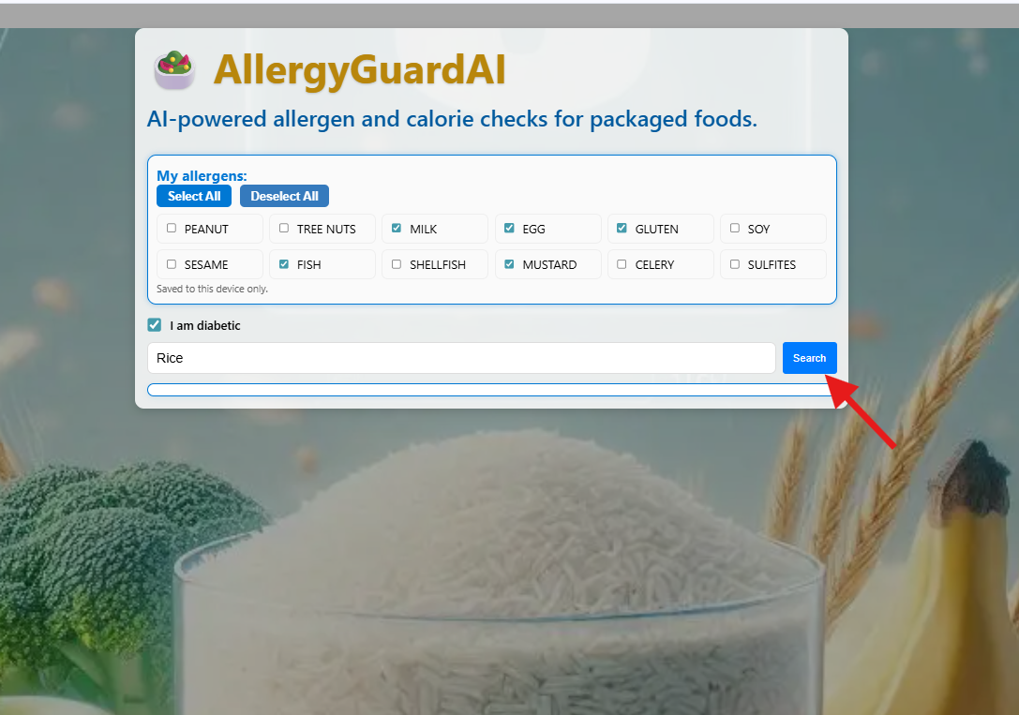
In this example, the user has selected specific allergens (Milk, Egg, Gluten…) and enabled the
"I am diabetic" option.
By typing “Rice” in the search bar and clicking Search, the application will instantly:
Check the product for the selected allergens.
Calculate calories and sugar content.
Apply diabetic-specific safety checks, highlighting products with high sugar levels.
The results will provide clear “Looks clear” or “Allergen risk” tags, along with nutrition details tailored to the user’s needs.

Slide 5
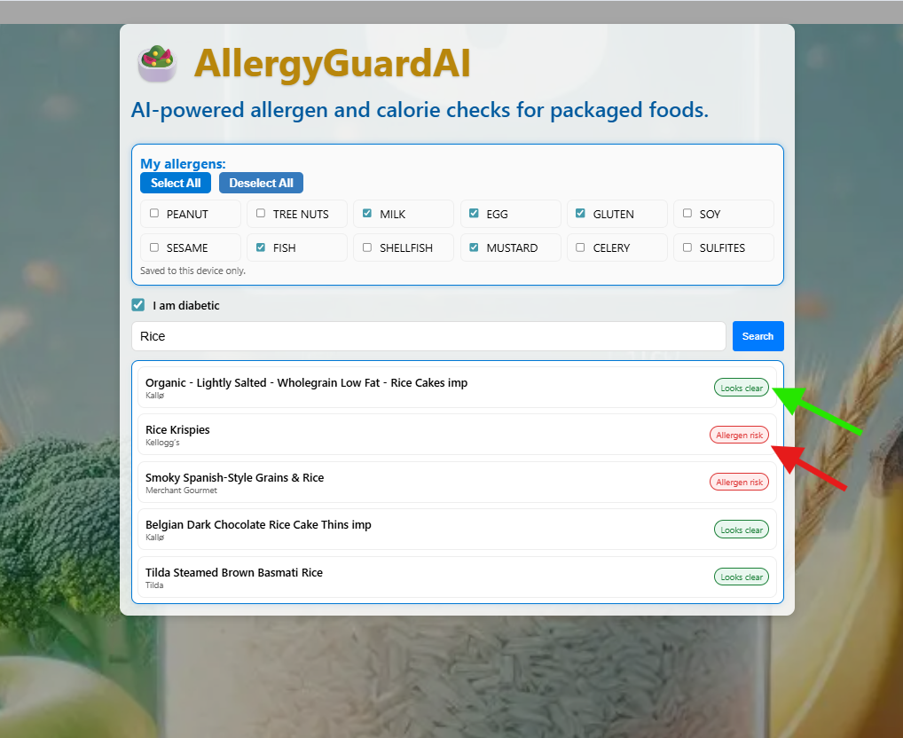
Lists all the packaged food with selected allergies and highlighting the food that has allergy.
Green – "Looks clear": No selected allergens detected
Red – "Allergen risk": Contains one or more selected allergens

Slide 6
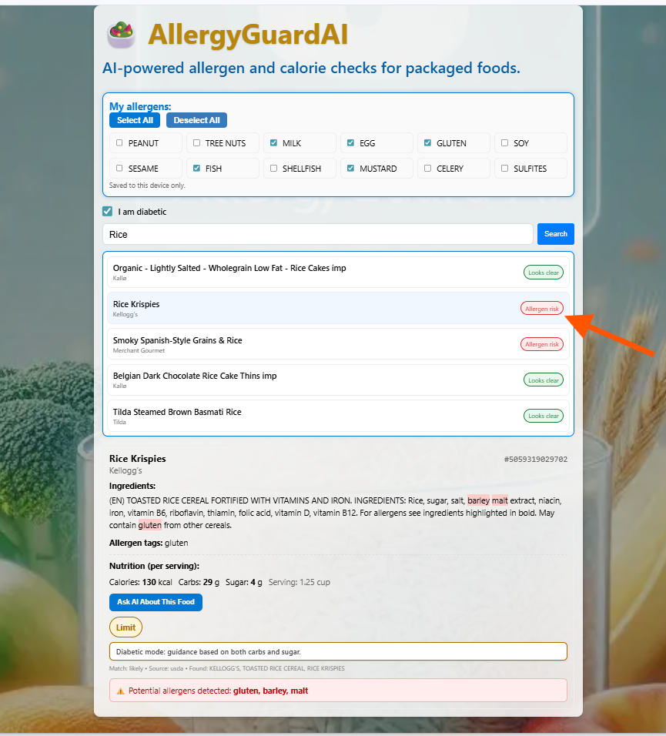
Detailed View – Rice Krispies
Marked Allergen risk (contains gluten).
Ingredients list with allergens highlighted.
Allergen tags: gluten.
Nutrition per serving: 130 kcal, 29g carbs,
4g sugar.
Diabetic mode: “Limit” (based on carbs & sugar).
Potential allergens: gluten, barley, malt.
Ask AI About This Food for extra analysis.

Slide 7
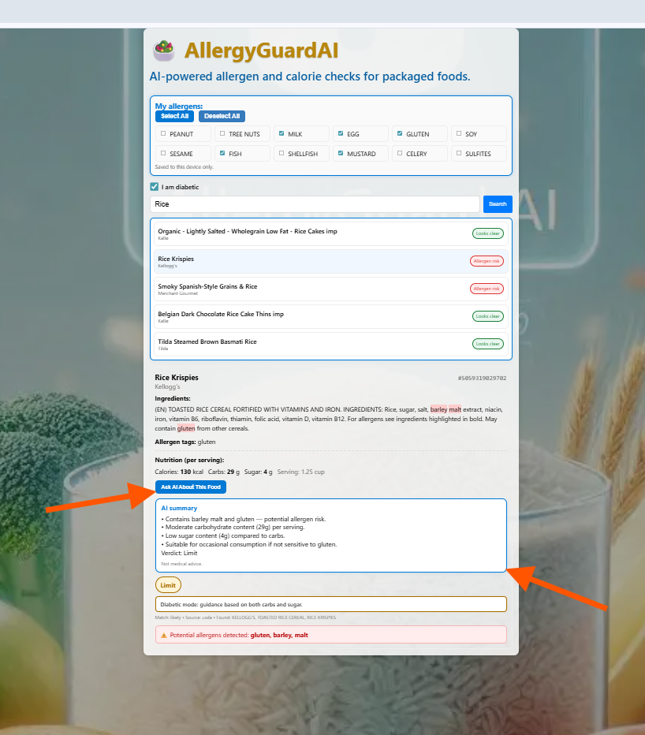
Clicking Ask AI About This Food generates an AI-powered nutritional and allergen summary.
AI analyzes:
Allergen risks (e.g., barley malt, gluten).
Sugar content and diabetic suitability.
Serving size and calorie considerations.
Usage recommendations (e.g., “Limit” for diabetics).
Provides a quick, user-friendly interpretation of the product’s health impact.
Ask AI about this food

Slide 8
Technology Used
Frontend:
React.js – UI development
TypeScript – Strongly typed code for better reliability
CSS – Custom styling for responsive layout
Backend:
Node.js + Express – API handling and server logic
OpenFoodFacts API – Ingredient and allergen data
USDA API – Nutrition (calories, carbs, sugar) data
AI Integration:
OpenAI API – AI-powered allergen and nutrition summaries
Other Tools:
GitHub – Version control
Visual Studio Code – Development environment

Slide 9
Future Enhancements
Barcode Scanning – Instantly fetch product details using a mobile camera.
Voice Search – Search for products hands-free.
Offline Mode – Save allergen preferences and cached product data for use without internet.
Expanded Database – Include more international food products.
Multi-Language Support – Cater to non-English-speaking users.
Dietary Filters – Add support for vegan, keto, low-sodium, and other diet types.
User Profiles – Save and sync preferences across devices.
AI Chatbot – Offer interactive dietary advice and meal suggestions.

