Slide 1
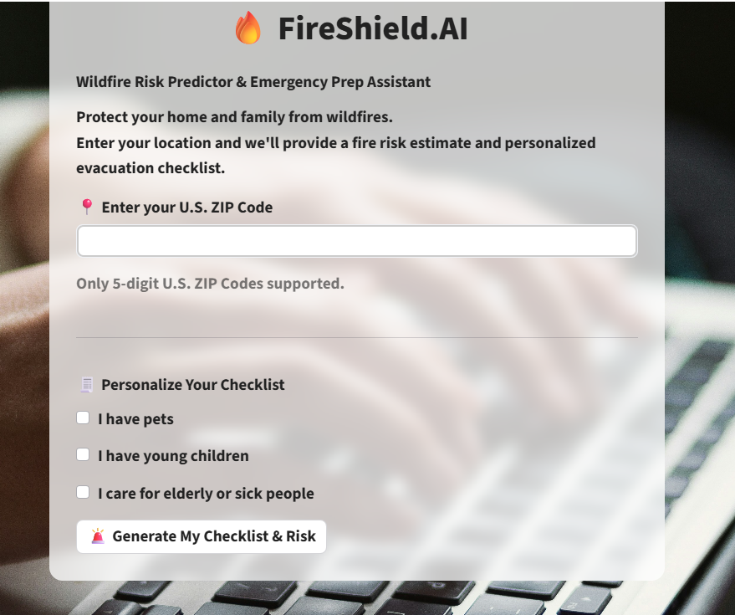
FireShield.AI – Wildfire Risk Detection & Shelter Locator
A Streamlit-powered AI Web App for Public Safety
When application launched first screen

Slide 2
What is FireShield.AI?
Detects wildfire risk by ZIP code
Locates nearby emergency shelters
Interactive map display
Built for safety and social good

Slide 3
Tools Used
Python & Streamlit
Pydeck for map visualization
Zippopotam.us & ArcGIS APIs
GitHub for version control

Slide 4
Get ZIP Coordinates
Uses Zippopotam.us API to fetch latitude and longitude for a ZIP code

Slide 5
Fire Risk Detection
Uses Haversine formula to detect proximity to wildfire hotspots

Slide 6
Locate Nearby Shelters
Pulls data from ArcGIS Shelter API or fallback CSV to display emergency shelters

Slide 7
Map Display
Displays user location and shelters using Pydeck map in Streamlit

Slide 8
Streamlit UI Design
Implemented custom CSS for a clean, user-friendly design

Slide 9
Upload to GitHub
1. Created GitHub repository
2. Uploaded code and README
3. Added project description

Slide 10
Final Thoughts
Saves lives with real-time location info
Clean and interactive interface
Live fire data & alerts, alternate fall back to offline data. Governments publishes when the fire in the state, it allocates schools, collages and churches as shelters. We can update fallback offline data in case if live data is not available.

Slide 11
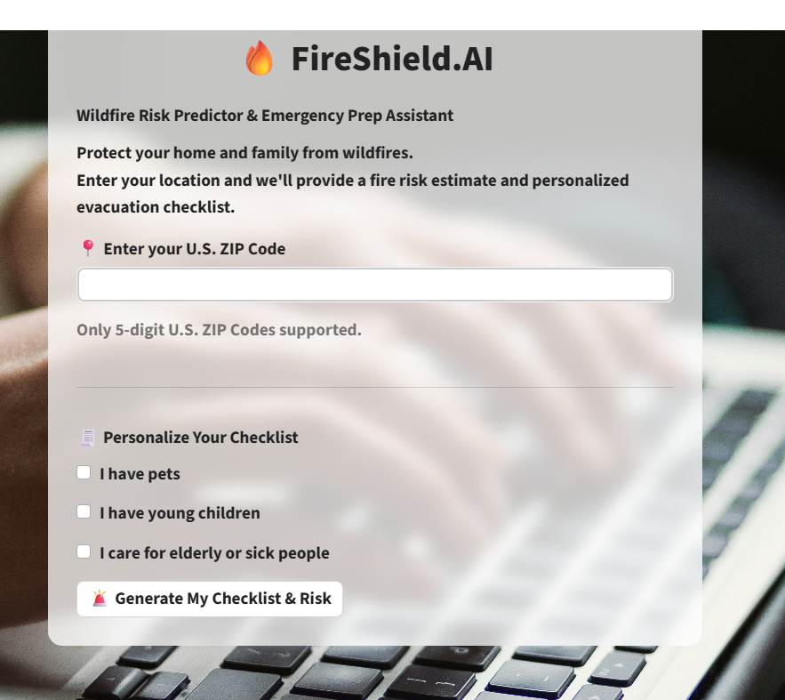
First application launch screen

Slide 12
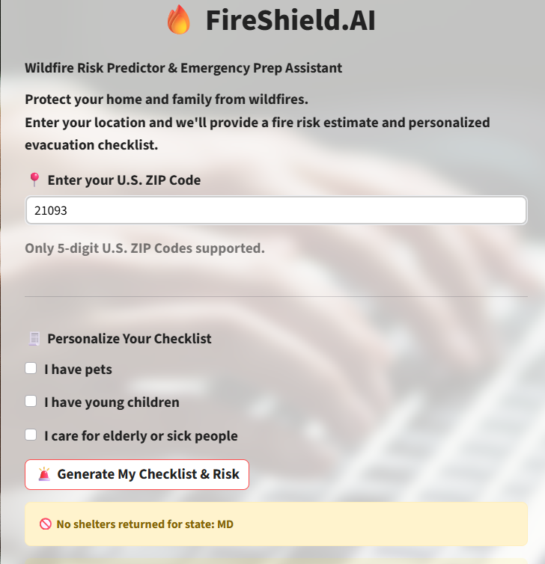
Search by zip code

Slide 13
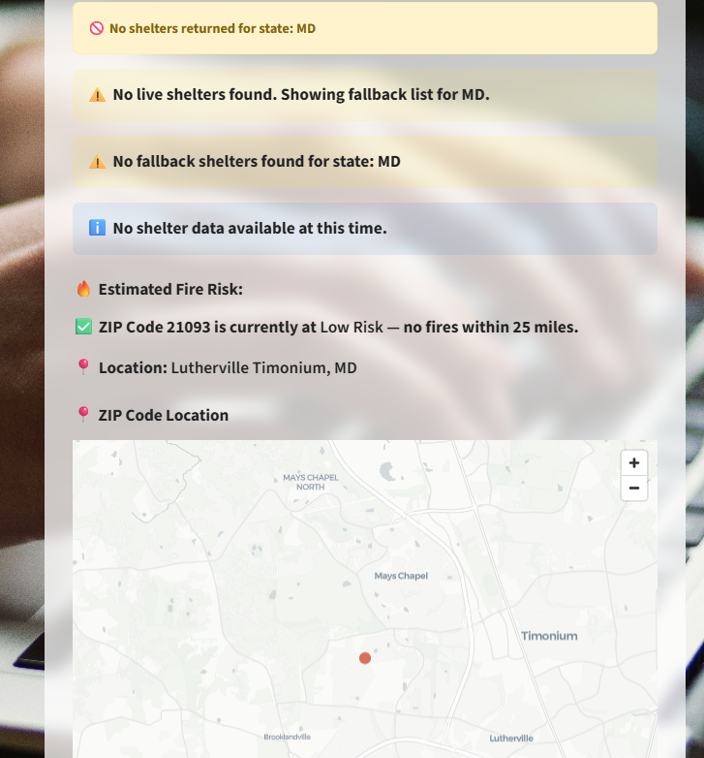
No shelter and map for the searched zip code and estimated risk

Slide 14
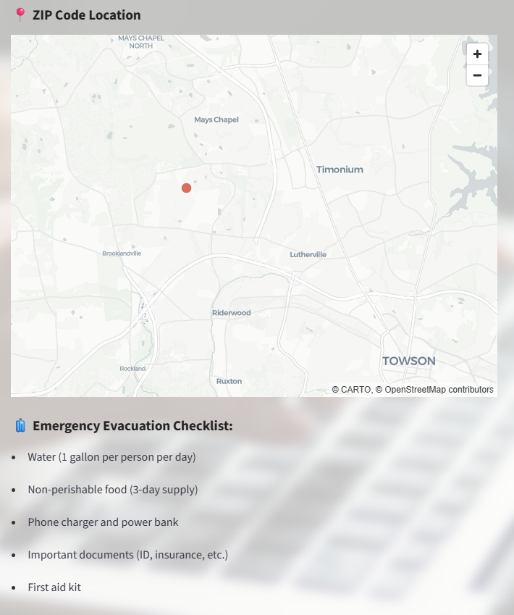
Emergency evacuation checklist before selecting personalized checklist

Slide 15
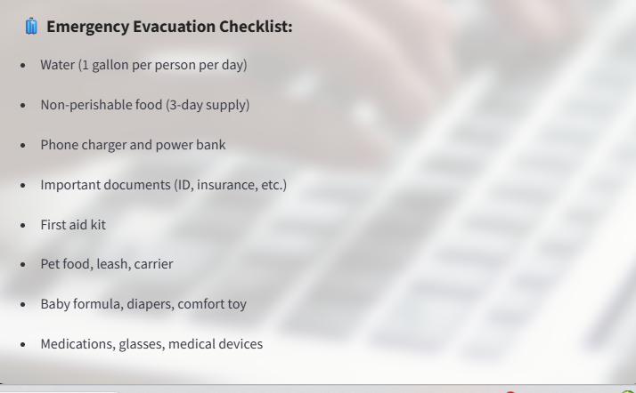
Emergency evacuation checklist after selecting all personalized checklist

Slide 16
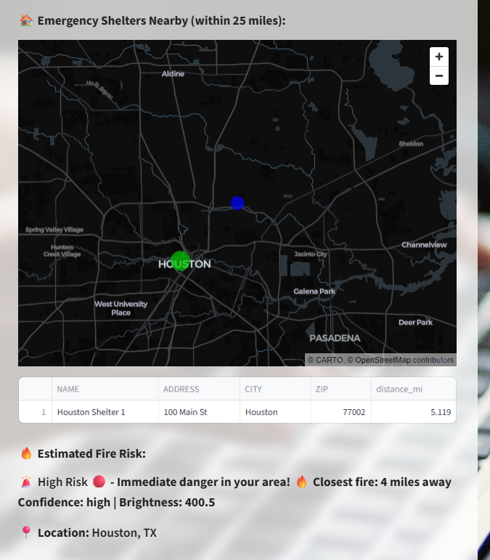
Search zip code 77001 Houston, Texas ( high risk). Showing nearly shelter by fallback list(since live data does not have any shelter). Blue dot represents searched zip, green dot represents shelter(on mouse over it shows zip and shelter respectively)

Slide 17
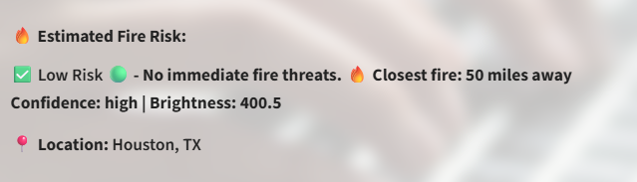
Conti.. Fire risk estimated. Fire 50 miles away(Low Risk)

Slide 18
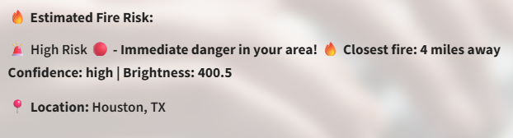
Conti.. Fire risk estimated. Fire <5 miles away(High Risk)

Slide 19
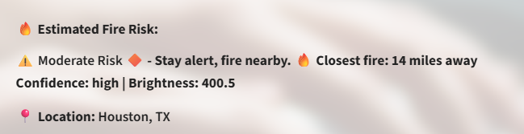
Conti.. Fire risk estimated. Fire <5 miles away(Moderate Risk)

Slide 20
How It Works – At a Glance
1. User enters a U.S. ZIP code
2. Application determines location coordinates
3. Fire risk is estimated using dummy or real fire data
4. Nearby emergency shelters are located (live or fallback)
5. Visual map with tooltips and checklist is displayed

Slide 21
Unique Features
✅ Combines real-time and fallback data seamlessly
📍 Visual map with ZIP code and shelter tooltips
🧳 Generates personalized evacuation checklist
💡 Works even if live shelter data is unavailable
🌐 Built using Streamlit, pydeck, Pandas, and REST APIs

Slide 22
Final Thoughts
🎯 Impact:
- Instantly helps users evaluate wildfire risk
- Provides shelter guidance within 25 miles
- Supports users in preparing an emergency checklist
🚀 Future Work:
- Integrate NASA MODIS/VIIRS real-time fire data
- Add alert system via email or text message
- Introduce multilingual interface for broader access

