Slide 1
Test Driven Development with JUNIT and Mockito

Slide 2
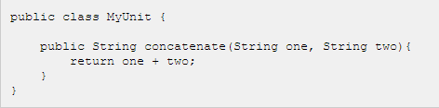
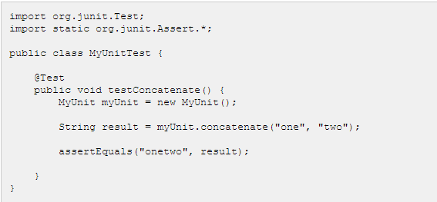
Introduction to Unit Testing/Junit
A unit test is a piece of code written by a developer that executes a specific functionality in the code to be tested and asserts a certain behavior or state.
JUnit is a unit testing framework for the Java Programming Language. It is important in the test driven development, and is one of a family of unit testing frameworks collectively known as xUnit.

Slide 3
Uses of Test driven development
Test Driven Development
Better understanding of what you're going to write
Enforces the policy of writing tests a little better
Speeds up development

Slide 4
Mockito
Mokito is used for unit testing in test driven development. This is a framework which can be used in conjunction with junit. Mockito allows to create and configure mock objects.
Mockito allows developers to test the units in isolation without interacting with other units though they are dependent on them.
This is done by mocking the dependent units.
Mock objects(units) are virtual objects that acts as if they are real objects, but behave based on how we configure them.

Slide 5
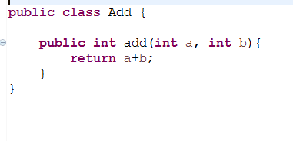
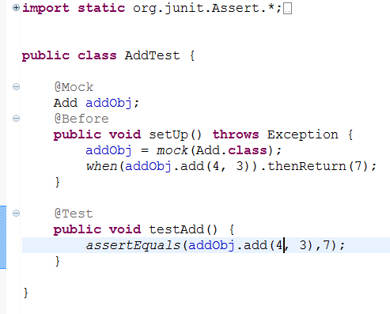
Sample Implementation

