Slide 1
Online Banking System Project
Internet Programming Class
Presented by:
Kodanda ramu yanamalachintala

Slide 2
Introduction
This project applies the skills learned in the Internet Programming class by developing an online banking system using ASP.NET Core MVC and C#. It aims to simulate real banking operations and improve customer and teller interactions through an online platform.

Slide 3
Identity and Roles Implemented
For Identity, I used ASP.NET identity tables for user authentication and role management.
The system features three main roles:
Manager (future development)
Customer: Registration, login, bill pay, account management
Teller: Account search, transaction management

Slide 4
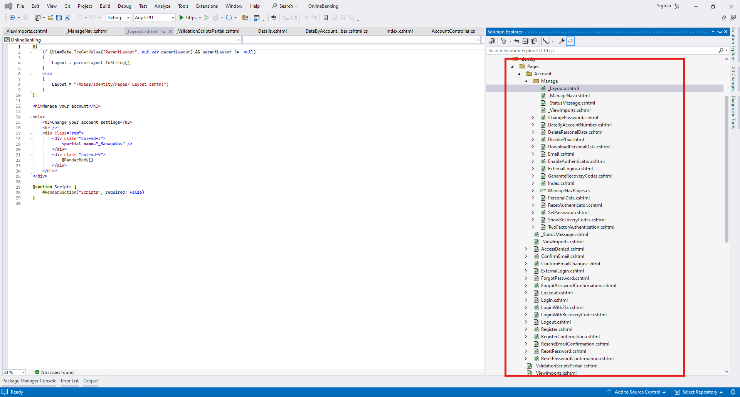
Identity Code from .Net

Slide 5
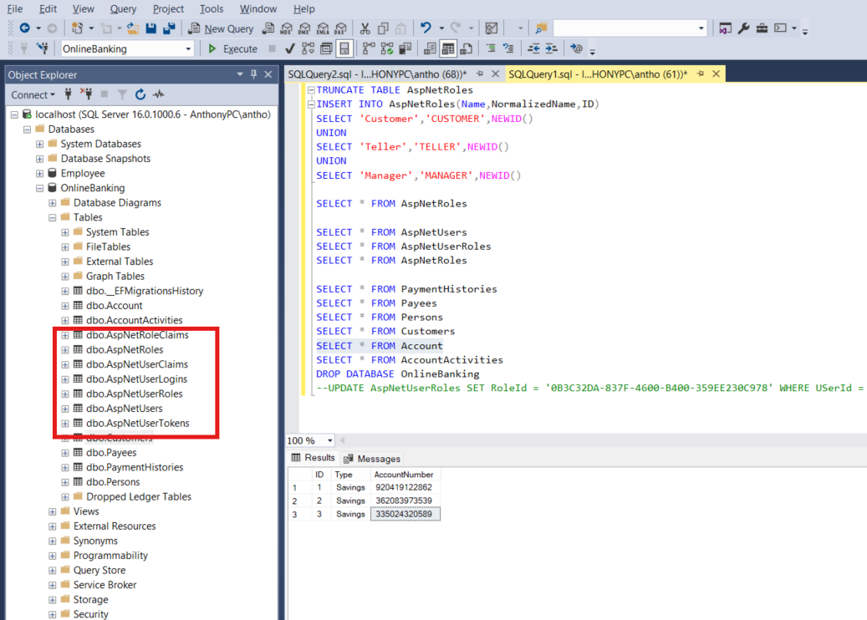
Database tables for ASP.NET Identity

Slide 6
Register and Login user
Customers can register and log into their accounts to manage personal information, review account balances, and perform transactions such as paying bills and adding payees.

Slide 7
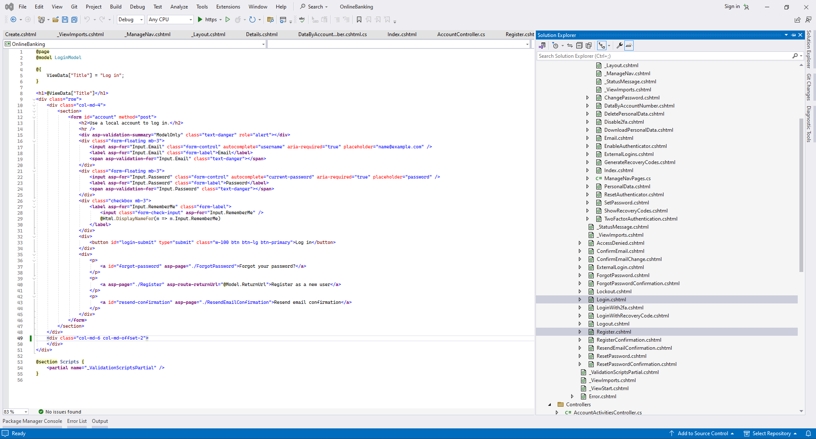
Code Sample

Slide 8
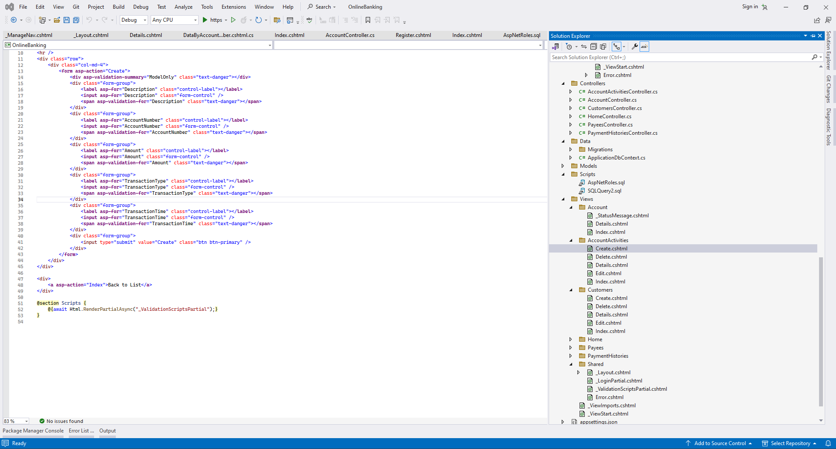
Account Activities
Customer can look at their account activities and manage transactions.

Slide 9
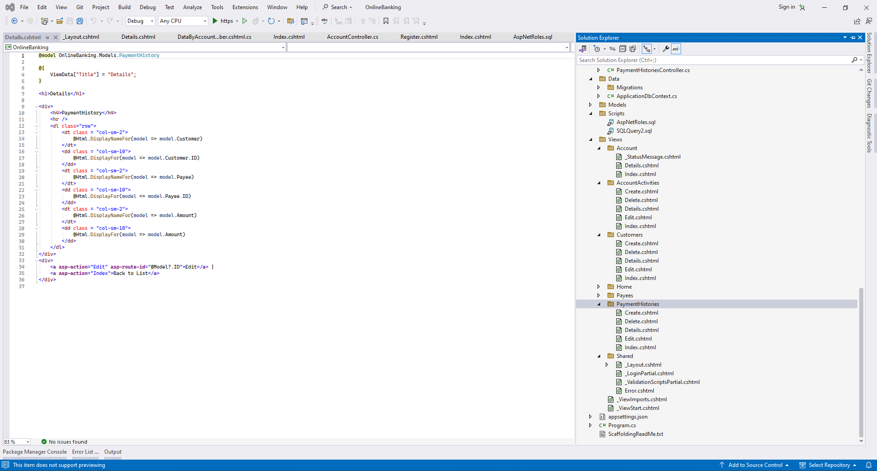
Payment Histories
The customer can look at the payment histories that are made on their account

Slide 10
Database Design
The database consists of tables such as Customers, Account, AccountActivities, Payees, and PaymentHistories. ASP.NET Identity tables are used for secure authentication and authorization processes.
Please find the Database SSMS screenshot in the next slide where it contains all the tables and sample data inserted.

Slide 11
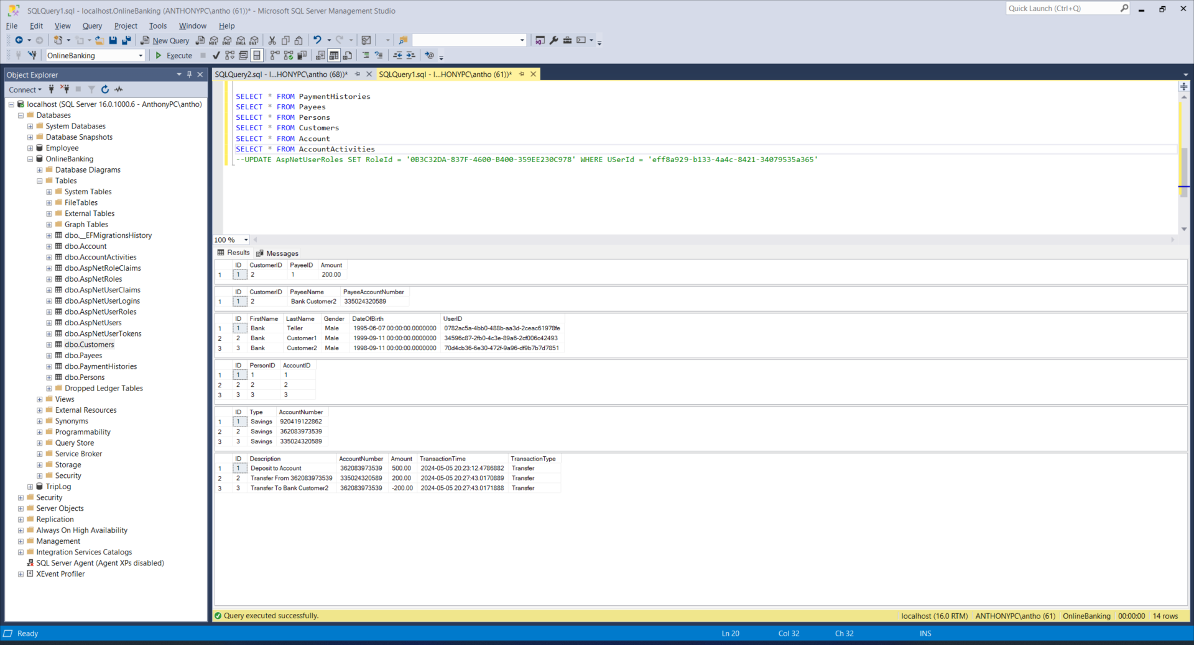
Data tables

Slide 12
Security and User Experience
Security is enforced through ASP.NET Identity, supporting secure login, password hashing, and user session management. The application uses HTTPS for secure data transmission and a user-friendly interface for easy navigation.

Slide 13
Skills Applied
Skills from the Internet Programming class utilized in this project include ASP.NET Core MVC, C#, Entity Framework, and frontend technologies like HTML, CSS, and JavaScript.

Slide 14
Conclusion
This project showcases a practical application of classroom learning to a real-world project, with potential for future enhancements including more comprehensive manager functionalities.

Slide 15
Questions
Thank you for your attention. Are there any questions?

