Slide 1
Sky Track: Aviation Data Pipeline and Analytics By
KODANDA RAMU, YANAMALACHINTALA

Slide 2
Project Info
This relates to the aviation project, focusing on how environmental factors affect flight takeoff and landing events. We collect historical flight data spanning from October 2023 to October 2024. Additionally, we gather environmental data to identify delays caused by weather conditions affecting takeoff or landing.
We analyze the data to report the top 10 delays attributed to environmental factors during this period and map these delays to corresponding weather data. Using standard metrics established by the aviation department, we evaluate and categorize the delays in landing and takeoff. This allows us to determine if specific weather events on a given day were responsible for the delays.

Slide 3
Technologies Used in the Project
Programming Languages: MySQL, Python, Pyspark,
Cloud Environment : Microsoft Azure
Azure Resources : Azure Data Factory, Azure Data Bricks, Key vault, Azure Sql DB
Reporting : Power Bi

Slide 4
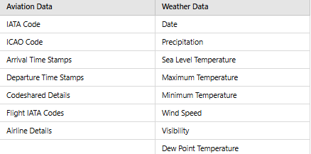
Data Required ..?

Slide 5
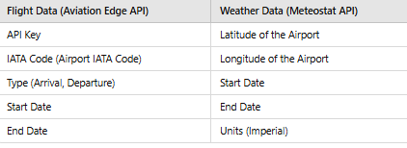
Dat Sources and its Parameters

Slide 6
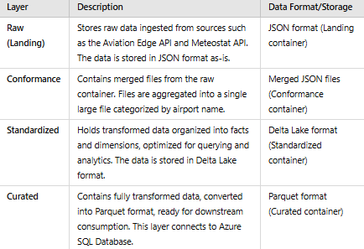
Storage Architecture

Slide 7
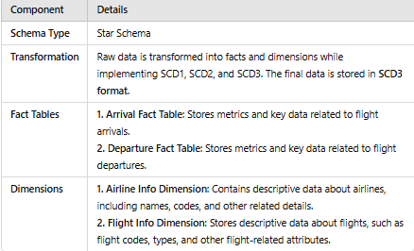
Data Modelling

Slide 8
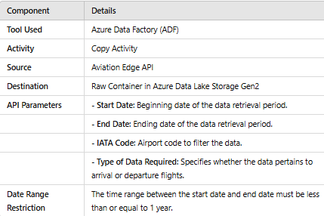
Azure Data Factory Copy Activity: Aviation Edge API to Raw Container

Slide 9
Ingestion Process of Aviation Edge
The given set of dates must be validated before passing them to the API to ensure compliance with the Date Range Restriction. To achieve this, a Python module is created in Databricks, which retrieves values from the Lookup Activity.
The Lookup Activity uses a CSV file that holds the values for the start date and end date. Additionally, Azure Key Vault is utilized to securely pass the API key to the Copy Activity in an encrypted manner, ensuring the API key is not hardcoded.

Slide 10
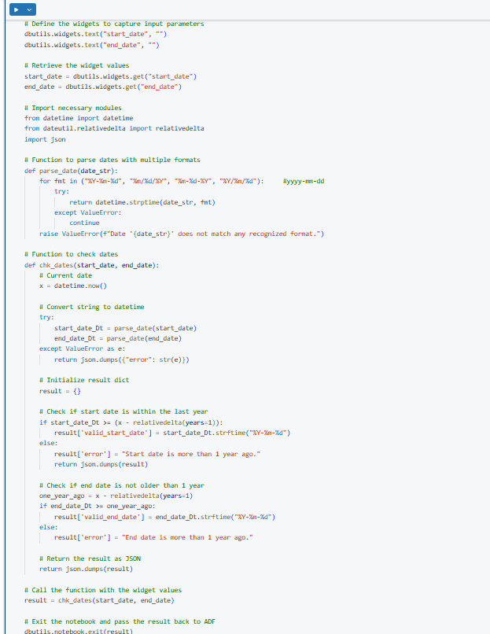
Dates Check-Code

Slide 11
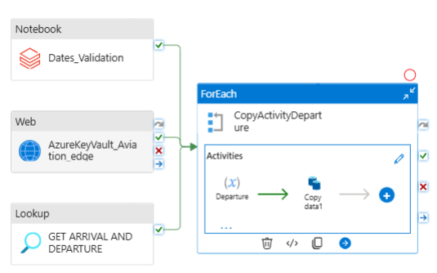
Ingestion Process Overview-Pipeline Level

Slide 12
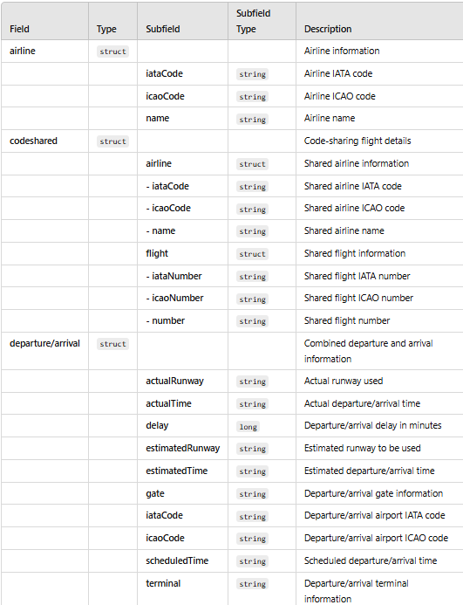
Transformations – Aviation Edge API-raw Data
The raw container holds the raw data that is in the format of json in with the below schema
Data Ingested are the arrival data : LAX,SFO,MIA
Data ingested for the departures are :ORD,JFK,LAX
Data ingested for the time stamp of 10/11/2023-10/31/2024
Total number of rows ingested across all the dataframe:5838408

Slide 13
Transformation –Raw to Conformance
Files for each airport were merged into a single file per airport, consolidating data from the entire time range (10/01/2023 - 10/31/2024). The resulting files were named as single data files, containing all the relevant data for the specified period.
The total rows copied were verified and successfully matched. The Delta files were named according to the type of data they contained, such as type=arrival or type=departure.
The data format was transformed from JSON to Delta tables, with transformations performed in Databricks. Additionally, the process ensured that the schema was consistently followed throughout the transformations.

Slide 14
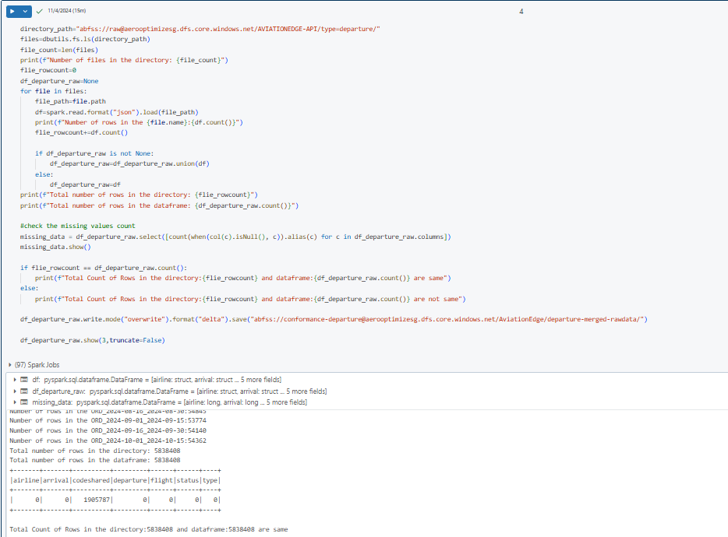
Raw Container to Conformance Container

Slide 15
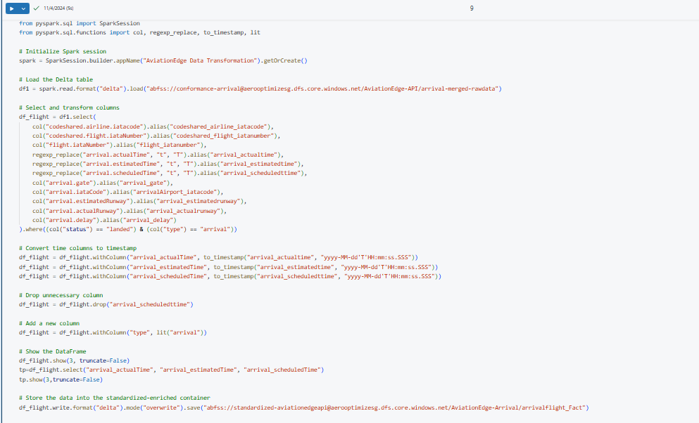
Fact Table : Arrival Flight/Departure Flight

Slide 16
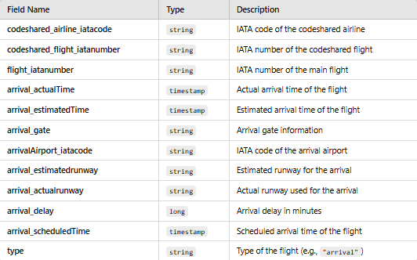
Schema of the Fact Table

Slide 17
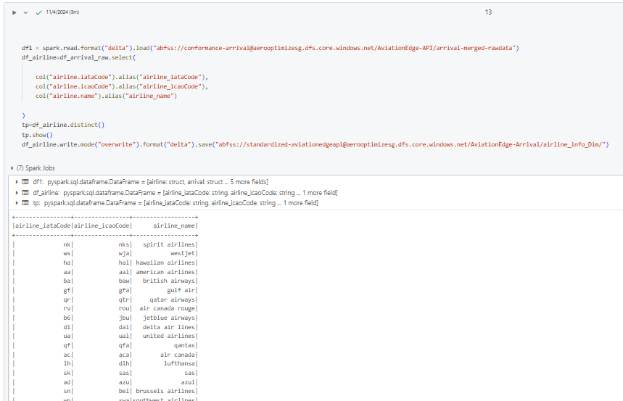
Airline Dimension

Slide 18
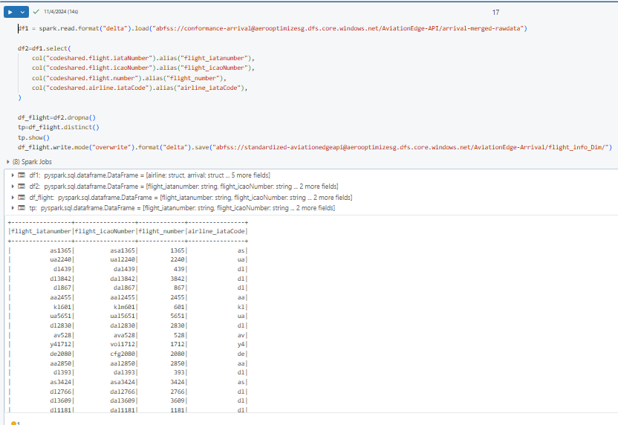
Flight Dimension

Slide 19
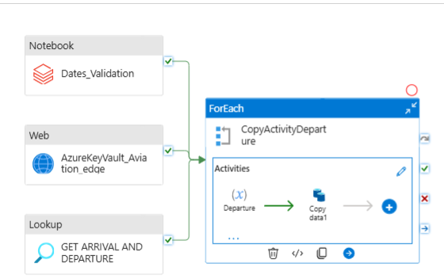
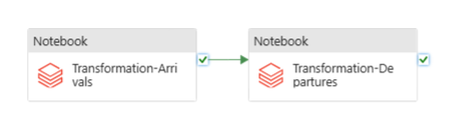
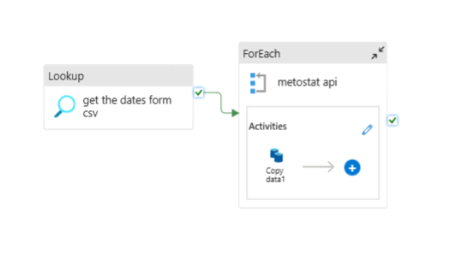
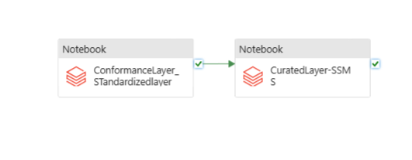
Pipeline Overview for the Flight Data and Weather Data

Slide 20
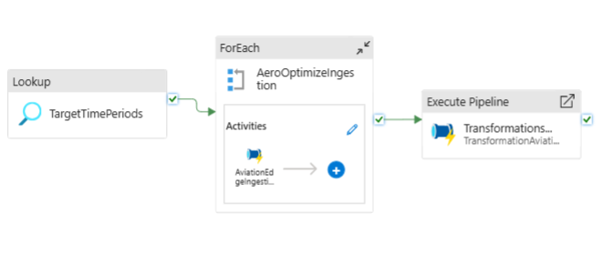
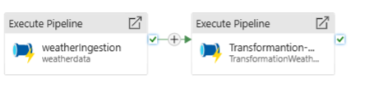
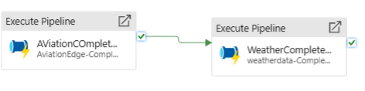
ETL Pipeline –Sky Scrapper

Slide 21
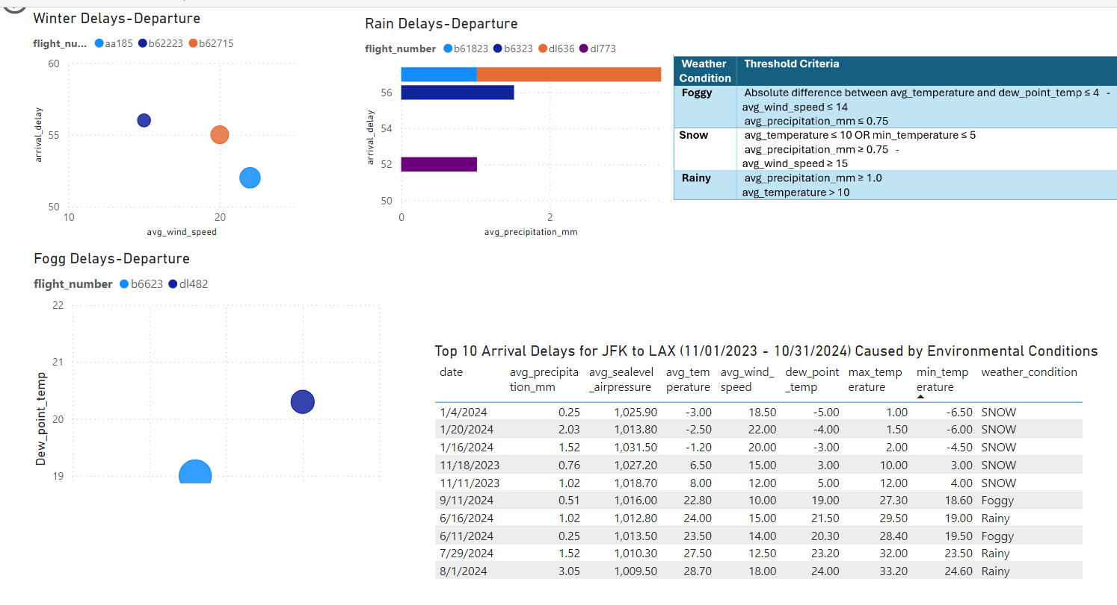
Top 10 Departure Flight Delays Caused by Environmental Conditions on Flights from JFK to LAX

Slide 22
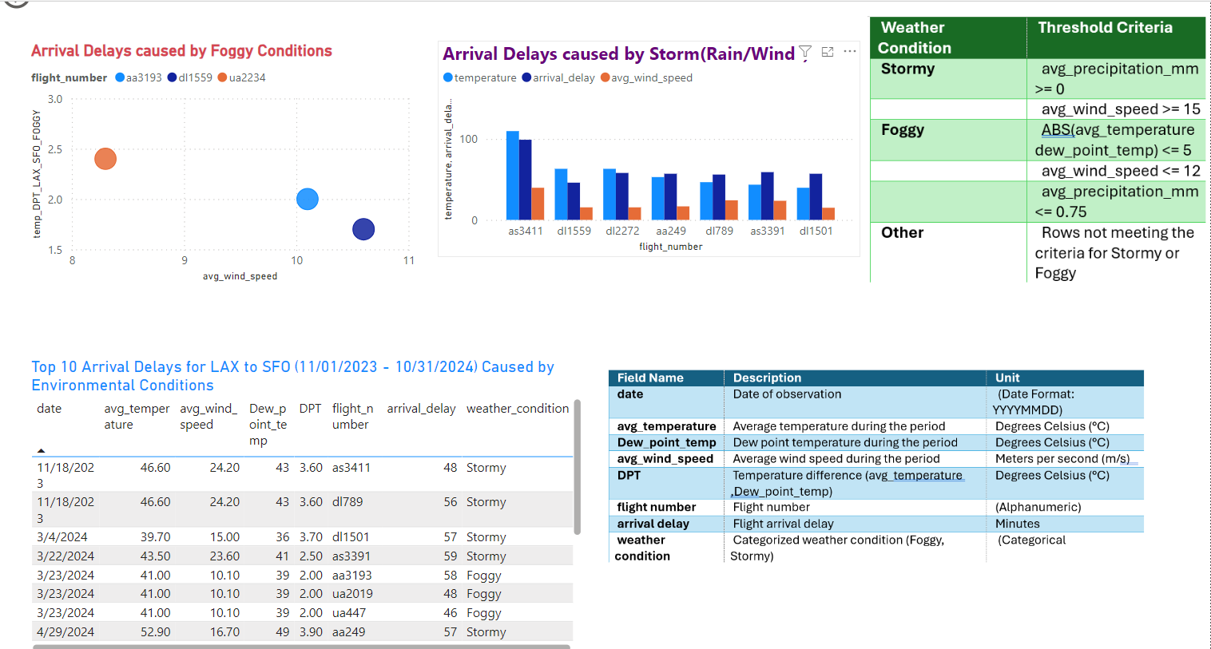
Top 10 Arrival Flight Delays Caused by Environmental Conditions on Flights from LAX to SFO

Slide 23
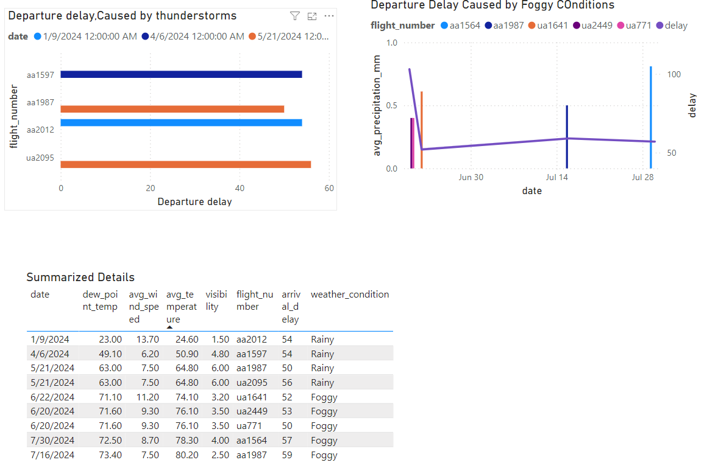
Top 10 Departure Flight Delays Caused by Environmental Conditions on Flights from ORD to LAX

Slide 24
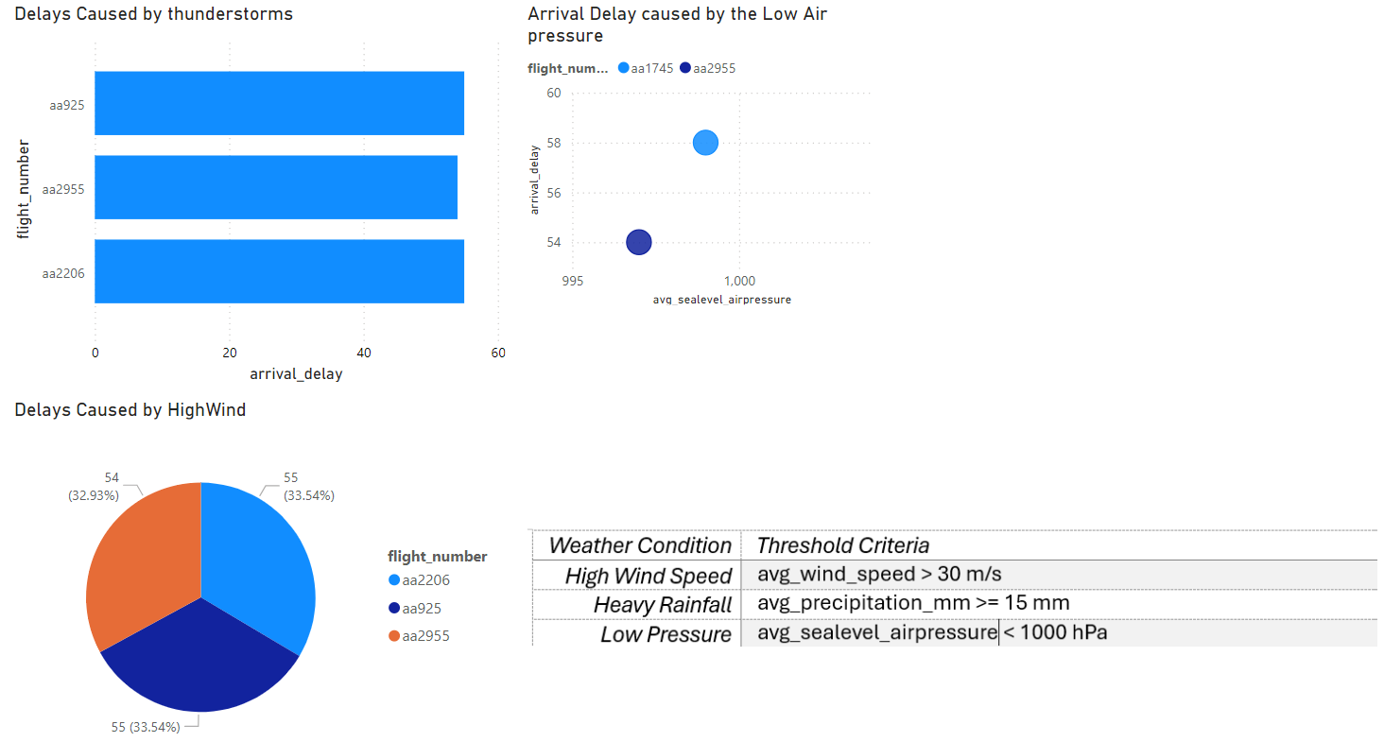
Top 10 Departure Flight Delays Caused by Environmental Conditions on Flights from DFW-MIA-High Speed

Slide 25
Thank You
“One World –One Family”

