Slide 1



Time-Series Forecasting for Predicting Sustainable Performance of Companies
Georgia Institute of Technology
CS6748 Practicum, Jul 2024
Final Presentation
Team 2: R. ElGendi, S. Lee, M. Palfenier
Notes:
Lee: Good morning and good afternoon everyone. This is Sinnie from Team 2.

Slide 2
Agenda
1
4
Key Factors influencing Sustainability
and Multivariate Model results
Final: Sprint 2
Comparison between Sprint 1 vs Sprint 2
2
5
Exploratory Data Analysis 2
Additional Findings, fillna & outlier
Additional Research Questions
Explicit Sustainability Commitment
Challenges with forecasting techniques
Actionable insights - Investor and stakeholder
3
6
Q&A
Forecasting Model Comparison
Performance accuracy
Notes:
Lee
Here is our agenda today. In this presentation we will go over the Sprint 2 results, what’s changed between Sprint 1 vs Sprint 2, additional findings after reflecting on Sprint 1 results, then we will walk through the forecast results with Mean Squared Error as the metric in deciding our final choice of our forecasting model. We will briefly talk through key factors influencing sustainability followed by addressing the additional research questions directly.

Slide 3
1 Forecasting Sustainability Metrics SPRINT 2 Modeling & Addressing Key Questions
What’s changed:
Sprint 1 was focused on establishing hypothesis given literature reviews, analyze the trend amongst the twelve-features; industries, countries, organization commitments, and its impact on the sustainability trajectory using univariate forecasting models, identify potential recharacterization of the features to reduce sparse-matrix driven by categorical features (e.g. country=57, industry=155).
Sprint 2 takes both univariate and multivariate forecasting approach given the correlation matrix and feature selection to train the prediction model to suggest possible future sustainability outcome of the company on YoY basis provide insights to investors and stakeholders. The results could serve as an indicator for the company’s operational efficiency, industry trend and challenges that carbon intensive vs services industry face and rigor needed in the regulation to reduce the emission at an absolute level.
Addressing key question:
How do different forecasting model perform in capturing the dynamic nature of sustainability over time? (page 5-18)
What are the key drivers and factors influencing the variability of sustainability indicators over time? (page 19-20)
Do organization with explicit commitment towards achieving global net zero emission, or target to reduce CO2 emissions, differ in their forecasted sustainability trajectories with respect to those without such commitment? (page 21)
What are the challenges associated with relying on forecasting techniques to predict the future sustainability performance of companies? (page 22)
How would the model perform when limited historical data is available for a given company and what is the minimal historical depth required to apply any meaningful forecasting technique? (page 22)
How do you anticipate that the integration of the forecasting technique could contribute to providing investors and stakeholders with actions insights regarding the future sustainability performance of companies? Is there any literature regarding this relationship? (page 22)
Notes:
Lee
Sprint 1 was focused on establishing hypothesis, understand the data we are given vs literature findings. As Clarity suggested that we conduct one complete cycle, we drilled into univariate forecasting models first picking individual features and understanding the trend and contextual background of emission reporting and industry consensus. It helped us to understand the limitations associated with the limited data, outline the assumptions, and comprehend complex models better in Sprint 2.
In the grey box, every key questions have page number indicated for you to read over after the presentation.
Before we dive into the model results, let’s take a moment to acknowledge additional findings during EDA as it will be reflected in multivariate ARIMA model.

Slide 4
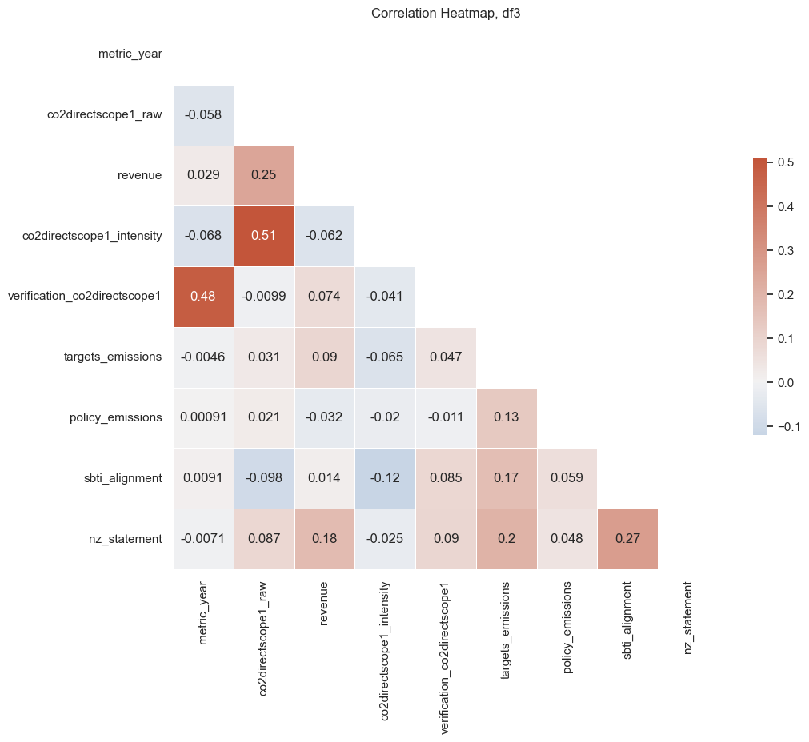
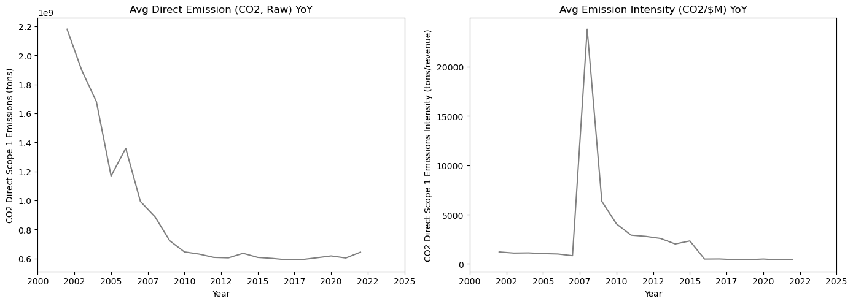
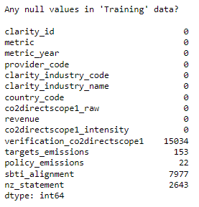
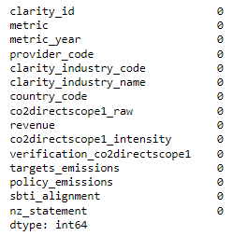
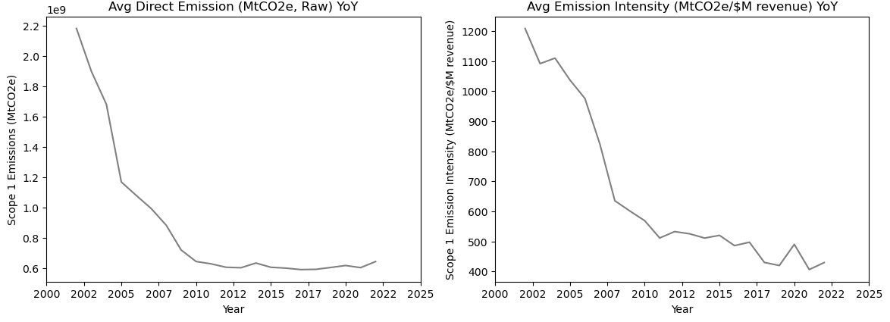
2 Exploratory Data Analysis: Additional Findings Impact of ‘fillna’ & outlier removal in the feature correlation and forecasting results
Lee
Overall correlation value increased (highest value from 0.23 to 0.51) with more distinct relationships.
Outlier and filling in the null values have help align with literature reviews where:
More companies are getting their Direct Emissions verified by third party for transparency and accuracy YoY
Net Zero Statement and SBTi commitment goes hand in hand
However impact of SBTi driven emission reduction is not clear
BEFORE
AFTER
BEFORE
AFTER
Figure 4 ‘Outlier’ removal
Figure 5. fillna with 0 in categorical variables
Figure 6. Correlation Heatmap, df3=fllna & outlier removal
Notes:
Lee: Team had debated a lot on whether to fill in missing values and how much of the outlier removal is required.
More intuitive findings are that outlier removal and null value imputation in categorical values improve the correlation values.
General trend is that more companies are getting their direct emissions verified by third party for transparency and accuracy year over year.
However the impact of SBTi alignment to the emission reduction is not evident.

Slide 5
3 Model Performance and Comparison Winning solution so far…
Lee
3.1 Univariate Forecasts to test the hypothesis that revenue is the most influential parameter in CO2 emission forecast given completeness in the data from 2002 to 2022
ARIMA
Exponential Smoothing ✔
Holt Winter Exponential Smoothing
Prophet
XGBoost
3.2 Multivariate to identify confounding variable that may affect the relationship between the independent and dependent variables. Parametrize the features' influence in CO2 emission forecast.
ARIMA
LSTM ✔
Why consider univariate as an option? In case
1) explicit commitment towards achieving global net zero or target to reduce CO2 emissions does not differentiate the forecasting results
2) due to limited historical data (e.g. LSTM requires minimum 10 steps and verification_co2directscope1 does not suffice) the multivariate models suffer in performance
Notes:
Scope 1 emission refers to direct GHG that results from activities within the organization’s control. This might include but not limited to “onsite fuel combustion, manufacturing and process emissions, refrigerant losses or company vehicles¹”.

Slide 6
Univariate Models
ARIMA / Exponential Smoothing / Prophet / XGBoost
Notes:
Ramy:

Slide 7
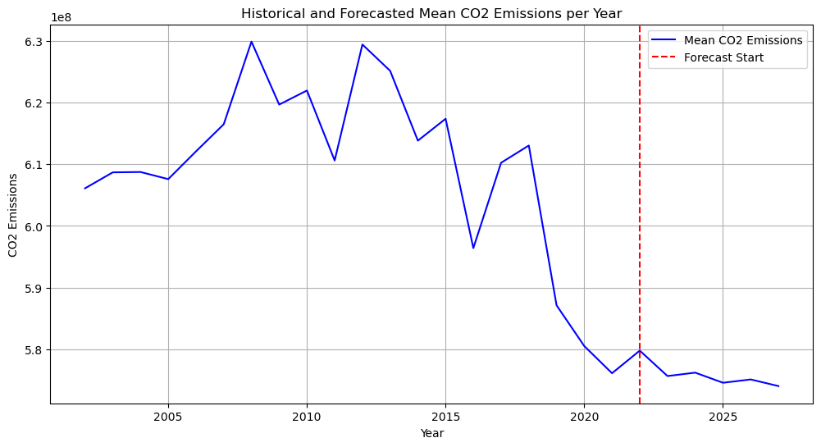
3.1.1 ARIMA (Univariate)
Univariate Model, Example of Best Prediction cases vs Worst Cases
Why ARIMA
Captures linear dependencies and trends within time series data
Effective for non-stationary data, which can be made stationary through differencing
Widely used statistical method for time series forecasting
Implementation
Data Preparation: Made data stationary using differencing techniques
Model Selection: Selected best parameters (p, d, q) using AIC and BIC
Model Fitting: Fitted the ARIMA model to historical CO2 emissions data
Forecasting: Used the fitted model to forecast future CO2 emissions
Metric | Value
MSE | 3.75E+17
MAE | 85630948
Accuracy (MAPE) | 82%
Accuracy | % of Companies
100 | 1%
80-90 | 80%
<80 | 19%
Notes:
Ramy

Slide 8
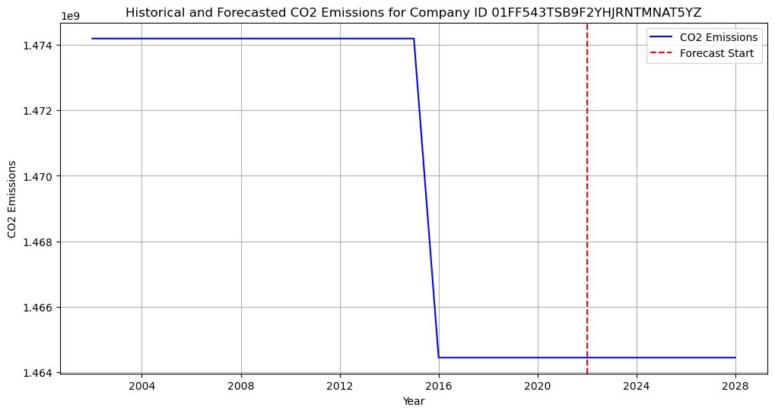
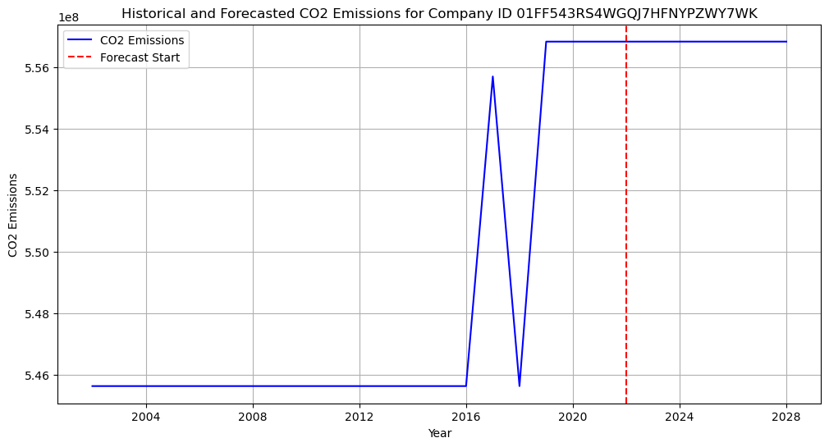
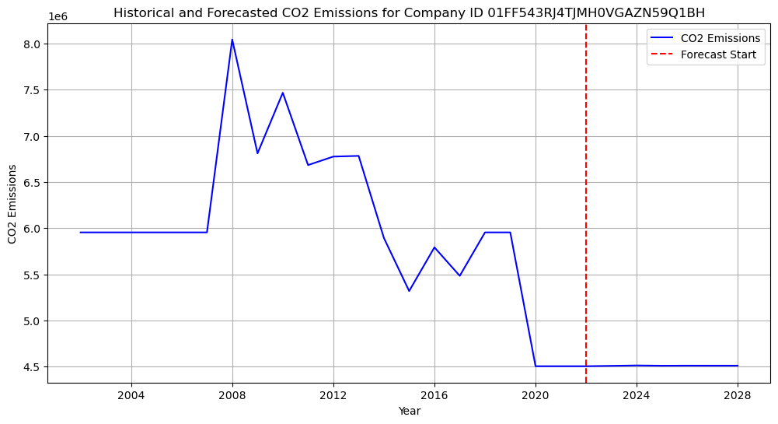
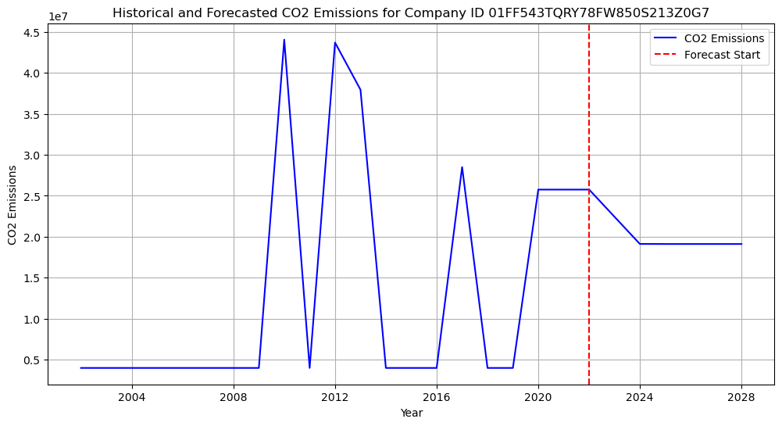
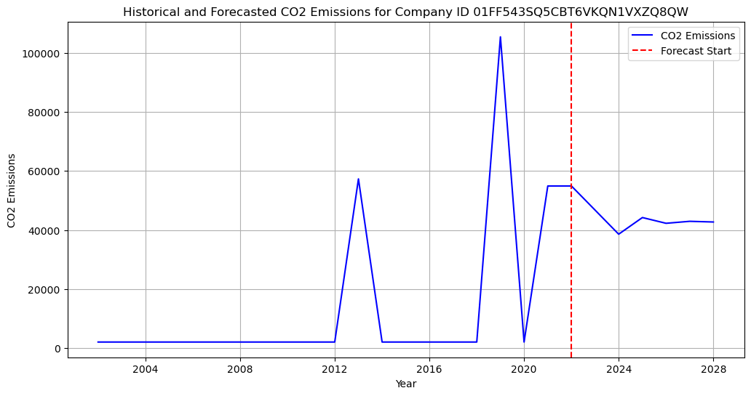
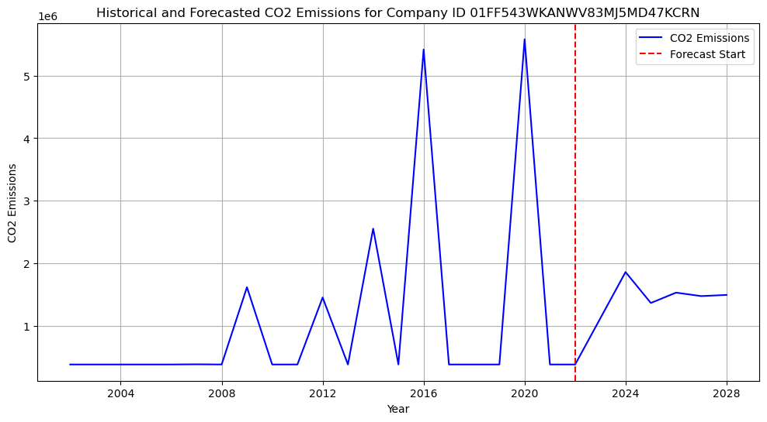
Top 3 Companies in CO2 Emissions Forecasting Accuracy
Bottom 3 Companies in CO2 Emissions Forecasting Accuracy
3.1.1 ARIMA (Univariate)
94.5% Accuracy
95.2% Accuracy
92.8% Accuracy
20.6% Accuracy
17.6% Accuracy
16.4% Accuracy
Arena strengths in capturing trends, however is not good enough with irregular data
Notes:
Ramy

Slide 9
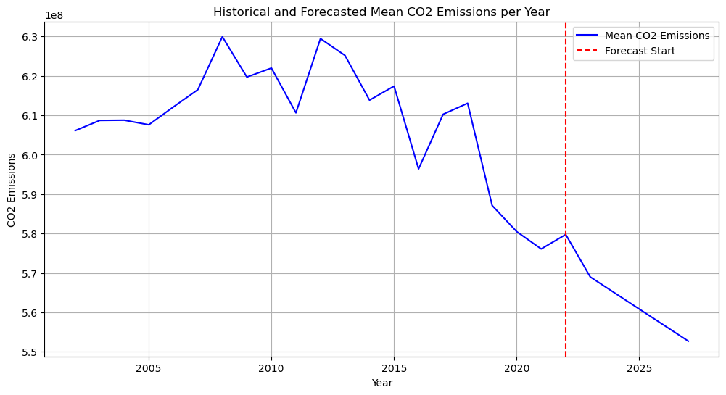
3.1.2 Exponential Smoothing/Holt-Winters (Univariate)
Univariate Model, Example of Best Prediction cases vs Worst Cases
Why Exponential Smoothing / Holt-Winters Smoothing
Effective for time series with trends and seasonality
Decomposes data into level, trend, and seasonal components
Provides accurate and reliable forecasts for complex datasets
Implementation
Data Preparation: Ensured data exhibited trends and seasonal patterns
Model Selection: Used Holt-Winters method to capture level, trend, and seasonality
Model Fitting: Applied model to historical CO2 emissions data
Forecasting: Generated future forecasts based on the fitted model
Metric | Value
MSE | 1.16E+17
MAE | 54282066
Accuracy (MAPE) | 87.5%
Accuracy | % of Companies
100 | 30%
80-90 | 60%
<80 | 10%
Notes:
Ramy

Slide 10
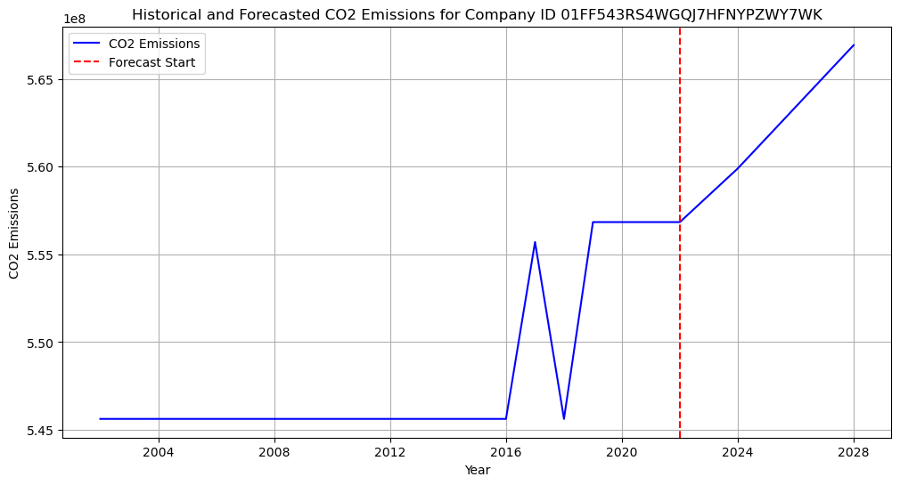
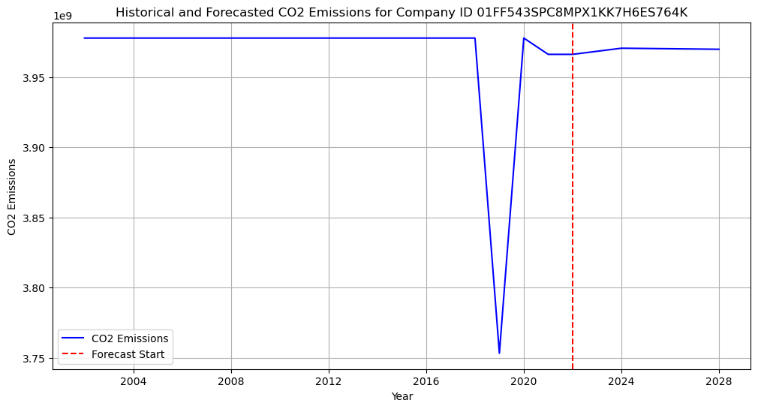
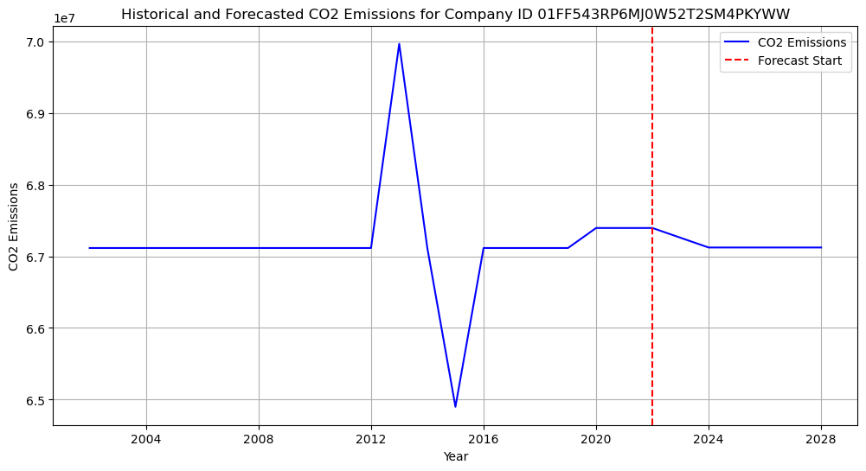
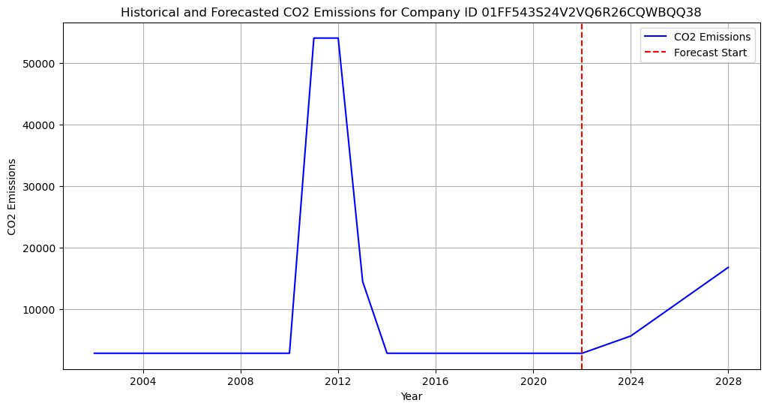
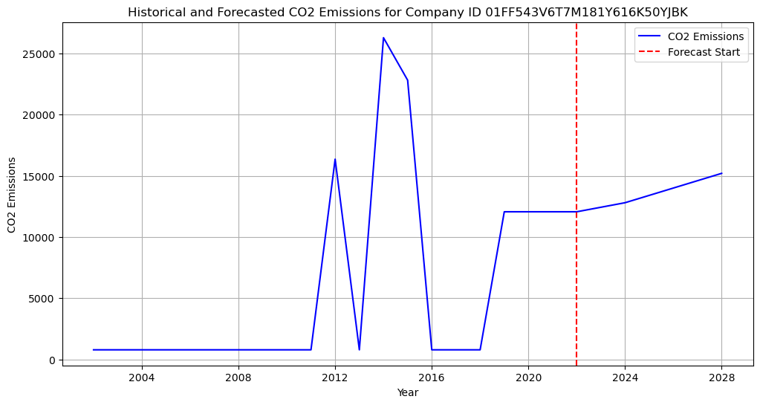
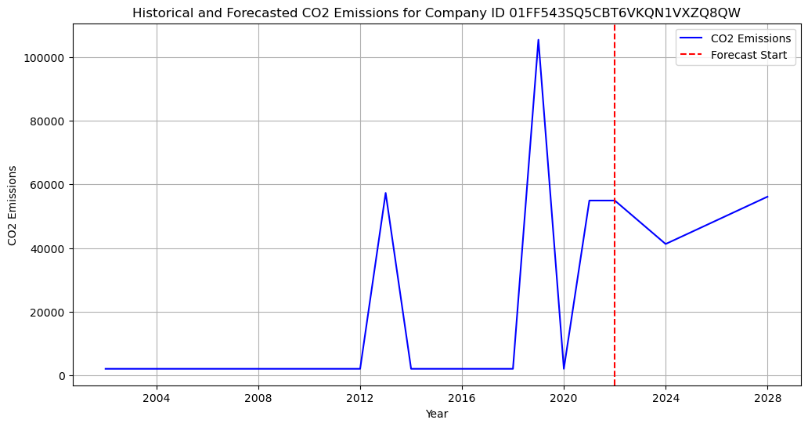
Top 3 Companies in CO2 Emissions Forecasting Accuracy
3.1.2 Exponential Smoothing (Univariate)
99.7% Accuracy
99.7% Accuracy
99.6% Accuracy
Bottom 3 Companies in CO2 Emissions Forecasting Accuracy
8% Accuracy
4% Accuracy
10% Accuracy
Exponential Smoothing has a strong ability to handle stable trends and seasonality, while is a bit limited with highly volatile data
Notes:
Ramy

Slide 11
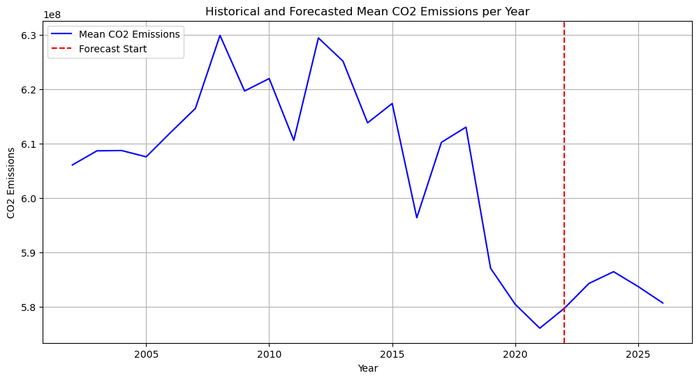
3.1.3 Prophet (Univariate)
ML, Example of Best Prediction cases vs Worst Cases
Why Prophet
Developed by Facebook, Prophet is an additive model for time series forecasting
Handles strong seasonal effects and several seasons of historical data
Robust to missing data and trend shifts
Implementation
Data Preparation: Included historical Scope 1 emissions and revenue
Model Components: Trend, seasonal patterns, holiday effects, and external regressors
Model Fitting: Tuned parameters to account for seasonality and holidays
Forecasting: Used the fitted model to forecast future CO2 emissions
Metric | Value
MSE | 1.17E+17
MAE | 65281774.5
Accuracy (MAPE) | 84%
Accuracy | % of Companies
100 | 50%
80-90 | 40%
<80 | 10%
Notes:
Ramy

Slide 12
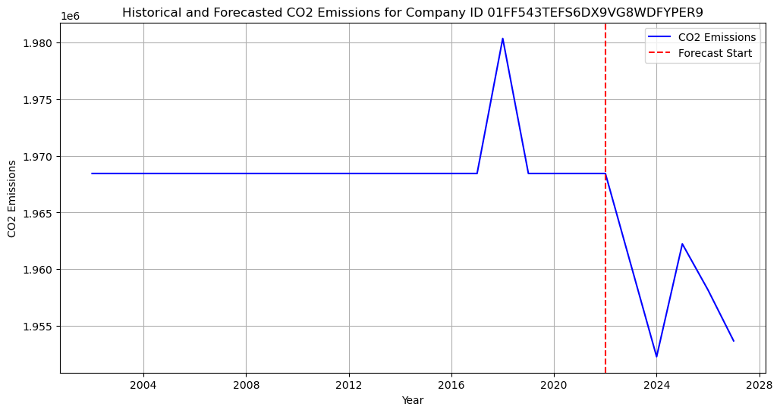
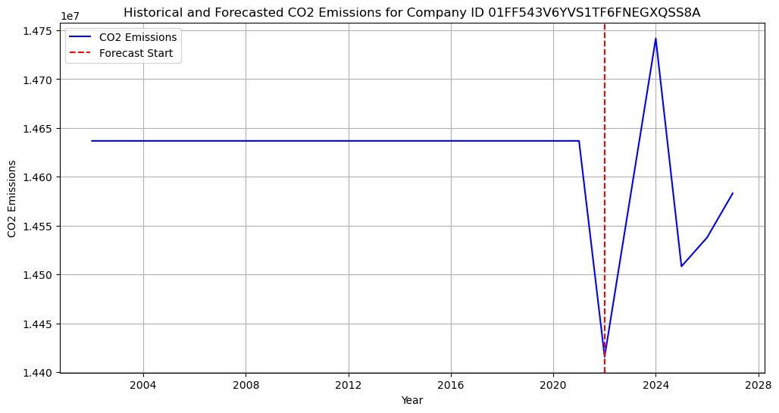
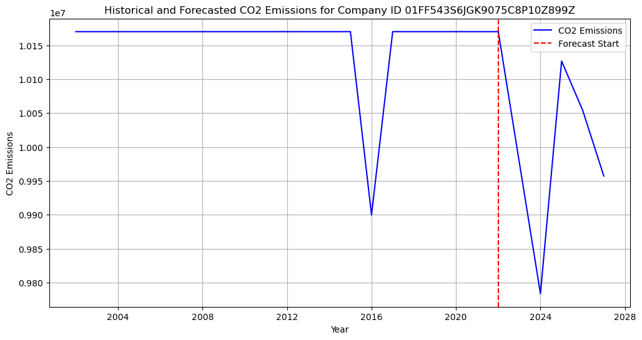
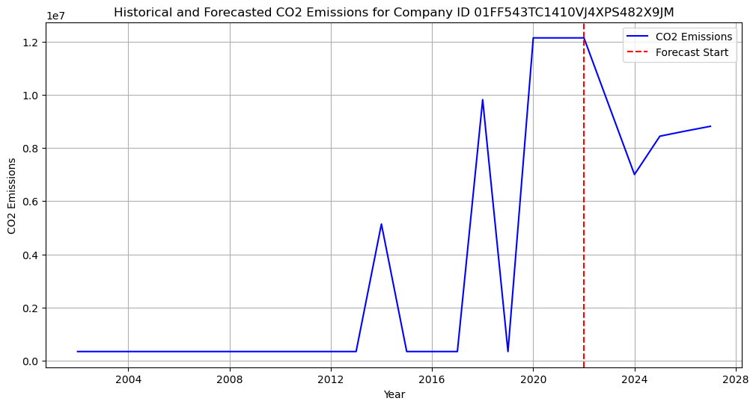
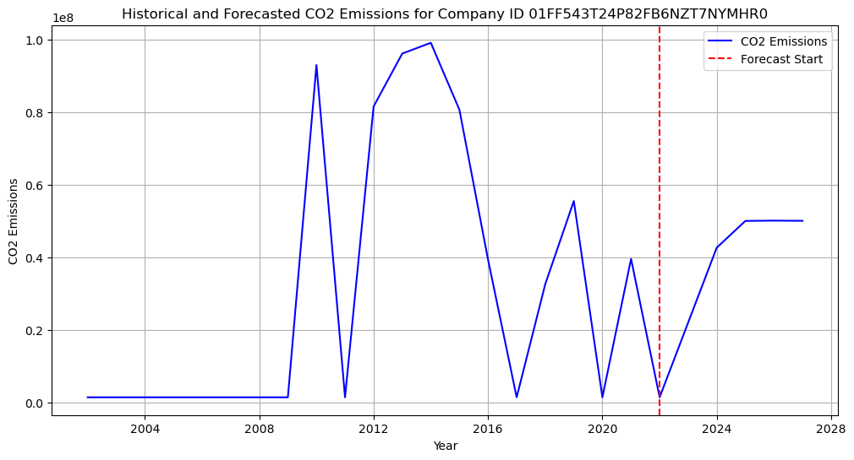
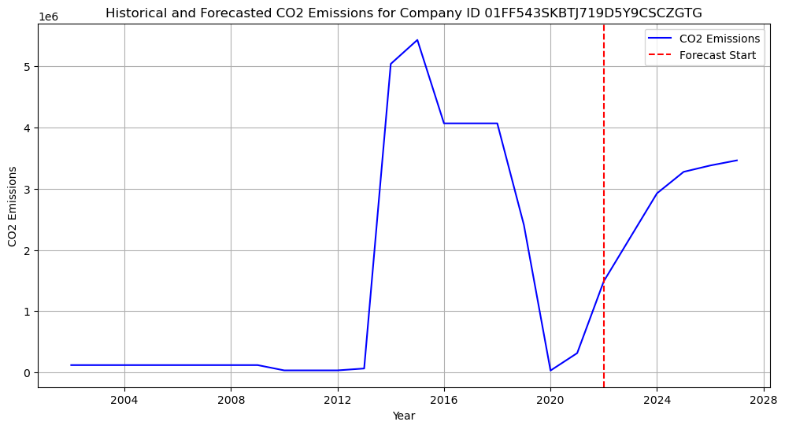
Top 3 Companies in CO2 Emissions Forecasting Accuracy
3.1.3 Prophet (Univariate)
99.8% Accuracy
99.7% Accuracy
99.9% Accuracy
Bottom 3 Companies in CO2 Emissions Forecasting Accuracy
4% Accuracy
4.4% Accuracy
3% Accuracy
Prophet strengths in handling consistent and predictable patterns but limits with highly volatile and irregular data
Notes:
Ramy

Slide 13
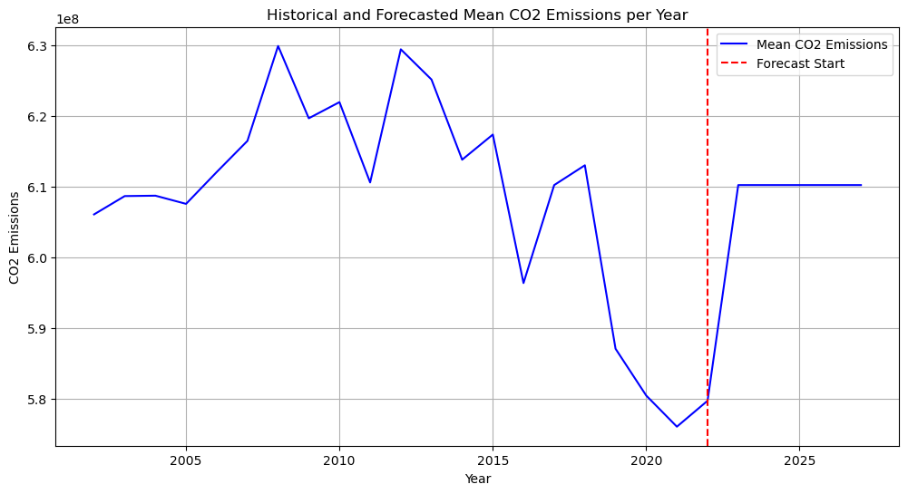
3.1.4 XGBoost (Univariate)
ML, Example of Best Prediction cases vs Worst Cases
Why XGBoost
Scalable and efficient gradient boosting algorithm
Handles large datasets and complex patterns effectively
Provides high performance and accuracy for time series forecasting
Implementation
Data Preparation: Included historical CO2 emissions and revenue
Model Selection: Fine-tuned parameters (number of trees, learning rate, max depth) using GridSearch
Model Fitting: Applied the model to the historical data
Forecasting: Used the fitted model to forecast future CO2 emissions
Metric | Value
MSE | 2.40E+17
MAE | 107503467
Accuracy (MAPE) | 59%
Accuracy | %
100 | 33%
80-90 | 35%
<80 | 27%
0 | 5%
Notes:
Ramy

Slide 14
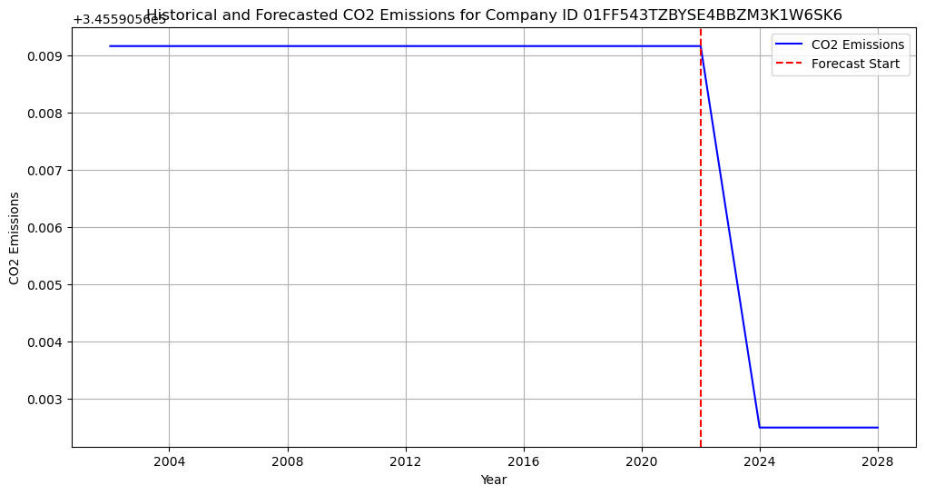
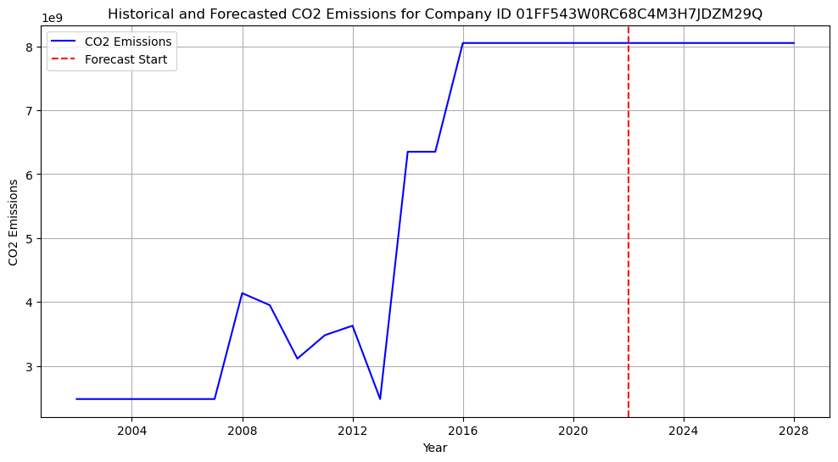
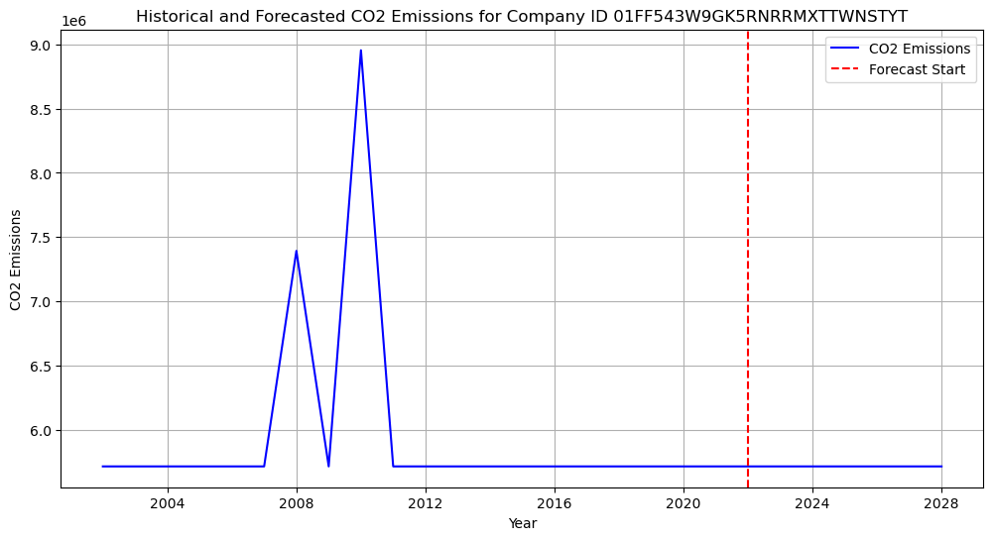
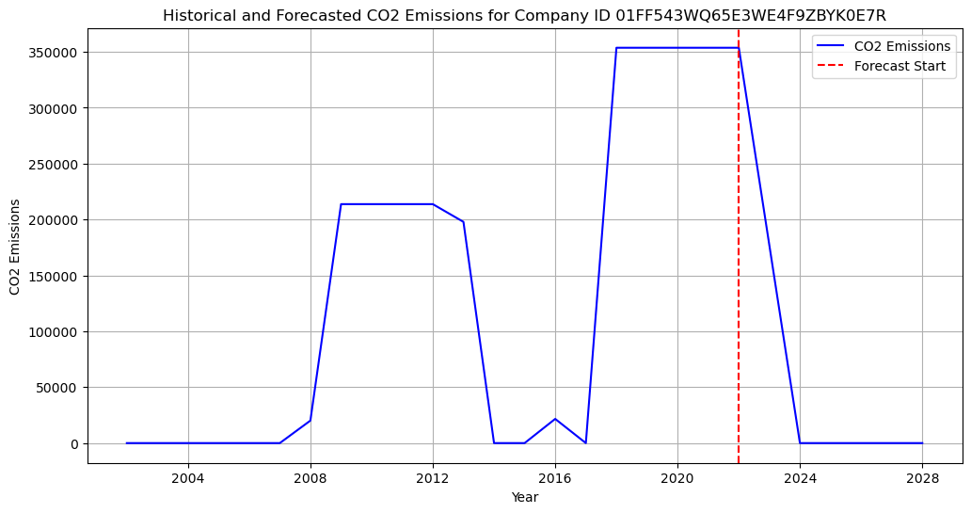
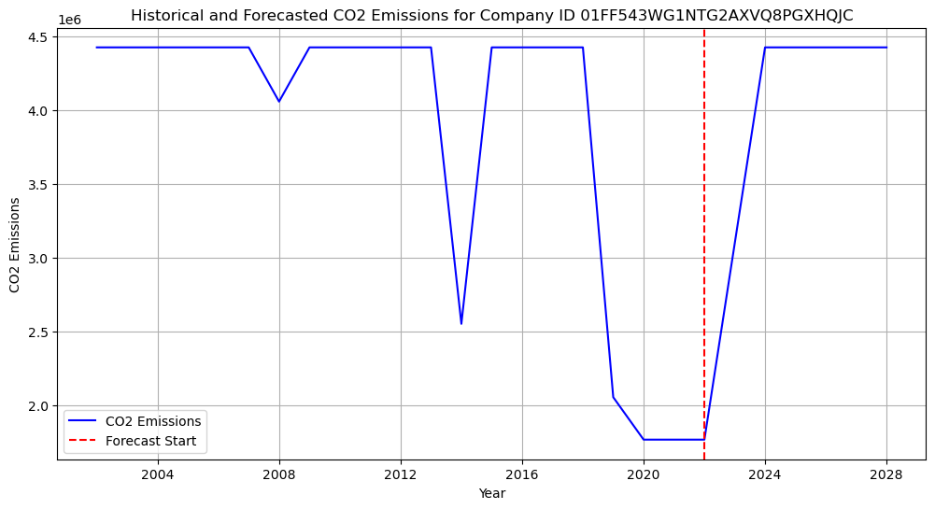
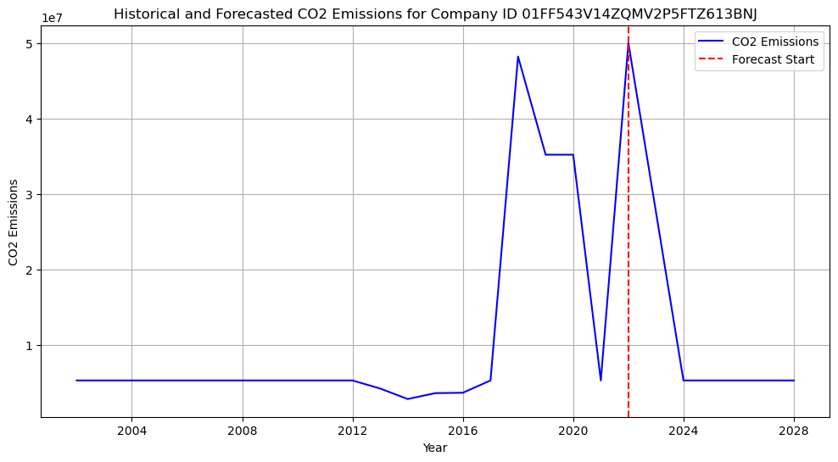
Top 3 Companies in CO2 Emissions Forecasting Accuracy
3.1.4 XGBoost (Univariate)
99.9% Accuracy
99.9% Accuracy
99.9% Accuracy
Bottom 3 Companies in CO2 Emissions Forecasting Accuracy
0.5% Accuracy
0.4% Accuracy
0.1% Accuracy
XGBoost strengths in handling complex patterns and large datasets and limits with irregular data
Notes:
Ramy

Slide 15
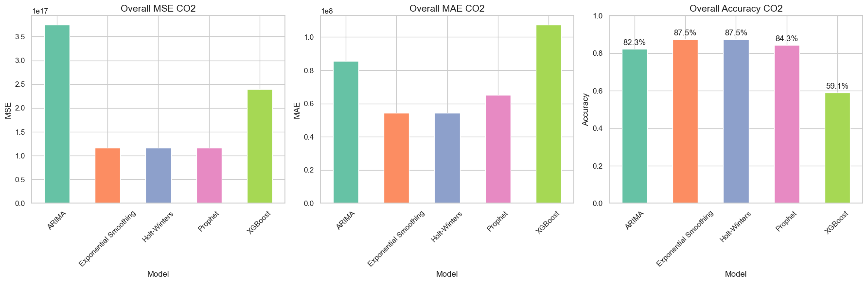

3.1 Univariate Model Comparison
Best performance delivered by Exponential Smoothing
Notes:
Ramy

Slide 16
Multivariate Models
ARIMA / LSTM
Notes:
Lee

Slide 17
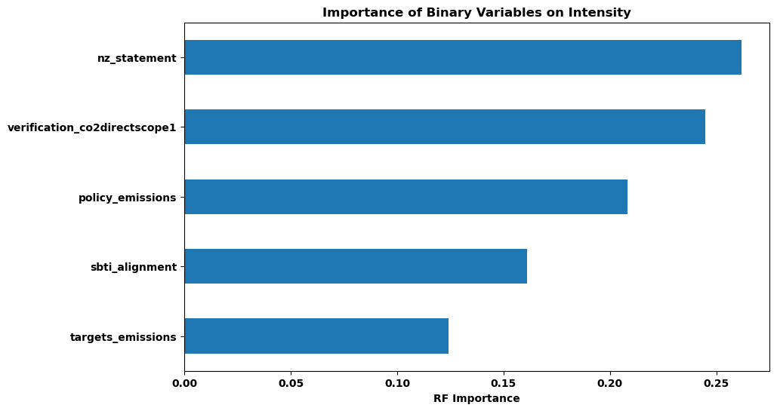
4 Key Factors influencing Sustainability Feature Engineering: Mean, Lasso and Random Forest, qualitative vs quantitative insight
Marshall
R² achieved: 3.31%
Notes:
Marshall
To preface the multivariate modeling, we’ll briefly review some of what we covered in the midterm presentation after the first sprint. We used Lasso regression and Random Forest regression, which you see pictured here, to determine feature importance. Across both methods, we found Net Zero pledges and Third Party Verification to be the most important indicators. However, Verification became a tricky variable to work with because positive values in the data only begin in 2018, which meant it had to be dropped from the LSTM model (which I will get to), which requires 10 sequential events. Surprisingly, modeling with these indicators alone only results in an R-squared of just over 3%. The real discovery was when we broke down the other columns in the data…

Slide 18
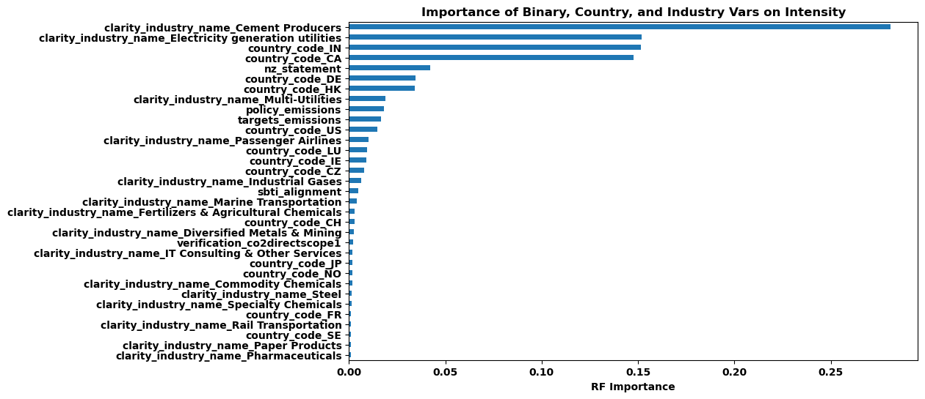
4 Key Factors influencing Sustainability (cont.) Feature Engineering: Mean, Lasso and Random Forest, qualitative vs quantitative insight
R² achieved: 79.12%
Notes:
Marshall
…showing that the most predictive factors of intensity are the Clarity-assigned industry and the country where a company is headquartered. Including these categories with the binary indicators swells the R-squared from 3% to a whopping 79%, which made them essential to the multivariate models. This chart isn’t the easiest to read, but we see the most important binary factor (Net Zero pledge) at the 5th highest importance, at roughly 1/6th the importance of the most explanatory industry.

Slide 19
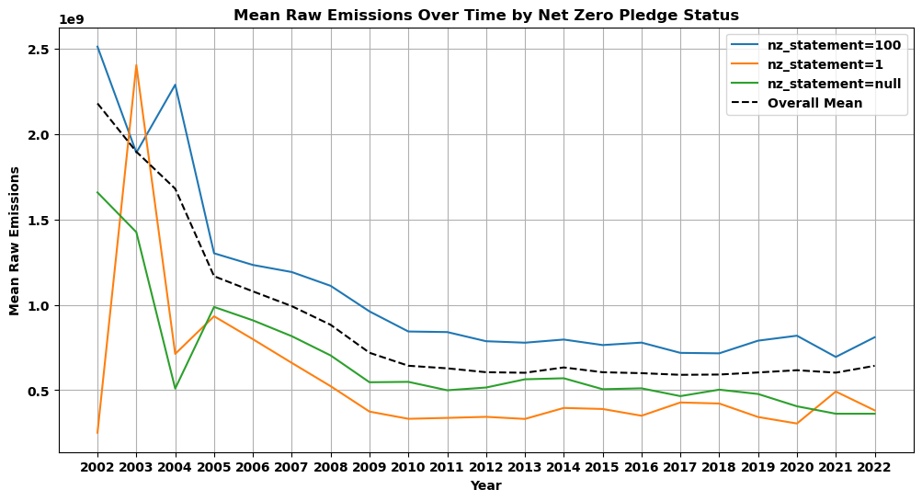
4 Key Factors influencing Sustainability (cont.) Feature Engineering: Mean, Lasso and Random Forest, qualitative vs quantitative insight
Companies that have pledged to reach net zero emissions are consistently higher than companies that haven't made this pledge
Notes:
Marshall
For each of the five binary variables, the full report contains a plot of that variable by status (i.e. true, false, or null) for each sustainability metric: one for intensity, one for raw emissions, and one for revenue, for a total of 15 charts. I have selected what I consider the most interesting one to discuss, which is the influence of the Net Zero Pledge on Raw Emissions as a sustainability metric. This one is interesting because it shows a clear pattern, but it may be the opposite of what you expect: Companies that have pledged to reach net zero emissions are consistently higher than companies that haven't made this pledge, and the gap is hardly closing. Not only is this a surprising result, but the Net Zero Pledge variable in particular represents an absolute value that demands these numbers approach zero. Other charts in the report back up this result, and a pattern is illustrated that it’s the companies that make these pledges, or set these targets, or commit to these initiatives, who are consistently the biggest culprits, causing the highest emissions. So, these factors are quite influential to the data, just perhaps not in the way you would expect.

Slide 20
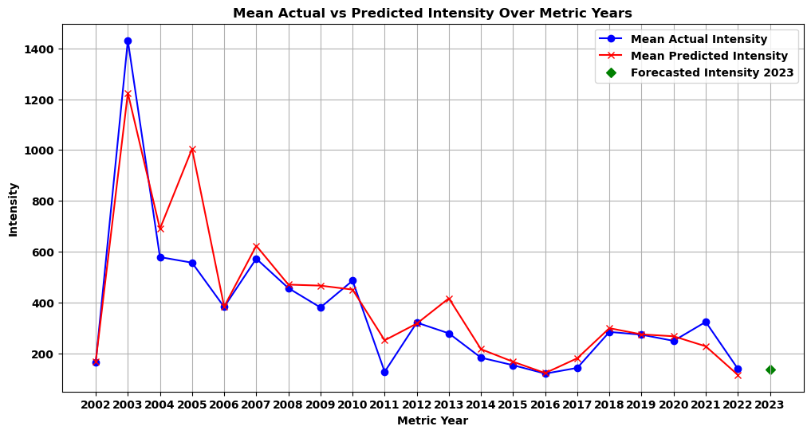
3.2.1 Long Short-Term Memory (Multivariate) Multivariate Forecasting with a recurrent neural network
Variable Parameters
LSTM Layers
Neurons per layer
Epochs
Dropout rate
Early stopping
Notes:
Marshall
Finally to the first multivariate modeling results. Long Short-Term Memory, or LSTM, is a recurrent neural network that is effective for long-term modeling. In front of us is a plot displaying Actual versus Predicted mean intensity values from the model, along with a predicted point for 2023. We went through several iterations of LSTM parameters, tuning the number of LSTM layers, which capture complex patterns and better handling of long-term dependencies at the risk of higher compute and overfitting; the number of neurons per layer, which are responsible for maintaining sequences and temporal dependencies in the data; the number of epochs, or complete passes through the entire training data, again at the cost of compute; the dropout rate, which assists regularization and allows the model to forget events that aren’t representative of the trend; as well as early stopping parameters to help determine when the model can stop training (which is when it is performing best on the validation set).
There are a lot of nitty gritty details about the model present in the full report, and I’ll be happy to answer any questions on them at the end if I haven’t covered those details in this review. Overall, we considered this model to be a success among the other candidates, as measured by Mean Squared Error.

Slide 21
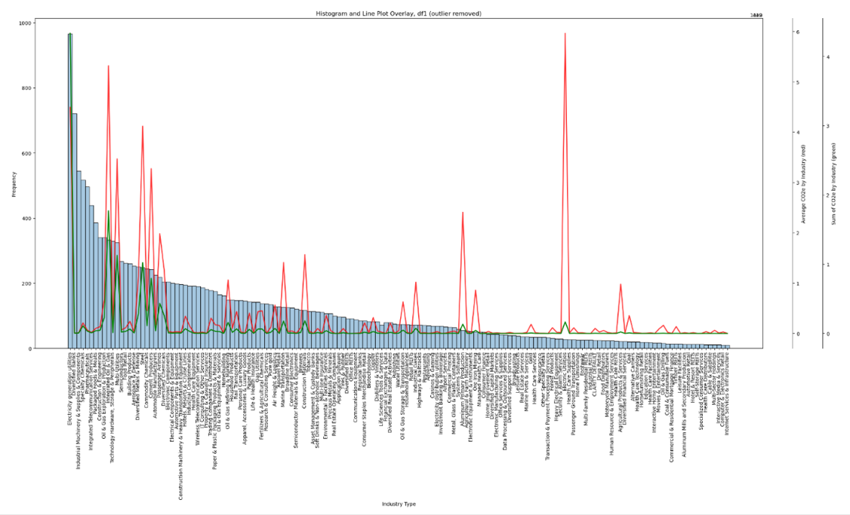
3.2.2 ARIMA (Multivariate) Multivariate Forecasting with Autoregressive Moving Average
Features considered in ARIMA Multivariate model: Revenue, Industry carbon intensiveness* and countries
Industry Carbon Intensiveness*: to resolve sparse matrix nature of one-hot encoding of 155 industries, the companies have been re-categorized into two types: production vs services industry after evaluating the industry trend in its emission intensity. Above >0.75 quantile from boxplot assessment, resulting 39 carbon intensive industry.
Parameter tuning; ARIMA(p,d,q)
p = auto-regressive, d= non-seasonal different, q = lagged forecast errors
Barchart: count of companies by industry type
Red lines: carbon intensity peaks of industry average
ARIMA | AIC | BIC | MSE
(1,1,1) | 835828316 | 836304.920 | 1293847.025
(2,1,0) | 840688.205 | 841164.809 | 1330306.454
(3,0,2) | 835510.154 | 836018.015 | 1282544.029
(3,0,3) ✔ | 835439.305 | 835954.978 | 1175894.884
(3,0,4) | 835503.206 | 836026.693 | 1289602.606
Future suggestion, use auto parameter tuning using optimization library called Mango (link), and create carbon intensive- and non-carbon intensive industry models to
Notes:
Lee: For this ARIMA model knowing there are a lot of empty gaps in between reporting years which naturally lead to the limitation of ARIMA model, I decided to only take in Revenue, Industry Carbon intensiveness and countries as the variable to forecast carbon intensity. Notice that we have re-characterised the industry into two types carbon intensive vs non carbon intensive industry. On the right hand side you see a barchart with red lines that indicates average carbon intensity value by industry. The enlarge version is included in the final report’s appendix 3. There are 39 industries that are categorized as carbon intensity while rest of 114 can be called as services industry where the revenue increase does not proportionally increase the absolute CO2 emission. The best performing tuning parameter for ARIMA was 3, 0, 3 given AIC, BIC and MSE values.
There are two suggestions I could make from ARIMA, choosing p, d, q with optimizaiton library caleld MAngo and have 2 ARIMA models, one for carbon intensive vs non-intensive

Slide 22
5 Additional Research Questions Impact of Explicit Sustainability Commitment, Challenges and limitations, Actionable Insights
5.1) What are the challenges associated with relying on forecasting techniques to predict the future sustainability performance of companies?
Inconsistent reporting of features poses challenges for fully leveraging forecasting techniques. Detailed reviews at the company level reveal that variability in emission reporting years and intermittent sustainability commitments reduce accuracy.
Data imputation can address these inconsistencies by setting new standards:
For missing emission reports, interpolate expected emissions using revenue data from SEC 10-K or equivalent reports.
For categorical features like sustainability commitments, use a conservative approach by assuming the previous year's status for missing data. For example, if a company commits to net zero emissions in 2016 but not in 2014, assume no commitment for 2015 (n = n-1).
Assign weights to each feature and apply penalties for high imputation levels to improve forecasting performance.
5.2) How would the model perform when limited historical data is available for a given company and what is the minimal historical depth required to apply any meaningful forecasting technique?
In LSTM: performance suffers greatly when the model accounts for all feature due to lack of historical dataset for ‘verification_scope1emission’ data being less than 10 time-steps (in this case years).
R² achieved: 79.12%
Notes:
Lee

Slide 23
5 Additional Research Questions (cont.) Impact of Explicit Sustainability Commitment, Challenges and limitations, Actionable Insights
5.3) How do you anticipate that the integration of the forecasting technique could contribute to providing investors and stakeholders with actions insights regarding the future sustainability performance of companies?
Hard to abate sector:
Industries such as integrated oil and gas, electricity generation, steelmaking, and cement production are among the largest polluters. Despite their progress, absolute emission values are not decreasing, classifying them as 'hard-to-abate' sectors. Forming alliance to invest in absolute emission reduction could be viewed as more sustainable company. (reference to ‘Net Zero Teeside’ Carbon Capture)
Classification of company’s existence:
Emission reporting by companies is often inconsistent due to voluntary disclosures, with some reporting every two years or irregularly (e.g., a Chinese cement producer reported annually from 2004 to 2020 but stopped in 2021). Determining whether a company has ceased operations or simply discontinued reporting due to financial constraints is essential. Identifying the company's status helps decide whether to impute data for missing years or rely solely on historical data for model training.
Sunk cost like Sunk emission
Poor financial performance does not proportionally reduce emissions. For example, a Danish (Clarity ID: ‘01FF54…..YXKF3’) multi-utility company's revenue fell by 67%, but emissions dropped only by 10%. Characterizing carbon-intensive industries and establishing a baseline for minimum emissions can help investors and stakeholders calculate actual emission reductions versus the purchase of carbon credits. This translates into operational costs impacting profit margins and investor returns.
Value in qualitative assessment
This approach will remain essential until mandatory emission disclosure and standard work for each industry type with validation process are established.
Notes:
Lee

Slide 24
6 Q&A

Slide 25
Appendix
Eight Timed Series Forecasting Method
Project Goals & Objectives

Slide 26
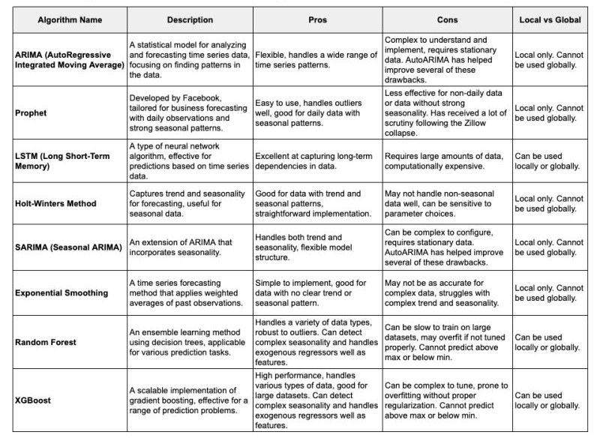
Eight (8) Time-Series Algorithms M.Dancho, 2024, LinkedinPost

Slide 27
Predicting Sustainable Performance of Companies 1. Problem Statement (Goals & Objective): Hypothesis and assumptions
G&O: ClarityAI is looking to enhance the predictive accuracy of sustainability indicators, focusing on Scope 1 Emission value for mid-term forecasting (2022~2030), using time-series methods.
Hypothesis and Assumptions: Relationship between Company’s REVENUE and SCOPE 1 EMISSION can be understood by 1) operational efficiency, 2) industry type and 3) regulatory environment. In this forecasting exercise we will apply ‘industry type’ to segment the data. Detailed reasons are as follows:
Operational Efficiency: Companies that optimize for energy efficiency tend to have lower Scope 1 emissions per unit of revenue. The efficiency gain leads to cost savings and higher profitability. However, in this scenario we assume that all companies and industries are embarking on the GHG accounting journey, process not mature yet to dissect the data into various population groups for time-series forecasting.
Industry Type: Industries such as manufacturing, mining, and oil & gas will produce higher Scope 1 emission due to the nature their business operations. As a result, close ties between revenue and emission levels can be expected (increased production leading to higher emission and higher revenue). Whereas Service-oriented industries like finance or technology is less likely to have directly correlated with emissions. As a result, industry population is categorized into two types, directly correlated and weakly correlated industries.
Regulatory environment: companies operating in strict environmental regulatory countries may incur higher cost to reduce GHG emissions effecting revenue. While those in less stringent countries companies might have higher emission value with higher short-term revenue. In this forecasting exercise, we assume regulatory environment is not significant for categorizing companies as ‘Carbon Tax’ is not penalizing at a significant level to enforce business’s operational and structural change. Currently (in 2024) Sweden, Finland and Singapore implemented more progressive compliance mechanism and higher fines, however given encoded company names via ID and assumed global practice, regulatory environment tied to the HQ country is assumed not meaningful hence excluded.
Notes:
Scope 1 emission refers to direct GHG that results from activities within the organization’s control. This might include but not limited to “onsite fuel combustion, manufacturing and process emissions, refrigerant losses or company vehicles¹”.

