Slide 1


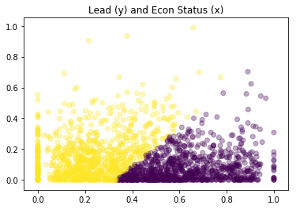
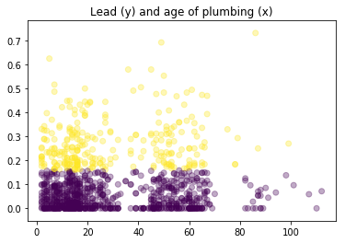
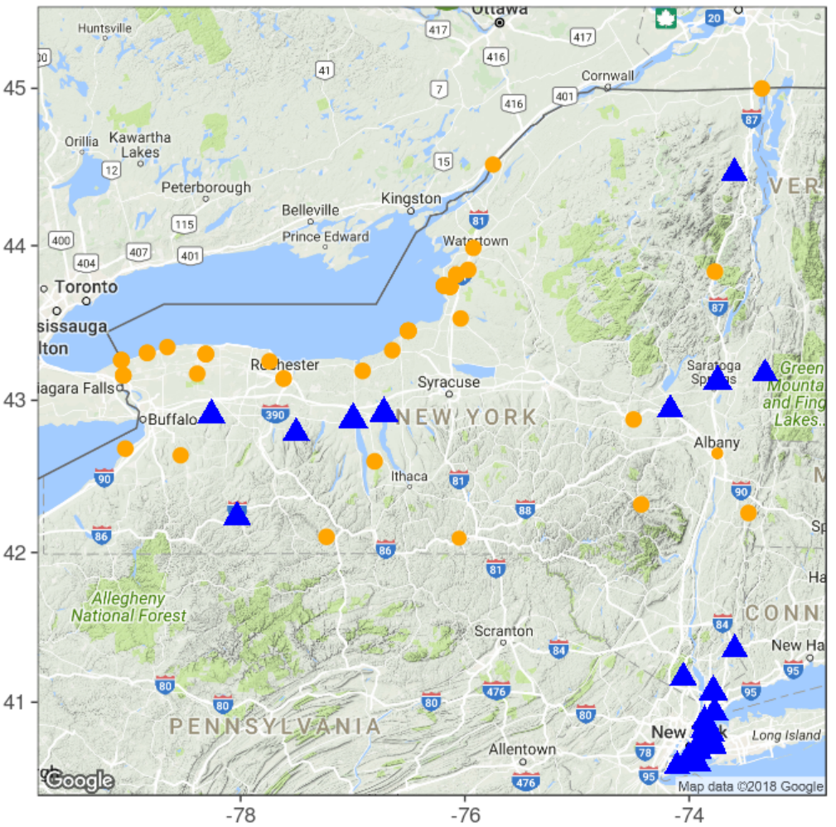
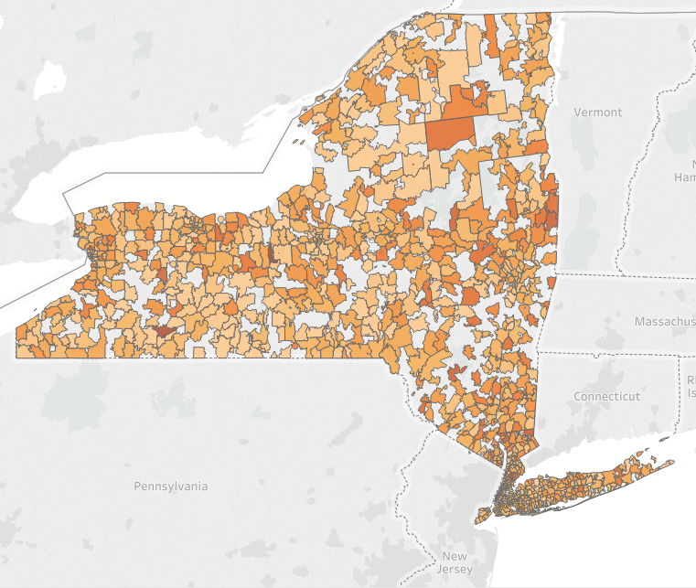

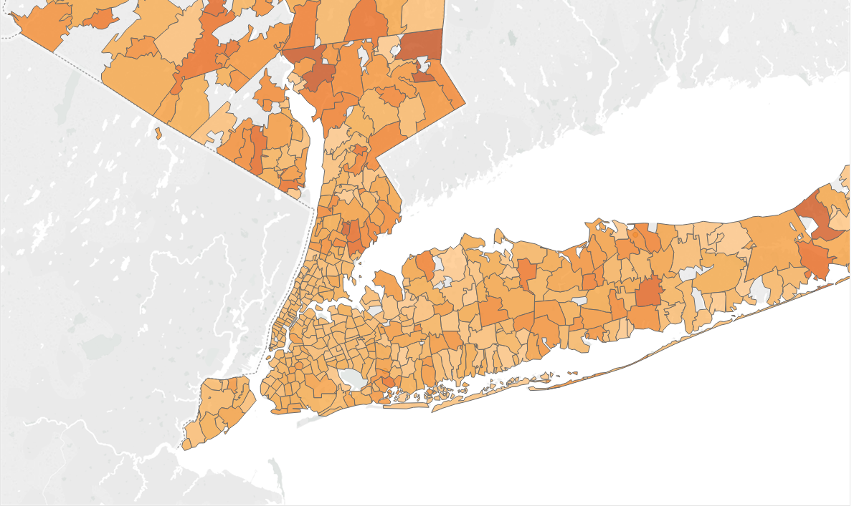
DRAFT: Exploratory Analysis of Lead in Public School Drinking Water in New York State
Ramy Jaber – MS in Data Science, Data Science Institute at Columbia University
Abstract
Following several national news stories about elevated lead levels in drinking water over the past few years, NY State Governor Andrew Cuomo issued a memorandum on September 15, 2016, requiring all public schools to test all water outlets for elevated lead levels on an annual basis, starting in the 2016-2017 school year. This research explores the results of the first year of testing, aiming to identify correlation or patterns which would assist in proactively addressing contaminated water outlets to reduce exposure to students.
Findings
Correlation with Economic Status
Student enrollment reports including number of Economically Disadvantaged students per grade, jointed with the lead testing results, leads us to conclude that there is no significant correlation between economic standing of a community and the likelihood of attending a school with excessive lead level in the drinking water
Background
New York State’s water system provides water for over 19Million residents, with many systems of varying size serving between 500 and 10 Million people. Although many of the water sources throughout the state (especially those that service NYC) are known to be contaminant free, harmful metals such as copper and lead can enter the water system through the use of outdated plumbing and groundwater contamination. Lead is a neurotoxin particularly harmful to the developing brain and nervous system of children under 6 years old.
Correlation with Age of Plumbing System
We also conclude that the source of lead contamination is likely not a school’s plumbing system, but rather some upstream contaminant.
Process
Research online for existing literature and initiatives around lead in NY State and nationwide.
Search for relevant data sets
Data Cleaning – Entity resolution to match data points across data sources
Feature Engineering – Organize and define new features based on raw data to calculate correlation
Correlation study
First Look
Grouping results by zip code shows that high risk (dark) neighborhoods reside near low risk (light) neighborhoods. High risk regions are more likely near high population areas such as Buffalo and Albany.
Data and References
Lead Testing in School Drinking Water Sampling and
Results - NY Open Data (data.ny.gov )
School Building Report Cards – survey of schools
buildings and infrastructure systems (i.e. plumbing)
Student Enrollment Demographics – economic status
http://www.p12.nysed.gov
Drinking Water Systems in New York The Challenges of
Aging Infrastructure, Office of Comptroller, NY State,
February 2017
Considering Groundwater Contamination
The EPA of NY State monitors and publishes results of water contamination in groundwater, wells, surface water, etc.
The map on the right shows that the 25 schools ( ) with most elevated lead levels, do not coreside with the natural water testing sites ( ) with highest lead levels.
Conclusion and Continuing Work
To date, we have not found hard evidence of a causal effect with elevated lead levels in school drinking water. Over the next months we will continue the feature engineering process, followed by machine learning to study the joint effect of several features on the lead results
Figure 1. Percent of water outlets over threshold shown by zip code
Acknowledgements
Thank you to The Earth Institute at Columbia University for providing support for this research

