Slide 1
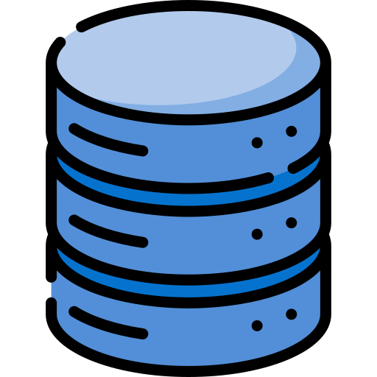

MVC Architecture
Database
Router
Select
Controller Method
Return DB
Response
Ask
DB
Request
Controllers
Inject
Data
Ask Data
Agent
Models
Response
Return Data
Response
Views
Or API

