Slide 1
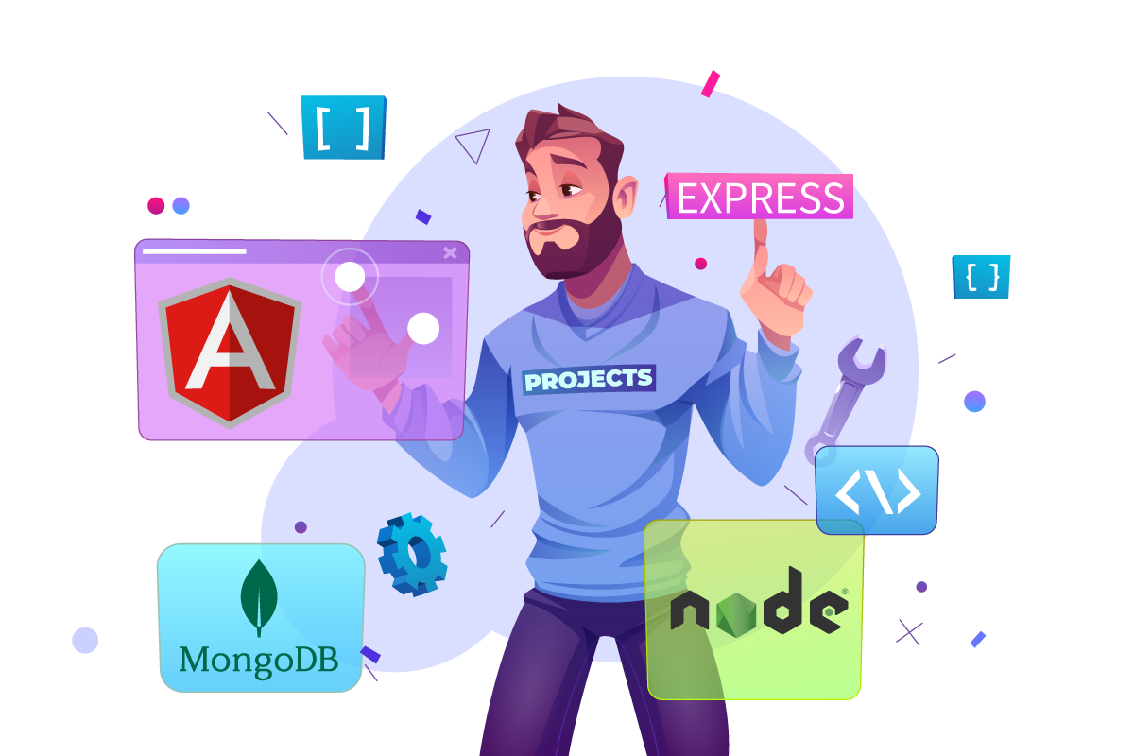

MEAN
stack
NTI
2025

Slide 2



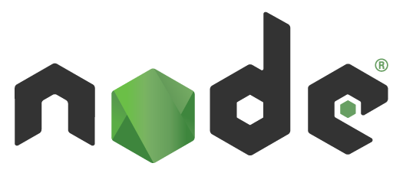
MEAN
stack
FRONT END
BACK END
DATABASE

Slide 3
MEAN
stack
MongoDB is a popular open-source, NoSQL database. It makes a good choice for applications with evolving data structures and complex data relationships.

Slide 4
MEAN
stack
Express.js is a flexible and minimalist web framework for Node.js that helps you build web applications and APIs efficiently.

Slide 5
MEAN
stack
Angular is a development framework used for building single-page applications (SPAs) using HTML and TypeScript. It's a popular choice for web developers due to its robust features, scalability.

Slide 6
MEAN
stack
Node.js is a powerful JavaScript runtime environment that allows you to run JavaScript code outside of a web browser.
Also is a JS cross-platform framework

Slide 7
Node.js framework dependencies :
ECMA-script :
is the standardized scripting language that serves as the foundation for JavaScript.
CommonJS :
is a module system used in Node.js to manage code organization and reusability. It defines how modules are structured, exported, and imported in a JavaScript application.

Slide 8
Node.js framework dependencies :
V8 engine:
is an open-source, high-performance JavaScript and Web Assembly engine.
Developed by Google, it was originally created to power Google Chrome.
Node.js uses V8 to execute JavaScript outside the browser, on the server.
LibUV :
is a C-based library that provides asynchronous I/O capabilities to Node.js. It's one of the core engines that makes Node.js non-blocking and event-driven.

Slide 9
Node.js framework dependencies :
NPM :
Stands for Node Package Manager.
A massive online repository of open-source JavaScript packages and modules.
Offers thousands of pre-written code libraries and tools for various purposes.
Simplifies code reuse, dependency management, and project development.

Slide 10
It's widely used for building:
Web applications: server-side logic, RESTful APIs
Real-time applications: chat apps, live dashboards, collaboration tools
Data streaming services: video/audio streaming, file transfer
Command-line tools and automation scripts: build tools, task runners, testing frameworks
Microservices architecture: building scalable, modular applications
IoT (Internet of Things): device communication and data processing

Slide 11
Key features:
JavaScript on the server: Use the same language for frontend and backend
Event-driven, non-blocking I/O: Efficiently handles many concurrent connections
Asynchronous programming: Keeps apps responsive with non-blocking I/O operations
npm (Node Package Manager): Access a massive ecosystem of reusable packages
Cross-platform compatibility: Runs on Windows, macOS, Linux, and more

Slide 12
MEAN
stack
Thank you
Eng.
Ramy Kamal

