Slide 1
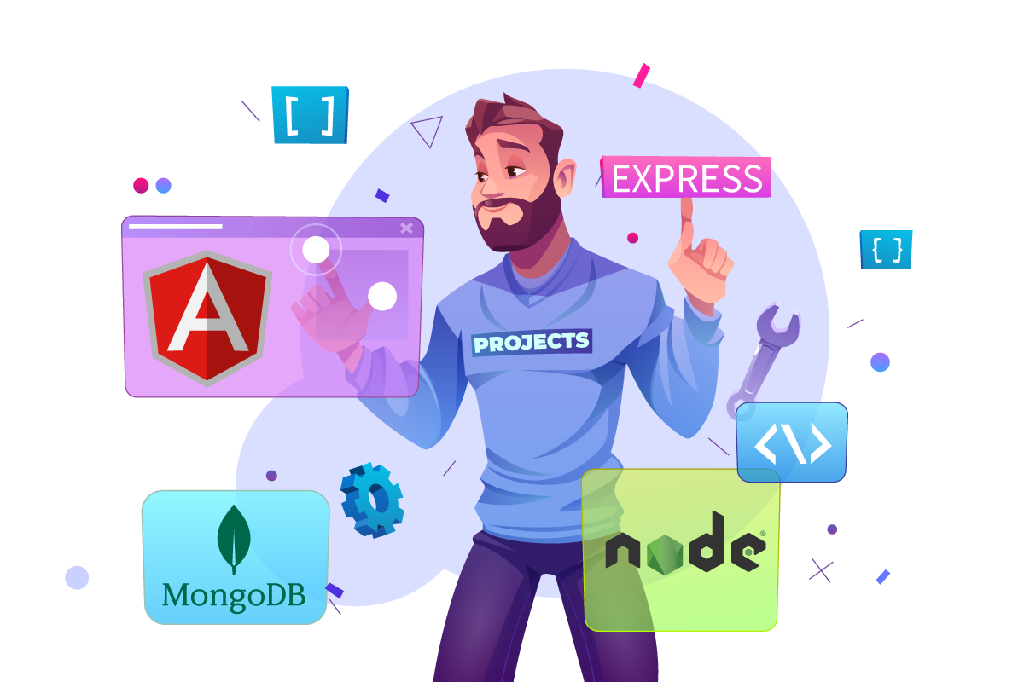

MEAN
stack
NTI
2024

Slide 2
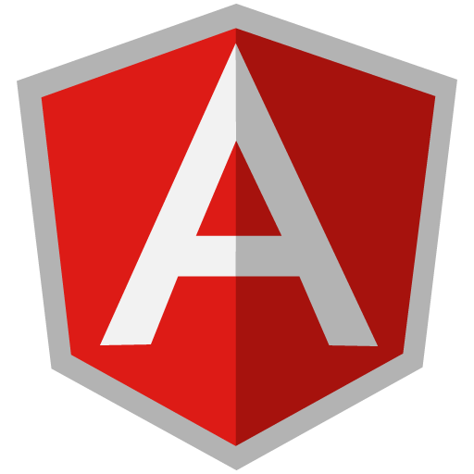


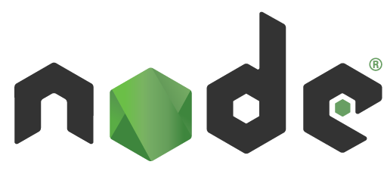
MEAN
stack
FRONT END
BACK END
DATABASE

Slide 3
MEAN
stack
MongoDB is a popular open-source, NoSQL database. It makes a good choice for applications with evolving data structures and complex data relationships.

Slide 4
MEAN
stack
Express.js is a flexible and minimalist web framework for Node.js that helps you build web applications and APIs efficiently.

Slide 5
MEAN
stack
Angular is a development framework used for building single-page applications (SPAs) using HTML and TypeScript. It's a popular choice for web developers due to its robust features, scalability.

Slide 6
MEAN
stack
Node.js is a powerful JavaScript runtime environment that allows you to run JavaScript code outside of a web browser.

Slide 7
V8 is Google's open-source, high-performance JavaScript engine, written in C++. It's the core of both Chrome and Node.js, responsible for:
Parsing JavaScript code
Executing JavaScript code

Slide 8
It's widely used for building:
Web applications: server-side logic, RESTful APIs
Real-time applications: chat apps, live dashboards, collaboration tools
Data streaming services: video/audio streaming, file transfer
Command-line tools and automation scripts: build tools, task runners, testing frameworks
Microservices architecture: building scalable, modular applications
IoT (Internet of Things): device communication and data processing

Slide 9
Key features:
JavaScript on the server: Use the same language for frontend and backend
Event-driven, non-blocking I/O: Efficiently handles many concurrent connections
Asynchronous programming: Keeps apps responsive with non-blocking I/O operations
npm (Node Package Manager): Access a massive ecosystem of reusable packages
Cross-platform compatibility: Runs on Windows, macOS, Linux, and more

Slide 10
Node.js developers depend on npm to access the ingredients (packages) they need to build amazing applications .
What is npm?
Stands for Node Package Manager.
A massive online repository of open-source JavaScript packages and modules.
Offers thousands of pre-written code libraries and tools for various purposes.
Simplifies code reuse, dependency management, and project development.

Slide 11
MEAN
stack
Thank you
Eng.
Ramy Kamal

