Slide 1

PHP 8 & Laravel 9
Part 2
By: Ramy Ibrahim

Slide 2


Outline
Laravel Course
Introduction to Frameworks and Design Patterns
Laravel Environment and Installation
Database Communication using Laravel
Implement Online-Store Application with Admin Panel
Publish and Secure Laravel Application

Slide 3

Laravel 9 Course
Introduction

Slide 4
Frameworks
What are frameworks?

Slide 5

Web Dev Framework
It’s a programming tool that helps developers to build robust, secure, and efficient applications
Frameworks have lots of tools, predefined functions, and helpers
Frameworks will solve a lot of pain, Remember!!

Slide 6
Web Dev Framework
Code Organization
Less Coding
Good Documentation and Supported by Community
Scalable, Maintainable
Session Management
Authentication and Authorization
Email Verification
Routing

Slide 7
Web Dev Framework
Web App and API
Storage
Easy to Test
Supported by Plugins and Libraries
Payment Gateway
Excel Sheet Import and Export
A lot more

Slide 8
Front-end vs Back-end
What is the difference between Front-end and Back-end Frameworks

Slide 9
Model View Controller
Design Pattern
View: is the UI representation
View uses model data to represent
Controller: Handle Request Logic and Manipulates Models
Controller Can get Model Data and send it to the View
Model: Represents Data as Objects

Slide 10
MVC
View
Sees
Updates
User
Model
Manipulates
Uses
Controller

Slide 11






MVC Frameworks
Each Language has its own Frameworks

Slide 12
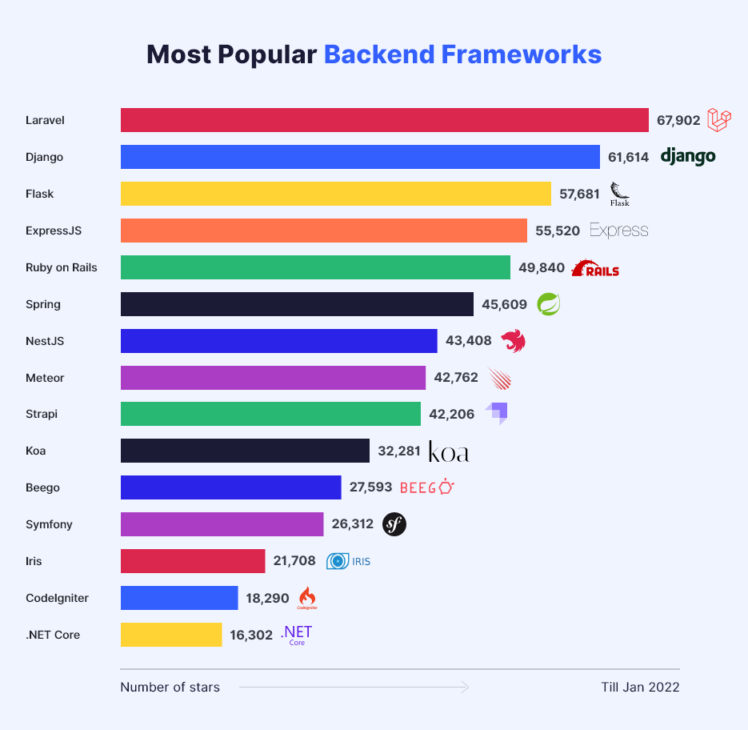
Laravel
Current Version is 9
First Released 2011
Command Line Interface
Migrations
Env File

Slide 13
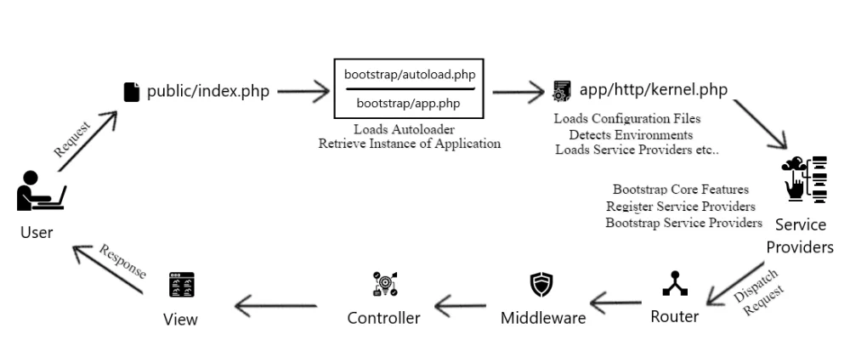
Laravel Request Life-Cycle

Slide 14
Where to put BL
Business Logic can be coded in
Controller
Service Layer
Models

Slide 15
Laravel 9 Prerequisites
PHP 8.0
Composer
Dependency Manager for PHP
Download latest compatible release of libraries
Used with many frameworks
Same as NPM

Slide 16
Laravel Installation
XAMPP
Composer
Artisan CLI

Slide 17
Create New App
Create Online-Store Application

Slide 18
File Structure
Where to write HTML
Where are
Models
Views
Controllers
Routes
Env Files
Config Files

Slide 19
Naming Conventions
Files, Models, Views, and Controllers

Slide 20
Routing
Routes Could return
View
Function
Controller Action

Slide 21
Blade Templates
Reduce Vanilla PHP

Slide 22
Forms
Use Helpers
CSRF
Validation with Requests

Slide 23
Models
Connect to database
Use Migrations
Eloquent Models and Relations

Slide 24
Migrations and Seeding
Seeding Data

Slide 25
CRUD Operations
Implement Categories and Items

Slide 26
Input Request ID
Get last inserted Id

Slide 27
Old Inputs
Inputs and Validation Messages

Slide 28
Upload Files
Use File Storage

Slide 29
Sessions
Use Sessions and Flash Sessions

Slide 30
Middleware
The use of Middlewares

Slide 31
Auth & Authorization
Protect the Admin Panel

Slide 32
Testing in Laravel
Test your application

Slide 33
Publish Laravel
Publish and Secure Laravel Application

