Slide 1
MD5 cipher

Slide 2
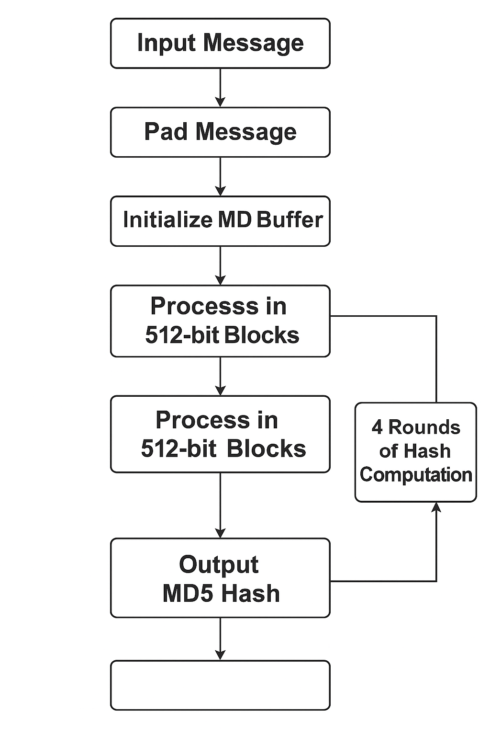
Step diagram

Slide 3
MD5 Algorithm - Step by Step
The MD5 algorithm is a widely used cryptographic hash function that produces a 128-bit (16-byte) hash value. It is commonly used to verify data integrity. Below are the key steps involved in the MD5 algorithm

Slide 4
Steps of the MD5 Algorithm
1. Padding: The input message is padded so that its length is 448 modulo 512. Padding is always performed, even if the message is already 448 mod 512 bits long. A single '1' bit is added, followed by the necessary number of '0' bits.
2. Append Length: A 64-bit representation of the original message length is appended to the result of step 1. The resulting message length is now a multiple of 512 bits.
3. Initialize MD Buffer: Four 32-bit variables (A, B, C, D) are initialized with specific constants: A = 0x67452301 B = 0xefcdab89 C = 0x98badcfe D = 0x10325476

Slide 5
4. Process Message in 512-bit Blocks: The padded message is divided into 512-bit blocks. Each block is processed in 4 rounds with 16 operations each (64 operations in total).
5. Define Auxiliary Functions: Four non-linear functions (F, G, H, I) are used in different rounds: F(X,Y,Z) = (X AND Y) OR (NOT X AND Z) G(X,Y,Z) = (X AND Z) OR (Y AND NOT Z) H(X,Y,Z) = X XOR Y XOR Z I(X,Y,Z) = Y XOR (X OR NOT Z)
6. Perform Transformation: For each 512-bit block, 64 operations are applied using the functions F, G, H, and I, pre-defined constants, and bitwise rotation operations.
7. Output: After all blocks are processed, the concatenated values of A, B, C, and D form the final 128-bit hash value.

Slide 6
SHA 1 cipher

Slide 7
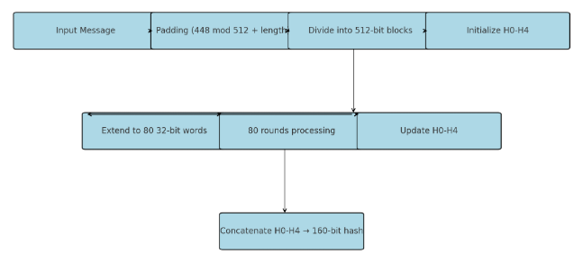
Step diagram

Slide 8
What Is SHA 1?
SHA-1 (Secure Hash Algorithm 1) is a cryptographic hash function that:
Takes an input of any length
Produces a fixed 160-bit (20-byte) hash value
Commonly represented as a 40-digit hexadecimal number
📌 Note: SHA-1 is now considered cryptographically broken and is not recommended for secure applications.

Slide 9
How It Works (Steps Overview):
Padding: Append 1 bit, then 0s until the length is 64 bits short of a multiple of 512, then add the original length.
Divide Message: Break into 512-bit chunks.
Extend: Expand 16 words into 80.Initialize Hash Values: Five initial 32-bit constants.
Main Loop: Run 80 rounds of transformations using bitwise logic and constants.
Combine Results: Add each round result to the current hash.
Output: 160-bit hash as a hex string.

