Slide 1
Dining Philosophers, Quantum!
Ramy Shahin
Qualgebra Systems

Slide 2
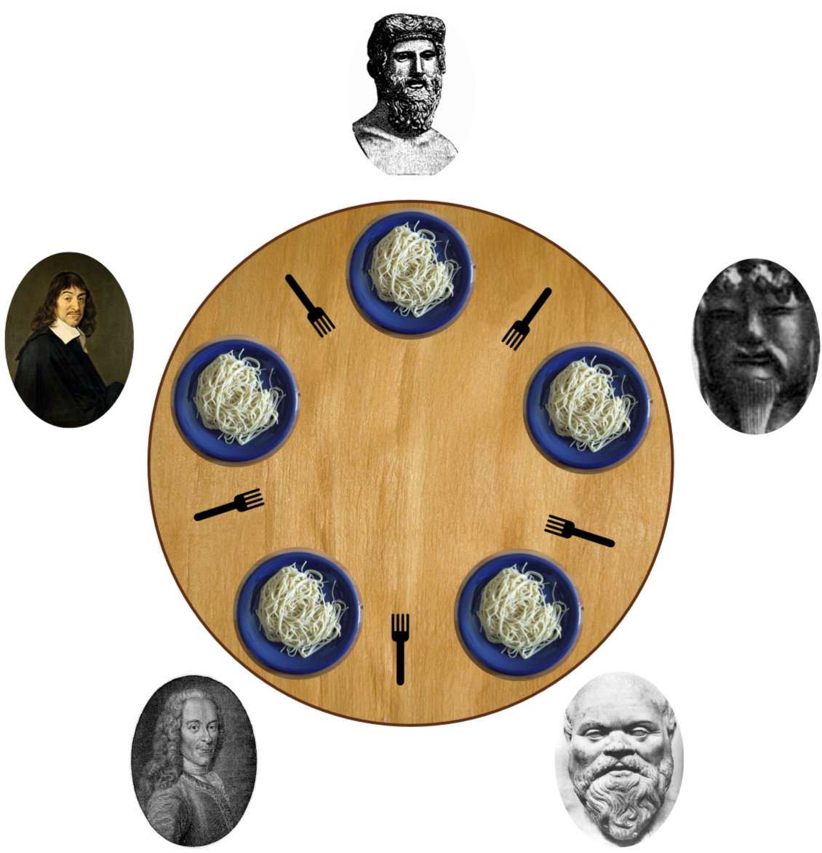
Dining Philosophers Problem
Source: Wikipedia
Notes:
N philosophers
Circular dining table
N chopsticks (forks)

Slide 3
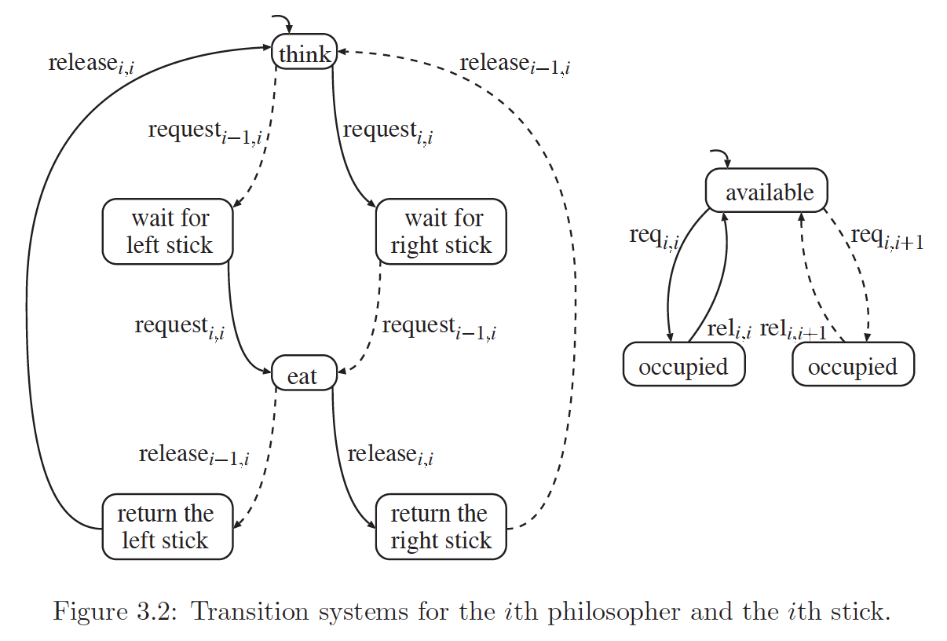
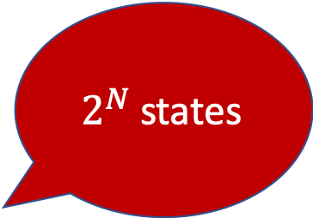
Dining Philosophers Problem (Formally)
$2^{N}$states
Source: Baier and Katoen, Principles of Model Checking, MIT Press, 2008.
Notes:
Parallel product of processes
Exponential Growth in state-space
What could go wrong?
Demo one possible state.

Slide 4
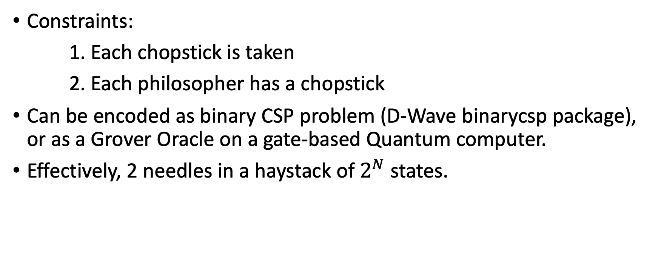
Deadlock Detection
Constraints:
1. Each chopstick is taken
2. Each philosopher has a chopstick
Can be encoded as binary CSP problem (D-Wave binarycsp package), or as a Grover Oracle on a gate-based Quantum computer.
Effectively, 2 needles in a haystack of $2^{N}$ states.
Notes:
Demo a deadlock state.

Slide 5
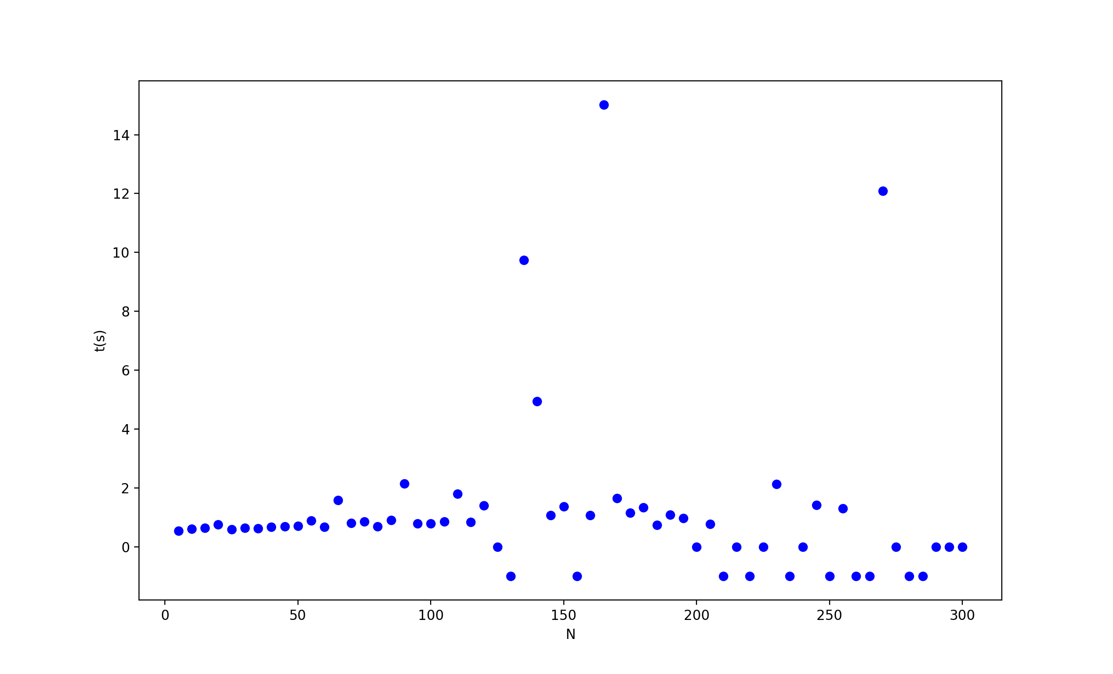
D-Wave Annealer Results
No deadlock detected
No embedding found
Notes:
Time not accurate (lots of overhead)
Zeros -> deadlock not detected
-1 -> no embedding found

Slide 6
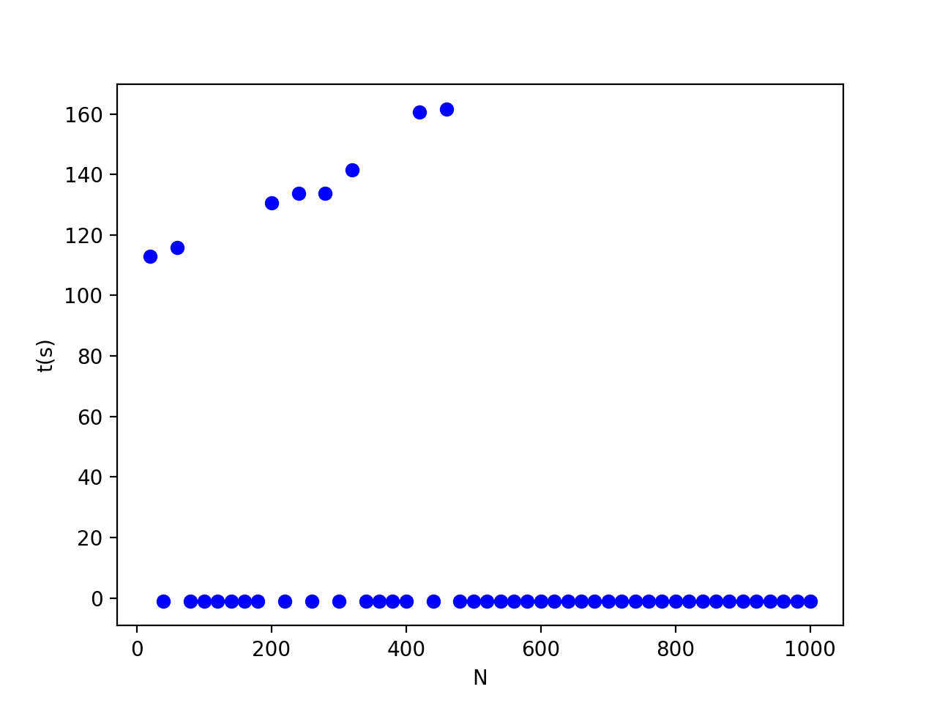
D-Wave Hybrid
Notes:
AutoEmbeddingComposite instead of EmbeddingComposite

Slide 7
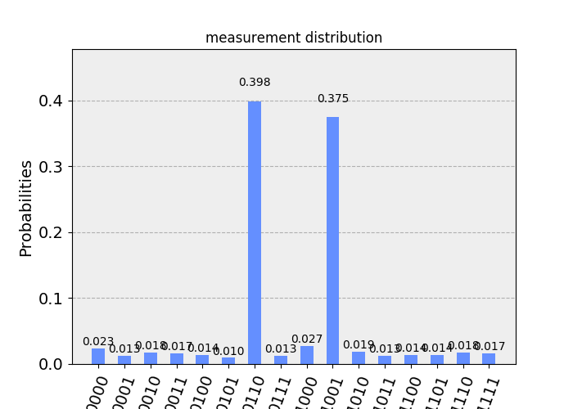
IBM Qiskit
Qiskit Aqua Boolean formula oracle
N > 2 does not fit on the simulator
N == 2 does not fit on any of the QPUs

Slide 8
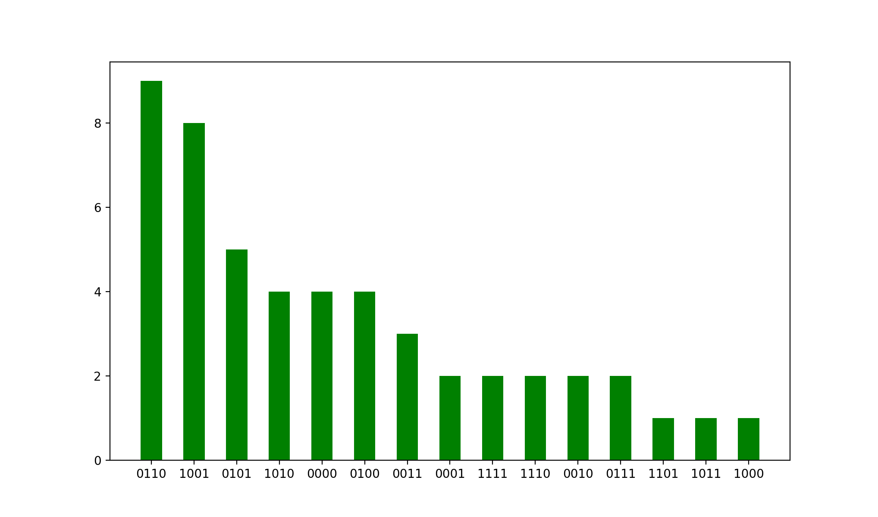
Rigetti QVM
N=2
50 samples

Slide 9
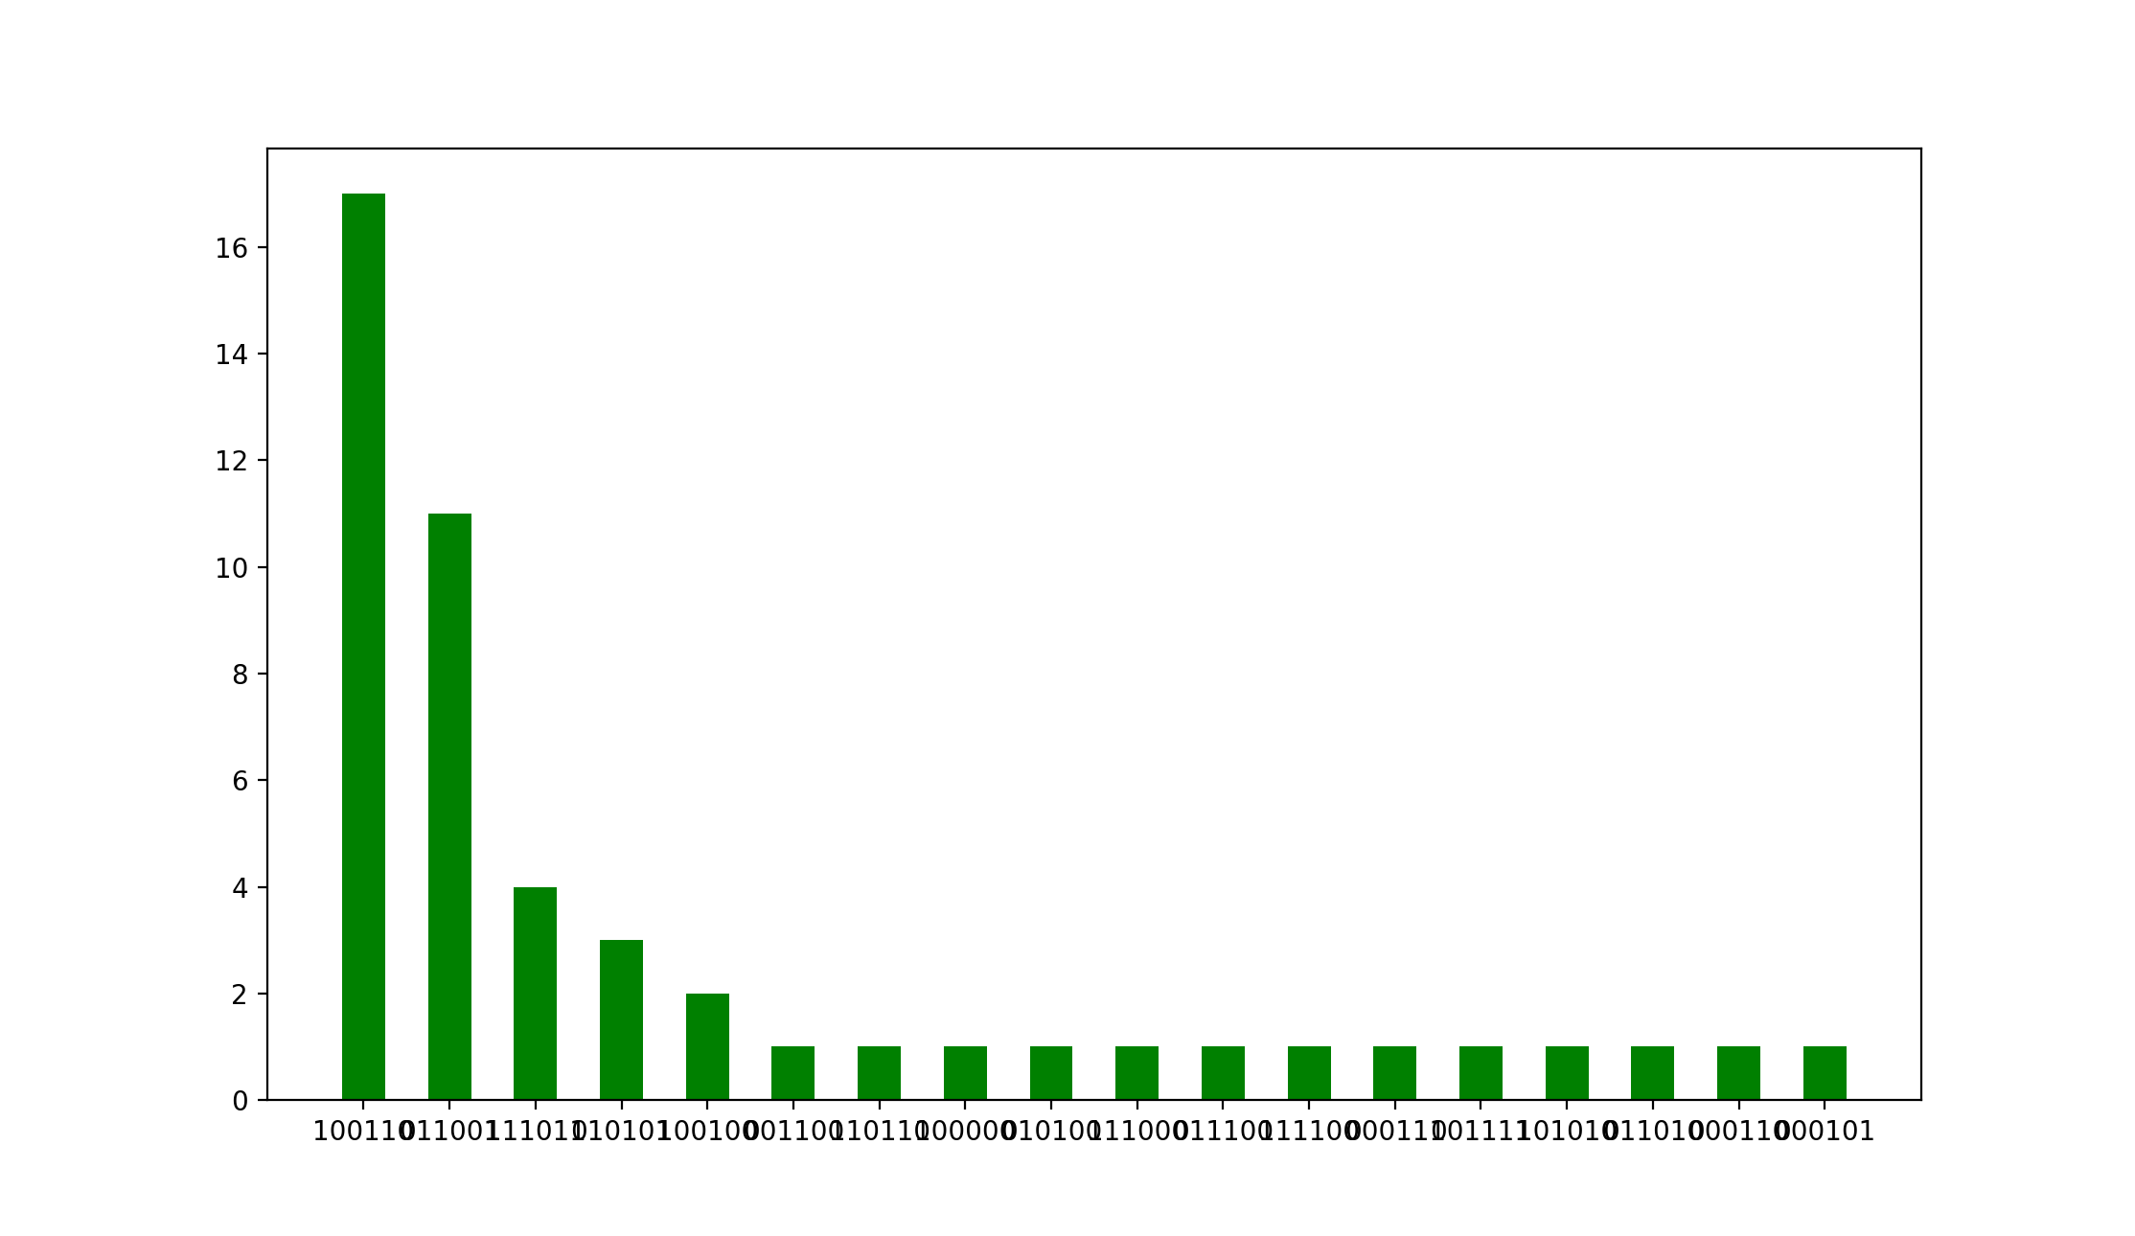
Rigetti QVM
N=3
50 samples

Slide 10
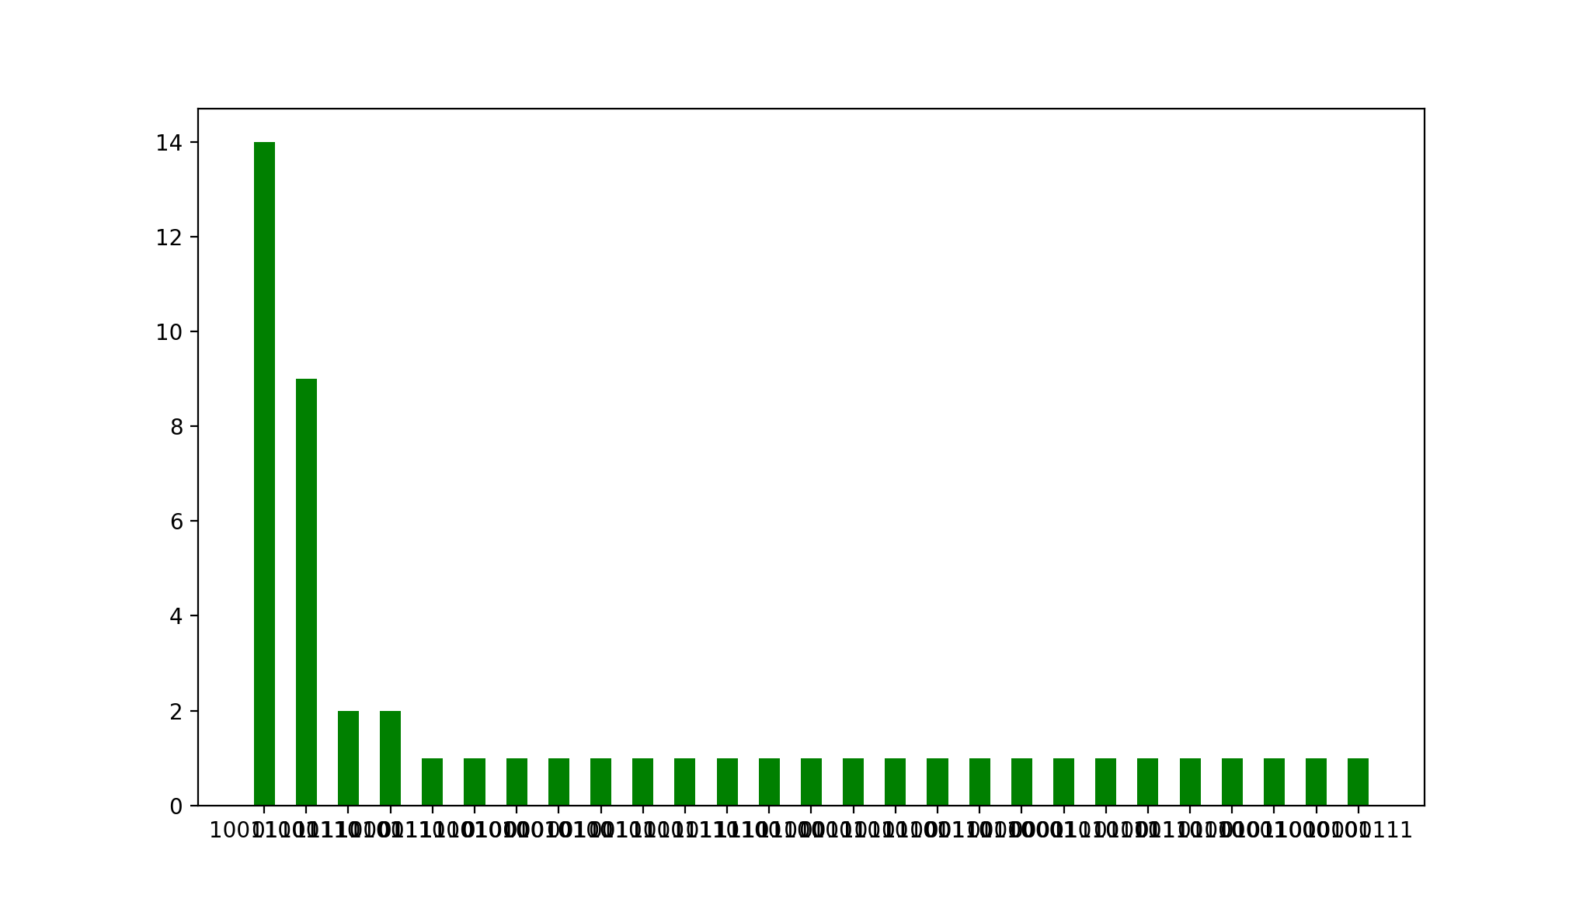
Rigetti QVM
N=4
50 samples

Slide 11
Lessons Learned
D-Wave binarycsp problem embeddings are non-deterministic.
D-Wave hybrid (at least KerberosSampler) needs further investigation.
Need to investigate further how Qiskit Aqua encodes the problem into a quantum circuit.
To try this on a Rigetti QPU.
To check if there is a Grover implementation on Xanadu.
A high-level Quantum programming language is badly needed!

Slide 12
Thank You
Questions

