Slide 1

Databases and Web Techniques
Name : Muhammad Ramzan Mahmood
Matriculation no. 513913
MS Automotive Software Engineering
Chemnitz University of Technology

Slide 2
Outline
Introduction
Used Technologies
Use Case Diagram
Code Implementation
Live Demo
Refrences

Slide 3
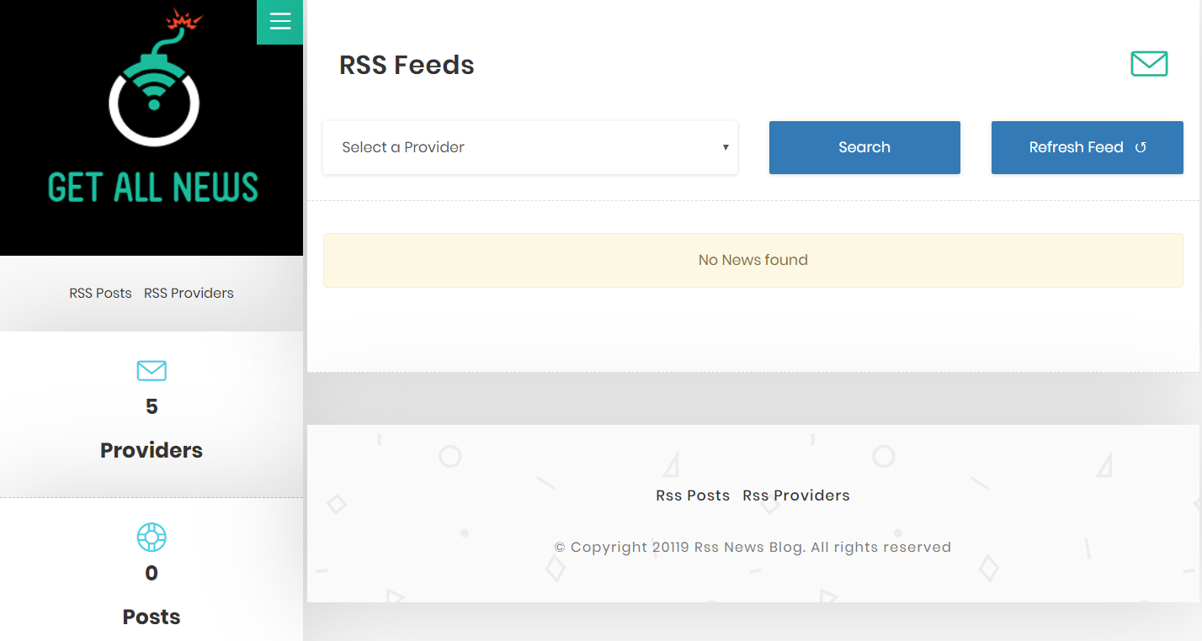
Introduction
Fetch News from multiple news sites from RSS and Atom format
View specific news
Filter specific Provider

Slide 4
Used Technologies
HTML
A standard markup language for making Web pages [1].
CSS
CSS is concerned with page presentation [2].
JavaScript /Jquery
Event handling and Ajax interactions for rapid web development [3].
PHP Laravel Framework
MVC architecture which allows better coding practice [4].
JSON
  A lightweight data-interchange format [5].
Mysql (DATABASE)
Free open-source Relational Database Management System [6].

Slide 5
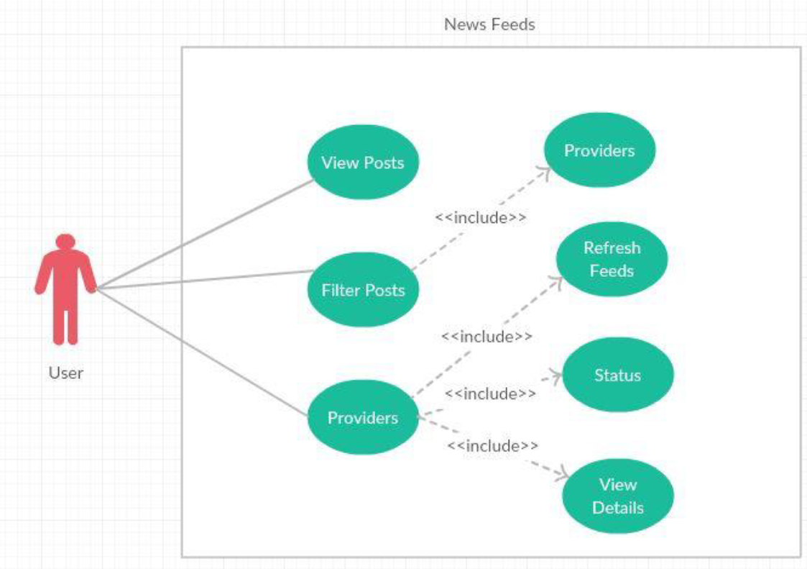
Use Case Diagram

Slide 6
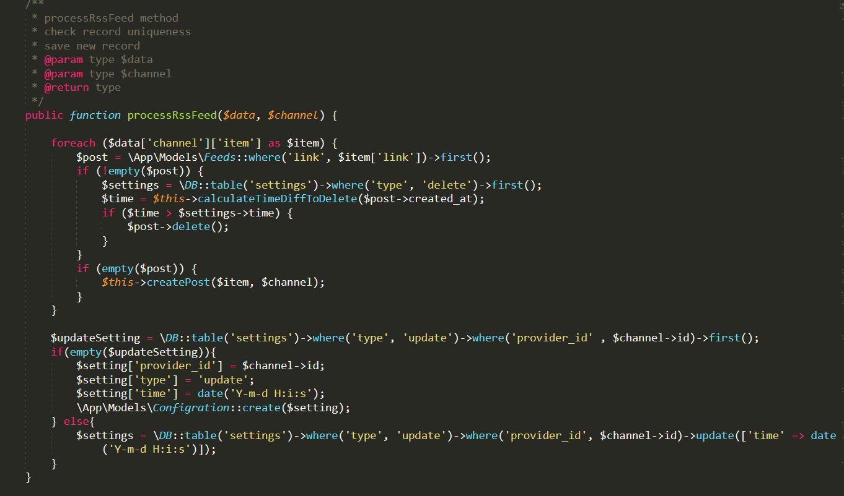
Code Implementation
Fetch Feeds

Slide 7
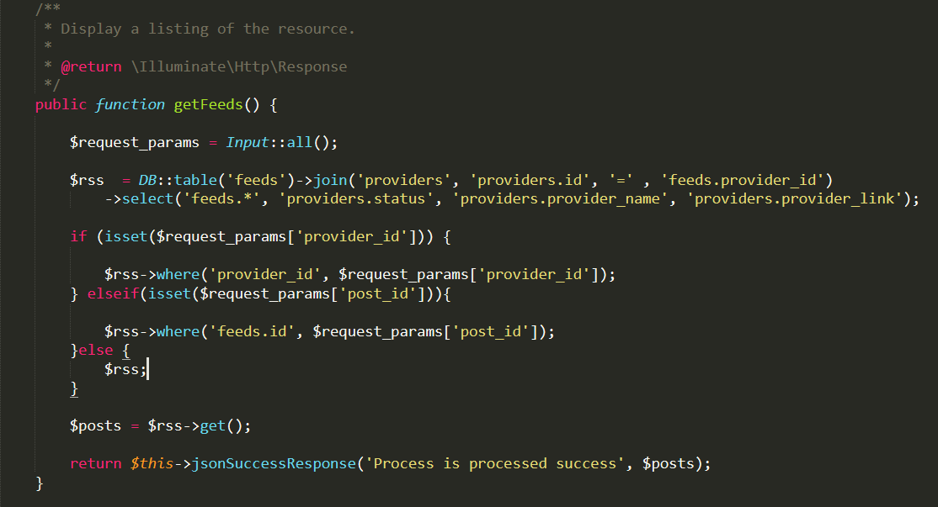
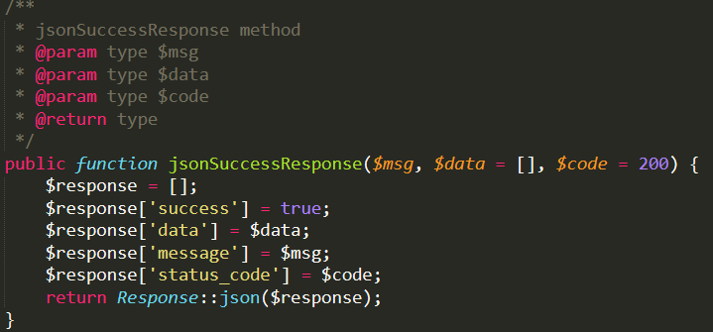
Code Implementation
API Controller

Slide 8
Live Demo
http://localhost/wdb-newsfeed/

Slide 9
Refrences
[1] “HTML Tutorial.” [Online]. Available: https://www.w3schools.com/html/. [Accessed: 02-Jul-2019].
[2] “CSS-Grundlagen,” MDN-Web-Dokumentation. [Online]. Available: https://developer.mozilla.org/de/docs/Learn/Getting_started_with_the_web/CSS_basics. [Accessed: 02-Jul-2019].
[3] J. F.- js.foundation, “jQuery.” .
[4] “Laravel - The PHP Framework For Web Artisans.” [Online]. Available: https://laravel.com/. [Accessed: 02-Jul-2019].
[5] “JSON.” [Online]. Available: https://www.json.org/. [Accessed: 02-Jul-2019].
[6] “MySQL.” [Online]. Available: https://www.mysql.com/de/. [Accessed: 02-Jul-2019].

Slide 10
Thank You!

