Slide 1
Question4
Ramzan Kamoto

Slide 2
Portfolio Commentary
Snake Oil capital closely follows its benchmark
Outperforms benchmark since Oct 2023
Resources and Industrials contribute most to upswings and downswings

Slide 3
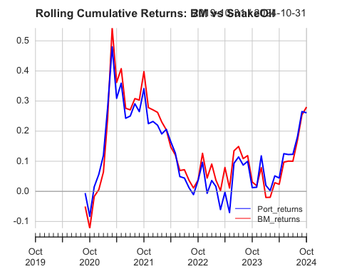
Rolling Cummulative returns
# Generate Charts generate_charts_q4(xts_data)

Slide 4
Performance Metrics vs BM
## a flextable object. ## col_keys: `Metric`, `Port_returns to BM_returns` ## header has 1 row(s) ## body has 12 row(s) ## original dataset sample: ## Metric Port_returns to BM_returns ## 1 Alpha 0.00 ## 2 Beta 0.88 ## 3 Beta+ 0.84 ## 4 Beta- 0.76 ## 5 R-squared 0.92

Slide 5
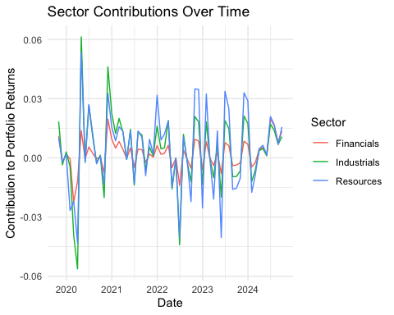
Sector Contribution
## `summarise()` has grouped output by 'date'. You can override using the ## `.groups` argument.

