Slide 1
Automated Generation of Executive Summaries for Meetings using NLP
Group Members:
1601-21-737-101: B. Sujith Kumar
1601-21-737-120: Mohd Ramzan Shareef
1601-21-737-119: Mohd Arbaz Ahmed
Under the guidance of:
Dr. B. Swathi Sowmya
Assistant Professor, CBIT

Slide 2
Table of contents
01
02
03
04
05
Introduction
Literature Survey
Problem Statement
Proposed System &
Methodology
Objectives

Slide 3

01
Introduction

Slide 4
1.Introduction
Online meetings are essential for communication in today's fast-paced work environment, with platforms like Google Meet, Zoom, and Microsoft Teams being widely used.
The increasing volume of meetings makes it challenging to keep track of key points, decisions, and action items.
Our project uses Natural Language Processing (NLP) techniques to automatically summarize online meetings.
The system captures audio from meetings, transcribes the content into text, processes it using advanced NLP algorithms, and generates concise summaries. These summaries highlight the main topics, decisions, and action items discussed during the meetings.
The solution saves time and ensures that important information is easily accessible, helping professionals stay organized and efficient.

Slide 5
02
Literature Survey

Slide 6
2. Literature Survey
Paper Title | Methodology | Observations | Research Gap
Meeting Summarizer using Natural Language Processing (Geethika Vadlamudi - 2022) (IEEE Xplore) (10.1109/ICOEI53556.2022.9777155) | The methodology integrates NLP tools, specifically TF-IDF and TextRank algorithms, to preprocess transcripts, extract relevant content, and rank sentences based on their importance. This approach is designed to produce extractive summaries, focusing on selecting key sentences from the original text. | The approach reduces manual effort in summarizing meetings, providing quick and efficient access to important information discussed in meetings. It leverages well-established NLP techniques to ensure relevance and accuracy in summaries. | Extractive summarization might miss out on providing a coherent narrative if key points are distributed across non-contiguous sentences. Lacks the capability to generate novel sentences that capture the essence of discussions more effectively.
Automatic Meeting Minutes Generation Using Natural Language Processing (Satish Muppidi, Jayanthi Kandi- 2023) (IEEE Xplore) (10.1109/EASCT59475.2023.10393102) | Proposes a model that uses NLP techniques to automatically generate meeting minutes. It converts speech to text and summarizes key points, focusing on extracting action items. The approach leverages models like BART, T5, and a Summarization Pipeline. | The system effectively automates the process of generating concise meeting minutes. It reduces the need for manual transcription and note-taking, saving time and minimizing human errors. High accuracy in generating summaries, as indicated by the ROUGE scores. | May suffer from noise and transcription errors in audio to text conversion, which could affect the quality of the generated summaries. May miss certain nuances of human conversation that require a deeper understanding of context.

Slide 7
Paper Title | Methodology | Observations | Research Gap
A Ranking based Language Model for Automatic Extractive Text Summarization (Pooja Gupta. - 2021) (IEEE Access) (10.1109/ICAITPR51569.2022.9844187) | Uses an n-gram language model to perform extractive summarization. The model ranks sentences by calculating unigram, bigram, and trigram probabilities and selects sentences with the highest cumulative scores to form the summary. | The ranking-based approach achieved reasonable summarization accuracy with ROUGE scores evaluated on the BBC and CNN news datasets, showing a higher accuracy on the BBC dataset (44%) than CNN (36%). | Limited accuracy and coherence in summaries, with a need for improvements to handle larger, diverse datasets effectively and enhance context understanding beyond simple n-gram modeling.
Write Summary Step-by-Step: A Pilot Study of Stepwise Summarization (Xiuying Chen - 2024) (IEEE Transactions) (1406) | Involves a step-by-step approach to summarization, using various NLP techniques to refine the summary. This includes tasks like text segmentation, keyword extraction, sentence ranking, and final summary generation. | The stepwise approach may lead to more controlled and transparent summarization processes, potentially increasing accuracy and allowing for better optimization of each summarization step. | The multi-step process could be more computationally intensive and time-consuming compared to end-to-end models. It might also require more fine-tuning to handle different text types effectively.

Slide 8
Paper Title | Methodology | Observations | Research Gap
Minutes of Meeting Generation for Online Meetings Using NLP & ML Techniques (Renu Kachhoria, Netal - 2024)(IEEE Access) (1109/ESCI59607.2024.10497256) | The methodology includes converting audio to text using the Whisper AI model, followed by speaker diarization with pyAnnote. The text is then summarized using a combination of abstractive and extractive summarization models, including PEGASUS, BART, and a customized summarization pipeline. Effectiveness is measured using ROUGE. | The use of multiple summarization models enhances the accuracy and relevance of the generated summaries. Integration of speaker diarization ensures that the meeting minutes accurately reflect who said what during the meeting. The model’s flexibility allows it to process various audio formats. | The complexity of integrating multiple models and techniques could lead to increased computational requirements. The accuracy of the speaker diarization may vary depending on the quality of the audio, which could impact the final summaries.
Video Based Transcript Summarizer for Online Courses using Natural Language Processing (Krishna Kulkarni, Rushikesh - 2021) (IEEE Transactions) (1406) | Involves two main NLP algorithms: Term Frequency-Inverse Document Frequency (TF-IDF) and the Gensim library for topic modeling. The system allows users to input a video URL, select a summarization model, and specify the desired summary length. The system uses TF-IDF . | The use of both TF-IDF and Gensim offers flexibility in generating summaries, allowing users to choose the most appropriate method for their needs. The system can process online course videos efficiently, providing a valuable tool for students to quickly review content. | The system’s reliance on transcript quality could affect the accuracy of the summaries if the transcripts are incomplete. Methods may not fully capture the context or subtleties of more complex educational content.

Slide 9
03
Problem Statement

Slide 10
3. Problem Statement
The shift to remote work has increased the frequency of online meetings, leading to information overload, time-consuming review processes, and inconsistent note-taking. Busy professionals struggle to identify key highlights such as action items and decisions within lengthy dialogues, making it challenging to retain essential information.
There is a need for an automated, accurate solution that can efficiently summarize meetings using NLP and machine learning, integrated into a user-friendly SaaS browser extension.

Slide 11
04
Proposed System & Methodology

Slide 12
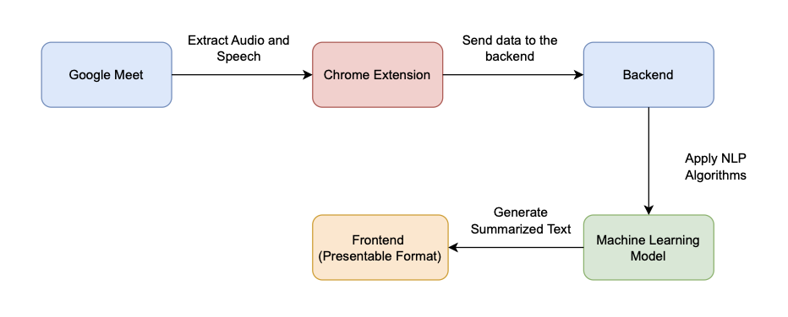
4. Proposed System

Slide 13
4. Proposed System
Built as a Chrome extension, providing easy access within the browser to capture and summarize meeting audio.
Backend uses Flask/Django/FastAPI for handling transcription, summarization, and user data via REST APIs.
Workflow: Audio is captured, transcribed, preprocessed, segmented, summarized, and displayed in the user dashboard.
User dashboard developed with ReactJS allows users to view, edit, and manage summaries, with customization options.
Technical components include a ReactJS front-end, Node.js and Express.js backend, and integration with NLP libraries and transformer models for summarization and entity recognition.

Slide 14
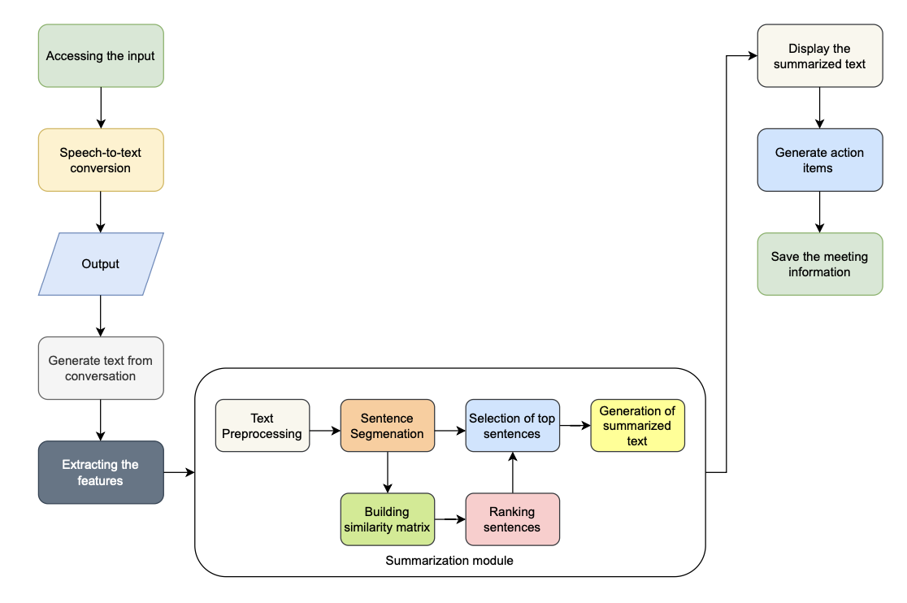
4. Methodology

Slide 15
4. Methodology
Captures audio from online meetings on platforms like Google Meet, Zoom, and Teams using the Chrome extension.
Converts audio to text in real-time with Speech-to-Text models, ensuring high accuracy across accents and noise levels.
Preprocesses text by removing filler words and standardizing words for clearer, structured input.
Applies extractive summarization using TF-IDF and TextRank to capture main discussion points based on word frequency and sentence importance.
Uses abstractive summarization models (BART, T5) to rephrase and produce fluent, concise summaries from the transcript.
Integrates Named Entity Recognition (NER) to identify key people, dates, and roles, and uses a classifier to extract action items for tracking tasks and decisions.
Processes lengthy transcripts through chunking, allowing for more efficient summarization by breaking text into smaller segments.

Slide 16
05
Objectives

Slide 17
5. Objectives
Develop an NLP-based system to automatically capture and summarize key points, decisions, and action items from online meeting audio, enhancing accessibility and organization for busy professionals.
Implement a user-friendly Chrome extension that integrates with popular meeting platforms (e.g., Google Meet, Zoom, Teams) to enable real-time transcription and summarization directly within the browser.
Optimize the summarization accuracy and efficiency by utilizing advanced NLP techniques, such as extractive and abstractive summarization, named entity recognition (NER), and classifier models, to ensure concise and relevant summaries for end-users.

Slide 18
Thank You!

