Slide 1
Offensive Content Identification in Arabizi Tweets
Milestone 3a – Final Presentation
EECE 693 – Spring 2020
Group #8
Majd Al Aawar, Ramzi Haddad, Yazan Hajj Diab, Ali Ismail

Slide 2
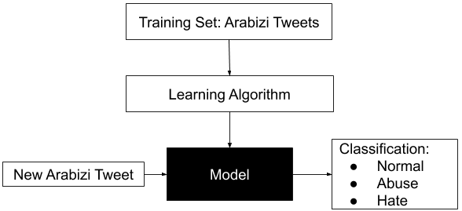
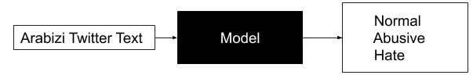
Problem Description & Research Challenges
Problem Description:
Hate speech
Language Diversity
Challenges:
Transliteration of the Arabic dataset to Arabizi.
No pre-trained word embeddings for Arabizi.
Class imbalance within the Arabic dataset.

Slide 3
Targeted innovations and contributions
A model able to identify offensive content in Arabizi tweets.
Compare results to classification done in Arabic to inform on whether it is a better practice to work with Arabizi writing or transliterate back to standard Arabic.
An experimental Arabizi dataset in Levantine dialect.

Slide 4
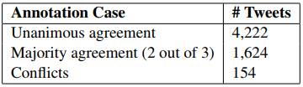
State-of-the-art Paper - L-HSAB: A Levantine Twitter Dataset for Hate Speech and Abusive Language [1]
Identification of hate speech specifically in the Levantine Arabic dialect (Lebanese and Syrian).
Achievements:
Created a dataset for offensive content identification in Levantine dialect.
Developed models to detect offensive content.
Weaknesses:
Did not address class imbalance.
Some labelling disagreement was reported among annotators.

Slide 5
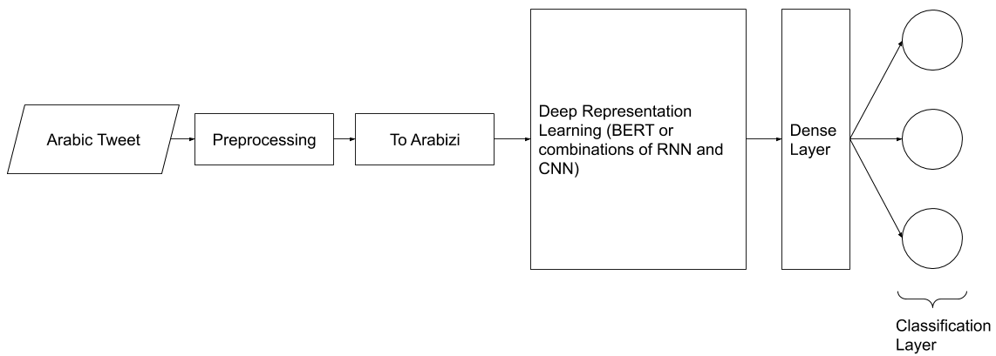
Proposed Method Overview

Slide 6
Detailed Methodology
Preprocessing:
Removed emoji, punctuation, interjections (“ههههه”) and gibberish.
Normalized elongated words (“حمااااااار”).
Transliteration:
Mapping each arabic letter to its corresponding english one.
Models used:
Multinomial Naive Bayes with tweets represented as TF-IDF vectors.
BiLSTM: word embeddings are fed to a BiLSTM layer followed by a softmax classifier.
CNN-LSTM: the combined architecture consists of an embedding layer followed by one convolutional layer with max pooling, followed by one LSTM layer finally leading to a dense softmax layer.
BERT: BERT base multilingual pre-trained model, fine-tuned on the present dataset.
Notes:
CNN-LSTM: Input text is represented as a grid, dimensions 100 x 280 (Embedding size x Max comment length), and first fed into the convolutional layer. In the convolutional layer, the network is able to learn short-term dependencies. The outputs of the convolutional layers are low level features which capture these short-term dependencies and positional relations between adjacent words. The LSTM layers take as input these low-level features and learn long term dependencies. The outputs of the LSTM layers are high-level features of the sentences which are then used for classification.
BERT:

Slide 7
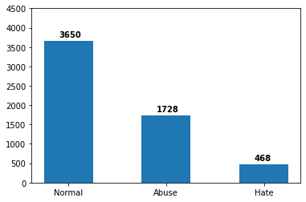
Experiments and Setup
Dataset: L-HSAB (original and Arabizi)
5846 Tweets in Levantine Dialect.
Classes: Normal, Abuse or Hate.
Experimental Setup:
Experiments performed in Google Colab using Python libraries (regular expressions, gensim, Scikit-learn, Keras, Pytorch, Simple Transformers).
Stratified train/test split 80/20 %.
Weighted loss function for data imbalance.
Model selection using random hyperparameter search and 5-fold cross-validation.
Experiments Carried:
Model development for the original Arabic data for benchmarking against previous work.
Transliteration of L-HSAB into Arabizi conforming to the writing style of the people of the Levant.
Model development for the Arabizi data.
Normal | llasf al72y2a tjr7 ys3d sba7k
Abuse | s7y7 ank wa7d ahbl ma btfhm
Hate | allh yl3nk wyl3n hyk bld fasd mthlk

Slide 8
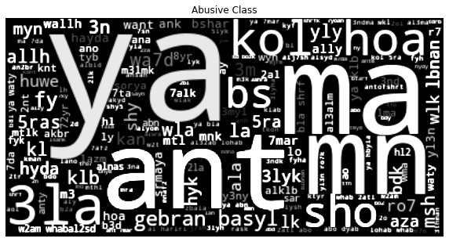
Results and Evaluation
Transliteration of dataset into Arabizi.
Diacritics would’ve made it more accurate [4].
Some outliers (MSA, orthography).
Classification Results
Arabic
 | Precision | Recall | F1 | Accuracy
Naive Bayes | 76 | 70 | 72 | 70
BiLSTM | 73 | 72 | 73 | 72
BiLSTM (AraVec) | 77 | 78 | 77 | 78
CNN-LSTM | 78 | 75 | 76 | 75
CNN-LSTM (AraVec) | 79 | 77 | 78 | 77
BERT | 81 | 82 | 81 | 82
Arabizi
 | Precision | Recall | F1 | Accuracy
Naive Bayes | 76 | 70 | 72 | 70
BiLSTM | 75 | 73 | 73 | 73
CNN-LSTM | 76 | 77 | 76 | 77
BERT | 75 | 76 | 76 | 74

Slide 9
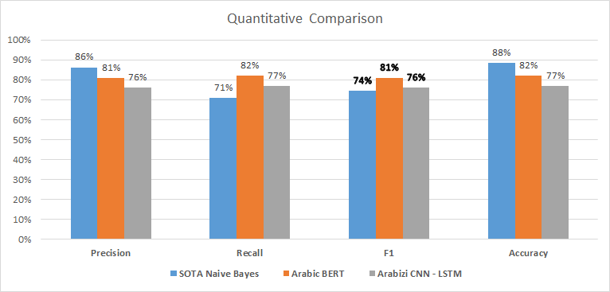
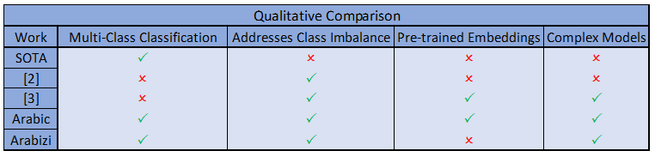
Quantitative Comparison with state of the art work & Qualitative comparison with top 3 prior work
F1- score used due to data imbalance in SOTA
Both Arabic and Arabizi models had better results
No pre-trained word embeddings for Arabizi
Utilized complex models for our task

Slide 10
Conclusion and Future Work
Conclusions:
Transliterated the Arabic dataset to Arabizi, proper diacritization needed to achieve more realistic results.
BERT achieved state-of-the-art performance in Arabic but not in Arabizi (multilingual pre-training did not transfer well to Arabizi, similar behavior shown in Hindi [5]).
CNN-LSTM achieved state-of-the-art in Arabizi (Recall here is important since it means the model is more likely to catch offensive tweets).
Future Work:
Collection of large Arabizi dataset.
Develop Embedding models for Arabizi.

Slide 11
Backup – Related work and what they have achieved (M2 details)
Paper # | Problem | Target Classes | Languages | Models
6 | Offensive content detection | OFF/NOT, TIN/UNT, IND/GRP/OTH | English | SVM, BiLSTM, CNN
1 | Offensive content detection | Normal, abuse, hate | Levantine Arabic | SVM, NB
8 | Sentiment Analysis | Positive/negative/neutral | Arabizi transliterated to Arabic | SVM, NB
This Work | Offensive content detection | Normal, abuse, hate | Arabizi | BERT, RNN-CNN

Slide 12
References
[1] H. Mulki, H. Haddad, C. Bechikh Ali, and H. Alshabani, “L-HSAB: A Levantine Twitter Dataset for Hate Speech and Abusive Language,” in Proceedings of the Third Workshop on Abusive Language Online, Florence, Italy, 2019, pp. 111–118, doi: 10.18653/v1/W19-3512
[2] B. Haidar, M. Chamoun, and A. Serhrouchni, “Arabic Cyberbullying Detection: Enhancing Performance by Using Ensemble Machine Learning,” in 2019 International Conference on Internet of Things (iThings) and IEEE Green Computing and Communications (GreenCom) and IEEE Cyber, Physical and Social Computing (CPSCom) and IEEE Smart Data (SmartData), Atlanta, GA, USA, 2019, pp. 323–327, doi: 10.1109/iThings/GreenCom/CPSCom/SmartData.2019.00074.
[3] H. Mohaouchane, A. Mourhir, and N. S. Nikolov, “Detecting Offensive Language on Arabic Social Media Using Deep Learning,” in 2019 Sixth International Conference on Social Networks Analysis, Management and Security (SNAMS), Granada, Spain, 2019, pp. 466–471, doi: 10.1109/SNAMS.2019.8931839.
[4]United Nations, "Romanization System from Arabic letters to Latinized letters", UNSTATS. New York, United Nations Publications, 2007. Available: https://unstats.un.org/unsd/geoinfo/UNGEGN/docs/11th-uncsgn-docs/E_Conf.105_137_CRP.137_14_Romanization%20System%20from%20Arabic%20%20letters%20to%20Latinized%20%20%20letters%202007%20-%20ENGLISH.pdf.
[5]T. Pires, E. Schlinger, and D. Garrette, “How multilingual is Multilingual BERT?,” arXiv:1906.01502 [cs], Jun. 2019, [Online]. Available: http://arxiv.org/abs/1906.01502.
[6] M. Zampieri, S. Malmasi, P. Nakov, S. Rosenthal, N. Farra, and R. Kumar, “Predicting the Type and Target of Offensive Posts in Social Media,” arXiv:1902.09666 [cs], Apr. 2019, Accessed: Feb. 11, 2020. [Online]. Available: http://arxiv.org/abs/1902.09666.
[8]R. M. Duwairi, M. Alfaqeh, M. Wardat, and A. Alrabadi, “Sentiment analysis for Arabizi text,” in 2016 7th International Conference on Information and Communication Systems (ICICS), Irbid, Jordan, 2016, pp. 127–132, doi: 10.1109/IACS.2016.7476098.

