Slide 1

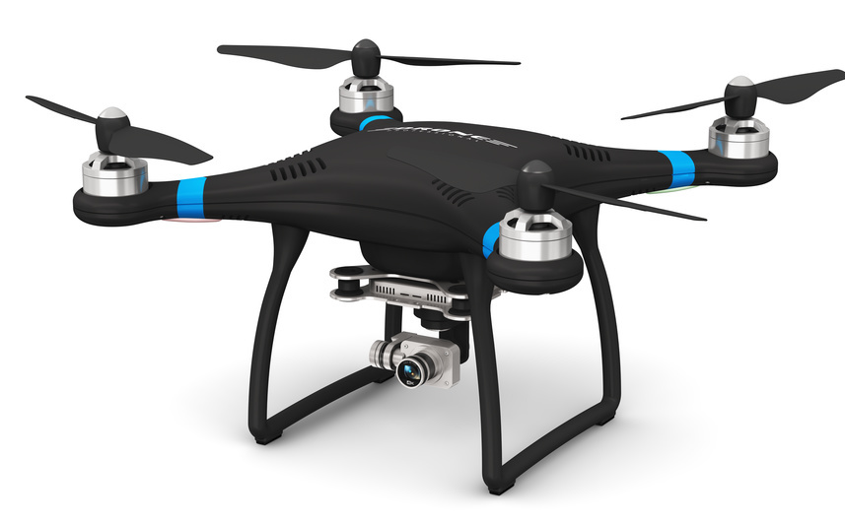
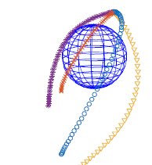
Convex Optimization Application:
Trajectory Planning
Omar Farhat
Ahmad Amin
Ramzi Haddad

Slide 2
Definition
Trajectory planning is a common problem in robotics, whether in wheeled robots or unmanned aerial robots.
Trajectory planning is the problem of creating motion from one point to another while avoiding collisions.
Collisions can be defined as an event in which the robot gets into contact with any other object in its environment.

Slide 3
Motivation
Unmanned aerial vehicles (UAVs) have prominent roles in aerial mission.
Trajectory planning is vital to increase the level of autonomy of UAVs.
The UAV must be capable of operating within a complex environment, which may include obstacles and other no-fly zones.
Trajectory planning is an NP-hard (non-deterministic polynomial time) problem which means that its algorithm’s execution time is usually long and grows exponentially with problem size.
There are different approaches for algorithms that tackle trajectory planning.
We will be discussing the convex optimization approach.

Slide 4
Goal
Generate collision-free trajectories in three dimensions for multiple quadrocopters within seconds.
The goal is to transition from an initial to a final set of states, each consisting of position, velocity and acceleration.
The vehicles must maintain a minimum distance between each other and satisfy other trajectory constraints.
Assumption: The environment is obstacle free
The method used can be applied for any vehicle type by modifying the constraints.
Notes:
Quadrocopter: a helicopter that is lifted by four rotors

Slide 5
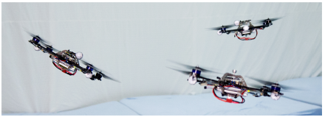
Problem Setup
Given: N vehicles that transition in a given time T.
Objective: Generate a collision-free trajectory for each vehicle by minimizing the total thrust at each time step for each quadrocopter.
Constraints: Physical limits of the vehicles, space boundaries, and avoidance constraints.

Slide 6


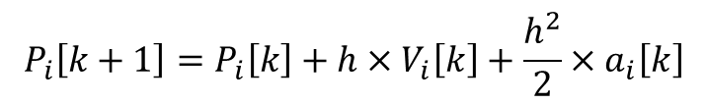
Dynamics Equations
$$V_{i}\left[k+1\right]=V_{i}\left[k\right]+h×a_{i}\left[k\right]$$
$$P_{i}\left[k+1\right]=P_{i}\left[k\right]+h×V_{i}\left[k\right]+\frac{h^{2}}{2}×a_{i}\left[k\right]$$
where:
$P_{i}\left[k\right]$: position of vehicle i at discrete times k
$V_{i}\left[k\right]:\text{velocity} \text{of} \text{vehicle} \text{i} \text{at} \text{discrete} \text{times} \text{k}$
k $ε \left\{1,…K\right\}$
${ P}_{i}\left[k\right]$, $V_{i}\left[k\right] \& a_{i}\left[k\right] ε ℝ^{3}$
h: discretization time step

Slide 7


Optimization Variable
The optimization variable is the vehicles’ acceleration at each time step k, denoted by $\text{Χ}.$
$\text{Χ} ε ℝ^{3×N×K}$
We can see that $P_{i}\left[k\right] \& V_{i}\left[k\right]$are affine functions of $\text{Χ}$.
So, each consists of 3 dimensions for N vehicles at K time steps (position, velocity, and acceleration.)
Iteratively, the dynamics equations become of the following form: (for k>1)
$V_{i}\left[k\right]=V_{i}\left[1\right]+h×{(a}_{i}\left[1\right]+a_{i}\left[2\right]…+$ $a_{i}\left[k−1\right])$
$P_{i}\left[k\right]=P_{i}\left[1\right]+h×\left(k−1\right)×V_{i}\left[1\right]+\frac{h^{2}}{2}×{((2k−3)×a}_{i}\left[1\right]+{\left(2k−5\right)×a}_{i}\left[2\right]+…+ a_{i}\left[k−1\right])$

Slide 8

Objective Function
The objective function, to be minimized, is the sum of the total thrust at each time for a quadrocopter.
It is defined as follows:
$$f_{0}=\sum_{i=1}^{N}{\sum_{k=1}^{K}{{\left\|a_{i}\left[k\right]+\vec{g}\right\|}_{2}^{2}}}$$
where $\vec{g}$ is the gravity vector.
Note: The objective function above is convex, and in fact can be written as quadratic function of the form: $f_{0}(\text{Χ}\text{)}={\text{Χ}}^{T}P\text{Χ}\text{+}{\text{q}}^{T}\text{Χ}\text{+}\text{r}$

Slide 9
Constraints
Convex Constraints:
Dynamics Equations (already defined)
Initial & final states for each vehicle
Boundaries on position, velocity, acceleration, and jerk (physical constraints)
Non-Convex Constraints:
Collision avoidance constraints

Slide 10

Initial & final states for each vehicle
The position, velocity and acceleration for each vehicle at times k=1 & k=K is given.
Thus, we have constraints on $P_{i}\left[1\right],V_{i}\left[1\right],a_{i}\left[1\right],P_{i}\left[K\right],V_{i}\left[K\right],{ \& a}_{i}\left[K\right].$
Note that $P_{i}\left[1\right] \& V_{i}\left[1\right]$ are already taken into consideration in the dynamics equations.
We are left with 4 constraints, each consisting of 3 components (x,y,z).
Thus, we have 12*N equality constraints.
In fact, they are affine functions of $\text{Χ}$ and have the form:
$A_{eq}\text{Χ}\text{=}$ $b_{eq}$
where $A_{eq} ε ℝ^{12N×3NK}$ & $b_{eq} ε ℝ^{12N}$

Slide 11

Boundaries on position, velocity, acceleration, and jerk (physical constraints)
Boundaries on position:
These are due to a limited workspace.
$P_{min,l}≤P_{i,l}[k]≤P_{max,l}$ where l $ε \{x,y,z\}$
This gives us 2 constraints, for each dimension, for each vehicle at each time step k.
Thus, we have 6*N*K affine inequality constraints.
Assume there is no limit on velocity

Slide 12

Boundaries on position, velocity, acceleration, and jerk (physical constraints)
Boundaries on Acceleration:
The collective thrust of each vehicle is limited by a minimum and maximum thrust value.
The constraint is as follows: $f_{min}≤\sqrt{{(a_{i,x})}^{2}+{(a_{i,y})}^{2}+{(a_{i,z}+g)}^{2}}$ $≤$ $f_{max}$
This quadratic constraint can be simplified by constraining each coordinate separately:
$a_{min,l}≤a_{i,l}[k]≤$ $a_{max,l}$ where l $ε \{x,y,z\}$
This gives us 2 constraints, for each dimension, for each vehicle at each time step k.
Thus, we have 6*N*K affine inequality constraints.
The limits are chosen such that: $\sqrt{{(a_{max,x})}^{2}+{(a_{max,y})}^{2}+{(a_{max,z}+g)}^{2}}$ $≤$ $f_{max}$ & $g+a_{min,z}≥f_{min}$

Slide 13

Boundaries on position, velocity, acceleration, and jerk (physical constraints)
Boundaries on jerk:
The jerk is the 3rd derivative of position.
It is bounded to ensure a continuity in acceleration and thus continuity in the attitude of a quadrocopter.
The constraints are as follows: $j_{min,l}≤j_{i,l}[k]≤$ $j_{max,l}$ where l $ε \{x,y,z\}$
where $j\left[k\right]=\frac{a\left[k\right]−a[k−1]}{h}$
This gives us 2 constraints, for each dimension, for each vehicle at k-1 time steps.
Thus, we have 6*N*(K-1) affine inequality constraints.

Slide 14
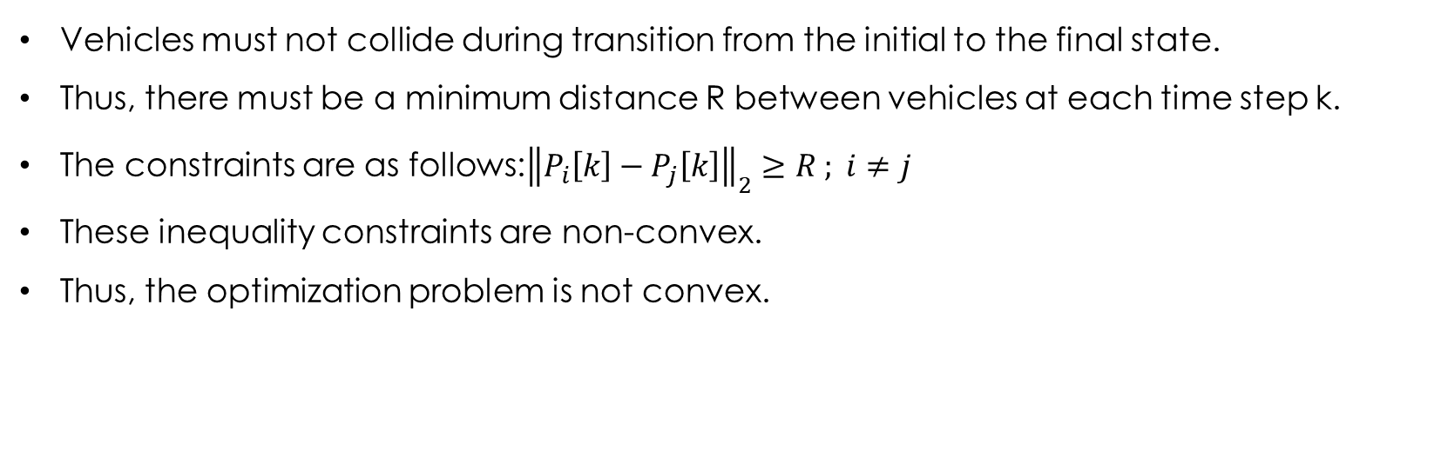
Non-Convex Constraints for Collision Avoidance
Vehicles must not collide during transition from the initial to the final state.
Thus, there must be a minimum distance R between vehicles at each time step k.
The constraints are as follows:${\left\|P_{i}\left[k\right]−P_{j}\left[k\right]\right\|}_{2}≥R ; i≠j$
These inequality constraints are non-convex.
Thus, the optimization problem is not convex.

Slide 15

Approximated Collision Avoidance Constraints
The goal is to turn the non-convex problem into convex optimization.
Using a first-order Taylor Expansion, the collision avoidance constraint at iteration (q+1) is linearized around the previous solution ${\text{Χ}}^{q}$.
It becomes of the following form:
$${\left\|P_{i}^{q}\left[k\right]−P_{j}^{q}\left[k\right]\right\|}_{2}+η^{T}\left[\left(P_{i}\left[k\right]−P_{j}\left[k\right]\right)−\left(P_{i}^{q}\left[k\right]−P_{j}^{q}\left[k\right]\right)\right]≥R$$
$$with η=\frac{P_{i}^{q}\left[k\right]−P_{j}^{q}\left[k\right]}{{\left\|P_{i}^{q}\left[k\right]−P_{j}^{q}\left[k\right]\right\|}_{2}}$$
$P_{i}^{q}$ is the position of vehicle I corresponding to the solution ${\text{Χ}}^{q}$.
We obtain $N∗\frac{N−1}{2}∗K$ affine inequality constraints.

Slide 16

Resulting Problem
minimize $\sum_{i=1}^{N}{\sum_{k=1}^{K}{{\left\|a_{i}\left[k\right]+\vec{g}\right\|}_{2}^{2}}}$
subject to $V_{i}\left[k+1\right]=V_{i}\left[k\right]+h×a_{i}\left[k\right]$ $P_{i}\left[k+1\right]=P_{i}\left[k\right]+h×V_{i}\left[k\right]+\frac{h^{2}}{2}×a_{i}\left[k\right]$
$a_{i}\left[1\right],P_{i}\left[K\right],V_{i}\left[K\right],{ \& a}_{i}\left[K\right]$
$P_{min,l}≤P_{i,l}[k]≤P_{max,l}$ $a_{min,l}≤a_{i,l}[k]≤$ $a_{max,l}$
$j_{min,l}≤j_{i,l}[k]≤$ $j_{max,l}$ $j\left[k\right]=\frac{a\left[k\right]−a[k−1]}{h}$
${\left\|P_{i}^{q}\left[k\right]−P_{j}^{q}\left[k\right]\right\|}_{2}+η^{T}\left[\left(P_{i}\left[k\right]−P_{j}\left[k\right]\right)−\left(P_{i}^{q}\left[k\right]−P_{j}^{q}\left[k\right]\right)\right]≥R$
$$η=\frac{P_{i}^{q}\left[k\right]−P_{j}^{q}\left[k\right]}{{\left\|P_{i}^{q}\left[k\right]−P_{j}^{q}\left[k\right]\right\|}_{2}}$$

Slide 17

Resulting Problem
This problem can be written as:
$$minimize {\text{Χ}}^{T}P\text{Χ}\text{+}{\text{q}}^{T}\text{Χ}\text{+}\text{r}$$
$$subject to A_{eq}\text{Χ}\text{= }b_{eq}$$
$A_{in}\text{Χ} {≼b}_{in}$
where $\text{Χ} ε ℝ^{3×N×K}$, $A_{eq} ε ℝ^{12N×3NK}$ , $b_{eq} ε ℝ^{12N}$ , $A_{in}$ $ε ℝ^{M×3NK} \&{ b}_{in} ε ℝ^{M}$
M, the number of inequality constraints, is equal to:$23.5∗K∗N−6∗N+0.5∗K∗N^{2}$
The problem consists of a quadratic function and affine constraints, so it is a quadratic program.
Notes:
M=6NK+6NK+6N(K-1)+0.5*N*(N-1)*K=17.5NK-6N+0.5*N^2*K??

Slide 18

Sequential Convex Programming (SCP)
SCP is a local optimization method for non-convex problems.
It works by replacing non-convex constraints with convex approximations around a previous solution ${\text{Χ}}^{q}$.
The convex problem is solved iteratively, starting from an initial guess ${\text{Χ}}^{0}.$
${\text{Χ}}^{0}$ is chosen by computing the solution of the problem without the avoidance constraint.
This method iterates until a stop condition is satisfied.
Stopping Conditions:
${\text{Χ}}^{q}$ is an optimal solution of the approximate convex problem.
${\text{Χ}}^{q}$ fulfills the non-convex constraint.
$\left|f_{0}({\text{Χ}}^{q−1}\text{)} −f_{0}({\text{Χ}}^{q}\text{)}\right|<ε$ , where $ε$ is a tuning parameter.
Notes:
3: convergence in the objective value is achieved

Slide 19

The Algorithm
Notes:
3: convergence in the objective value is achieved

