Slide 1
Google Code Source Forge
Easy as:
  Project name
  Project summary
  Project description
  VCS selection
  Licensing

Slide 2
License Selection
License selection:
  Apache License 2.0
  Artistic License GPL
  Eclipse Public License 1.0
  GPL v2/v3/LGPL
  MIT License
  Mozilla Public License 1.1
  New BSD License
  Other (always if accpeted by OSI)

Slide 3
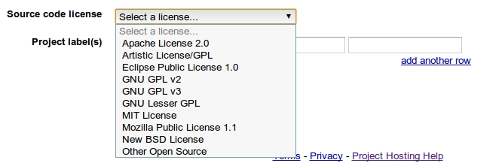
License Selection

Slide 4
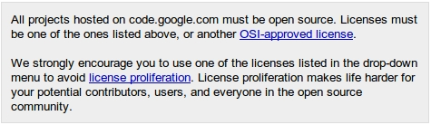
License Selection
License requirements:
  OSI-approved license (pragmatic's view)
  Avoid License proliferation

Slide 5
VCS Features
Ease of Use / Easy paths checkout
Browse Area
  Browse directories / Inspect files
  Edit and commit files “on-line”
Download Area (non automatic)
Change area
  View changes
  Review changes
  Vote changes
Cloning

Slide 6
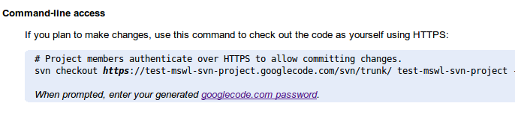
VCS Features
Ease of Use / Easy paths checkout

Slide 7

VCS Features
Browse Area:
  Browse File Hierarchy
  Browse Files
  Edit and commit online !

Slide 8

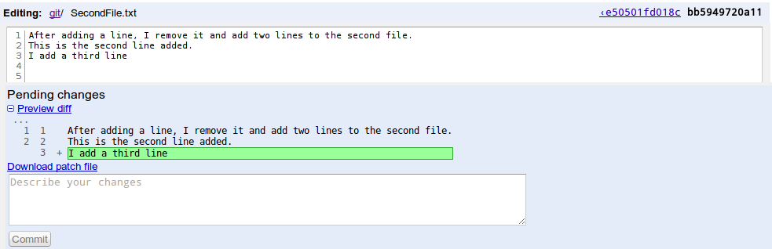
VCS Features

Slide 9
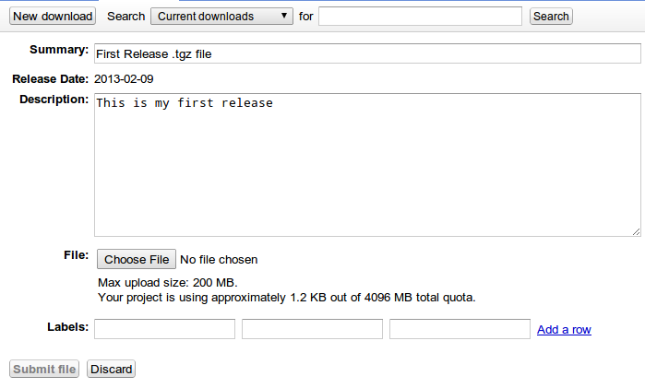
VCS Features
Downloads: Allow uploading “release files”

Slide 10

VCS Features
Changes Area: Browse Changes

Slide 11
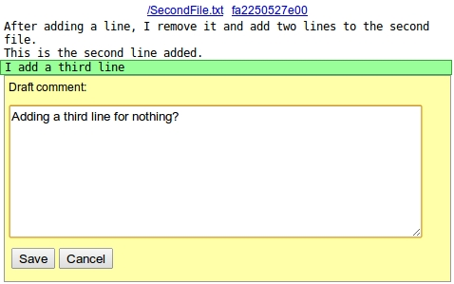
VCS Features
Changes Area: Review Changes
  Line by line comments

Slide 12
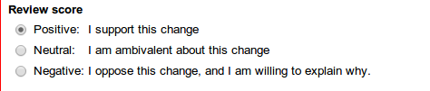
VCS Features
Changes Area: Vote Changes

Slide 13
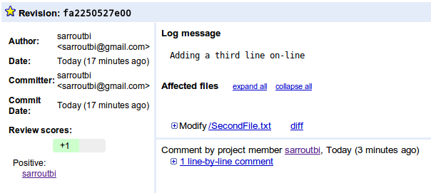
VCS Features
Changes Area: Vote Changes

Slide 14
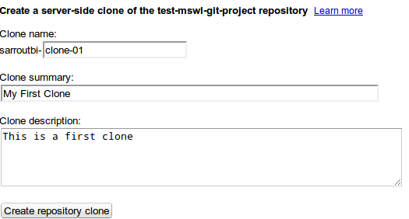
VCS Features
Fork:

