Slide 1

Credit Cardholders Segmentations for Marketing Stategies

Slide 2
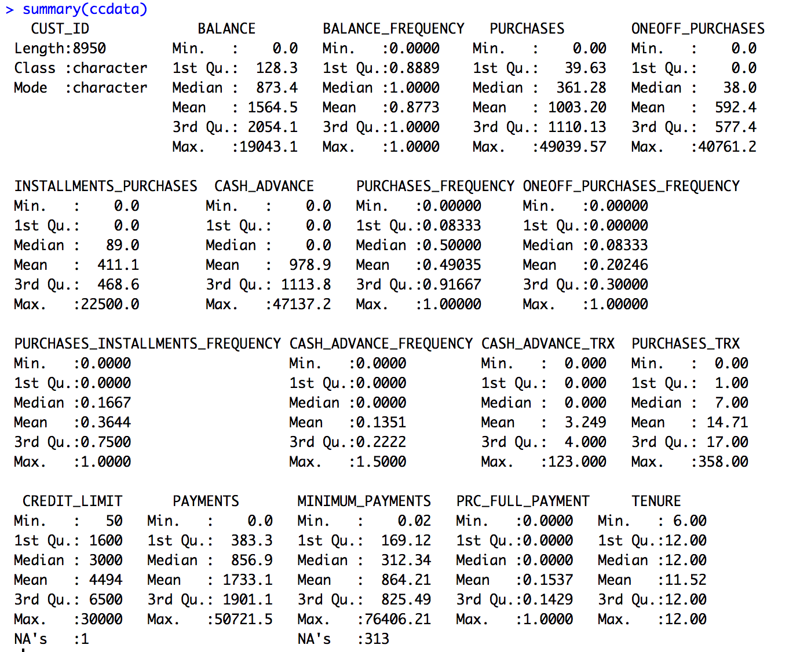
Background Information
Basic data exploration – 2 columns have NAs
Statement of marketing question
Description of the dataset
usage behavior of about 9000 active credit card holders
18 behavioral variables
how to use data analytics to make a customer segmentation for defining the marketing strategy based on the Credit Card Dataset

Slide 3
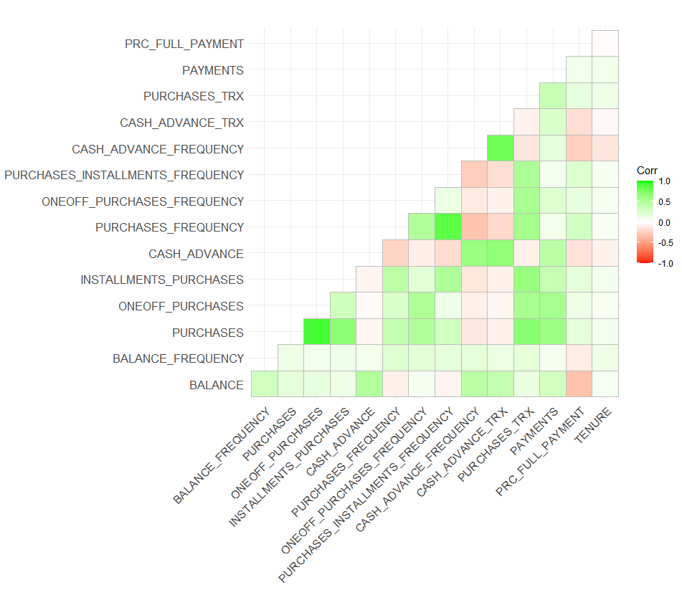
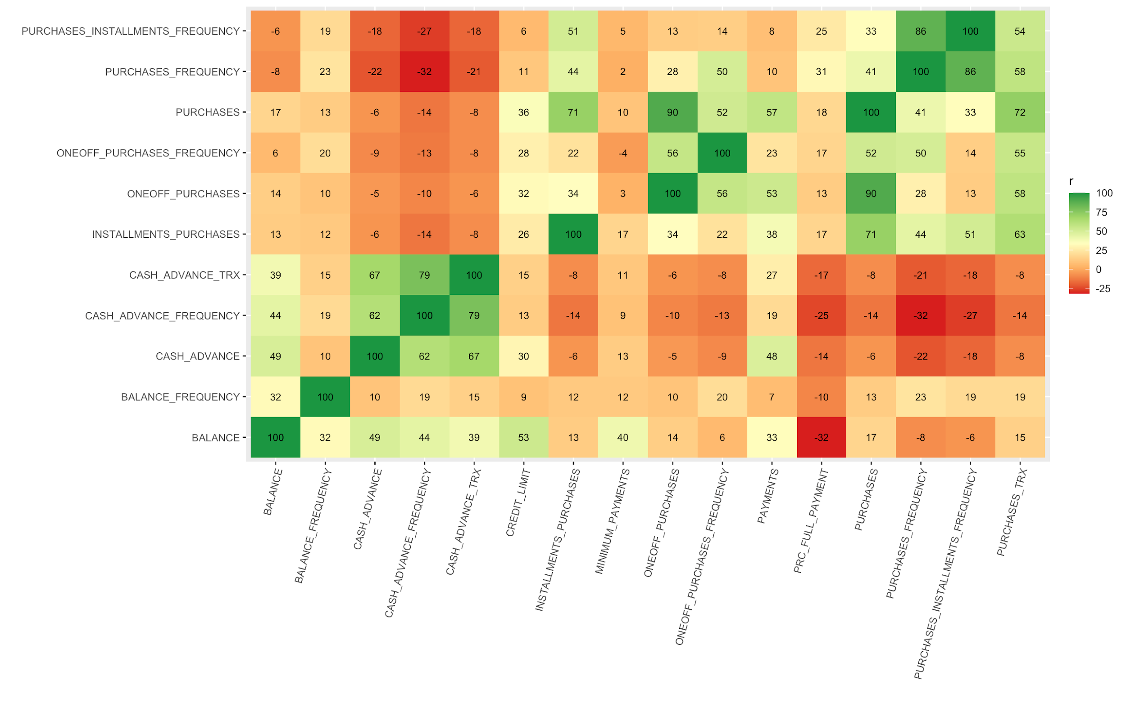
Correlation
No obvious relationship
Most people buy thing within affordability and the purchasing behavior doesn’t change

Slide 4
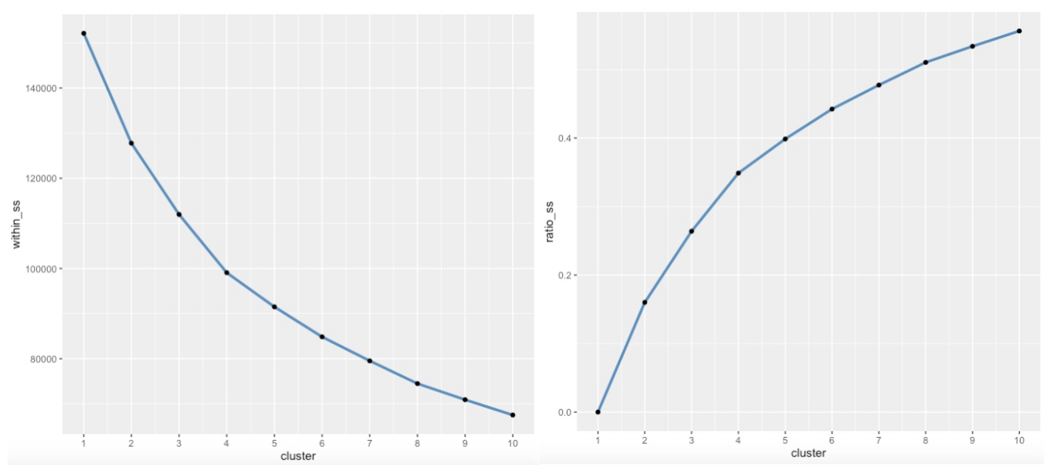
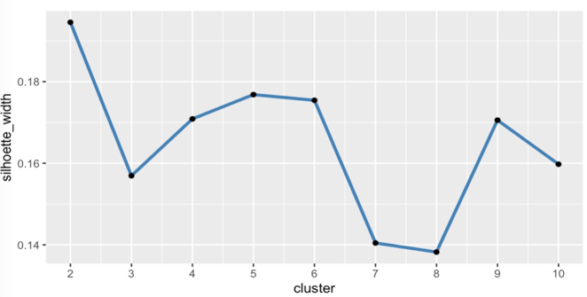
Determining the number of clusters
Total Within Sum of Square Plot
Ratio Plot
Silhouette Plot
3,4
4
2
4
Notes:
We use the tota within sum of Square plot, ratio

Slide 5
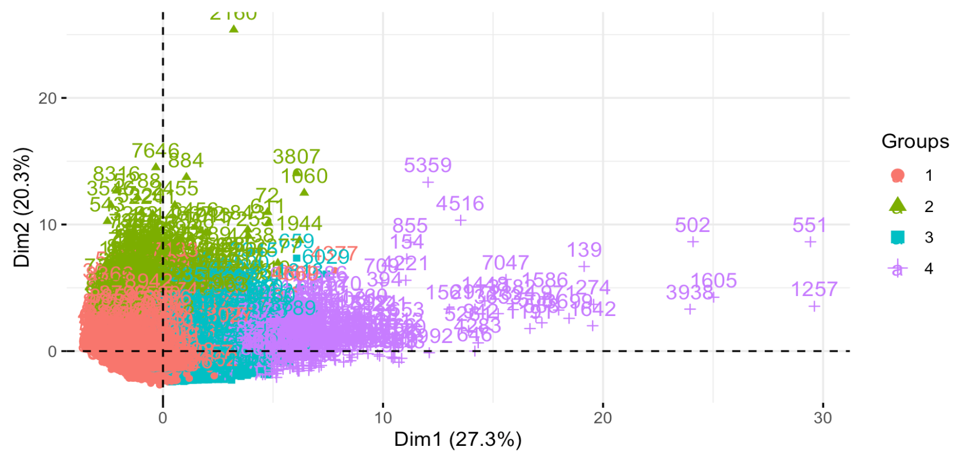
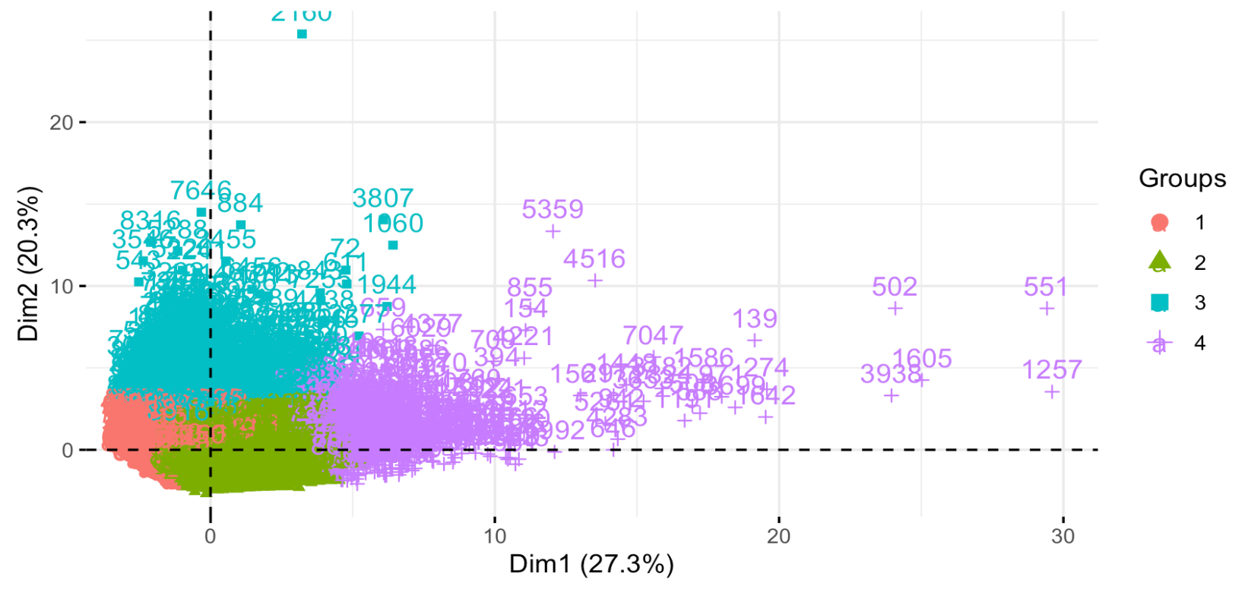
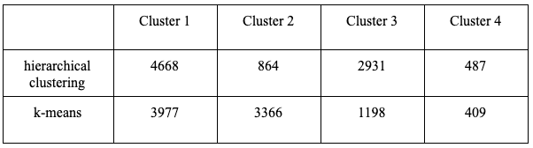
Hierarchical & K-means PCA Comparison
Notes:
Hierarchical left
As the table below, hierarchical clustering and k-means have similar assignment percentages
The k-means graph’s boundary is more clear and there are fewer points from different clusters overlapping with each other. However, we can not conclude which way is better only based on our naked eyes. We also do the silhouette plot comparison.

Slide 6


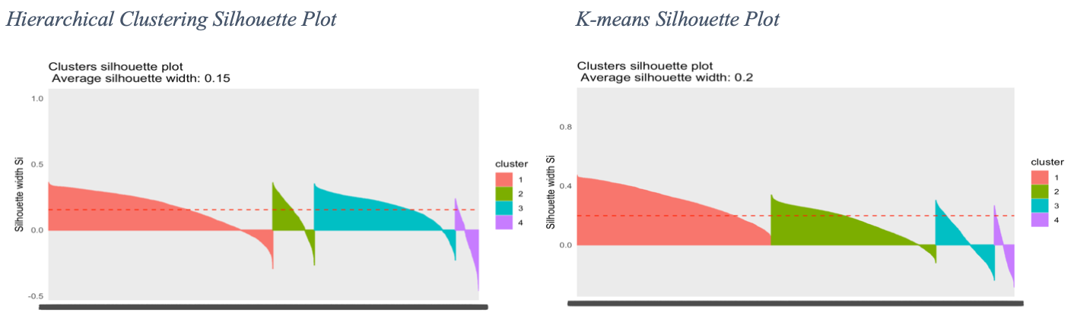
Hierarchical Clustering v.s. K-means
Fail to scale well for large dataset
Suitable for large dataset
Comparatively LOW avg Silhouette width
-- many observations in that method are
probably in the wrong clusters
Comparatively HIGH avg Silhouette width
Notes:
The heirarchical one has a realativly low silhouette width
that indicates that many observations in that method are probably in the wrong clusters.
K-means is the better one.

Slide 7
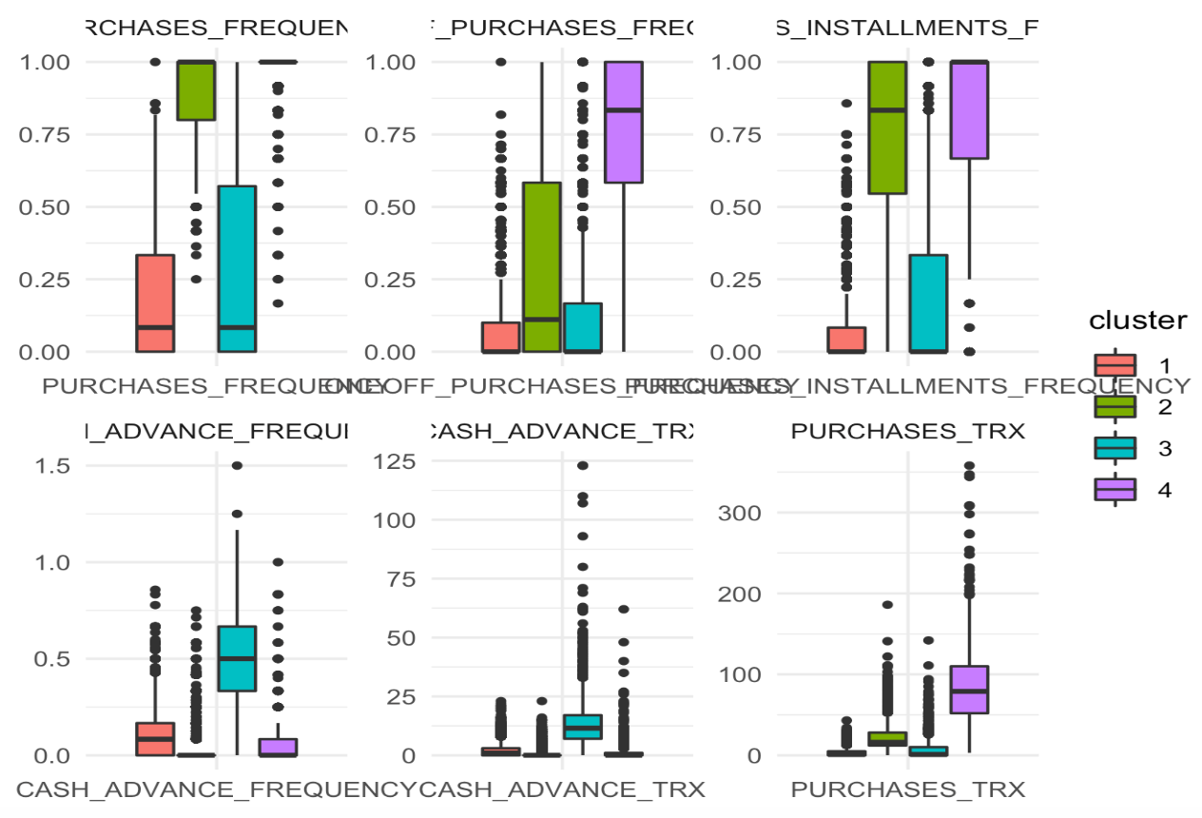
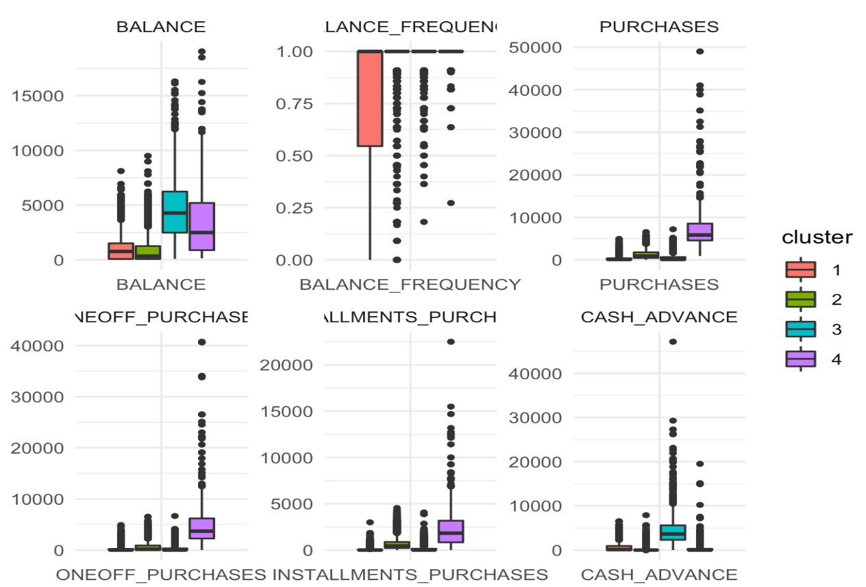
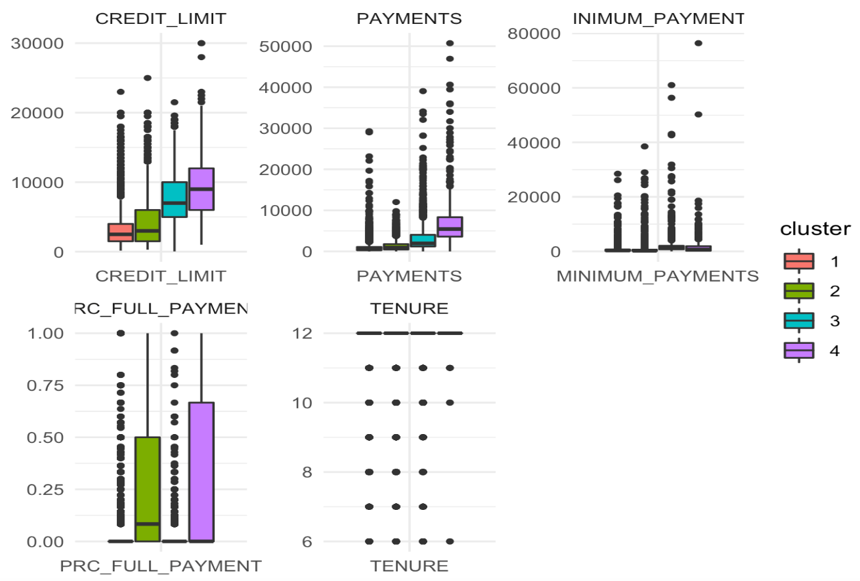
Analyzing Box Plots & Conclusion
Customer Profile – interesting results
Cluster 1: Rare user, with (probably) low to mid income
Cluster 2: Frequent user, with (probably) low income
Cluster 3: Mid to rare users, with (probably) high income
Cluster 4: Super frequent user, with (probably) mid to high income, frequently purchasing with installment
Notes:
Finally, our conclusion is that low-income customers with the least consumption, low-income customers with regular consumption, mid-income customers with high consumption, and high-income customers with low consumption.That is pretty interesting result.

Slide 8
Limitation: K-means is sensitive to outliers but we did not
eliminate outliers, because there are too many
of them in the dataset.
Improvements:
Address outliers problem
Dimension Reduction to deal with sparse observations

Slide 9
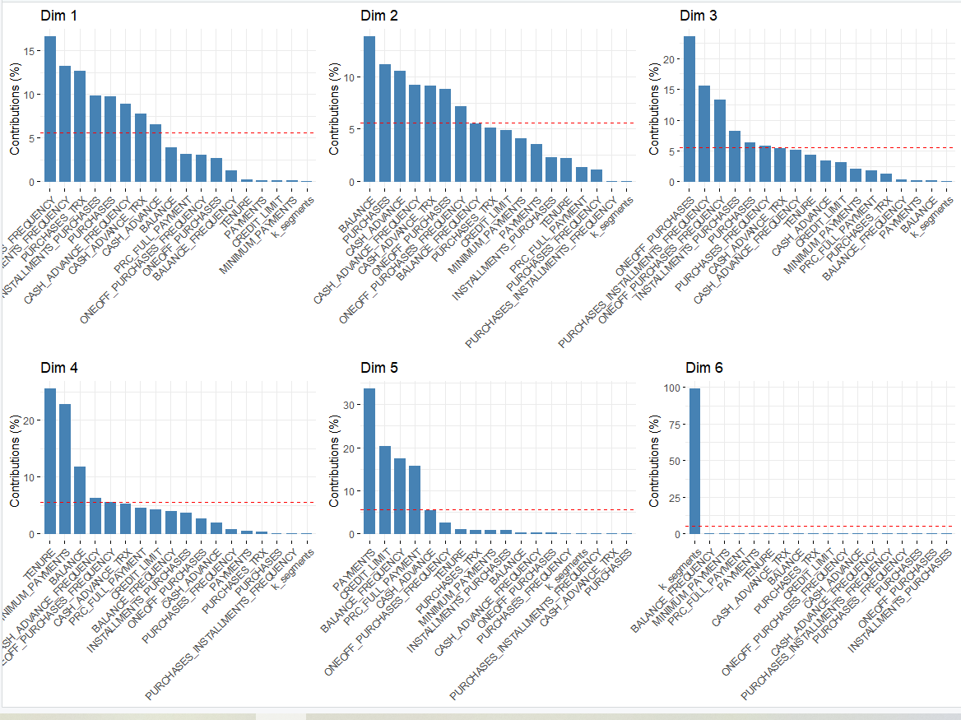
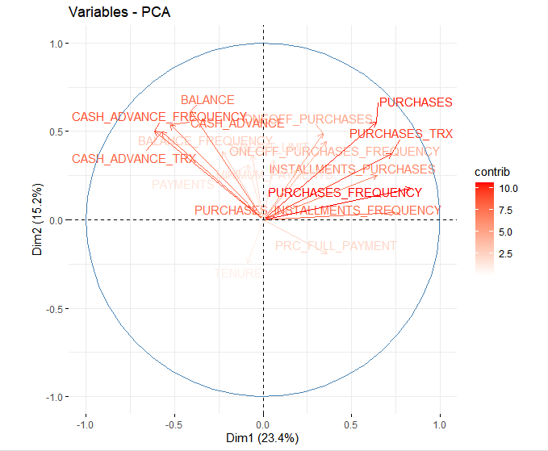
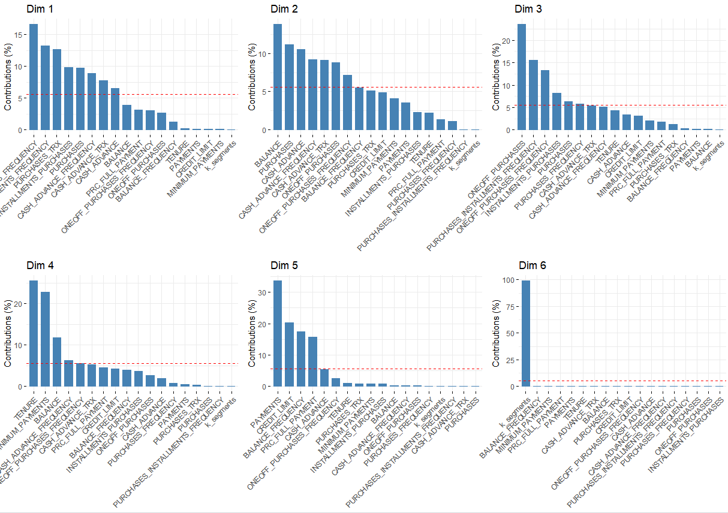
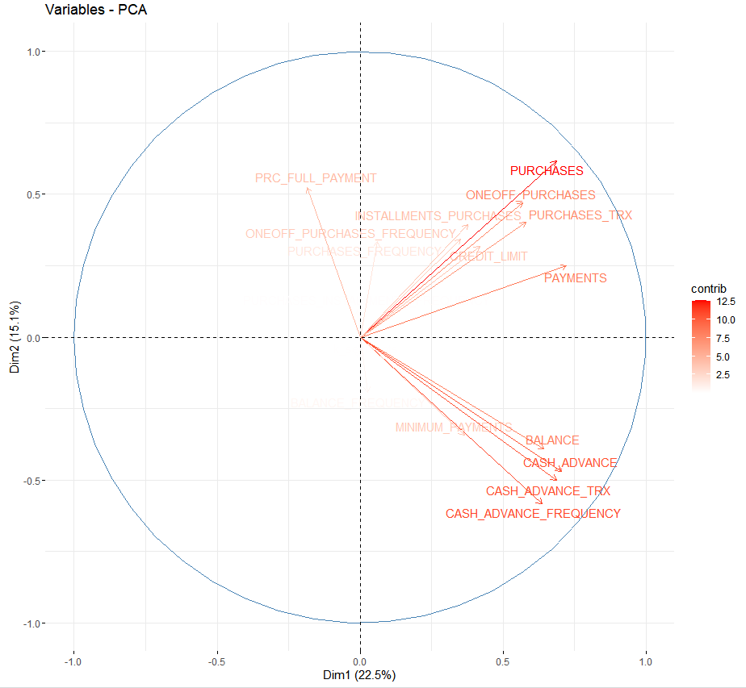

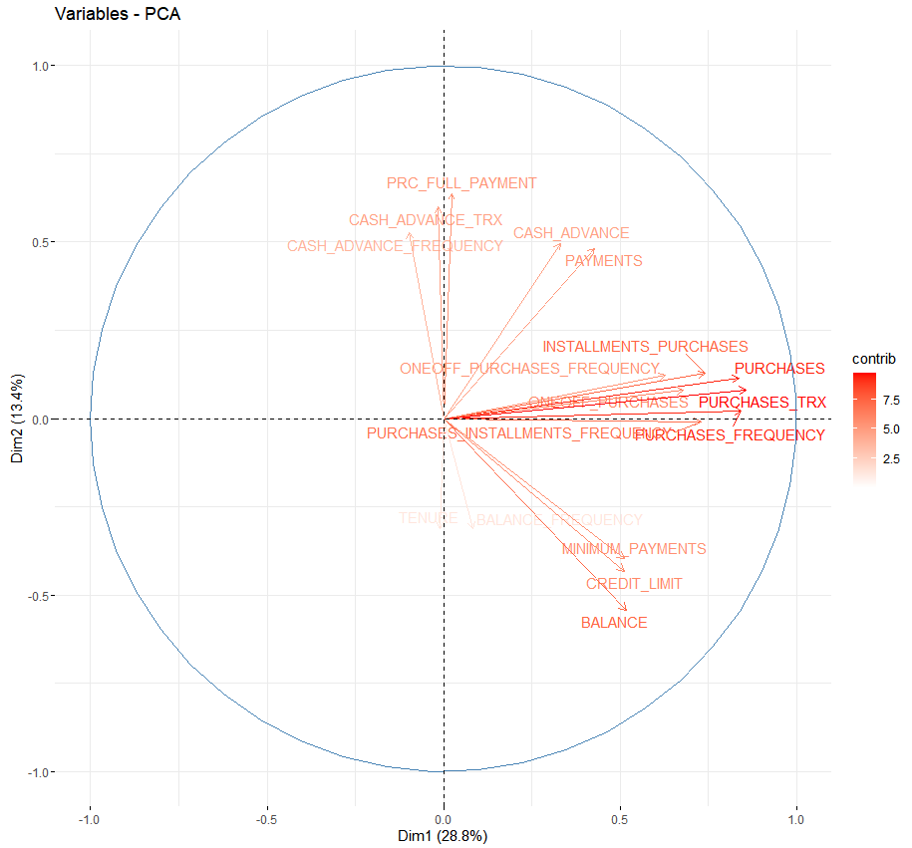
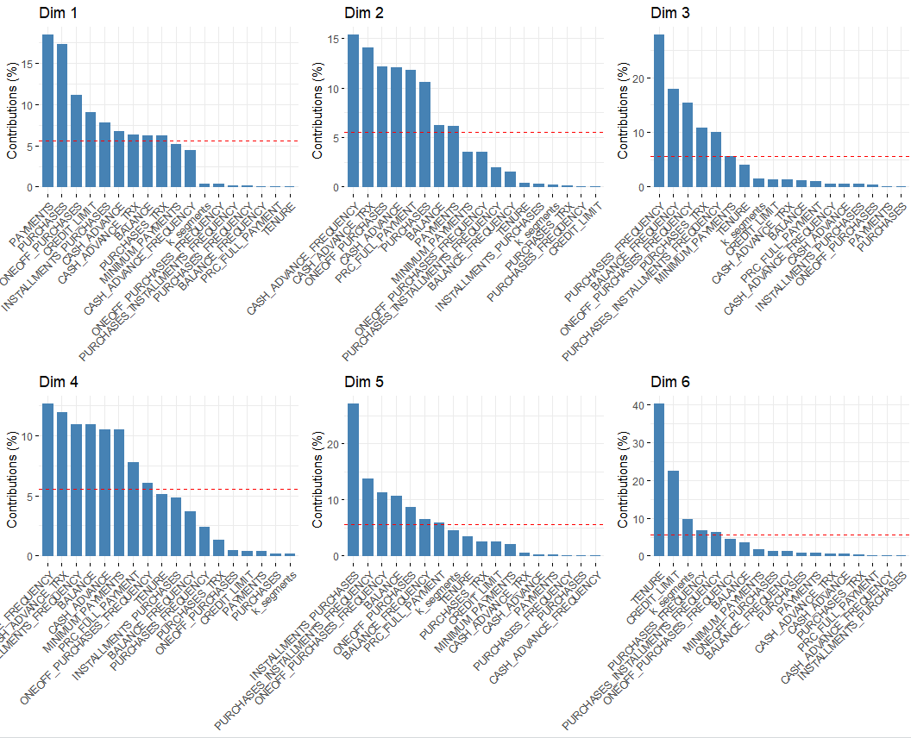
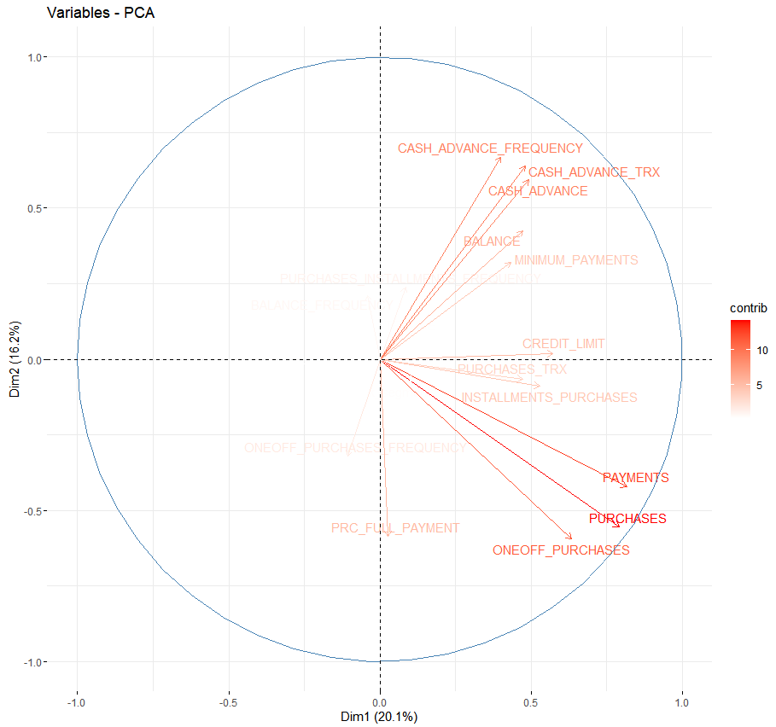
Dimension Reduction
low income (cluster1&2): more one-off purchases
rich group (cluster3): more purchase installment
middle income (cluster4): more cash advance and purchase installment

