Slide 1
Projects Admin
How to use
Projects_Admin
Tab

Slide 2
What’s in the Projects_Admin tab?
You Can:
Browse Projects separated by departments
Define a New Project
Browse Funding sources
(find out about their progress, projects, libraries, and work requests associated with them)
Add New Funding
Look at Statistics from different departments

Slide 3
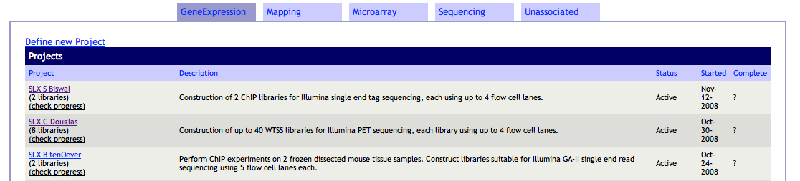

How to browse Projects?
When you log in you will see projects separated according to departments
Select a group
Click on Project Name to view project homepage
Click ‘(check progress)’ link to view progress report directly
NOTE:
There is also a tab for ‘Unassociated’ Projects which do not belong to any group

Slide 4
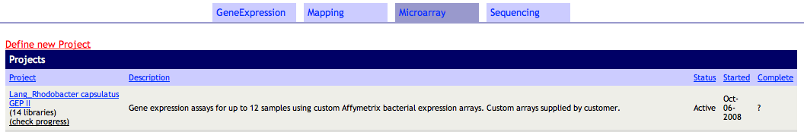
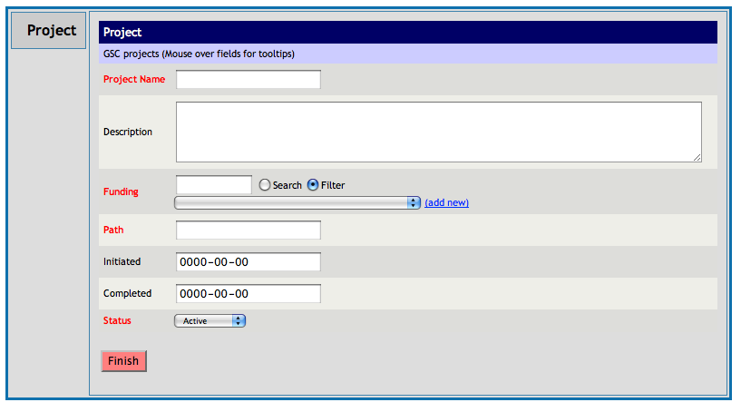
How to add a new Project
Click on the link ‘Define New Project’ available immediately under each department’s tab
You will be directed to the
appropriate form
Fill in the form
Press ‘Finish’ button
(Remember fields in Red are mandatory and you cannot submit the form without filling them out)

Slide 5
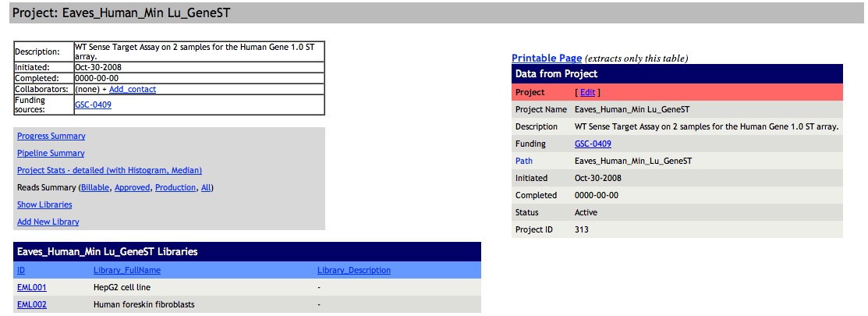
Project Homepage
This is the ‘homepage’ for a particular project:
NOTE: If Project belongs to ‘Sequencing’ Group there is also a statistics box available

Slide 6
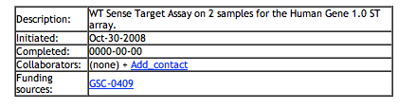
Projects Homepage Details
On top and on the right there is general information about the project
‘Add Contact’ for the project
see Funding information
(Words in blue are links to new pages)

Slide 7
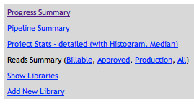
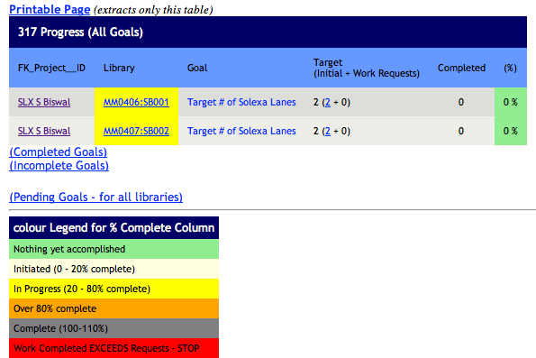
Projects Homepage Links
This is the links box containing project specific information
View ‘Progress Summary’

Slide 8
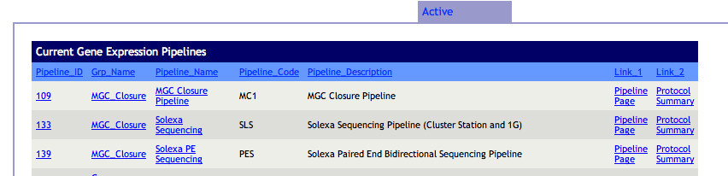
Projects Homepage Links
This is the links box containing project specific information
View ‘Pipeline Summary’
(view plates in progress)

Slide 9
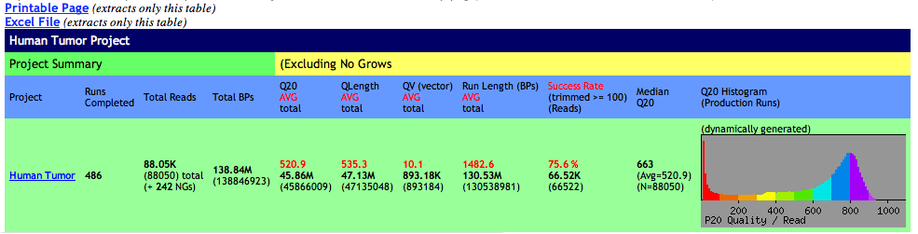
Projects Homepage Links
View ‘Project Stats’
(example below applies only to
Sanger Sequencing Data)

Slide 10
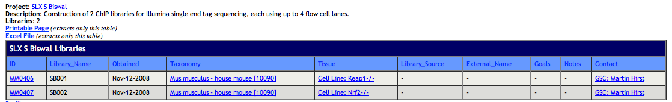
Projects Homepage Links
View ‘Libraries’
(shows more details than appear on
The home page)

Slide 11
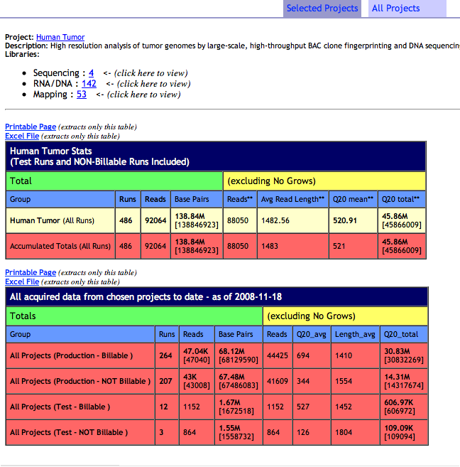
Projects Homepage Links
View ‘Reads Summary’
(Sanger Sequencing specific)

Slide 12
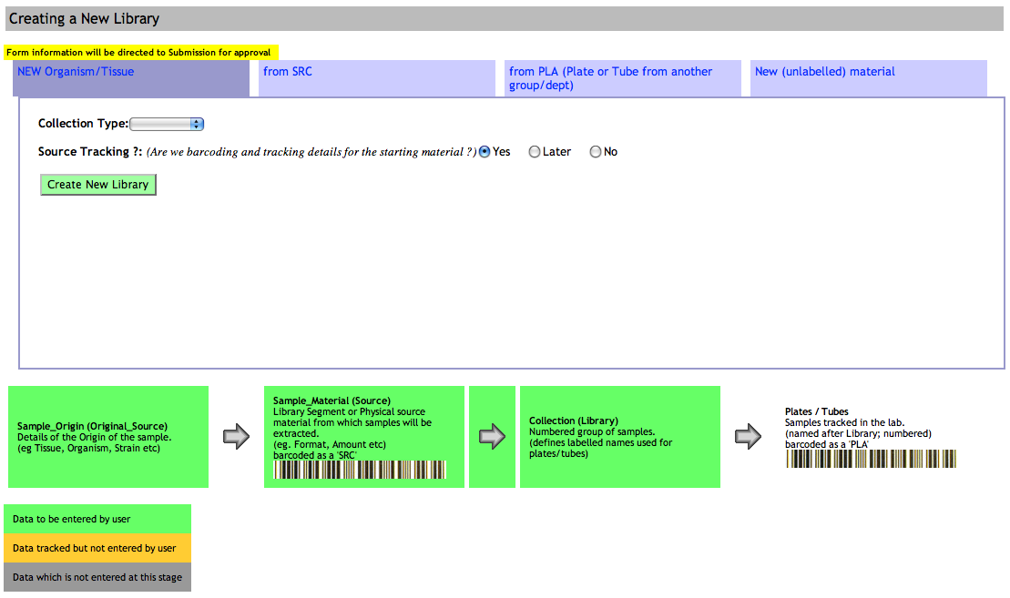
Add New Library to Project

Slide 13
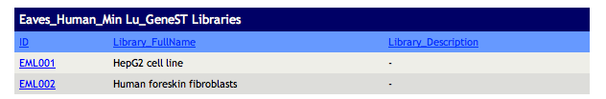
Project Libraries
There is a table on bottom of the page displaying the libraries in the project
Press on each link to view that Library

Slide 14
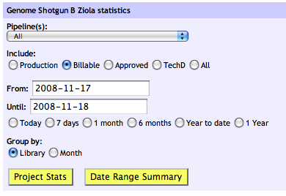
Statistics Box
The Statistics box can be used to get Project specific statistics.
Select Search Criteria
Press ‘Project Stats’ or ‘Date Range Summary’ to view results
(NOTE: None of the search criteria are Mandatory)

Slide 15
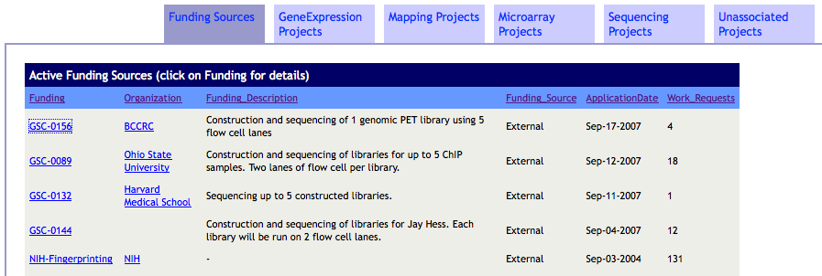
Browsing Funding Sources
Another layer on the main page lists all active funding sources.

Slide 16
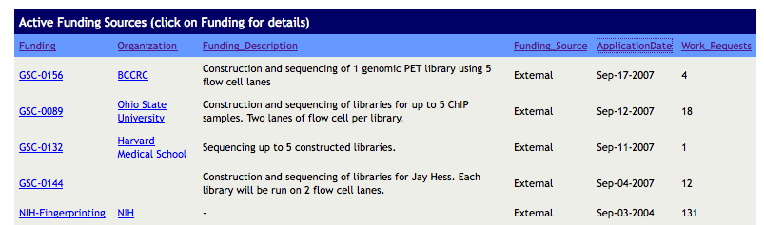
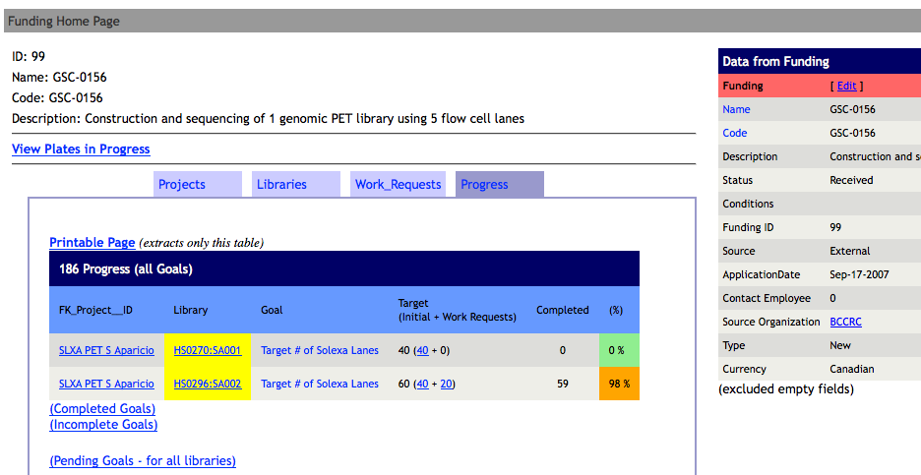
Just click on any funding source

Slide 17

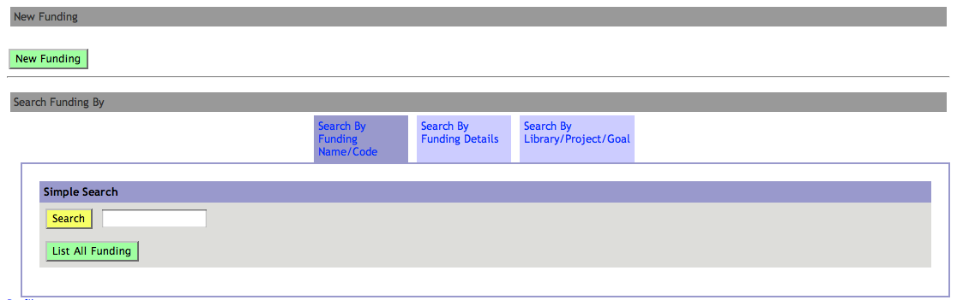
Other Funding options
To get to the general funding homepage, simply click on the Funding icon on top of the page below the navigation bar. (Top left side)
From this page you can:
Create New Funding
Search for Funding

Slide 18

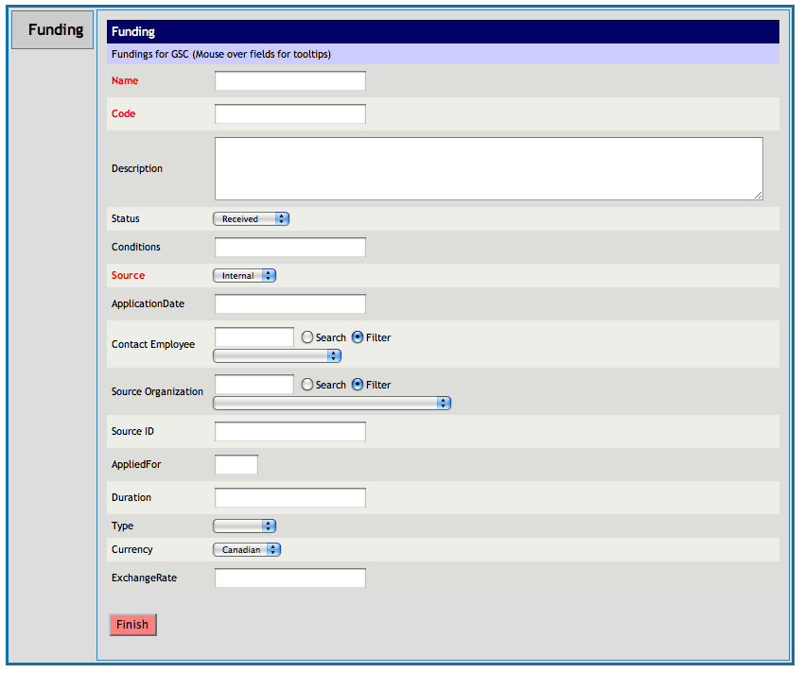
Adding New Funding
Simply click on the ‘New Funding’ button and
you will be directed to the form
Fill in the fields in the table and
Press the ‘Finish’ button when done
The fields in red are mandatory and
you cannot proceed if they are left empty
Try to fill out as many fields as you can

Slide 19

How to use Funding Search
There are 3 ways of finding the Funding you are looking for
Select the method of search by clicking on the appropriate tab

Slide 20
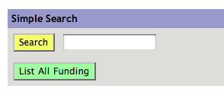
Search By Name / Code
Enter the name or Code in the box
Press ‘Search’ button to view results
OR
press ‘List All Funding’ to view a list of all available Funding

Slide 21
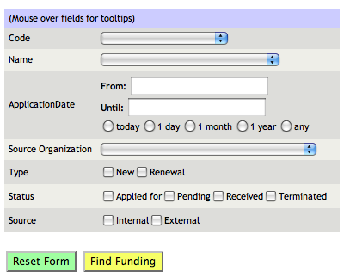
Search By Funding Details
‘Search By Funding Details’
to find your target Funding by supplying details about the funding
(eg. Date ,Type, or Organization)
Fill in the Fields
Press ‘Find Funding’
NOTE: The less fields you fill in the more search results you will see

Slide 22
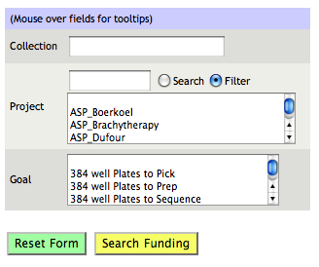
Search By Library/Project/Goal
‘Search By Library/Project/Goal’
to find the Funding associated with any Library, Project or Goal
Choose search criteria
Press ‘Search Funding’
NOTE: ‘Collection’ is a synonym for Library

Slide 23
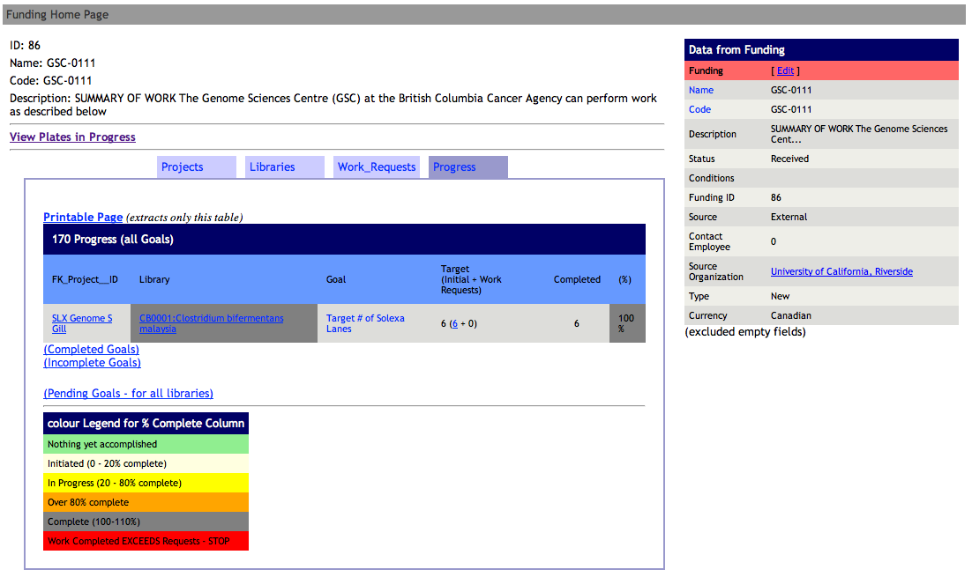
Funding Homepage
This is the homepage for a specific Funding Record
Overview
Link to view
plates in progress
Layers showing:
Projects
Libraries
Work Requests
Progress
Database Details
(‘Edit’ link at top)

Slide 24

Statistics
To access funding, simply click on the Stats icon on top
of the page below the navigation bar. (Top left side)
Statistics are divided by Department
Select your choice of statistics by clicking on one of the tabs available
(note that the views available vary by department)

Slide 25
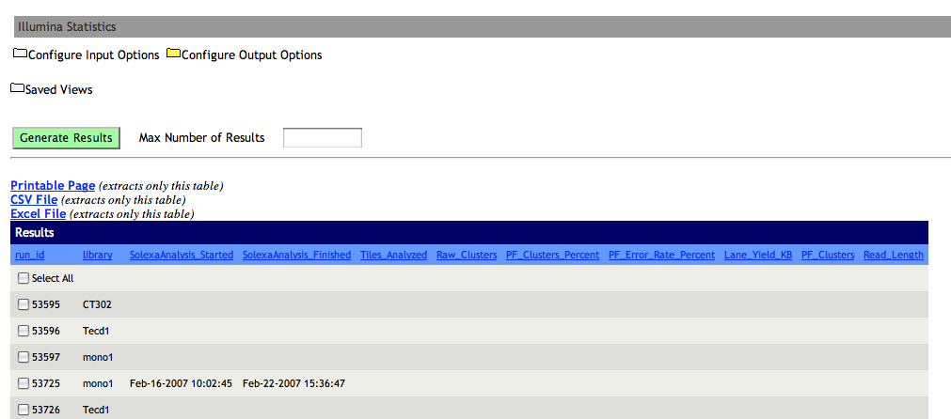
Gene Expression Statistics

Slide 26
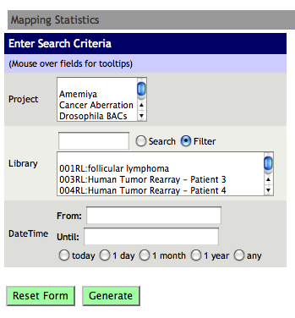
Mapping Statistics

Slide 27
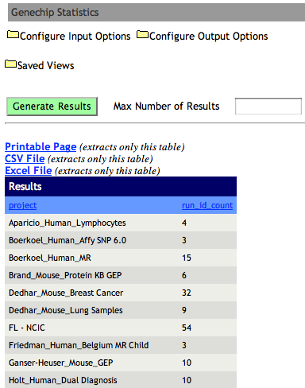
Microarray Statistics

Slide 28
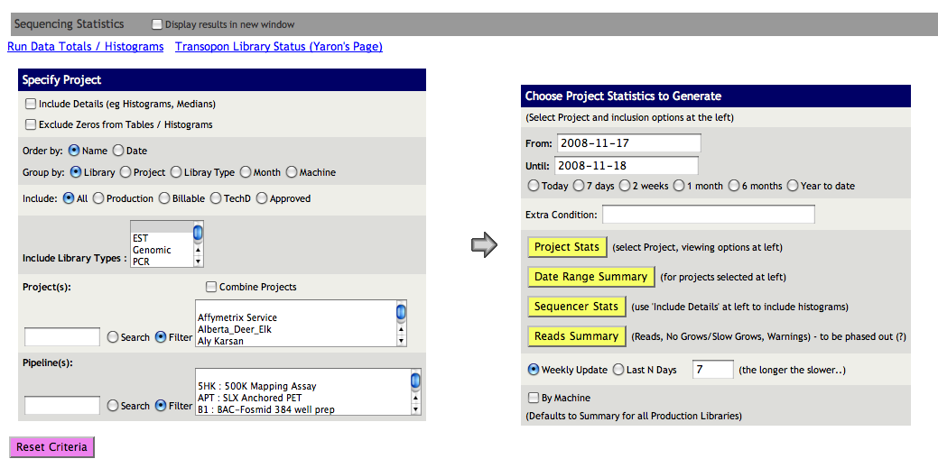
Sequencing Statistics

Slide 29
The End

