Slide 1
How to Receive Stock
(Purchasing Shipments)

Slide 2
Overview
Things you will learn:
  General Process
  Enter New Stock
  Find Items in Catalog
  (Items that have been previously ordered)
  Add Items to Catalog
  (Items not previously ordered)

Slide 3
General Process
The steps you will generally take are
  Find Item in Catalog
  Fill in General Stock Form
  (common for all items)
  Fill in Specialized Stock Form
  (variable depending on Stock Type)

Slide 4

Receiving Stock
Enter catalog number
Press the ‘New Stock’ button
Or if you just have a name…
Choose ‘By Name’ (radio button)
Enter the name of the item (or search pattern)
Press the ‘New Stock’ button

Slide 5
Result
There are 3 possibilities from this action depending on the information you have entered :
  There are Several Matches for the criteria
  There is only One Match in catalog matching the criteria
  There are No Matches found in catalog
Lets proceed according to the results

Slide 6
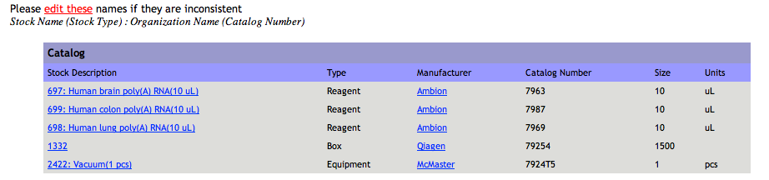
List of Matching Catalog Items
(Several Matches)
The matching results will be displayed in a table for you where you can choose the item that best fits
Clicking on the link under the ‘Stock Description’ column

Slide 7
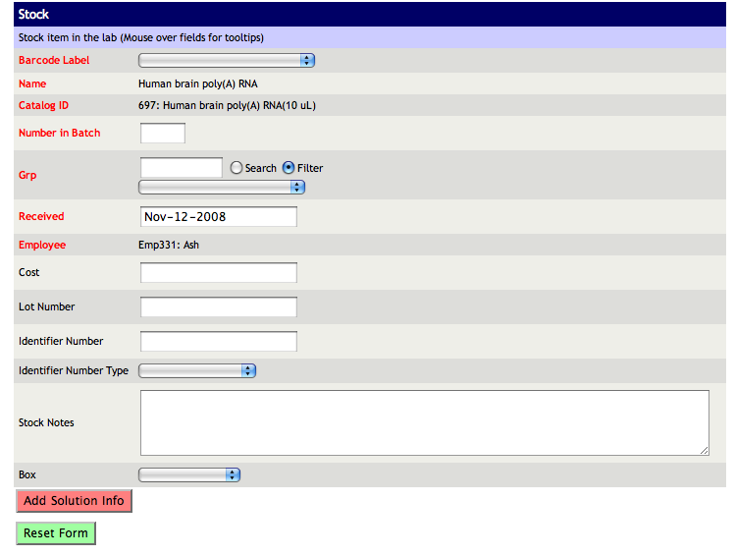
General Stock Form (One Match)
You will arrive here by either choosing an item from the list or directly from the first page. (Because there was only one match)

Slide 8
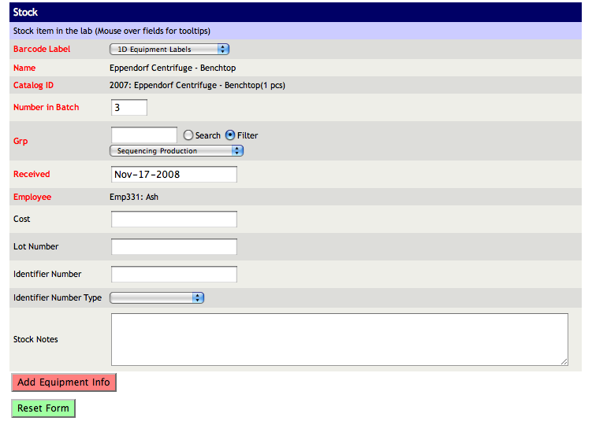
Filling the General Stock Form
Now it’s time to enter the details for the shipment you have received.
Fill in ‘Number in Batch’
Choose the Grp it is for
Enter other optional info:
  Lot Number
  Cost
  PO Number
Press ‘Add Equipment Info’
Notes:
‘Number in Batch’ indicates the Number of Barcodes which will be printed
Do not use ‘$’ sign in cost, just the number

Slide 9
Specialized Stock Form
Now you will be directed to a second and final form you need to fill out
According to the type of stock that you are receiving you might be directed to different form. The types are:
  Type 1: Solution, Reagent, Matrix, Buffer
  Type 2: Primers
  Type 3: Boxes, Kits
  Type 4: Microarrays
  Type 5: Equipment
NOTE:
The number of rows you will see in this page is the same number you entered in last form for ‘Number in Batch’ and is intended to allow you to assign specific data for each individual item. If ‘Number in Batch’ is 1 the form will look different than if there are several items.

Slide 10
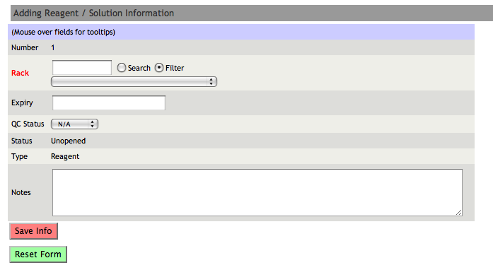
Specialized Stock Form - Single Item
Fill in the fields as you did with previous form

Slide 11
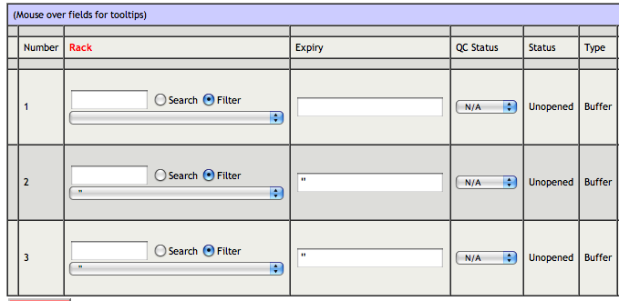
Specialized Stock Form - Multiple Items
Most Stock types have this very simple form
There are two main fields you need to fill out
Rack
Expiry Date

Slide 12
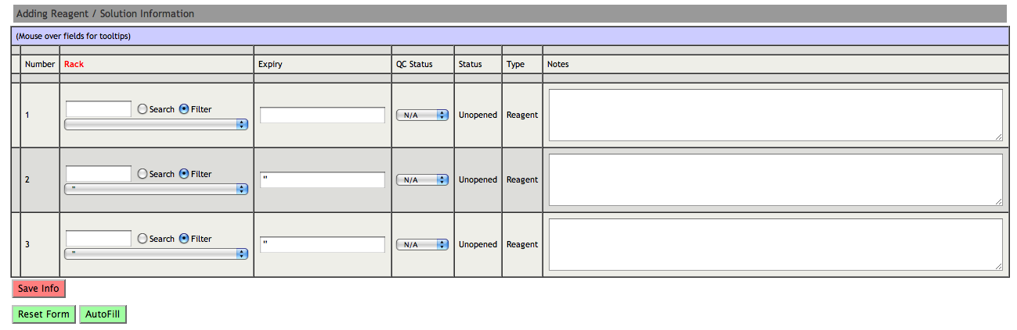

How to Fill Multiple Rows
This form allows you to fill in information for several items at once.
Fill in the first row
Change the information on other rows ONLY if they are different from first row
Press ‘AutoFill’ button at the bottom of the page to help you fill out the rest of the items and match them to their previous row
Note: In order for AutoFill to work the box must be set to ‘’ (default)

Slide 13
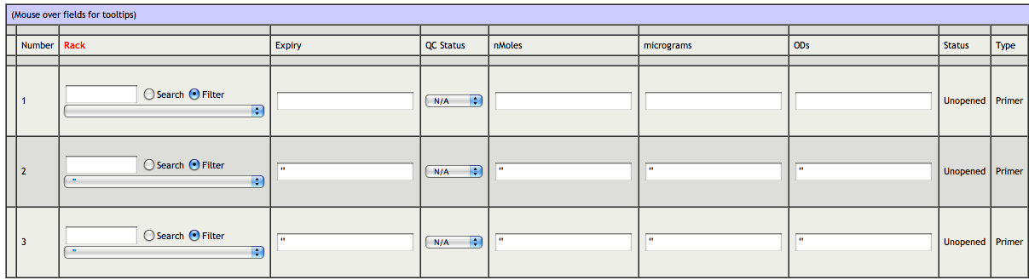
Primer Form
The form for ‘Primers’ contains additional fields to be completed

Slide 14
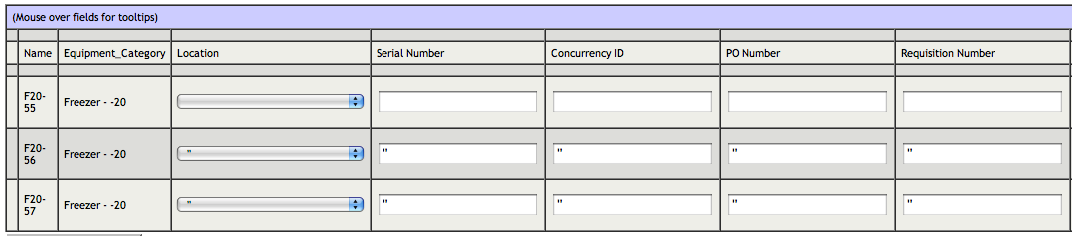
Equipment Form
The form for Equipment has completely different fields from other types including ‘Location’ and ‘Serial Number’

Slide 15
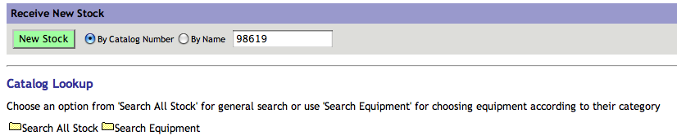
Finding Items in Catalog (No Matches)
If your search does not produce any results you will be directed to a page with more search options, which allows you to further search the catalog.
There are three ways of searching the catalog in this page
  By Catalog Number or Name
  (same search used previously but you can change the parameters and search again)
  ‘Search All Stock’ (by Type, Source, Manufacturer or Vendor)
  ‘Search Equipment’ (search for equipment only)

Slide 16
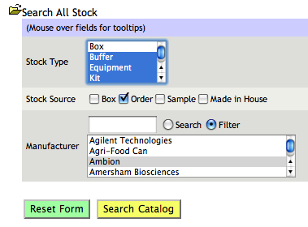
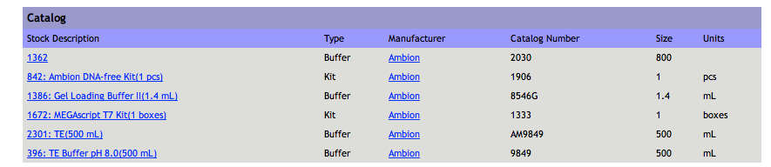
Search All Stock
You can use a combination of parameters to find catalog items that match the criteria. If you are not sure which option to choose you can select multiple options from each field to narrow the results.

Slide 17
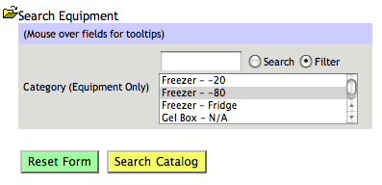
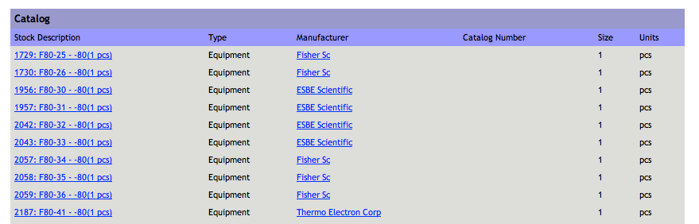
Search Equipment
This search box is used to find specific types of equipment by the category they fit into

Slide 18
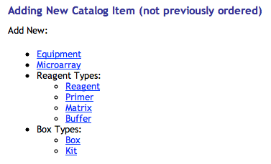
Item NOT found in Catalog
There is some chance that the item you are receiving has never been ordered before and therefore will not exist in the catalog.
Ask the admin to add this item to catalog for you.
If you are an admin you will see the following options at the bottom of your screen
Click on one of the links to add a new item to catalog

Slide 19
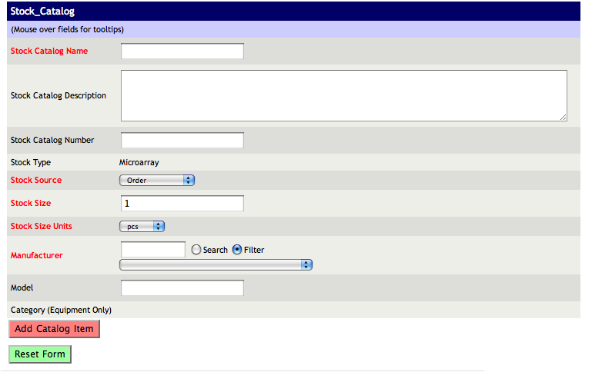
Adding to Catalog
You will see the following table
You might notice that the last field is blanked out for everything except equipment.
This field is crucial for entering equipment, because it is used to name each piece.
Please be VERY careful when selecting the category.
If you are not sure or cannot find the appropriate category please ask labops for help.

Slide 20
Finish

