Slide 1
Library Goals,
Work Requests &
Funding Sources

Slide 2
Overview
Why do we need this ?
Definitions
Creating a new Work Requests (during Library submission)
Updating Work Request information
  During approval for a Submission
  After Library approval
Defining Work Requests for new Plates/Tubes
Downstream changes
  Making additional Work Requests (after Library approval)
    Standard
    Custom
  Editing specific Work Requests
  Changing Work Request tied to specific Plates
  Monitoring Progress

Slide 3
Why ?
Goal tracking enables:
Automated progress tracking
Automated updating of Library status
Linking of costs between SOWs and individual plates/tubes in the lab
Customized tagging of work to be done at the individual Plate/Tube level.

Slide 4
Definitions: Library Goal
A Library Goal indicates what has been requested of the lab.
All submissions to the lab are required to supply a ‘goal’, though this goal can be added to, or additional goals appended as required.
Standard goals are tracked automatically, enabling the status of Libraries to be updated automatically in real time.
Lab administrators may be notified when all of the goals have been met, or when new additional goals have been requested.
Goal tracking enables automated monitoring of progress based upon work completed and target expectations.
Custom goals may also be defined, though completion of these goals must be indicated manually by lab administrators.

Slide 5
Definitions: Funding Sources
Funding Sources define how work that is carried out in the lab is accounted for financially.
Examples of Funding Sources might include:
  A grant
  An account which can be charged with work
  A ‘Statement of Work’ (SOW)
  Any person or lab taking on financial responsibility for lab work

Slide 6
Definitions: Work Requests
A Work Request is something that is requested of the lab.
A Work Request is associated with 1 and only 1 Funding Source
A Work Request is associated with 1 and only 1 Library/Collection
Any work carried out in the lab should be assigned to at least 1 Work Request
A Plate/Tube may optionally be tied to a specific Work Request. Alternatively, it inherits Work Requests from the applicable Library.
Examples of Work Requests might include:
  M 96-well Plates to Pick
  N Fingerprint Gels to run
  A Customized request

Slide 7
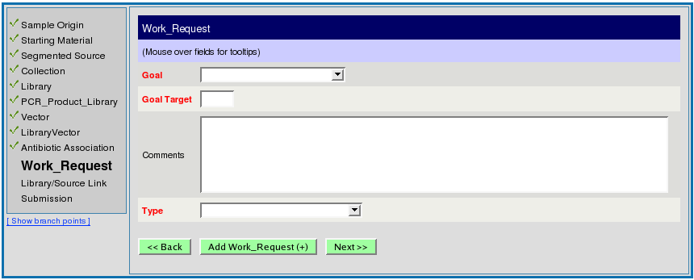
Creating a Work Request
During library submission
work request information is mandatory and a work request record will be created when a library is submitted

Slide 8
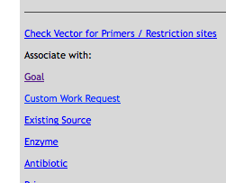
Creating a Work Request
After library approval
Go to the applicable Library home page (‘Scan’ the Library name)
Click on the ‘Goal’ link in the ‘Associate with:’ section

Slide 9
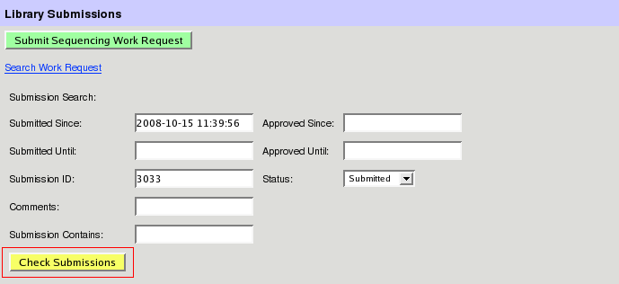
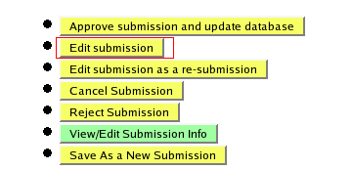
Updating Work Requests from a Submission
Retrieve any pending library submission
… edit the submission

Slide 10
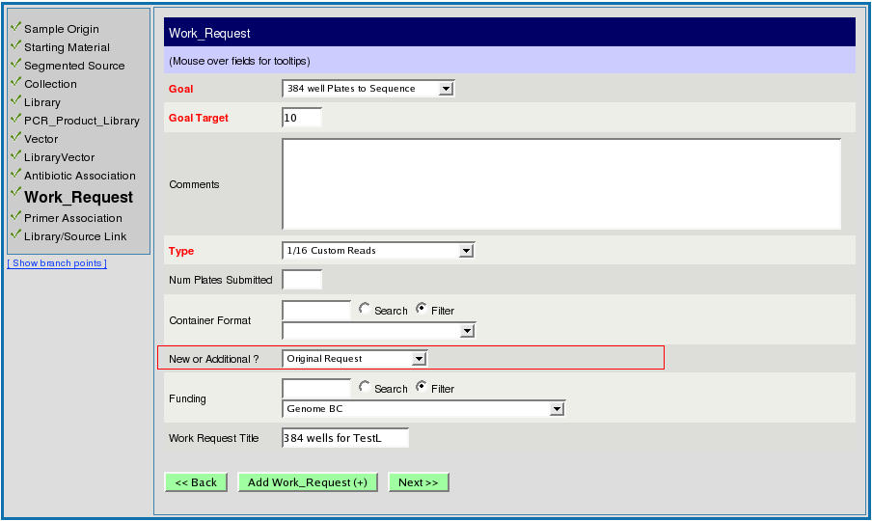
Updating Work Request Information
Work requests default to 'Original Request’ during Library submissions.
Later, additional requests can be either:
‘Added to Original Request’ (ie the final target increases)
‘Included in Original Target’ (ie the final target remains the same)

Slide 11
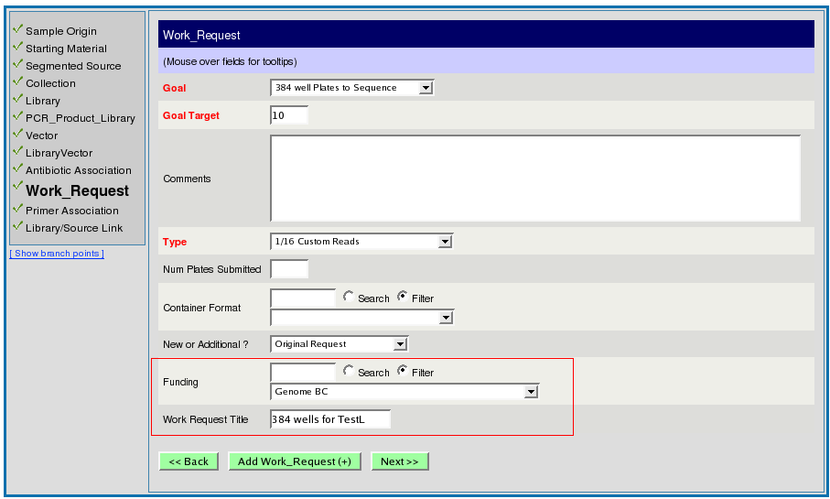
Updating Work Request Information
Update the Funding Source
Update the ‘Work Request Title’ (optional - defaults to Goal_name)
(these fields are hidden from the collaborators).

Slide 12
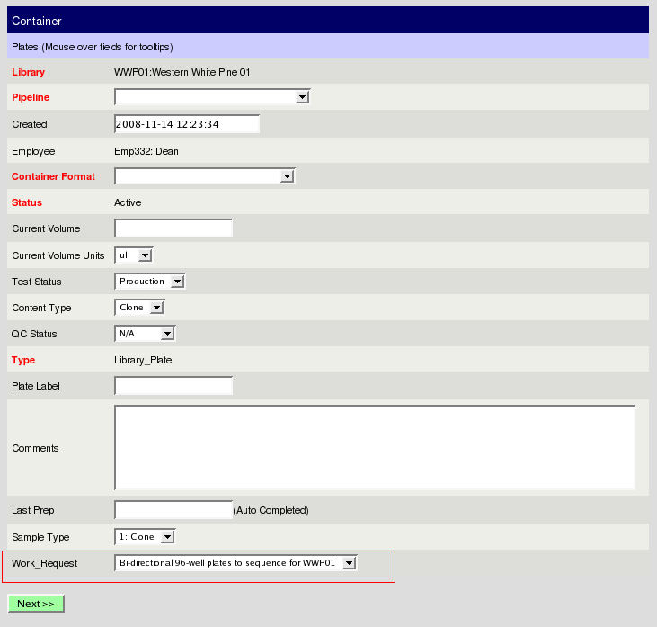
Linking a Work Request to a Plate
if there is only 1 work request for the library it is filled in by default.

Slide 13
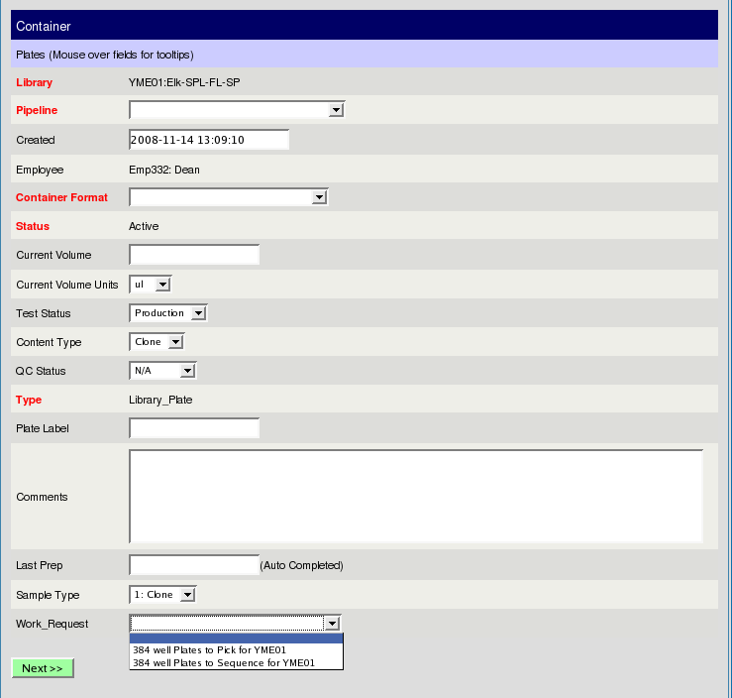
Linking a Work Request to a Plate
If there are multiple work requests for the library, then the work request field is blank by default with a list of work requests to choose from.

Slide 14
Linking a Work Request to a Plate
Note:
Linking work request to a plate is currently not mandatory so if no work request is chosen, the plate is inherently associated to those work requests defined for the Library to which it belongs.
If the Work Request you are interested in is not listed, then you first have to assign that work request to the Library itself. (follow steps previously described for adding new work requests for Libraries)

Slide 15
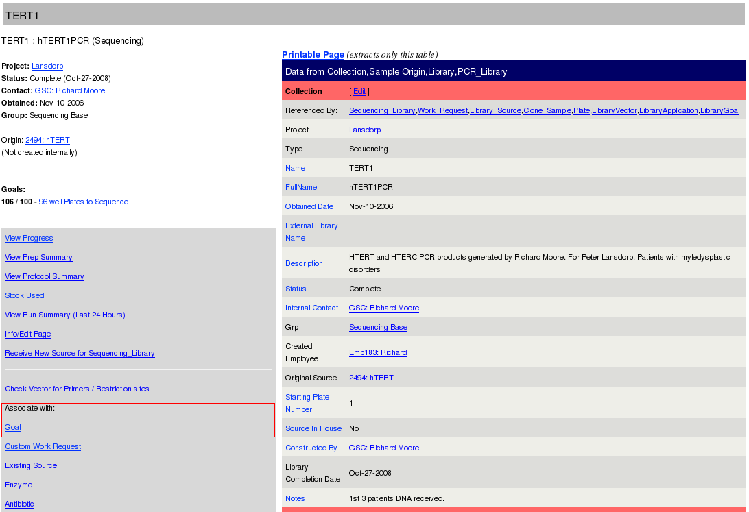
Add New Work Request to a Library
Scan a library
click on associate with goal link

Slide 16
Downstream changes
Adding additional requests
Adding custom requests
Examining/Editing prior requests
Changing Work Request tied to a Plate

Slide 17

Add a New Custom Work Request
Scan a library
click on ‘custom work request’

Slide 18
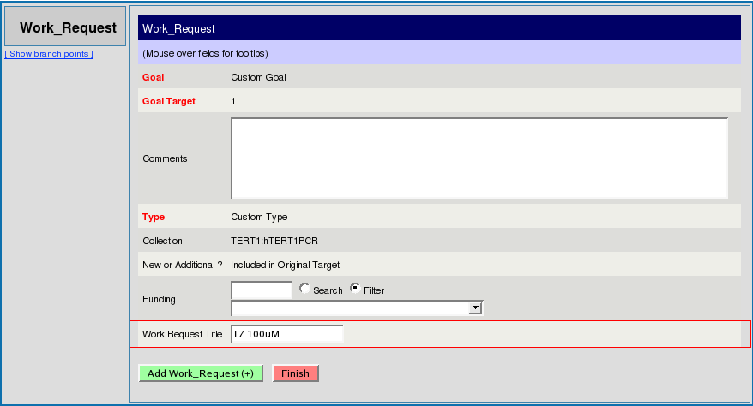
Add a New Custom Work Request
Fill in work request title (goal oriented fields are already preset)

Slide 19
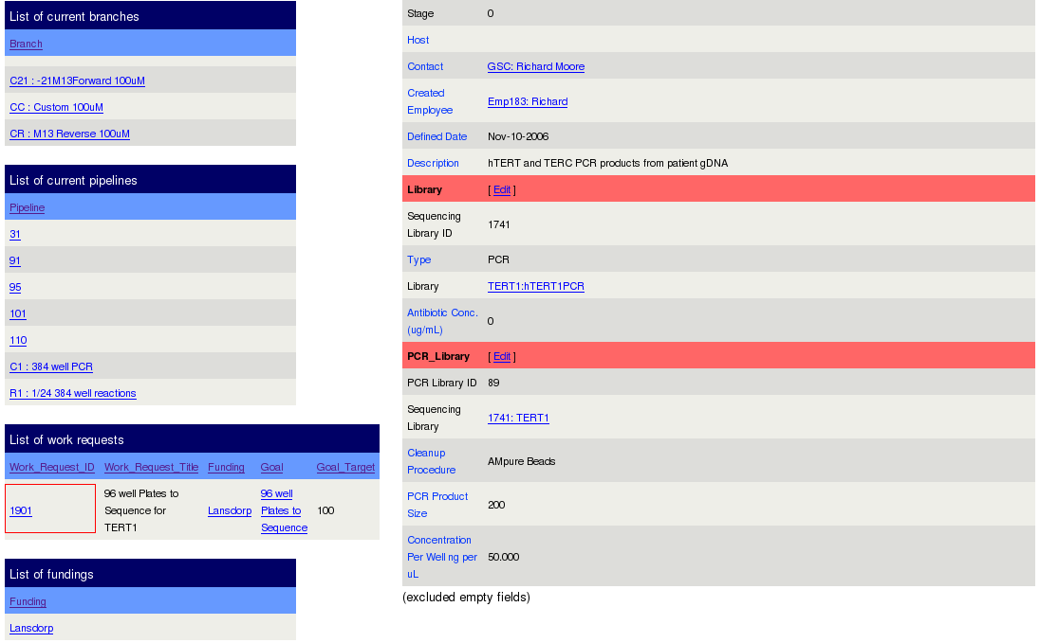
Updating Work Request information
(after library approval)
Scan a library
click on work request ID of interest

Slide 20
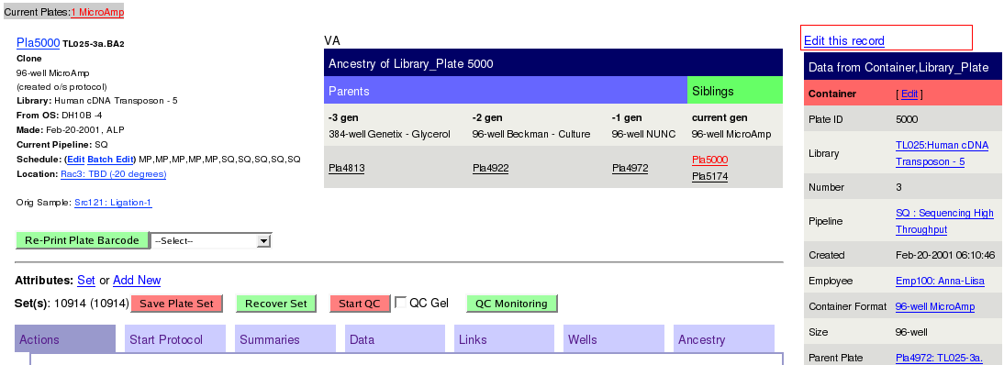
Editing the Work Request tied to a Plate
scan in a plate
edit the plate record
(By default, any new daughter plates will inherit the work request of the parent plate)

Slide 21
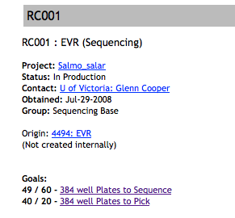
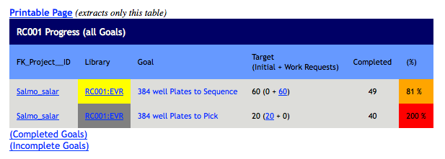
Monitoring Progress
Overall progress may be easily viewed for a Library or Funding Source:

Slide 22
Finish

