Slide 1
Attribute Enhancements
Work Package
Design Document

Slide 2
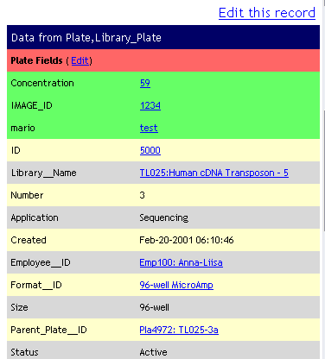
Requirement #1
Allow the user to view object attribute information when an object is scanned in.
  User scans the barcode of an object and is taken to the object’s homepage.
  Object attributes are automatically retrieved added to the display_Record table.

Slide 3
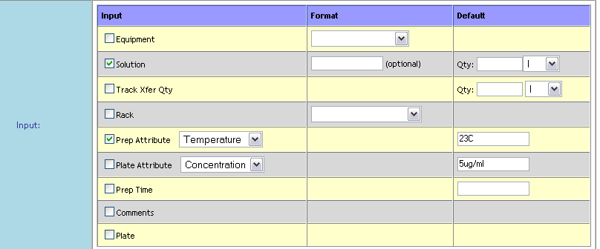
Requirement #2
Create interface allowing user to tie attributes (prep & plate) to specific protocol steps.
  User can select predefined prep/plate attributes directly from the protocol step details page.

Slide 4
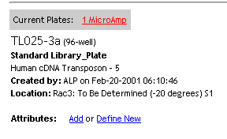
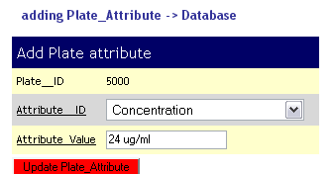
Requirement #3
Create interface for allowing user to add attributes for a set of tracked objects or events in the lab.
  User scans the barcode of an object and is taken to the object’s homepage.
  User selects “Add Attribute” button and is prompted for Attribute details
    Name – New or one selected from the list of existing Object attributes
    Value – All attribute values would be stored as text.

Slide 5
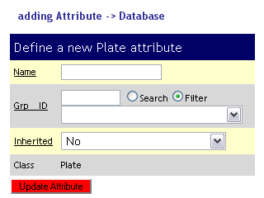
Requirement #4
Create interface for allowing user to define new attributes for a set of tracked objects or events in the lab.
  User scans the barcode of an object and is taken to the object’s homepage.
  User selects “Define New” button and is prompted for Attribute details
    Value – All attribute values would be stored as text.

Slide 6
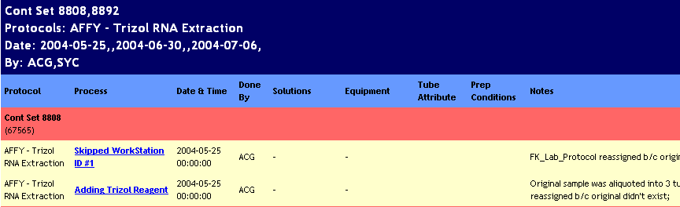
Requirement #5
Modify protocol summary/plate history view to include attribute information if applicable
Container attribute and Prep Container will are displayed in the Container_History table. Container attributes will be displayed in the following format:
    Attribute_Name:Attribute_Value ex: Concentration:25ng/ug
Should multiple Attribute_Values be seperated by ‘;’? Eg. Tubes from different libraries
Should Prep_Condition also have a Name?

Slide 7
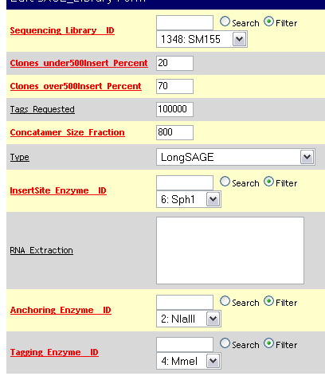
Requirement #6
Pre-fill submission library fields based on attributes tied to the plate.
  Whenever a form is generated for an Object, the system checks if a corresponding “attribute field” exists for any blank fields and pre-fills the field with the attribute value.

Slide 8
Requirement #7
Modify scanner protocols to allow user to enter plate_prep and plate attribute values
  User is prompted for attribute values in the usual way that he/she is prompted for input during protocols.
  Multiple plate attributes can be entered by separating values with ‘;’ where each value would be applied to the respective plate/tube (by order)
  Prep Attributes would only accept single values that would be applied to the prep step and would indicate that all plates/tubes that went through this step where treated in that particular way.

